Slide 1
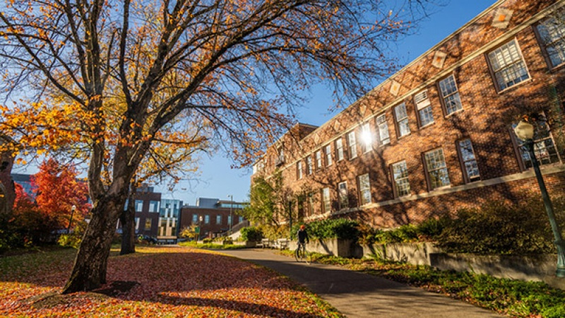
Facilities Liaison Meeting
10-25-2022

Slide 2
Agenda
Welcome, Future of FL Meetings – Mike Harwood
Location Innovation Lab Update – Justin White
UOPD Security Operation Center Update – Jason Wade
Design and Construction Project Update – Bruce Budzik
Planning – Emily Eng
Q&A – Jeff Butler

Slide 3
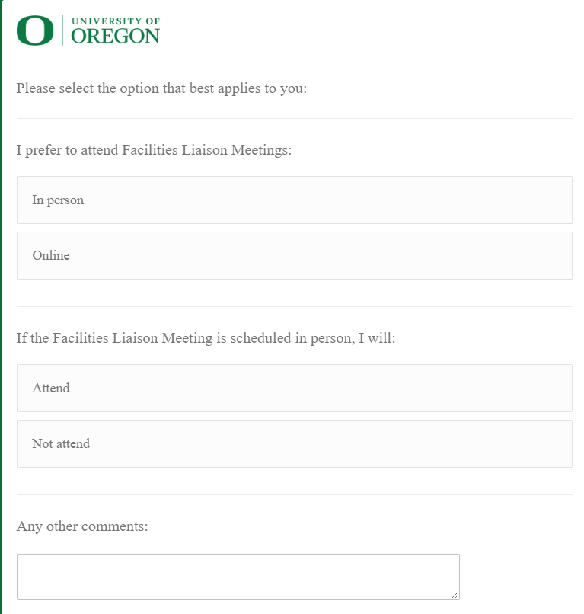
Survey
https://oregon.qualtrics.com/jfe/form/SV_9ttTldOBSItQ7To

Slide 4
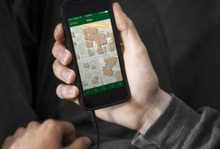
Location Innovation Lab (Live Demo)
The campus Location Innovation Lab provides wide-ranging services and products such as behind-the-scenes data, analysis and applications, and publicly-facing maps and other products and applications that serve campus.
https://map.uoregon.edu/
Contact: gis@uoregon.edu
Ken Kato, Director Location Innovation Lab (P) 541-346-5810
Justin White, Senior Developer (P) 541-346-5827
Brook Eastman, GIS Analyst Programmer (P) 541-346-4709
Lillie Parker, GIS Analyst

Slide 5
21st CP Review and Re-envisioned SOC
Presented by:
Jason Wade
Chief of Police
University of Oregon Police Department

Slide 6
We are Transparent
Demonstrated
Solid police department policy built together with our community
We have created free and unobstructed access to police service for our students
Create paths to police service for every member of our community
We are accountable
Oversight – complaint process
We address and support a perception of safety along with a demonstrated reduction in crime on campus
Considered a resource by our students
A Successful Campus Police Department Is

Slide 7
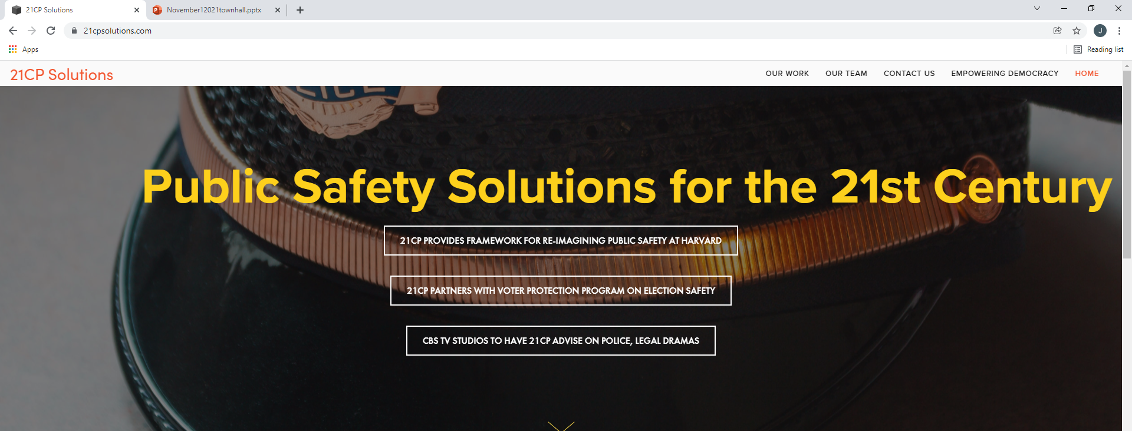
UO hired an outside consultant to work with the campus community to develop additional proposals to ensure the university’s public safety agency is viewed with confidence and trust.

Slide 8
Developing a New Police Accountability Process/Review Board Structure
1. Investigation and assessment of the current Complaint Review Committee.
2. Review of model and best practices of police accountability processes and structures.
3. Conduct a gap analysis comparing current practices and best practices, resulting in specific, actionable recommendations.

Slide 9
Options for Improved Mental Health Responses and/or Community Partnerships​​
1. Investigation and assessment UOPD’s current responses to individuals in​ crisis and community partnerships. ​
2. Review of model and best practices for police responding to individuals in​ crisis.
3. Conduct a gap analysis between current practices and best practices​ resulting in specific, actionable recommendations.

Slide 10
Additional Changes to the Functions of Armed Police Officers​
1. An assessment of community issues requiring police response and​ current functions and responses currently performed by UOPD officers.​
​2. Hold Co-Design Public Safety Sessions. Contractor has found that sessions​ involving a broad array of University stakeholders are useful in helping to reimagining​ public safety on a campus. ​
3. Conduct a gap analysis between current practices and desired future​ state for public safety on campus.

Slide 11
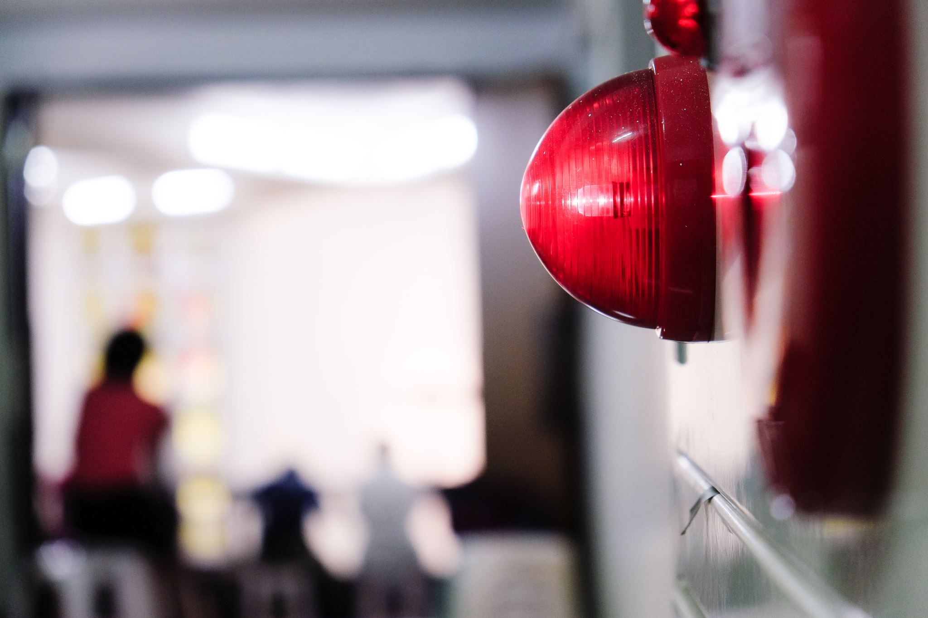
SECURITY OPERATIONS CENTER KEY FUNCTIONS (as of today)
The SOC is a resource for dispatching personnel for emergency maintenance or campus concerns, with 24-hour access to:
Campus support and customer service
Fire and security alarm monitoring
Access control and lockout dispatch
Camera monitoring and assistance
Monitoring and dispatch for security, parking, athletics, campus
operations, and all UO channels

Slide 12
Integrated Operations Center (Tentative Project Name)
Transition from contracted staff to UOPD based staff
Integrate with Police Services Call Taking
24/7 On-call After hours call center enterprise wide
Improved integration and workflow procedures with CPFM Work Control, including after-hours Call Log coverage
Integrate police activity into Call Log for transparency
Research enhanced security methods to include live monitoring of video systems with access control
Provide campus wide service to act as campus operator to provide for better access to campus needs and resources
Utilize technology to provide better safety and security

Slide 13
Design and Construction Current Projects and Small Projects
October 25, 2022
Notes:
Intro of ourselves and topic
Darin and Tom

Slide 14
Design and Construction Leadership
Darin Dehle, Director
Rob Basto, Assistant Director of Business Operations
Jeff Madsen, Assistant Director Engineering/Utilities
David Cates, Design Manager and Staff Architect
Tom Shepard, Sr. Associate Director of Capital Projects
Bruce Budzik, Small Projects Manager and Capital Improvement Coordinator

Slide 15
Departmental Context
Organizational Structure
Academic/Auxiliary
Small Project/Capital Improvement
Engineering
Design
Business Operations
Org Chart here
Notes:
(Darin)
CPFM Sub Org.
Staffing
33 current staff (8 unfilled)
15 OAs
18 Classified
Organizational Structure
Academic/Auxiliary
Science and Research
Small Project/Capital Improvement
Engineering
Design
Business Operations

Slide 16
Design and Construction Services
Capital Project Management
Scoping and Estimating
Architectural Design
Interior Design
Lab Planning
Furniture Design and Procurement
Engineering and Commissioning
Contract Management
Accounts Payable
Notes:
Stabilizing Organizational Structure and Roles Within CPFM (Darin)
Improving Campus Relationships (Darin)
CAS Administration
OVPRI
Process Stabilization (Tom)

Slide 17
Active Large Projects Highlights
Under Construction
Huestis Deferred Maintenance
Walton Replacement
Central Plant Chilled Water Tank
Knight Library Exterior Restoration Ph I
In-Design
Heritage Project (University & Villard)
Knight Library Exterior Restoration Ph II
Knight Campus Phase II
Hamilton Demolition
NE Portland Campus
College of Design Acoustic Testing Chamber
In-Consideration
Friendly Hall Deferred Maintenance
https://cpfm.uoregon.edu/construction-map

Slide 18
S/M Projects Highlights
Wrapping Up
Baker Downtown Center Roof
Baker Downtown Center Psychological Sciences
Chilled Water Thermal Storage Tank
Susan Campbell Sidewalk Improvements
Gerlinger Sun Porch
Up Coming
Knight Library Elevator 5 Modernization
Knight Library Fire Alarm Upgrade
Knight Library Master Visioning
East and West Science Electrical Loop
Volcanology Steam Line Replacement
https://cpfm.uoregon.edu/construction-map

Slide 19
SMALL PROJECTS
Project Development
Project Submission Time Lines and Examples
Notes:
(Tom)
Recruiting, Supporting, and Retaining a Diverse and Highly Competent Staff
Effective and Efficient Service
Campus Service and Relationships
Institutional Priorities
Departmental Goals

Slide 20
Key Staff to Know
David Cates – Design Manager and Staff Architect
Small Project Design, Finishes and Furniture
Bruce Budzik – Small Projects and Capital Improvement Manager
Launching of Small and Capital Repair projects

Slide 21
PROJECT DEVELOPMENT
KEY PROJECT STEPS:
Initiation from user (Call Log)
OR/PM/User define scope
OR/PM develops charter
Charter approval
Design process
Bidding and permit process
Construction contract execution
Construction
Closeout process

Slide 22
PROJECT SUBMISSION TIME LINES: Steps 1 through 7
$0-$25K 8-12 weeks to start construction
$25K-$50K 10-18 weeks to start construction
$50K-$100K 12-20 weeks to start construction
$100K-$1M 20-30 weeks to start construction

Slide 23
$0-$25K Before

Slide 24
$0-$25K After

Slide 25
$25K-$50K Before

Slide 26
$25K-$50K After

Slide 27
$50K-$100K Before

Slide 28
$50K-$100K After

Slide 29
$100K-$1M Before

Slide 30
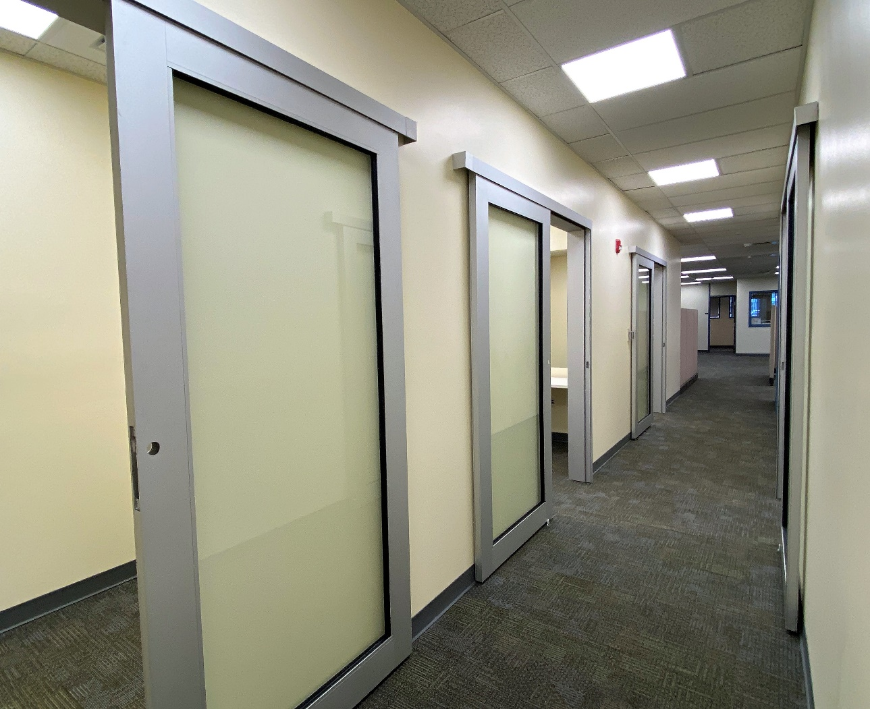
$100K-$1M After

Slide 31
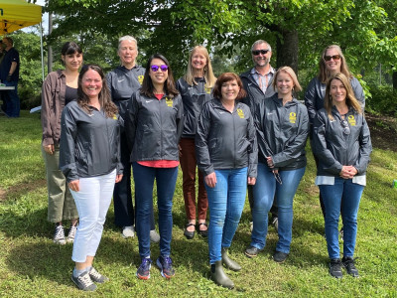
Campus Planning
Emily Eng
Interim Director of Campus Planning Senior Planner
eeng@uoregon.edu
541-346-5606
Campus Planning General Inquiries
uplan@uoregon.edu
541-346-5562

Slide 32
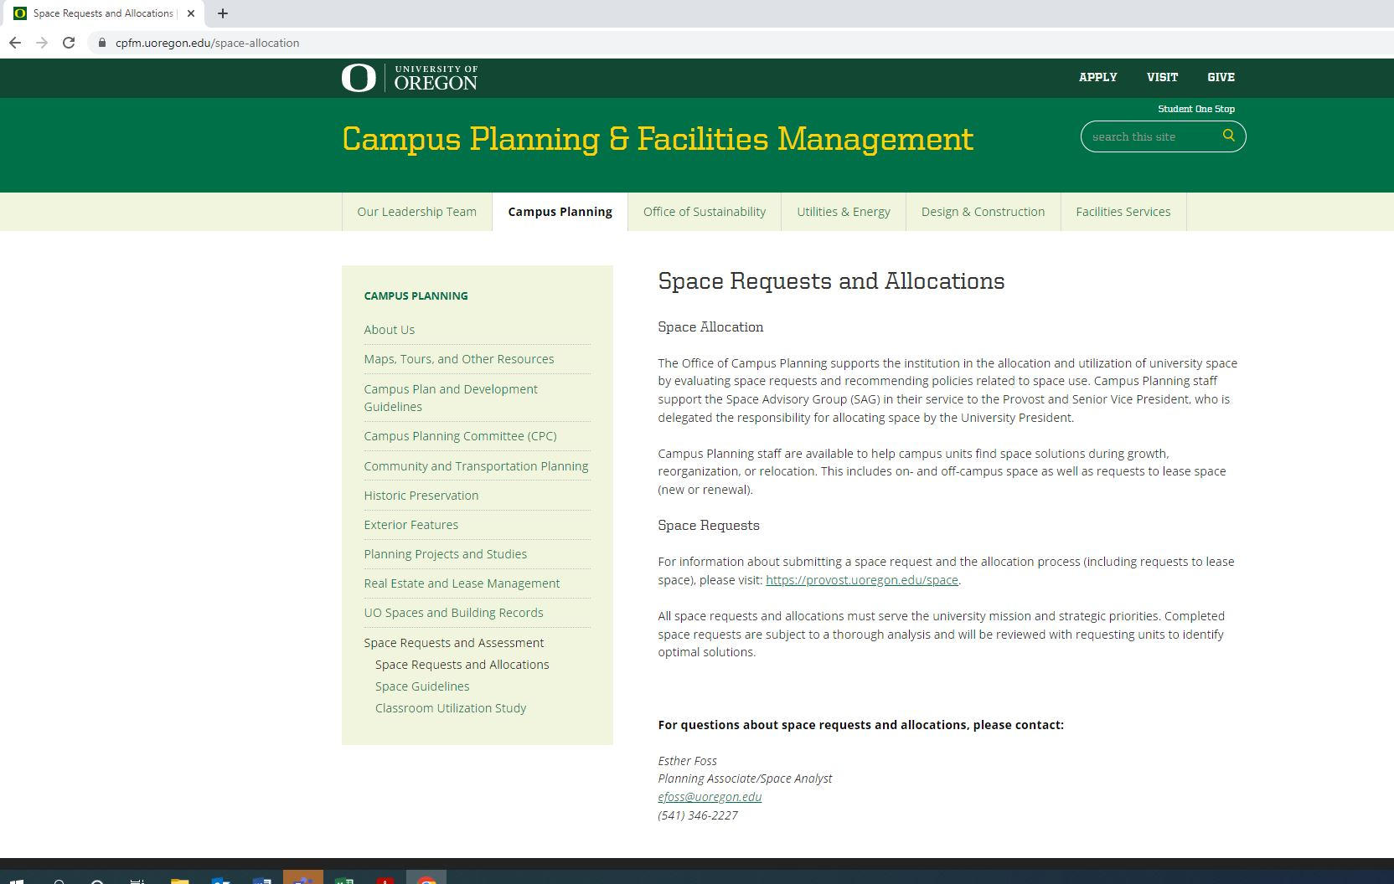

Slide 33
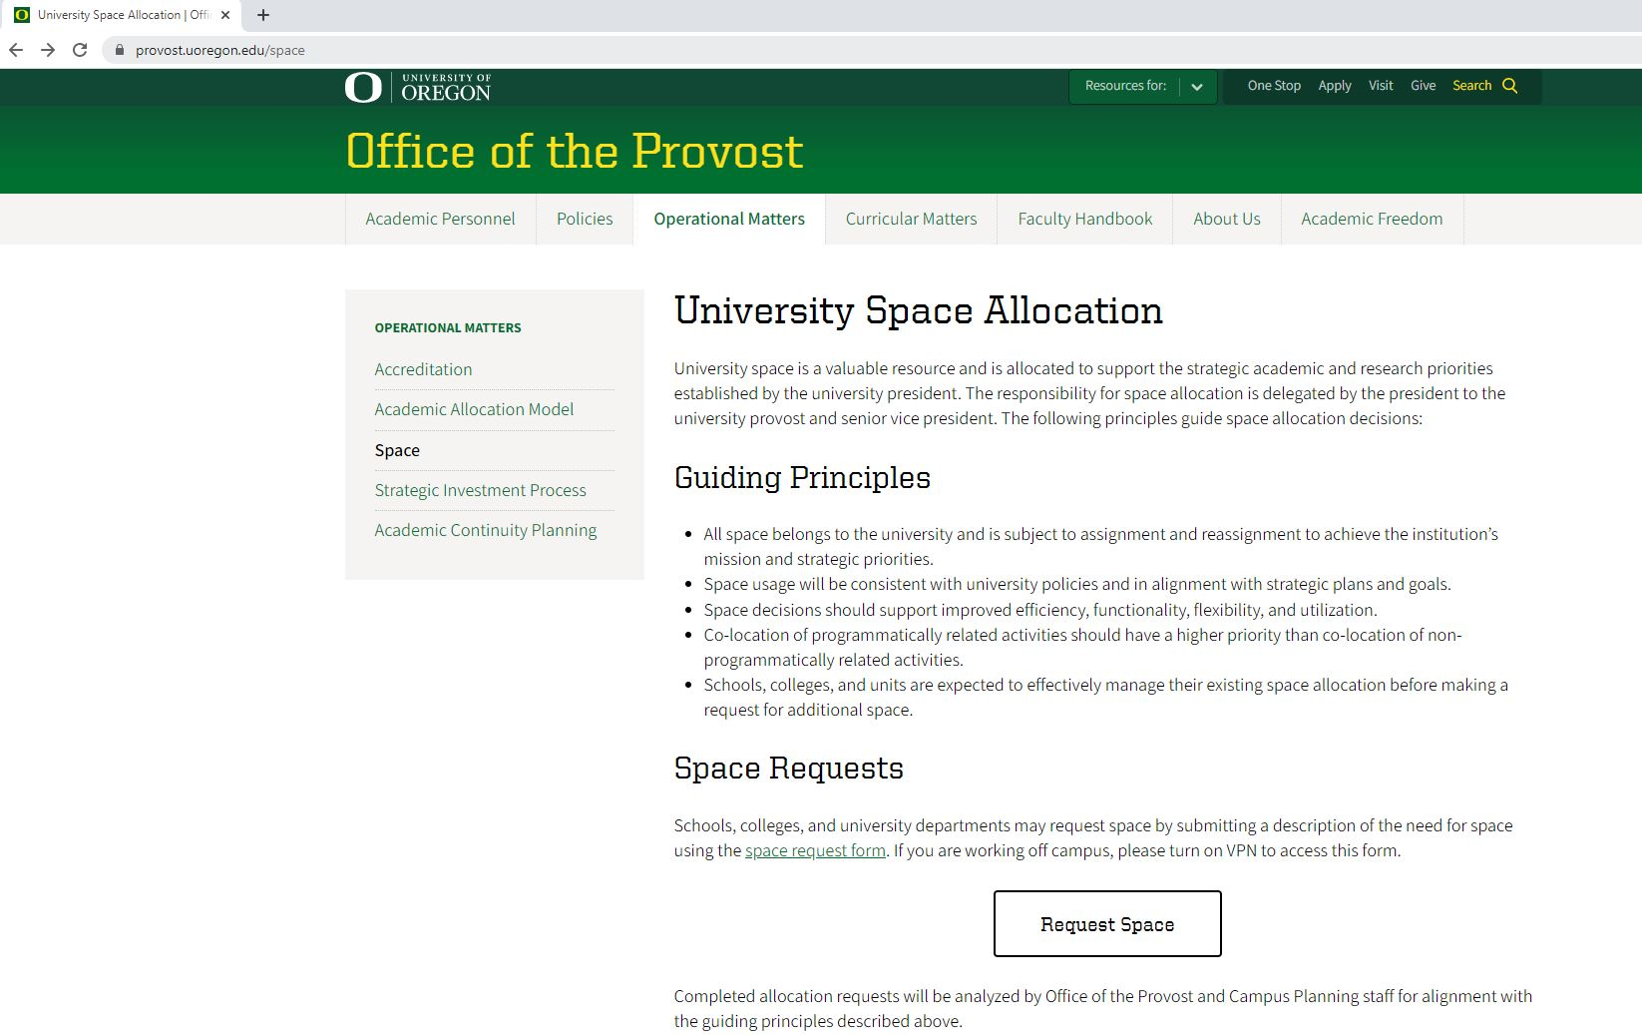

Slide 34
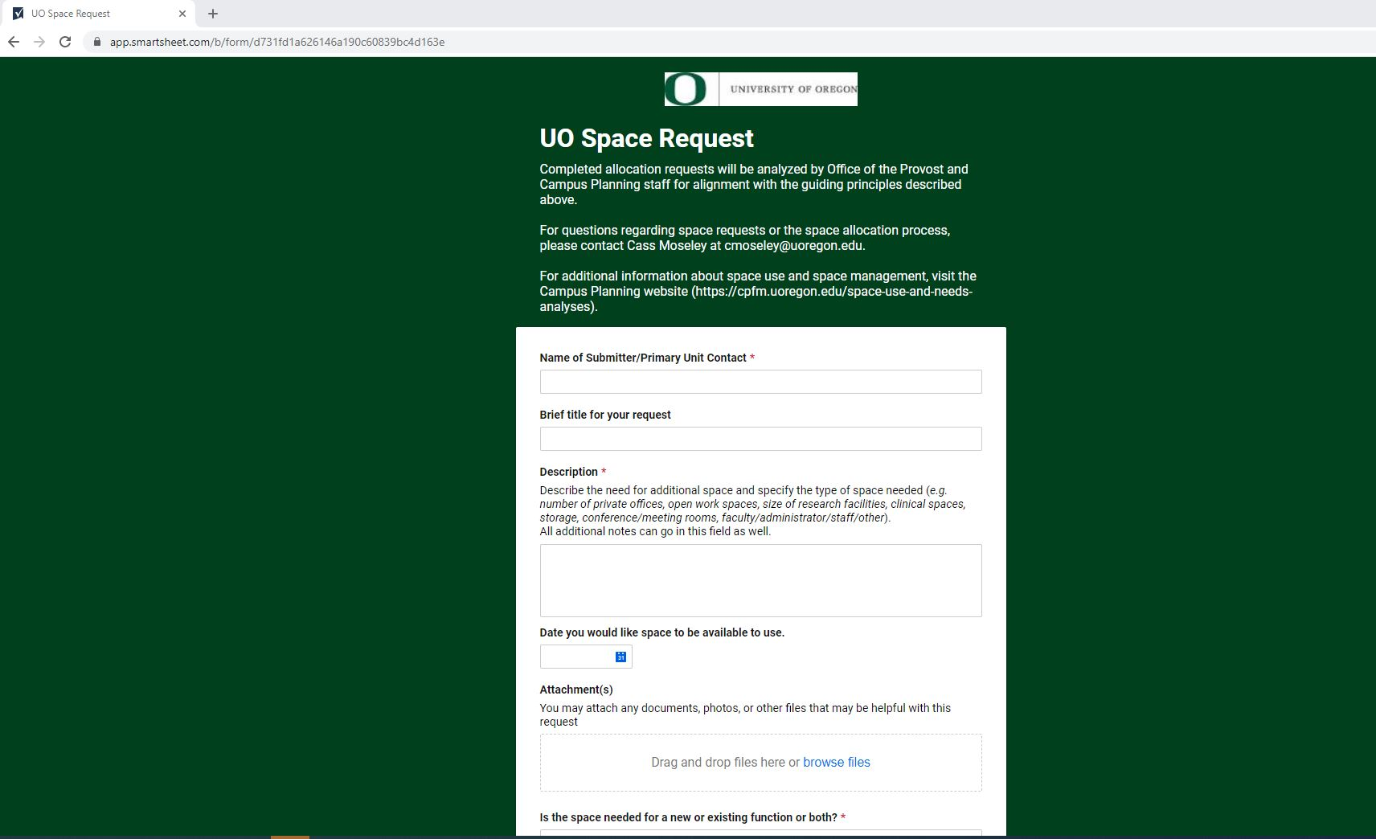

Slide 35
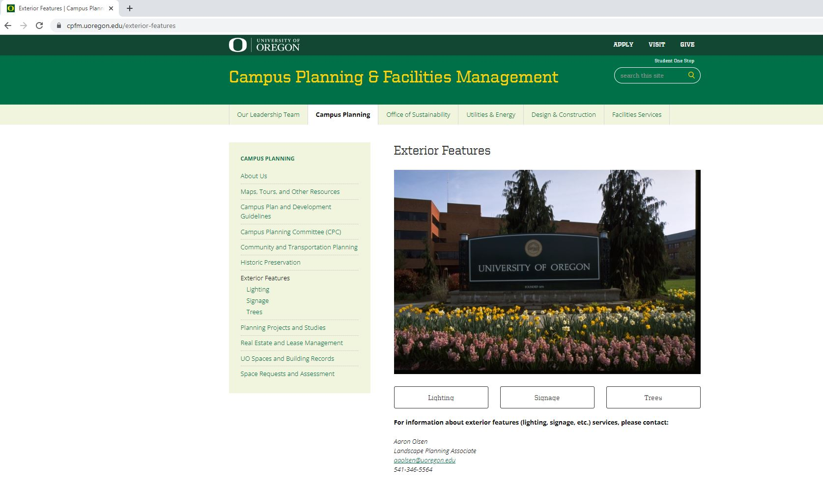

Slide 36
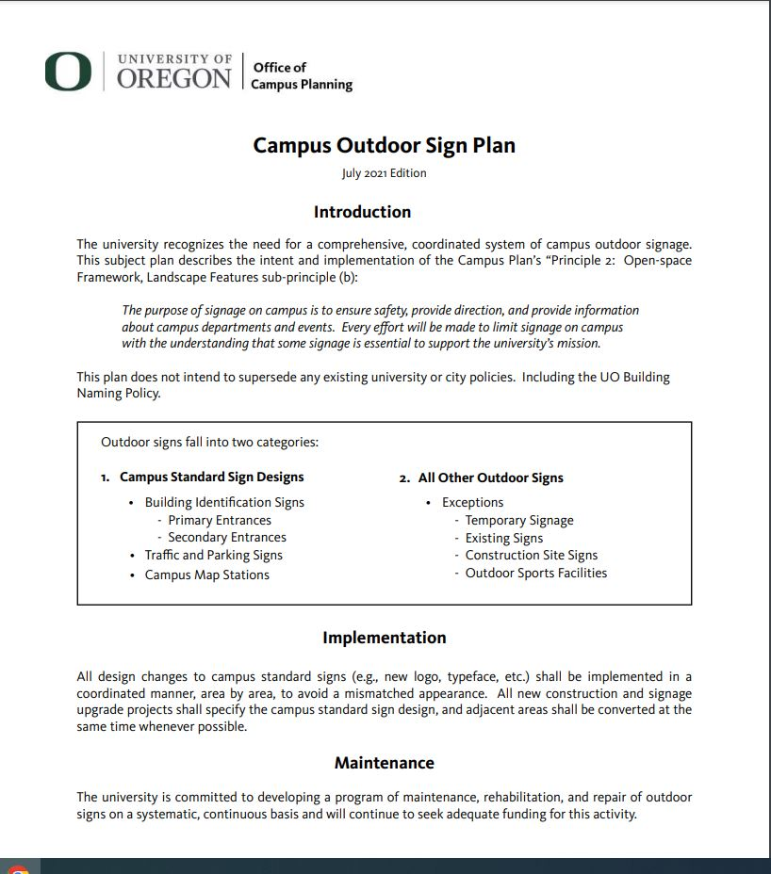
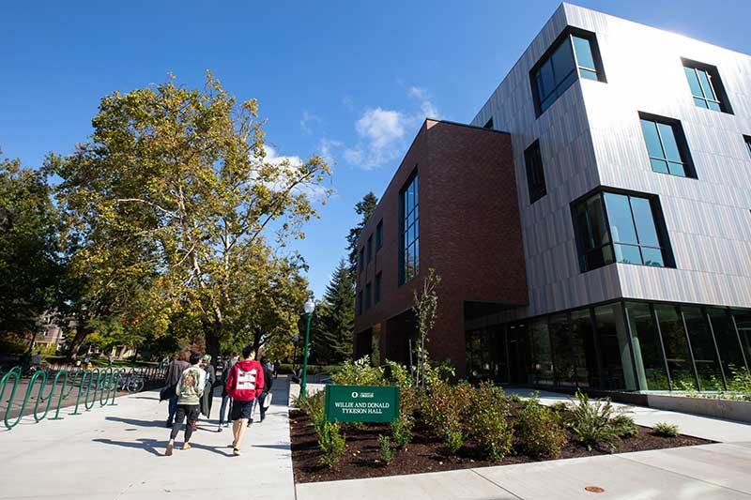

Slide 37
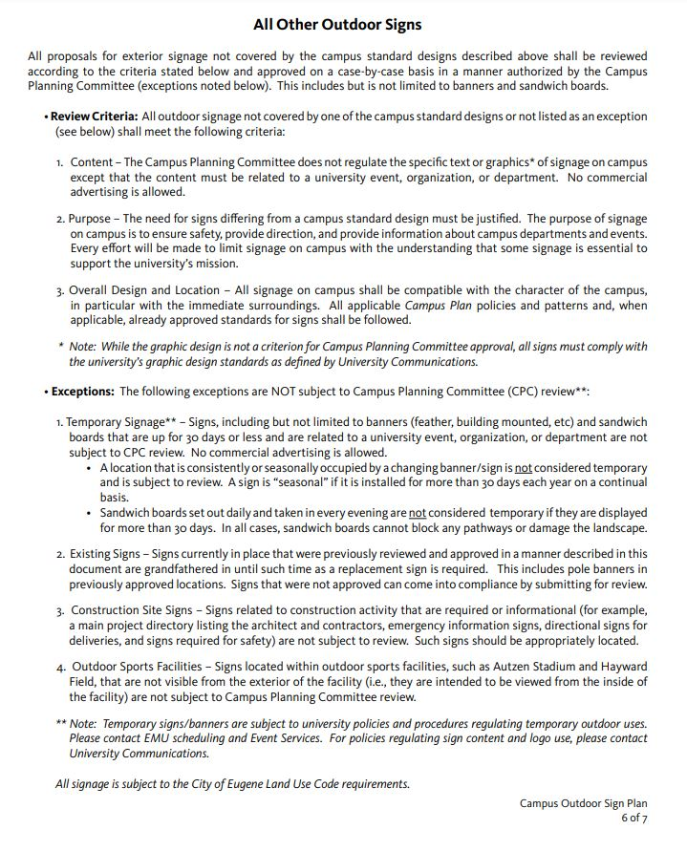
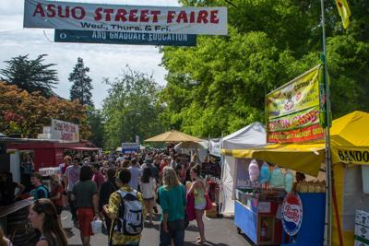
https://cpfm.uoregon.edu/signage-0

Slide 38
Q&A

Slide 39
Thank you for joining us.

