Slide 1
Innovations in Assessment: From the Assessment of ELLs (Duran & Wackerle-Hollman; Linan Thompson), Reading Comprehension (Biancarosa), to Implementation (Harn)
“Devil is in the nuances” (Duran, 2017)

Slide 2
The development of a Spanish story-book based preschool universal screening measure
Lillian Durán - University of Oregon
Alisha Wackerle-Hollman - University of Minnesota

Slide 3
What are the Individual Growth and Development Indicators- Español?
Brief, easy to implement general outcome measures (GOMs)
Designed for Spanish-English bilingual preschoolers who are in United States who may move into English-only or bilingual K-12 experiences.
Includes measures of oral language, phonological awareness, & alphabet knowledge
Designed by specifically attending to how Spanish develops, rather than translating English tasks, leading to an emphasis on tasks that are potentially more culturally and functionally salient for Spanish–English bilinguals.

Slide 4

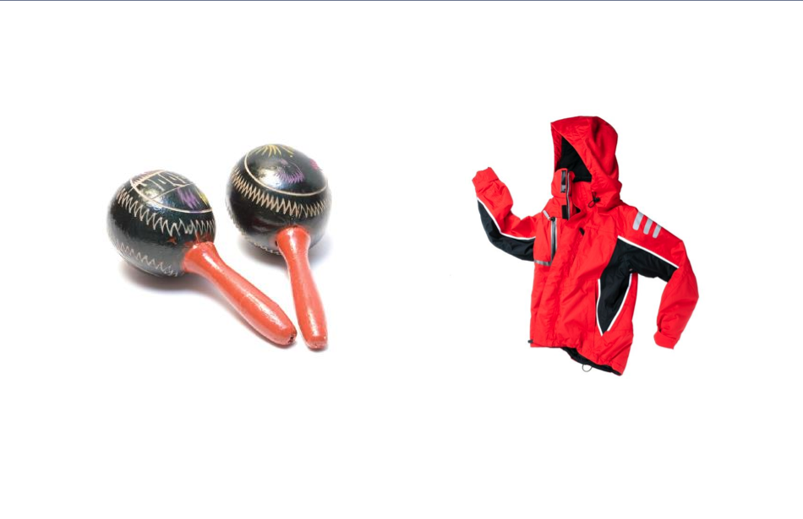
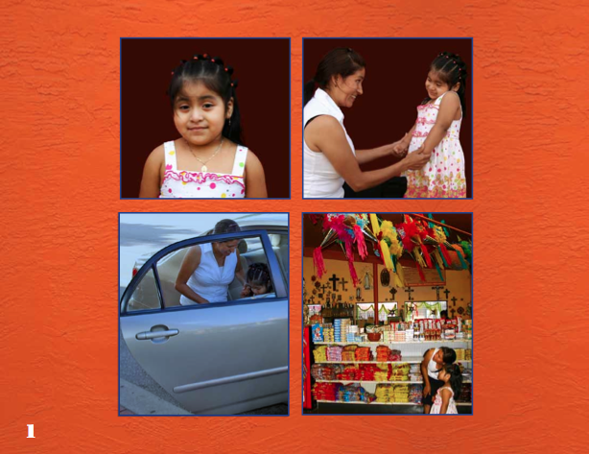
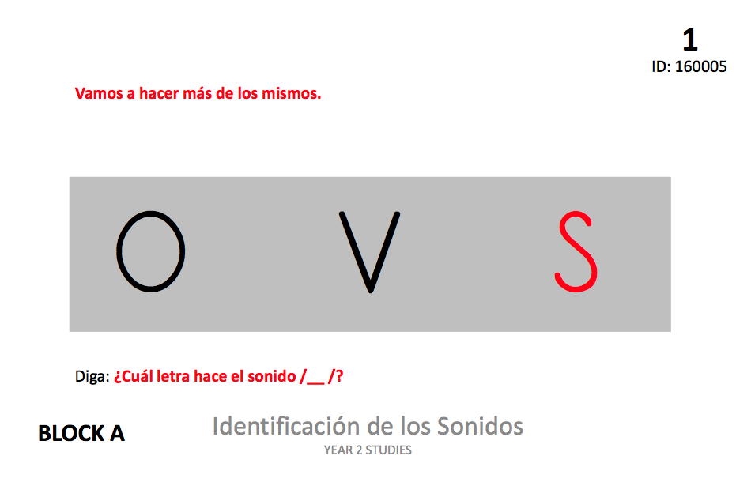
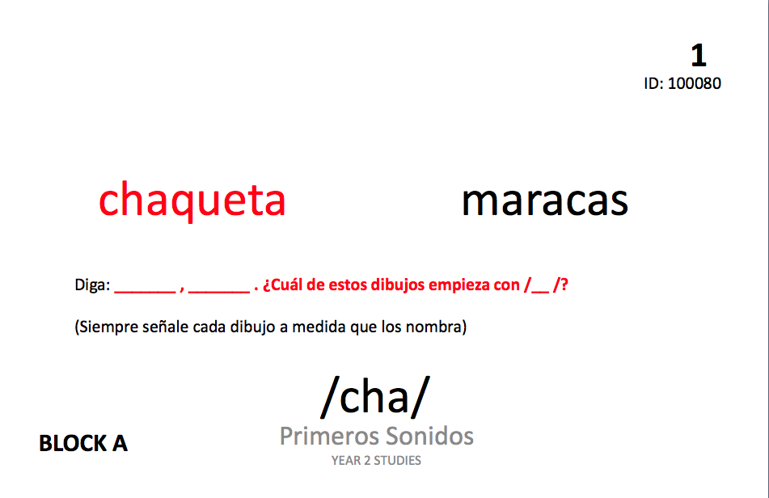
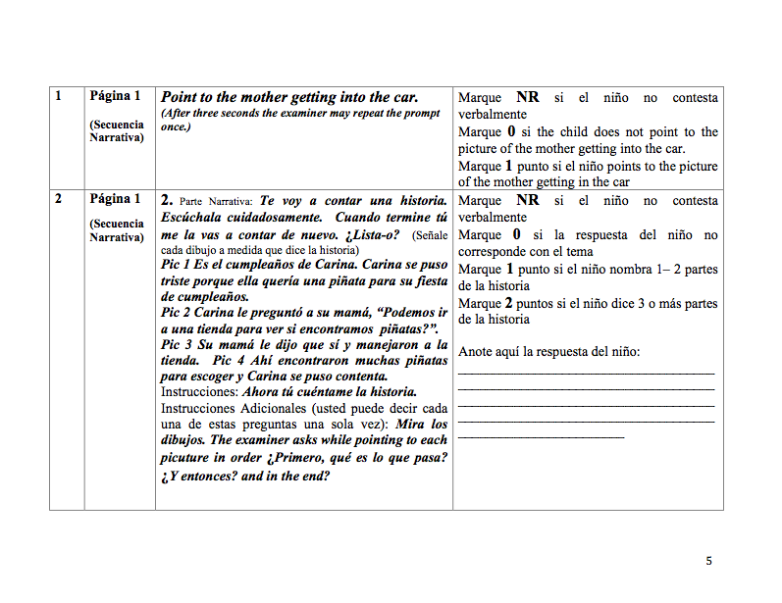
S-IGDIs: Letter Sounds, First Sounds, Storybook

Slide 5

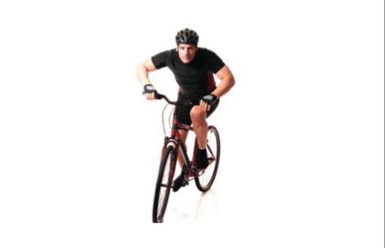
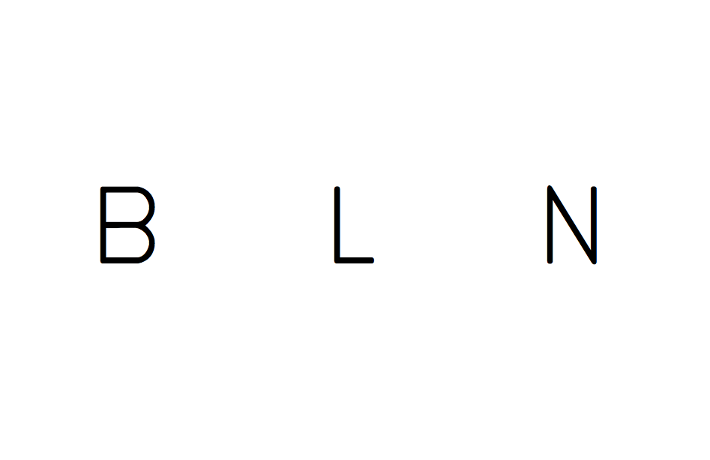
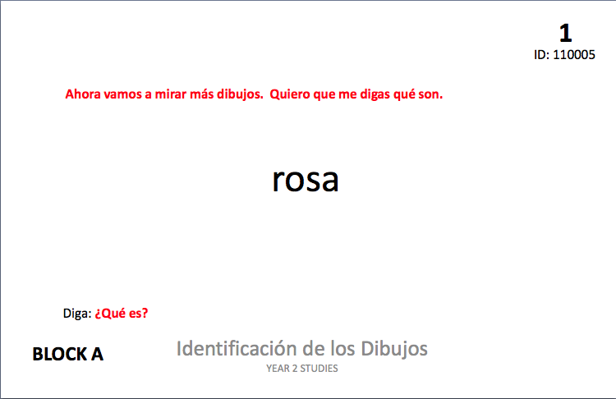
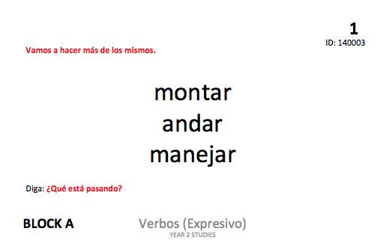
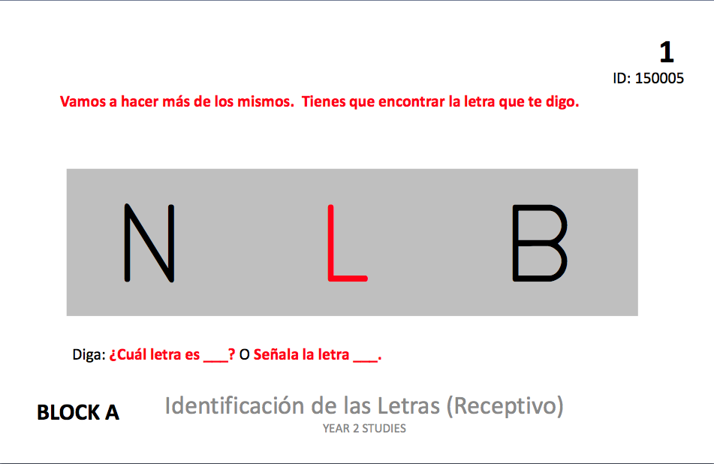
S-IGDIs: Picture Naming, Expressive Verbs, Letter ID
Notes:
Chase add in this content here for all of the tasks.

Slide 6
S-IGDI approach to bilingual measurement
We measure Spanish and English separately (Using IGDIs 2.0 in English) and provide guidelines to teachers that allow them to make instructional decisions in each language
We argue that Spanish and English early language and literacy skills represent different constructs and we need tests that reflect the linguistic and cultural considerations appropriate to each language in separate approaches to measurement.
We also argue that having information in each language is best suited for instructional planning

Slide 7
Storybook -¡Vamos a la tienda! Let’s go to the store
The storybook measure was designed to capture naturalistic language samples
The measure includes items that test expressive language, receptive and expressive vocabulary, and story retell.
The theme of going to the grocery store to prepare for a birthday party was purposefully selected as a common experience shared by most young children in the US
Notes:
Lilly

Slide 8
Study Sample
Partner programs included:
  Migrant Head Start
  Head Start
  Private pre-k program
  Voluntary Pre-k statewide preschool (Florida)
  School-based extension programs (pre-k programs within Elementary schools funded by title 1 and other funds)
Spanish English bilinguals who are in the year before Kindergarten (4 &5)
This study reports on two years of data with storybook, including 402 total students from MN, UT, ID, CA, FL
Samples represented Mexican, Caribbean and a smaller proportion of South and Central American SEBs.

Slide 9
S-IGDI Measure Development
Wilson’s model (2004)
Construct map-What are we measuring?
Item design-How will we measure it?
Outcome space-How will we score responses?
Measurement model- How will we scale items? (Rasch modeling)
Constructing Measures: An Item Response Modeling Approach
Notes:
We’ll talk about one specific measure in this process today, storybook

Slide 10
Item Design: Narrative Assessment, Story Retells & Language Samples
Narrative assessments have been found to be less biased than norm-referenced testing for children who speak languages other than English (Gutiérrez-Clellan, 1995: Fiestas & Peña, 2004)
Story retells have diagnostic value because they require additional processing demands and the ability to sequence (Gutiérrez-Clellan, 2002)
Speech and Language Pathologists use language samples to get a more detailed understanding of children’s language skills because they provide a more authentic view of language ability and they can be more sensitive to growth and documenting change (Costanza-Smith, 2010)

Slide 11
Receptive Vocabulary & Expressive language examples

Slide 12
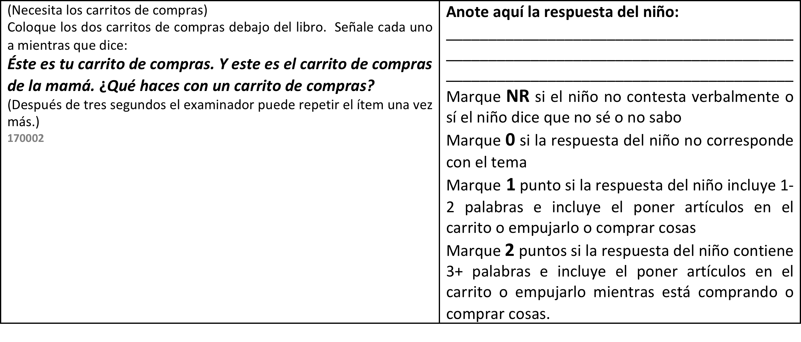
Expressive Language

Slide 13
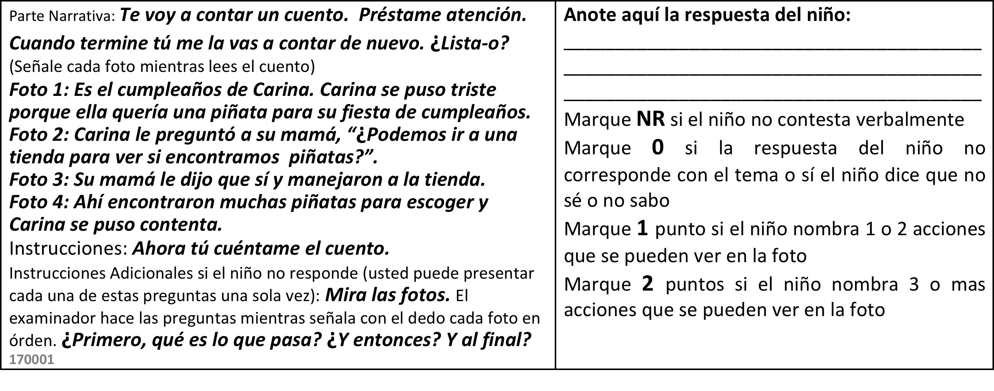
Story Retell

Slide 14
Measurement Model: Calibration Results
Rasch Model was used to calibrate items
Calibrations only included students with valid responses (all ND/DK were excluded)
Initially 75 items were calibrated.
Items with poor fit (PBSE<.20, infit and outfit great than 1.5 or less than .5, p value below .2) were eliminated and the total pool was recalibrated after initial items were removed.
A final set of 52 items were then calibrated, 30 of which featured partial credit.
Measure | n | Mean (Raw Score) | Mean (Rasch score) | SD (Rasch units) | Person Reliability
Storybook | 402 | 18 | .829 | 1.35 | .82
*the form length was 32 items, Maximum Rasch was 4.40, min was -3.47
Notes:
First two measures still working on this year’s calibration—Item scoring keys more difficult

Slide 15
Outcome Space
Or “how do we score and interpret responses?”
What is scored as correct or incorrect is based on the original construct definition
We included only Spanish in the original construct
Therefore our challenge with this measure was to include only Spanish responses as correct.

Slide 16
Response Examples
Spanish Only
170012: Story retell about egg accident
Carina estaba triste queria piñata, le dijo a su mama y se fueron a la tienda y vieron piñatas y esta feliz
Code Mixed
170012: Story retell about egg accident
Shari egg uno niño push her uno egg broken su mama say ok uno señora limpia
170017: Tell me about your birthday party.
yo jugo con my dog
170073: Tell me what we did in the store?
compramos uno cake uno coconuts

Slide 17
Our challenge
At present, this measure aligns with a construct definition that emphasizes Spanish only, however considerations for English in addition to Spanish are emerging.
  This addition creates an environment conducive to asking:
    To what degree do code-mixed responses impact tier designation on IGDI measures that DO NOT include English responses? (Picture Naming and Expressive Verbs)
    To what degree do we add empirical value in the measurement scale?
    To what degree do code-mixed responses on Storybook change tier level candidacy across IGDI measures?

Slide 18
Tier designation based on code-mixed responses
Season | Tier 1 | Tier M | Tier 2/3 | Row total
Picture Naming/Identificación de los Dibujos Spanish-only
Fall | 78/19.4% | 134/33.3% | 191/47.4% | 403/100%
Spring | 139/34.5% | 123/30.5% | 141/35% | 403/100%
Picture Naming/Identificación de los Dibujos code-mixing recalculation
Fall | 78/19.4% | 138/43.2% | 187/46.4% | 403/100%
Spring | 141/35% | 123/30.5% | 139/34.5% | 403/100%
Expressive Verbs/Verbos Expresivo Spanish-only
Fall | 80/19.8% | 151/37.3% | 174/43% | 405/100%
Spring | 65/16% | 150/37% | 174/43% | 405/100%
Expressive Verbs/Verbos Expresivo code-mixing recalculation
Fall | 84/20.7% | 155/38.3% | 166/41% | 405/100%
Spring | 73/18% | 159/39.3% | 173/42.7% | 405/100%
Notes:
Did it change –No!

Slide 19
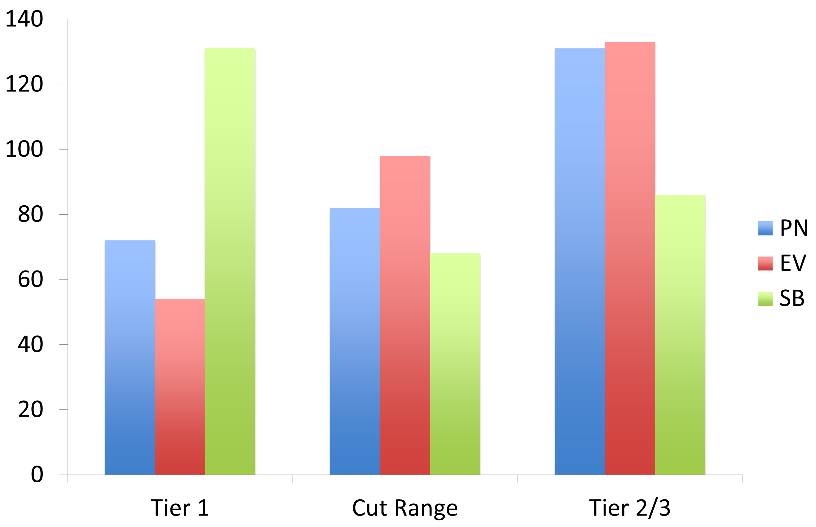
How Storybook compares to other measures in tier designation

Slide 20
Challenges in Scoring
1. Scoring code-mixed responses
¿Piensas que la mamá debería compartir su soda con Carina? ¿Por-qué/por qué no?
no porque she is thirsty
2. Response with many words but does not answer question
Éste es tu carrito de compras. Y este es el carrito de compras de la mamá. ¿Qué haces con un carrito de compras?
chiclet, nuggets, huevos

Slide 21
Challenges in Scoring
Scoring for meaning-Subjectivity of what makes sense
¿Qué pasa si te caen los huevos?
“unos pollitos”
Éste es tu carrito de compras. ¿Qué haces con un carrito de compras?
“comida, desayuno, galletas”
“esta caminando y echar cosas”
Scoring for meaning—Scoring within stated guidelines
¿Como puedes saber que el señor está feliz?
Response is supposed to be something about him smiling or laughing, but some scorers included many responses as correct such as
“esta tomando cerveza”
“Esta feliz porque va a tomar la coca y porque tiene dinero”
“Porque le gusta la fiesta”

Slide 22
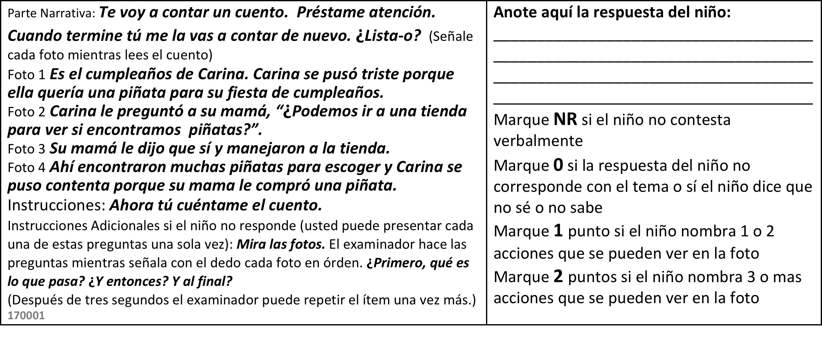
Challenges in Scoring
In story retell item scorers are supposed to count number of actions retold by child, but there is discrepancy across scorers in what constitutes an “action”
“agarrando su mano, su happy birthday, ir a la tienda”
“quiere candy pa su pinata y una pinata ahi
era su cumpleanos, platico con su mama que quiere una pinata, fueron a la tienda, escogieron una pinata

Slide 23
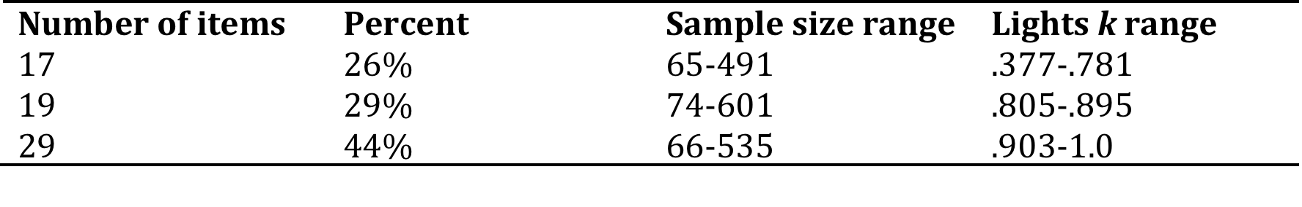
Inter-rater reliability results
Notes:
Lights K provides an average of the pairwise reliabilities between all three of the raters. We used listwise deletion, so if they were missing any item score, all that child’s data was removed, however, this only occurred in approximately 2% of our data. 65 total items

Slide 24
Implications
Inconsistency in scoring reduces claims of valid ability metrics for children’s scores, as a result, determining a best approach to maximize consistency is paramount.
Balancing ease of scoring and standardization while not limiting meaningful information that can be gathered from children’s responses is challenging at best.
Variability in Spanish proficiency of scorers likely interacts with reliability of scoring (but can only be confirmed in future studies).

Slide 25
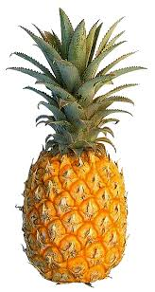
Summary & Big Questions
¿Qué es?: La casa de Spongebob”
It is hard to predict the universe of responses with young children in general and with bilingual populations code-mixing and scoring natural language samples will continue to provide unique challenges to developing reliable scoring criteria.
How can we ensure a better balance between treatment integrity and technical adequacy in developing assessments?
How can we maximize opportunities to provide culturally relevant assessments while maintaining rigor in scoring and item design?
Notes:
In response to ¿Qué les pasaría a los globos si Carina los deja ir?

Slide 26
Thank You!!
lduran@uoregon.edu & wacke020@umn.edu
”

Slide 27
Assessing English Learners’ Writing Development
Sylvia Linan-Thompson
February x, 2017
PCRC
Coronado Island, CA

Slide 28
Acknowledgments
The work presented here was funded by the Office of Special Education Programs
Grant #H326M140002

Slide 29
Rationale
72% of fourth graders are below proficient level on the National Assessment of Educational Progress (2003).
There is increased interest in examining student writing.
Measures of writing that measure student progress and identify students who are struggling are available but Els have not been included in much of the research.

Slide 30
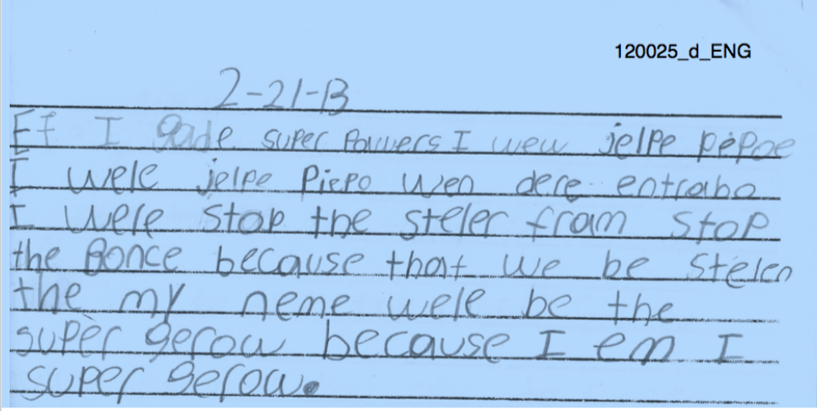
Sample

Slide 31
Introduction
“Holistic bilingualism the bilingual is not the sum of two complete or incomplete monolinguals; rather, each child has a unique and specific linguistic configuration” (Grosjean, 1989, p. 3.)
The use of side-by-side linguistic analyses of student work highlights the intersection of language development and literacy acquisition among emergent bilingual students.

Slide 32
Introduction
Using information from cross-linguistic transfer can support assessment and distinguish students who are in the process of normal language development in an L2 from those who may have learning disabilities (Durgunoglu, 2002).
However, most practices fail to take into account the interrelatedness of literacy skill development leaving children vulnerable to identification for special education while they are in the process of becoming biliterate.

Slide 33
Research: EL writing
Explicit instruction in L1 positively correlates with correct orthography in that language, an absence of instruction in L2 will cause the students to recourse to the abilities developed in their first language (Francisco et al., 2006).
Raynolds and Uhry (2010) found that students tended to draw on their Spanish phonology in order to represent English phonemes with no Spanish equivalent.

Slide 34
Research: EL writing
Helman (2004) suggests that consonant and vowel variations may create possible confusion for the writing of second language learners.

Slide 35
Research: EL writing
Errors are actually a natural part of language development and are a window into a writer's development (Schleppegrell & Go, 2007).
According to Díaz-Rico (2008), "persistent errors, rather than random mistakes, provide insight into the learner's rule set" (p. 246).

Slide 36
Research: EL writing
ELs often use their L1 to plan their writing, develop ideas, and produce content, and organize (Arndt, 1987; Edelsky, 1982; Uzawa, 1996; Woodall, 2002).
  The use of the L1 is impacted by students’ proficiency in English.
  Students with low levels of English proficiency tend to directly translate form their first to second language throughout the writing process.
  Students with higher levels of English proficiency tend to compose in English but may use their first language to generate ideas and word search (Woodall, 2002).

Slide 37
Research: Assessment
Words written, words spelled correctly, and correct letter sequence were:
  Sensitive to growth within year and across grades
  Discriminated between student with and without disabilities
  (Deno et al., 1982; Marston & Deno., 1981; Marston, Deno, & Tindal, 1983)
Analytic scores added to those measures discriminated between general education students and students with LD, at-risk, and low performance (Tindal & Hasbrouck, 1991).
Percent of words spelled correctly
  Best screening tool (Parker, et al. 1991b).

Slide 38
Purpose
This exploratory study seeks to better understand the writing development of English language learners by examining their skills in English.
We hypothesize that this information in addition to their performance on tasks in each language, may help us differentiate between ELLs who have a disability and those who lack English proficiency.

Slide 39
Setting
The study was conducted in an elementary school with a bilingual English/Spanish dual language program.
Students received reading instruction in Spanish but writing instruction was in both languages.
Students had multiple opportunities to write: creative bilingual journals, independent writing.
Teachers used a writers’ workshop model for writing instruction.

Slide 40
Participants
A subsample from a larger study
  7 second grade students
    2students identified with dyslexia
    3 students who scored 2 on the writing subtest of the SELP
    2 students who scored 4 on the writing subtest of the SELP

Slide 41
Data Sources
Stanford English Language Proficiency
Stanford Spanish Language Proficiency
Journal samples
  Samples from September, October, November/December,

Slide 42
Research Questions
Which variables discriminate across the three groups?
Are there differences in rate of growth among the three groups?
Which types of bilingual strategies do students use in their writing?
Does the nature of the strategies change over time?
Are there differences in strategy change over time by group?

Slide 43
Variables
Total number of words
Correct word sequence
Correct word sequence without spelling
Number of correctly spelled words

Slide 44
Variables
Bilingual strategies
  Discourse level
  Sentence/phrase level
  Word level
  (Adapted from Soltero-González, Escamilla, & Hopewell, 2011).
Holistic rating
  1-5 scale
  Organization/content
  Topic maintenance
  Cohesion
  Referential cohesion
  Complexity

Slide 45
Results
Student | WW | Unique | WSC | CWS | CWS w/o | Holistic
Dyslexia | 42.6 | 24.22 | 16.88 | 7.66 | 33.11 | 5.88
Low | 72.36 | 30.09 | 27 | 9.18 | 54.27 | 5.81
Average | 53.77 | 30.55 | 49.55 | 42.55 | 50.77 | 11

Slide 46
Results
Time of year | Total # of words | Unique words | % of errors | % of unique errors Spanish phonology | % of unique errors English approximations | % other unique errors | Spanish word
a | 57.7 | 25 | 69.80 | 74.77 | 11.41 | 4.50 | -
b | 56 | 28 | 43.67 | 54.91 | 31.21 | 6.08 | -
c | 49 | 28 | 39.91 | 65.34 | 31.17 | 4.33 | -
d | 56.5 | 32 | 43.85 | 70.59 | 26.05 | 2.70 | -
e | 68.6 | 30 | 30.22 | 58.64 | 41.03 | - | -

Slide 47
Results
Time | Initial consonant | Final consonant | Short vowels | digraph | blends | Long vowels | Other vowels | inflected | irregular | Middle doubling
a | 15.4 | 13.9 | 21.4 | 2.5 | 4.5 | 17.9 | 13.4 | 0.0 | 6.5 | 4.5
b | 4.5 | 7.5 | 33.0 | 3.5 | 4.0 | 21.5 | 8.0 | 7.5 | 1.0 | 9.5
c | 7.1 | 3.5 | 28.3 | 11.5 | 1.8 | 28.3 | 6.2 | 2.7 | 5.3 | 5.3
d | 8.1 | 4.5 | 15.8 | 7.2 | 6.8 | 19.4 | 27.5 | 1.8 | 1.4 | 7.7
e | 10.7 | 10.1 | 21.8 | 5.5 | 4.4 | 20.8 | 14.4 | 2.6 | 3.4 | 6.2

Slide 48
Results: Bilingual Strategies
Student | Syntax | Literal Translation
Dyslexia |  | Mai tio hies
Low
Average | …rolacoster of water | …another one of ginger

Slide 49
Results: Analysis of errors
Majority of errors were short vowel errors followed by common long vowels, other vowels and irregular words. Examples include end for and, wi for we, and fram for from.
In instances where the incorrect consonant was used, it was either letters that are not differentiated in Spanish such as v and b. For example, lives spelled as lebs or English sounds that are represented by a different letter in Spanish such as gi for he or jelpe for help.
However, some students did not take advantage of Spanish phonology when spelling words that were cognates. A student spelled family as fimoli when the correct word is Spanish is familia. It’s not clear if the student’s own pronunciation of the word might have influenced the spelling.

Slide 50
Summary
Generally, average language proficiency students write more words than students in other groups.
They are better spellers than students in the other two groups as measured by both TWC and CWS.
They have higher holistic scores than students in the other two groups.
Most bilingual strategies are at the word level.

Slide 51
Current Study
176 ELs in 1st to 3rd grade
  (54, 66, 56)
Writing samples collected in October and May
3-minute task
Students responded to the prompt: Some of the things I like to do on the weekend are…

Slide 52
Research questions
What are the differences in the English writing quality and quantity of first, second, and third grade ELs?
What are the differences in the English writing quality and quantity of first grade ELs between the beginning and end of the school year?
What are the differences in the English writing quality and quantity of second grade ELs between the beginning and end of the school year?
What are the differences in the English writing quality and quantity of third grade ELs between the beginning and end of the school year?

Slide 53
Scoring
Total word count
Unique words
Total words spelled correctly
Types of spelling errors
Use of bilingual strategies
Holistic

Slide 54
Results
 | 1 |  | 2 |  | 3
 | Pre | Post | Pre | Post | Pre | Post
Total words | 10.88 (8.8) | 11.44 (7.7) | 29.7 (13.8) | 27.5 (11.5) | 36.3 (19.1) | 35.9 (17.1)
Unique words | 8.00 (5.7) | 8.42 (5.1) | 18.0 (7.9) | 18.1 (6.5) | 23.1 (9.8) | 22.5 (9.1)
Correct words | 3.45 (4.3) | 4.20 (5.1) | 18.4 (12.6) | 20.1 (10.8) | 24 (15.6) | 25.7 (15.3)
Rating score | .94 (2.0) | .69 (1.5) | 4.5 (3.2) | 3.6 (3.3) | 4.4 (3.9) | 4.5 (2.9)

Slide 55
Results Grade 1
 | Pre |  | Post
 | Lowest 25% (n=13) | 75% (n=40) | Lowest 25%(n=14) | 75% (n=40)
Total words | 1.31 (1.75) | 14.08 (7.99) | 1.79 (2.39) | 14.82 (5.69)
Unique words | 1.23 (1.64) | 10.32 (4.70) | 1.71 (2.27) | 10.82 (3.42)
Correct words | .38 (.77) | 1.14 (1.92) | 4.50 (4.54) | 5.28 (5.44)
Rating score | 0 | 1.26 (2.19) | 0 | .92 (1.64)

Slide 56
Results Grade 2
 | Pre |  | Post
 | Lowest 25% (n=17) | 75% (n=49) | Lowest 25% (n=49) | 75% (n=49)
Total words | 12.1 (8.5) | 35.8 (9.3) | 14.1 (5.2) | 32.2 (9.1)
Unique words | 8.9 (6.2) | 21.2 (5.6) | 10.8 (4.3) | 20.8 (4.9)
Correct words | 5.1 (5.2) | 23.0 (11.1) | 8.7 (4.8) | 24.0 (9.5)
Rating score | 1.9 (3.9) | 5.4 (2.4) | 1.5 (2.1) | 4.4 (3.3)

Slide 57
Results Grade 3
 | Pre |  | Post
 | 25% (n=14) | 75% (n=42) | 25% (n=14) | 75% (n=42)
Total words | 13.9 (8.6) | 43.8 (15.4) | 15.7 (9.0) | 42.6 (13.5)
Unique words | 11.6 (6.8) | 27.1 (7.1) | 12.8 (7.7) | 26.1 (6.5)
Correct words | 8.0 (7.3) | 29.3 (13.8) | 9.9 (7.0) | 31.0 (13.5)
Rating score | 1.1 (1.9) | 5.5 (3.8) | 2.4 (2.7) | 5.2 (2.6)

Slide 58
Spelling
Conventional spelling | Spanish phonology | Transition | English approximation | Spanish word | Other
It | It (eat) | com | grama | en | mexico
to | gremoder | end (and) | abaut | mi | fredis
read | bot | bech | walc | las | dont
play | bacashion | swimg | wat | los | tony
books | end (and) | bac | bight |  | our selves
visit | plei | toks | playgraund |  | chopqins
favorite | layc | liyk | lik |  | misu

Slide 59
Next steps
Examine types of errors across grade
Examine Spanish writing samples of lowest 25%

Slide 60
Conclusions (so far)
Writing provides evidence of student development in the process of becoming bilingual/biliterate.
Need more analysis/data to determine if this can be used to discriminate between students with disabilities and low language proficiency.
Student writing may be an alternative to parallel monolingual assessments.
May be easier to use and more sensitive than oral proficiency measures.

Slide 61
Poor Reading Comprehension in a Diverse Sample of
Intermediate Grade Children
Gina Biancarosa, Mark Davison, Ben Seipel, Sarah E. Carlson, Bowen Liu, & HyeonJin Yoon
The research reported here was supported by the Institute of Education Sciences, U.S. Department of Education, through Grant R305A140185 to the University of Oregon. The opinions expressed are those of the authors and do not represent views of the Institute or the U.S. Department of Education.

Slide 62
Theoretical and Practical Basis
Poor comprehenders: comprehension below expectations for adequate or better “component” skills
Types of poor comprehenders (e.g., Carlson et al., 2014; McMaster et al., 2012; Rapp et al., 2007)
  “Paraphrasers”
  “Lateral Connectors” (“elaborators”)
  Recent research suggests different types of poor comprehenders respond better to different interventions (McMaster et al., 2012)
Current assessments only identify good vs. poor comprehenders, but teachers and researchers want more (Klingner, 2004; Pearson & Hamm, 2005; RAND Reading Group, 2002)

Slide 63
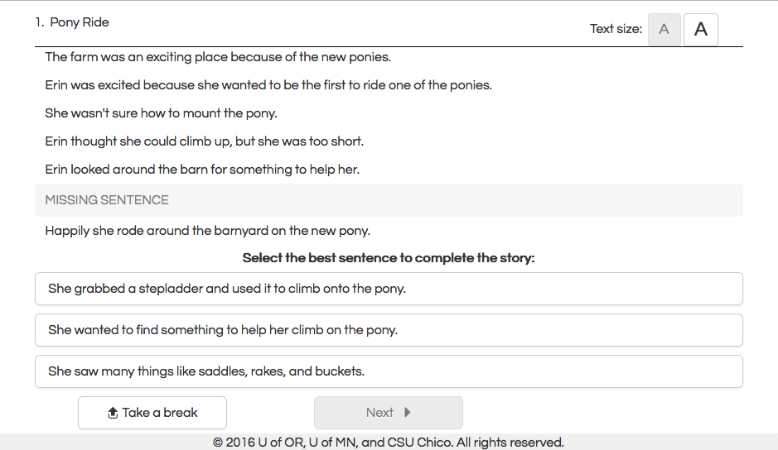
MOCCA Item Design
1. Wild Birds
In the summer, Nan always took care of her mother’s grape vines.
One night, she found her crying because wild birds were eating her grapes.
7-sentence story
If the birds ate all the grapes, then there would be none to sell.
She decided she would build a giant scarecrow to keep all the wild birds away.
Nan gathered some straw, paint, and old clothes.
Missing sentence creates causal gap
Her mother was happy that Nan saved the grapes.
She placed the scarecrow in the vineyard and no wild birds ate any grapes.
Alternatives provided as multiple choice responses (maze)
She wanted to build a scarecrow to help take care of her mother’s grapes.
She also used some buttons to make the face on the scarecrow.

Slide 64
MOCCA Item Design, 2
1. Wild Birds
In the summer, Nan always took care of her mother’s grape vines.
One night, she found her crying because wild birds were eating her grapes.
If the birds ate all the grapes, then there would be none to sell.
She decided she would build a giant scarecrow to keep all the wild birds away.
Nan gathered some straw, paint, and old clothes.
She placed the scarecrow in the vineyard and no wild birds ate any grapes.
Her mother was happy that Nan saved the grapes.
She placed the scarecrow in the vineyard and no wild birds ate any grapes.
She wanted to build a scarecrow to help take care of her mother’s grapes.
She also used some buttons to make the face on the scarecrow.
Next

Slide 65
MOCCA Uses Informative Distractors
Previous “distractor-driven” assessment work primarily in science (Hestenes, Wells, & Swackhamer, 1992; Sadler, 1998)
Answer choices
  Correct response is a causally coherent inference that fills the causal gap
  Informative distractors are based on comprehension process preferences of poor comprehenders
    Paraphrase of story’s main goal
    Lateral connection from 5th sentence to extra-textual information (e.g., elaboration, association, or explanation)
    The causal gaps remains!

Slide 66
MOCCA Item Design, 3
1. Wild Birds
In the summer, Nan always took care of her mother’s grape vines.
One night, she found her crying because wild birds were eating her grapes.
If the birds ate all the grapes, then there would be none to sell.
She decided she would build a giant scarecrow to keep all the wild birds away.
Nan gathered some straw, paint, and old clothes.
Her mother was happy that Nan saved the grapes.
She placed the scarecrow in the vineyard and no wild birds ate any grapes.
Causally coherent inference
She wanted to build a scarecrow to help take care of her mother’s grapes.
Paraphrase
She also used some buttons to make the face on the scarecrow.
Lateral connection

Slide 67
MOCCA Study Design
Year 1
  Test specifications
  Item writing and review
  Pilot administration in Oregon and California
  Preliminary analyses
Year 2
  Item revisions
  National administration
  Model testing
Year 3
  Final item revisions
  National administration
  Norming, equating, and reporting finalized

Slide 68
Research Questions
To what extent are MOCCA scores reliable using classical test theory and a 2-dimensional, choice theory, 2-PL IRT model?
How prevalent are the poor comprehender types?
To what extent is MOCCA valid using traditional construct validity correlations?
To what extent does MOCCA accurately predict not meeting standards on state English Language Arts accountability measures?

Slide 69
Year 2 MOCCA Design
Administered online: February 1 – June 16
3 forms per grade; 40 items per form (forward and backward versions)
Students randomly assigned to form within grade level and school after consent
  Grade 3, N = 1301
  Grade 4, N = 1116
  Grade 5, N = 959
Approximately 25 US districts or local education agencies
  A bit Whiter than national demographics
  Main shortfall in representation of Black students
  Over 50 schools in 13 states
Administration time (M ≈ 35 minutes; SD ≈ 15 minutes)
Notes:
Ns are for students with ALL demographic information: gender, race, FRL, SPED, ELL

Slide 70
RQ1 Results
Reliability

Slide 71
Classical test theory internal consistency
1.0
0.8
CCI
PAR
LCN

Slide 72
Item variables for the 2-dimensional model
if the causal coherent option chosen
if the paraphrase or lateral connect chosen
if the paraphrases is chosen
if the lateral connect is chosen
missing if the causal coherent answer chosen

Slide 73
2-dimensional Choice Theory IRT Models
where θ₁ is a reader’s propensity to make causally coherent inferences or not,
and θ₂ is a reader’s propensity to paraphrase as opposed to making lateral connections
Notes:
Theta dimensions are different here
Theta 1 is correctness
Theta 2 is propensity to choose paraphrase over lateral connection given you got item wrong

Slide 74
Means, SDs, and IRT Reliability
Dimension 1 (comprehension): α = .88-.91
  Grade 3: M = 22.15, SD = 10.6
  Grade 4: M = 24.82, SD = 10.7
  Grade 5: M = 27.27, SD = 10.0
Dimension 2 (error propensity): α = .78-.85
  Grade 3: M_{P} = 7.31, SD_{P} = 6.4; M_{LC} = 5.92, SD_{LC} = 4.5
  Grade 4: M_{P} = 5.65, SD_{P} = 5.6; M_{LC} = 5.12, SD_{LC} = 4.5
  Grade 5: M_{P} = 5.06, SD_{P} = 5.2 ; M_{LC} = 5.01, SD_{LC} = 4.4
Notes:
Dimension 1: Means rise, variability steady
Dimension 2: Paraphrase means and variability fall

Slide 75
RQ2 Results
Prevalence of Poor Comprehender Types

Slide 76
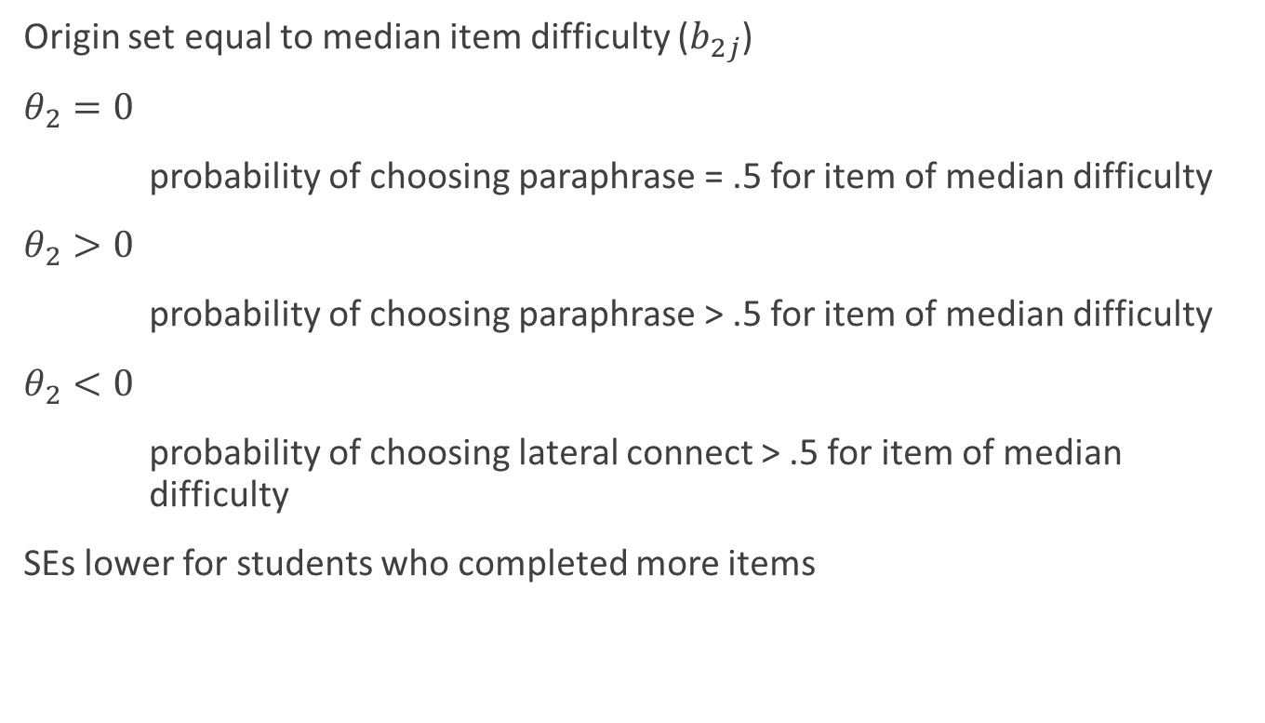
Dimension 2 Interpretation
Origin set equal to median item difficulty ($b_{2j}$)
$θ_{2}=0$
probability of choosing paraphrase = .5 for item of median difficulty
$θ_{2}>0$
probability of choosing paraphrase > .5 for item of median difficulty
$θ_{2}<0$
probability of choosing lateral connect > .5 for item of median difficulty
SEs lower for students who completed more items
Notes:
Zero on scale is equal to median item difficulty to center the paraphrase dimension scale on mean difficulty
0 is point of indifference, no propensity one way or the other
Correlation is small, which means different info; negative means good comprehenders more prone to lateral connection

Slide 77
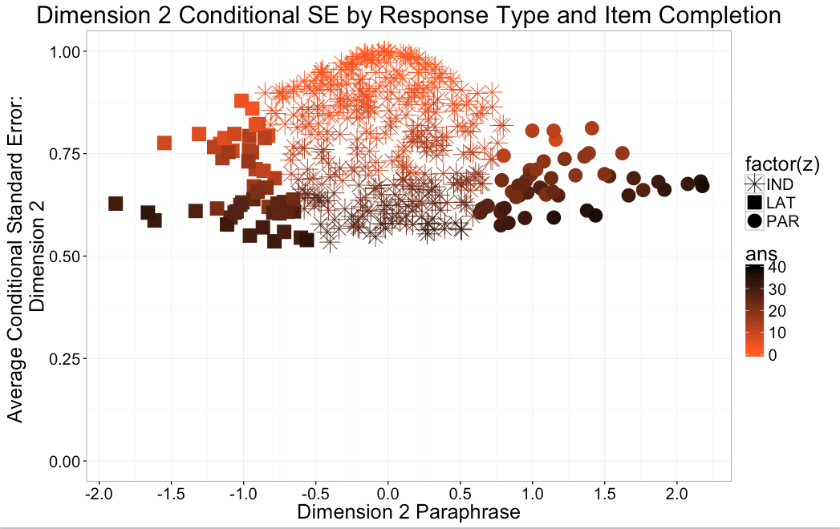
Number
of items
answered
Lateral
Connectors
Paraphrasers
Indeterminate
(Includes good comprehenders, average comprehenders, and poor decoders

Slide 78
Prevalence of Comprehender Types

Slide 79
RQ3 Results
Validity Correlations

Slide 80
Convergent and Divergent Validity Correlations
Measures | Grade 3 |  | Grade 4 |  | Grade 5
easyCBM CCSS ELA | .575**, n = 216 |  | .645**, n = 148 |  | .502**, n = 129
easyCBM CCSS math | .346**, n = 219 |  | .473**, n = 148 |  | .356**, n = 123
MAP reading (MN) | .655**, n = 68 |  | .585**, n = 73 |  | .654**, n = 70
MAP math (MN) | .536**, n = 68 |  | .382**, n = 73 |  | .540**, n = 70
MCA-III ELA |  |  | .544*, n = 73 |  | .588**, n = 67
MCA-III math |  |  | .376**, n = 73 |  | .501**, n = 67
PSSA ELA |  |  | .745**, n = 166 |  | .303**, n = 188
PSSA math |  |  | .650**, n = 165 |  | .191**, n = 187
SBAC ELA |  |  | .698*, n = 221 |  | .614**, n = 219
SBAC math |  |  | .622**, n = 214 |  | .589**, n = 161
*p < .05, **p < .01, ***p < .001. Note. CBM = Curriculum-based measure; ELA = English language arts; MAP = Measures of Academic Progress; MCA-III = Minnesota Comprehensive Assessments – Series III; MN = Minnesota; PSSA = Pennsylvania System of School Assessment; SBAC = Smarter Balanced Assessment Consortium. State assessments from prior academic year (2014-2015).

Slide 81
RQ4 Results
Predictive Validity

Slide 82
ROC Analysis Results by ELA Measure and Grade
Measure | Grade | N | AUC
SBAC ELA | 3 | 246 | 0.843
 | 4 | 214 | 0.855
 | 5 | 173 | 0.822
AzMERIT ELA | 3 | 137 | 0.802
 | 4 | 117 | 0.923
 | 5 | 145 | 0.853

Slide 83
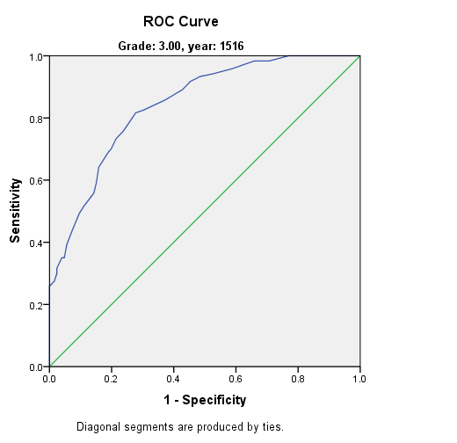
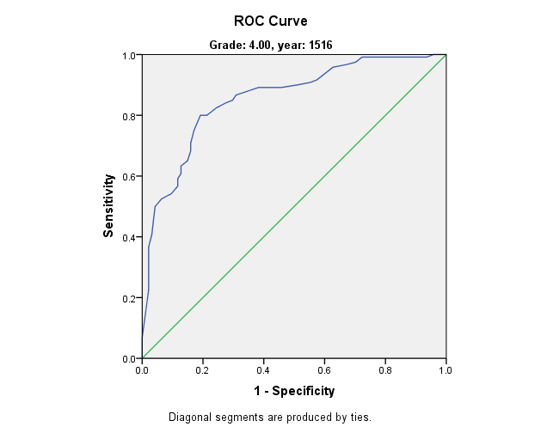
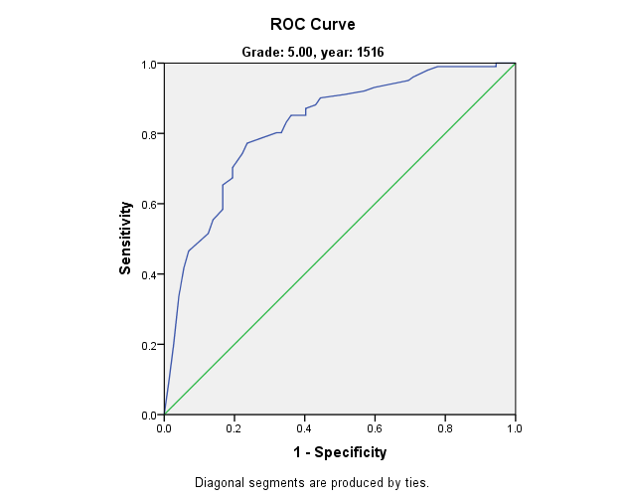
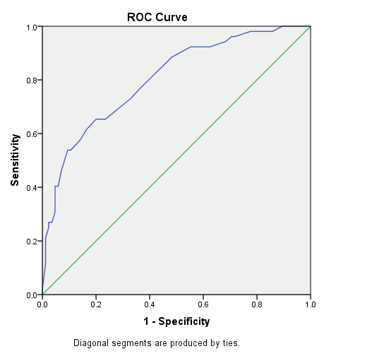
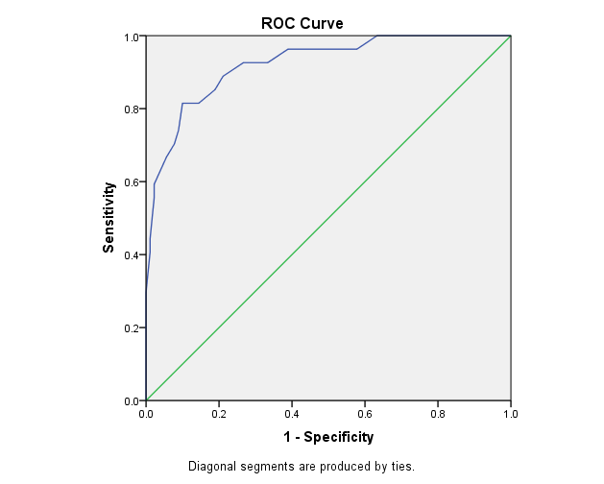
Grade 3 Grade 4 Grade 5
AZMERIT SBAC

Slide 84
Summary, Next Steps, Implications
  Excellent reliability
  Good initial validity
    Including as a risk indicator!
  Questionable prevalence of poor comprehender types
  National norming
  Validity of poor comprehender types
  Instructional relevance?
  Change indicator?

Slide 85
Thank you!
Special thanks to our grad students and partner school districts!

Slide 86
Implementation: Assesing the Quality of Our Intervention Efforts
Beth Harn (bharn@uoregon.edu)
University of Oregon, Special Education Program

Slide 87
Overview
Challenges in measuring implementation
Examining the QIDR (Quality of Intervention Delivery and Receipt) in relation to:
  Other implementation measures
  Student Outcomes
Examining Variation
  At the school-level
  By interventionist
Increasing the efficiency of measuring

Slide 88
“Teaching and learning will not improve if we fail to give teachers high-quality feedback based on accurate assessments of their instruction as measured against clear standards for what is known to be effective.”
(Archer, Kerr, & Pianta, 2016)
Notes:
This quote was really what drove my research and helped me to focus my efforts. If we are to see improvement in instruction that will improve student outcomes, we need to make sure that we can measure the implementation in such a way as to be able to provide feedback that will improve instruction.

Slide 89
What We Know About Implementation
Variability in instructional delivery impacts student outcomes (Cook & Odom, 2013; Fixsen, Blase, Metz, & Van Dyke, 2013)
Students most at-risk for academic difficulty need the highest quality instruction to ensure academic gains (Boardman, Buckley, Vaughn, Roberts, Scornavacco, & Klingner, 2016; Simmons et al., 2011; Swanson, 1999)
What do we know about what happens in schools:
  Interventionists (i.e., ed assistants) with little or no formal training (Causton-Theoharis, Doyle, Giangreco, & Vadasy, 2007)
    False belief that interventions are “plug & play”(Fixsen et al., 2005)
  Interventions are not regularly being monitored due to:
    Limited time to evaluate and provide feedback (Knight, 2007)
    No tools for measuring quality in intervention (Johnson & Semmelroth, 2012)
Notes:
To begin to explain the purpose for my study, I want to first discuss some of the things that we already know as informed by prior research. We know that students at-risk need to be provided with high-quality intervention in order to make gains and catch them up to their peers. I think we can all agree that the goal of all intervention or any type of instruction is to improve student outcomes. We want to know that our efforts are effective and that student achievement will be enhanced as a result of our intervention. We also know that differences in the way instruction is delivered can, and does, impact student outcomes.

Slide 90
One Size Does Not Fit All
Instructional practices in intervention settings should be different than general education (Zigmond & Kloo, 2011)
  General education: Wide variety of approaches for diverse learners (Hall, Vue, Strangman, & Meyer, 2014)
    CLASS, FFT, etc.
  Intervention: Specific approaches to meet individual needs and accelerate learning (Justice, 2006)
    Tools for measuring quality must be different (Johnson & Semmelroth, 2013; 2015)
Notes:
So this problem of not having appropriate tools for measuring instruction in intervention settings is one of the biggest problems with evaluation of intervention implementation. Although some researchers have attempted to measure both environments the same way, one size does not fit all when it comes to measuring instructional quality in various settings. What we consider quality in the two settings is very different and should be. In general education, our teachers need to be using multiple varied approaches to instructional delivery to meet the needs of a very diverse learner population. A general education teacher should be using higher-order questioning, problem-solving, and other multiple varied creative approaches to instruction. Instruction in an intervention setting, on the other hand, by necessity, must look vastly different than that. First of all, intervention instruction is typically short in duration, 30 minutes or less, and the approaches used in intervention are usually addressing basic skills. Intervention instruction needs to incorporate repetition and explicit instruction, and needs to be very specific and tailored to meet individual needs of students. So, given the differences in instruction, there also needs to be differences in the way we measure the quality of instruction.

Slide 91
Examining the Quality of Instructional Delivery & Receipt (QIDR)
Measuring the quality of essential, research-based instructional practices
  Evaluated using a behavioral rubric
  Scale of 0 - 3
Measuring Student Response to Instruction
  Group-level
  Individual student: responsiveness, Self-regulation, and emotional engagement

Slide 92
Quality of Intervention Delivery (Tool developed to examine small group intervention delivery and student response such as in Title and Special Education to target professional development needs.) **Must be used with accompanying rubric
Item | Level of Implementation | Comments
a. Interventionist is familiar with the lesson | 0 1 2 3
b. Instructional materials are organized | 0 1 2 3
c. Transition from one activity to another is efficient and smooth | 0 1 2 3
d. Interventionist expectations are clearly communicated and understood by students | 0 1 2 3
e. Interventionist positively reinforces correct responses and behavior as appropriate (group and individual) | 0 1 2 3
f. Interventionist appropriately responds to behaviors of concern | 0 1 2 3
g. Interventionist is responsive to the emotional and cultural needs of the students | 0 1 2 3
h. Interventionist uses clear and consistent lesson wording | 0 1 2 3
i. Interventionist uses clear auditory or visual signals | 0 1 2 3
j. Interventionist models skills/strategies | 0 1 2 3
k. Interventionist uses a clear and consistent error correction that has students practice the correct answer | 0 1 2 3
l. Interventionist provides a range of systematic group or partner opportunities to respond | 0 1 2 3
m. Interventionist presents individual turns systematically | 0 1 2 3
n. Interventionist modulates lesson pacing/provides adequate think time | 0 1 2 3
o. Interventionist ensures students are firm on content | 0 1 2 3

Slide 93
Item | 0 points <50% | 1 point >50% | 2 points >80% | 3 points >95%
e) Interventionist positively reinforces correct responses and behavior when appropriate (group and individual) (e.g., interventionist inserts affirmations, specific praise, and confirmations either overtly or in an unobtrusive way). | Interventionist does not use positive reinforcement to reinforce correct responses and appropriate behavior through verbal and nonverbal feedback when appropriate. | Interventionist occasionally uses positive reinforcement to reinforce correct responses and appropriate behavior through verbal and nonverbal feedback when appropriate. | Interventionist typically uses targeted positive reinforcement (specific and general) to reinforce correct responses and appropriate behavior through verbal and nonverbal feedback when appropriate | Interventionist consistently and effectively uses positive reinforcement (specific and general, individual and group) to reinforce correct responses and appropriate behavior through verbal and nonverbal feedback when appropriate.
f) Interventionist appropriately responds to behaviors of concern (e.g., including off task; emphasizes success while providing descriptive, corrective feedback; positively reinforces to get students back on track). | Interventionist does not appropriately respond to behaviors of concern across multiple students. Interventionist primarily provides negative feedback or ignores behaviors of concern for extended period of time (resulting in limited student participation, e.g., more than 20% of activity). | Interventionist sometimes appropriately responds to behaviors of concern. Interventionist provides some positive or corrective feedback but does not regularly emphasize success. Interventionist may have difficulty consistently responding to one student’s behavior of concern but sometimes responds appropriately to other students. | Interventionist typically responds appropriately to behaviors of concern by emphasizing success and providing neutral corrective feedback for most students. Or no behaviors of concern occurs during the instruction. | Interventionist consistently responds appropriately to behavior of concern by emphasizing success and providing descriptive corrective feedback as needed for all students. (e.g., interventionist “catches” students engaging in appropriate behavior and provides descriptive positive feedback to encourage appropriate behavior).
g) Interventionist is responsive to the emotional needs of the students (e.g., interventionist connects not only academically but personally and with cultural sensitivity to each student; by calling them by name, smiling, joking with them, asking about their day/family, etc.). | Interventionist provides limited/no positive feedback, may use sarcasm, and is unresponsive/unaware of students’ emotional needs. | Interventionist is generally neutral, may provide positive feedback but is directed toward academic content (i.e., no demonstration of being aware of students’ emotional needs). | Interventionist is typically positive, responsive and aware of most students’ emotional needs. Interventionist greets students by name, makes students feel welcome, respects their individuality, makes an effort to make a connection, and appears to enjoy students. | Interventionist is consistently very positive, responsive and aware of all students’ emotional needs. Interventionist greets students by name, makes students feel welcome, respects their individuality, makes an effort to make a connection, and appears to enjoy students.

Slide 94
Research Setting
Setting:
  2 Title I Schools
  Super K Intervention Program
    Reading Mastery & ERI
    Small groups (3-5 students; n = 8)
    30 minutes daily
    8-9 weeks
    Videos collected weekly
Participants
  At-risk kindergarten students (n = 34)
    Selected through schoolwide screening (DIBELS LNF & ISF; < 3 sounds or letters per minute)
  Interventionists (n = 7)
    Instructional assistants
      9-15 years experience
      3-14 years using reading programs
Notes:
Follow-up to earlier study by Dr. Beth Harn
Data obtained from original investigation
2 Title 1 Schools
Super-K
8 small groups
30 minutes/day for 8-9 weeks
At-risk kinders—i.d. with DIBELS
7 instructional assistants as interventionists—substantial experience
My study was a follow-up to an earlier study led by Dr. Beth Harn, which was investigating student and instructional characteristics that might impact student response to reading intervention. So, the data used for my study was obtained through this original investigation. The context for the research involved two title one schools which employed a super k program for reading intervention. This provided kindergarten students considered at-risk with 30 minutes each day of small group intervention using reading mastery and early reading intervention. There were 3-5 students in each group, and the study involved eight different instructional groups. The intervention sessions took place either before or after their half-day kindergarten program, and the original study followed these groups for 8-9 weeks. The participants for my study are 34 children identified as at-risk through schoolwide screening using DIBELS and 7 instructional assistants who were serving as interventionists. The IAs were experienced as instructional assistants and with using the specific reading programs involved in the intervention.

Slide 95
Data
Extant dataset: 64 videos
  Weekly observations
  Full videos range from 14:58-29:27 minutes (M = 25 minutes)
  Students were also assessed with the WRMT pre-post of the 8-week intervention
  Observers were trained and obtained adequate inter-rater reliability on all measures
Notes:
Through the 8 or 9 weeks of intervention during this original study, weekly observations were video recorded. There were 64 total videos of lessons. For my study, I used 24 videos from weeks, 2, 5, and 8. From those 24 videos, three 10-minute segments were extracted from the beginning, middle, and end of the lessons for a total of 72 segments.

Slide 96
Comparing the QIDR to Existing Measures
Measure | Dimension | Teacher-Student Interaction
OTR | Structural Measure/Dosage | Opportunities to Respond
CLASS | Process Measure | Emotional Supports Classroom Organization Instructional Supports
QIDR | Multi-component Measure (Process & Dosage) | Quality of Intervention Delivery Student Response During Delivery (Group)
(Hamre et al., 2007; Hamre et al., 2009; Pianta & Hamre, 2009; Pianta et al., 2008Smolkowski & Gunn, 2012; Stichter et al., 2008; Sutherland et al., 2008; Swanson & O’Connor, 2009)

Slide 97
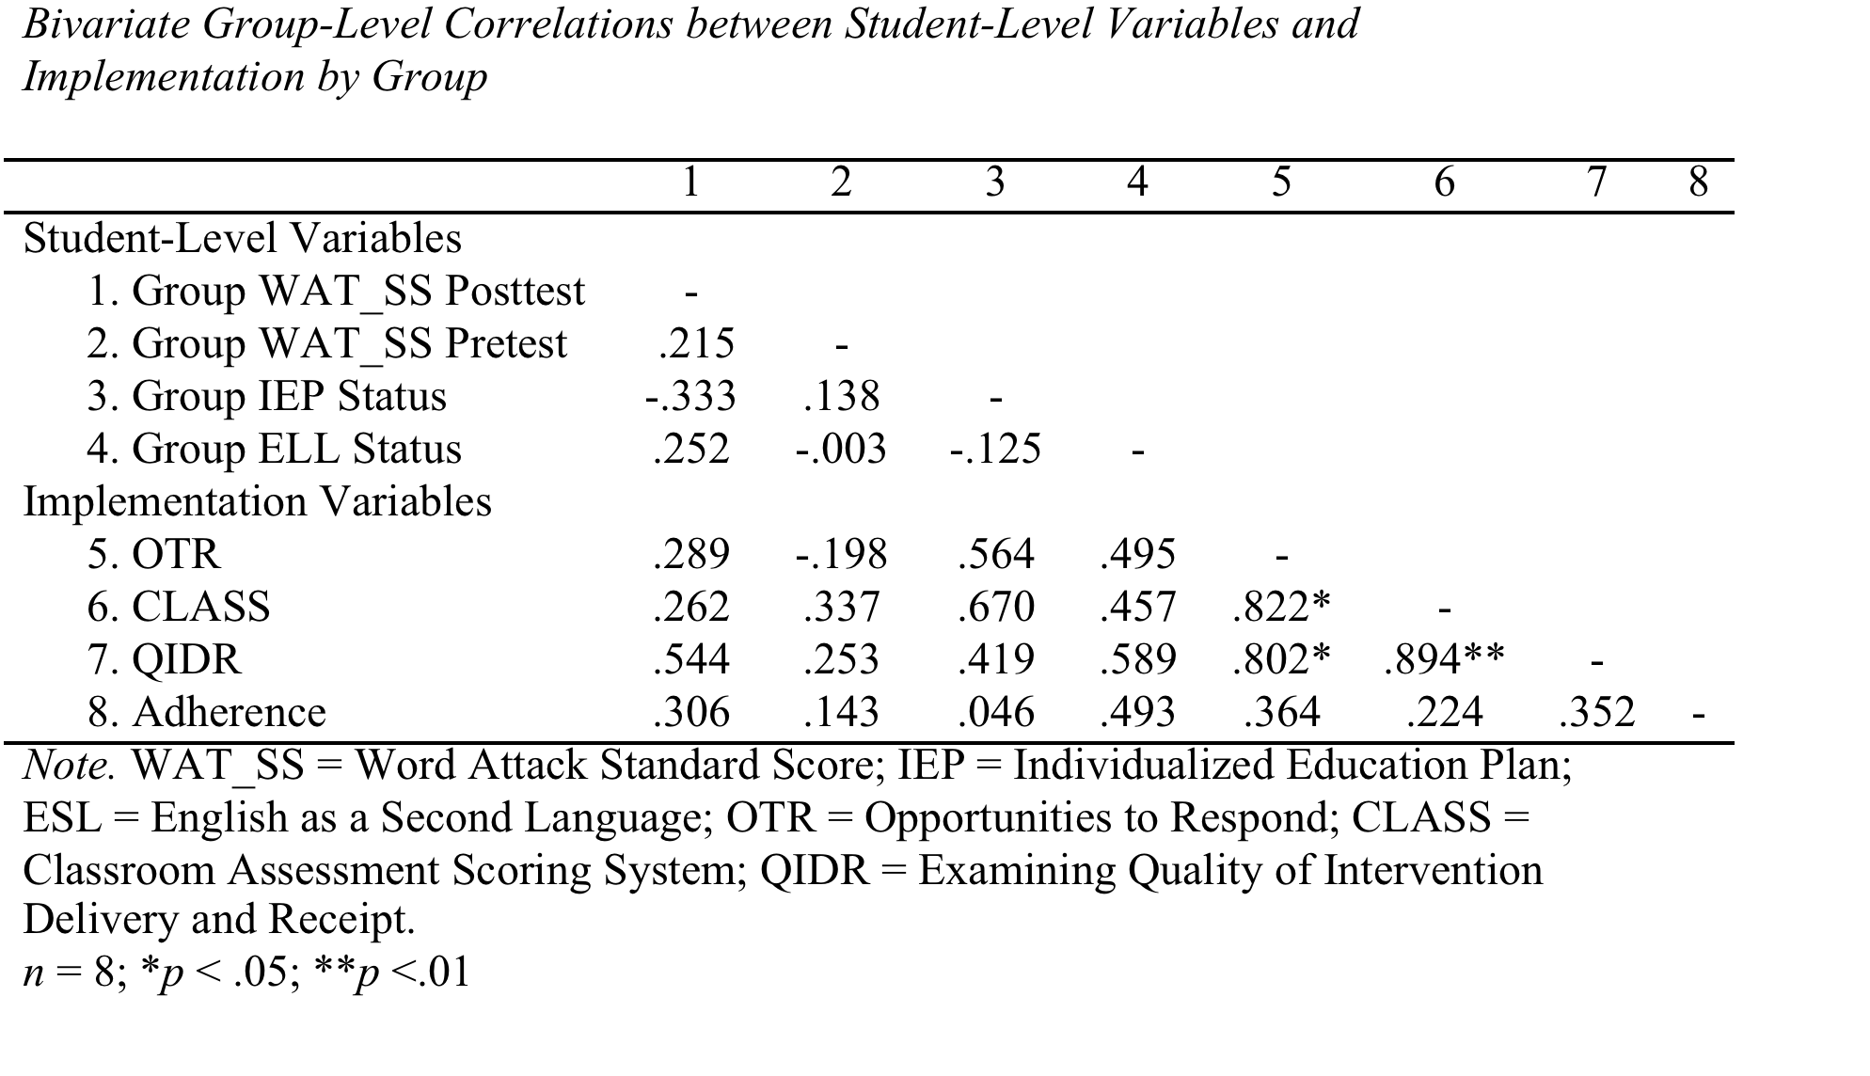
Correlations Across Measures

Slide 98
What is the relation to outcomes?
The QIDR accounted for the most variance in outcomes

Slide 99
Examining Variability in Implementation

Slide 100
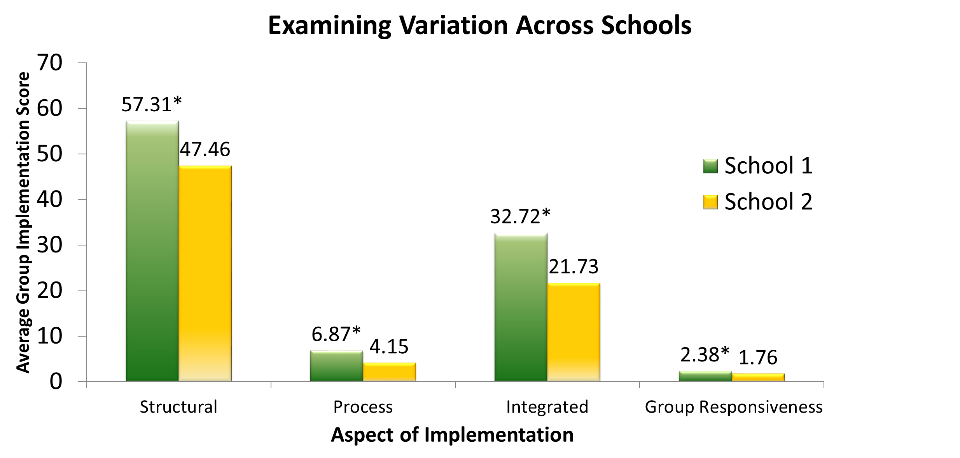

Slide 101

Efficiency in Observation & Feedback
Current observation tools designed for providing feedback recommend extensive observation periods (Danielson, 1997; Johnson & Semmelroth, 2012; 2014; Pianta, et al., 2005)
Providing frequent feedback can improve instruction (Fixsen, 2005)
Notes:
So, if we have a tool that is appropriate for measuring implementation in intervention settings, we still have to consider the challenge of observing and providing feedback frequently. In order to do this, we have to begin to think about how to more efficiently measure implementation. Current tools are not only designed for general education classrooms, but also often require extensive training, as well as recommend observation periods equal to full lessons which could be 30 minutes or more. In order to make observation and feedback more accessible, we have to think about ways to make the use of tools more efficient.

Slide 102
Maximizing Efficiency
Pratt & Logan, 2014
  SNIPPETS: 6-minute observations using an interval-based scheme
    Able to achieve overall exact agreement of 98%
  Used Classroom Assessment Scoring System (CLASS; Pianta, et al., 2005) for 2, 15-minute observations
    Achieved 89% within-one agreement
Ho & Kane, 2013: Measures of Effective Teaching
  Framework for Teaching (FfT; Danielson, 1996): 33% of lessons (1st 15 minutes)
    Achieved comparable reliability w/ full-length lessons

Slide 103
Bivariate Correlations for QIDR Ratings Between Full-length Observations and Intervention Phases (N = 24)
Phase | 1 | 2 | 3 | 4
1. Full-length Observation | -
2. Phase A | 0.77* | -
3. Phase B | 0.94** | 0.75* | -
4. Phase C | 0.95** | 0.80* | 0.95** | -
Note. **p < .01; *p < .05.
Bivariate Correlations for QIDR Ratings Between Full-length Observations and Lesson Segments (N = 24)
Lesson Segment | 1 | 2 | 3 | 4
1. Full-length Observation | -
2. Beginning | .81** | -
3. Middle | .74** | .88** | -
4. End | .72** | .82** | .84** | -
Note. **p < .01

Slide 104
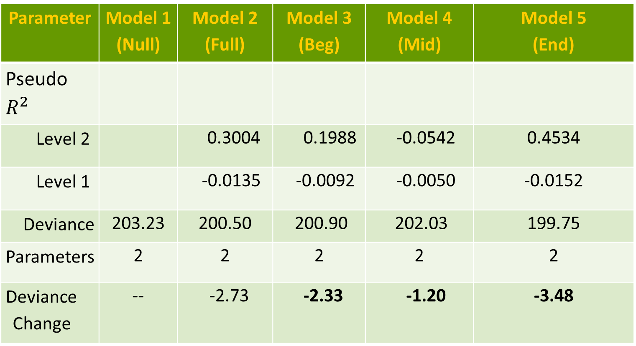
Which part of the lesson is most related to outcomes?
Parameter | Model 1 (Null) | Model 2 (Full) | Model 3 (Beg) | Model 4 (Mid) | Model 5 (End)
Pseudo $R^{2}$
Level 2 |  | 0.3004 | 0.1988 | -0.0542 | 0.4534
Level 1 |  | -0.0135 | -0.0092 | -0.0050 | -0.0152
Deviance | 203.23 | 200.50 | 200.90 | 202.03 | 199.75
Parameters | 2 | 2 | 2 | 2 | 2
Deviance Change | -- | -2.73 | -2.33 | -1.20 | -3.48

Slide 105
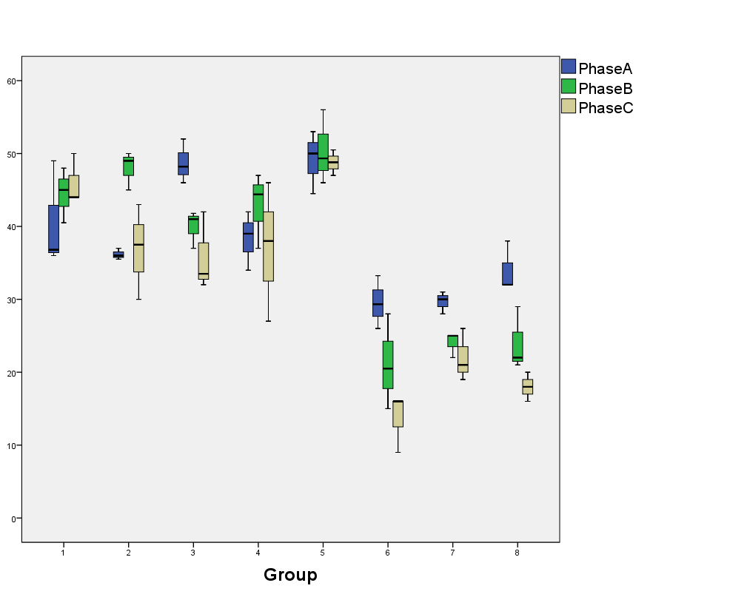
How is Consistent is Implementation over Time?

Slide 106
Conclusions
Measuring Implementation is Important
  Related to student outcomes
  Variation across schools and groups over time
    Implementation that is “low” remains low over time without feedback
Some implementation measures are more related to outcomes then others
  QIDR is more related to outcomes then other established measures (CLASS, OTR)
Can measure implementation more efficiently
  Can reliably and validly measure outcomes with a “snippet” of a lesson (10 minutes)
Challenges in obtaining reliability

Slide 107
Implications: We need to monitor the quality of our investments
Valid & efficient tools could encourage an RtI-like model for supporting teachers
  Allow for more frequent observations
  Be more responsive to providing instructional support to target those interventionists most in need (Myers, Simonsen, & Sugai, 2011)
  Improve student outcomes
Tier 3
Intensive support
Tier 2
More frequent observation/feedback, targeted PD
Tier 1
Screening, PD for all
Notes:
Shorter observations could provide the means for a system for providing supports to interventionists that is similar to an RTI system. For instance, all interventionists could receive a “screening” observation early in the school year. Those interventionists who score at a certain higher level (e.g., 35 on the QIDR), would then be scheduled to receive observation and feedback mid-year, while those scoring lower than the pre-determined score, would receive observation and feedback monthly. For those whose implementation improves, observation and feedback could be decreased to a less frequent interval, while those whose implementation does not improve, would move to tier 3 supports which would include more frequent observation and feedback, along with possible additional professional development not provided in tier 2.

Slide 108
Future Research
Need to streamline the QIDR tool
  Redundant items, too many
Need to determine what a “good” score is
Examine utility in other grade-levels and content areas
Utility of the QIDR for improving instruction (e.g., as a coaching/feedback tool)
Notes:
This study did bring about some additional questions that should be addressed in future research. Given the issues with reliability, it is necessary to explore what observer traits may impact reliability. This may include developing a screening measure that could elucidate those characteristics that may make a coder more or less likely to be accurate. Because earlier studies have found that reliability is more difficult as more items are included in an observation tool, it is necessary to investigate the ways in which the QIDR may be streamlined, so that it can be even more efficient while still providing enough information to inform feedback. Lastly, research determining whether or not using the QIDR as a coaching tool to provide feedback actually improves implementation of interventions is very important given that this is really the underlying intent of observing and providing feedback.

Slide 109
Thematic Questions
What is the role of theory in developing assessments on complex constructs or less studied populations (e.g., ELLs, specific disabilities, etc.)?
How can we ensure a better balance between treatment integrity and technical adequacy in developing assessments?
How can we maximize opportunities to provide culturally relevant assessments while maintaining rigor in scoring and item design?
How can we harness the power of technology in developing assessments that inform and evaluate instructional meaningfully?

