Slide 1
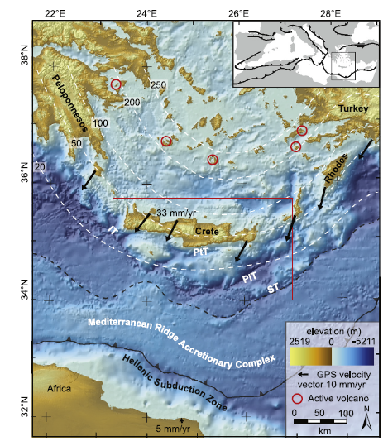
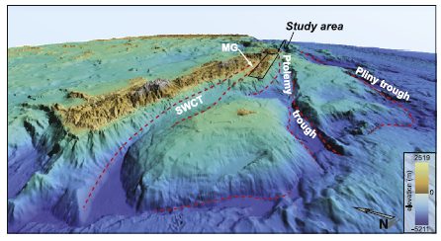

Slide 2
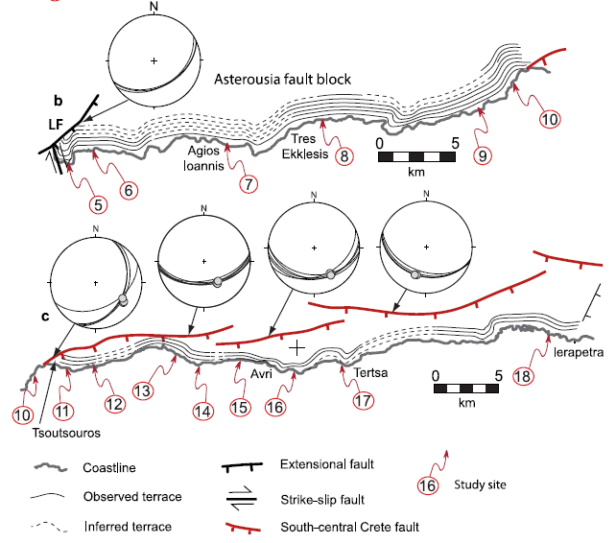

Slide 3
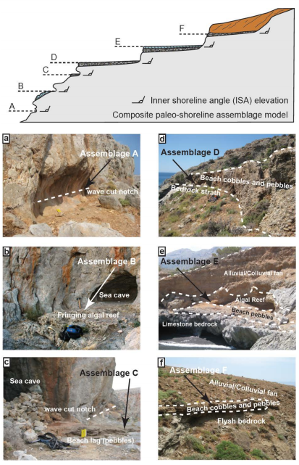
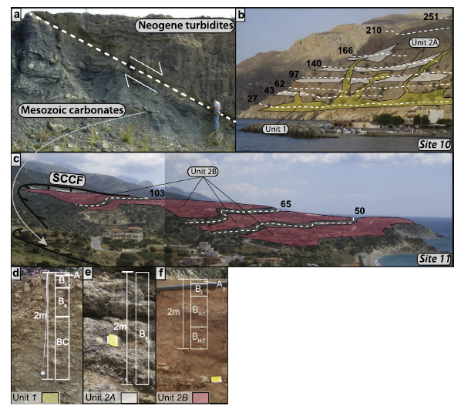

Slide 4
Optically Stimulated Luminescence (OSL)
Measures time since mineral grains were buried (last exposed to sunlight).
Trace amount of radioactive isotopes (K, U, Th, Rb) slowly decay over time. Produced ionizing radiation absorbed by mineral grains (usually quartz) as charge called ‘electron trap’.
‘Trapped’ charge accumulates predictably.
Stimulating these grains using blue or green light causes a luminescence signal to be emitted. Strength is dependent on time since burial.

Slide 5
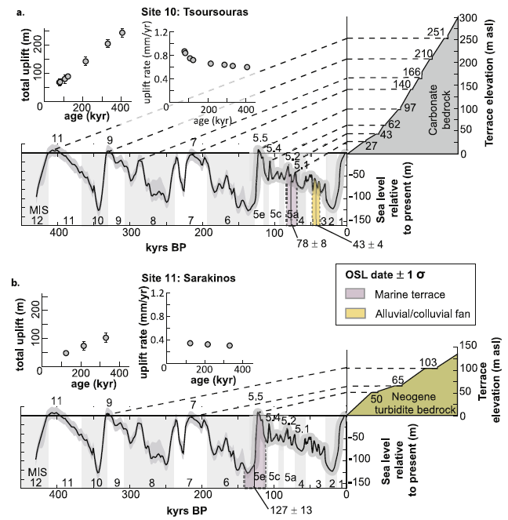
OSL dates from alluvial fan deposits on terraces show younging of deposits from east to west.
Age of alluvial fan deposits and height of terraces predict uplift rate.
Terrace heights and ages correlate with known sea level highstands that generally correspond with interglacials.

Slide 6
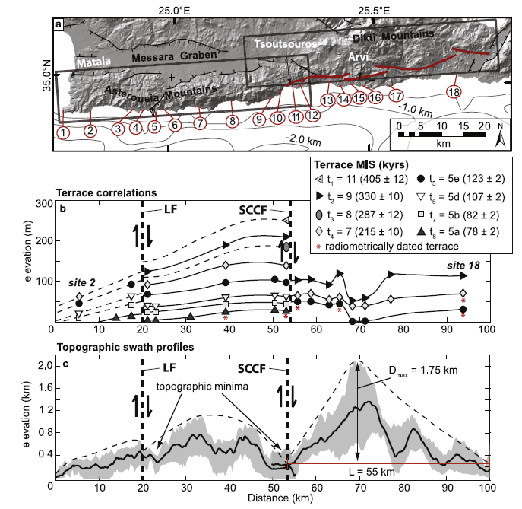
Terraces offset by Lentas Fault (LF) and South-Central Crete Fault (SCCF).
LF and SCCF slip rates of 0.2-0.35 mm/yr.
Westward tilt of terraces and eastward increase in terrace elevation spacing indicates different block uplift rates.
Terraces preserved in footwalls AND hanging walls.
Uplift regional (0.1-1.0 mm/yr), despite faults being extensional.
Single topographic maximum suggests faults are kinematically linked.

Slide 7
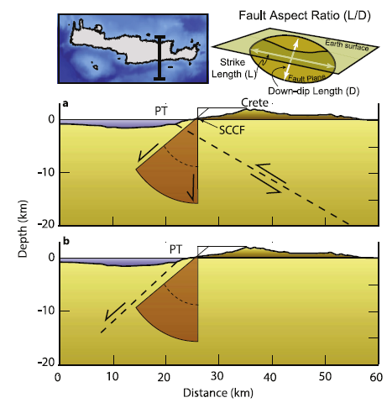
Fault aspect ratio suggests faults extend to brittle-ductile transition.
Earthquakes and focal mechanisms suggest faults extend to depth and are extensional.
Ptolemy Fault must be south-dipping, and is likely extensional.
North dipping Ptolemy fault would cross-cut the South-Central Crete fault at depth. → Geometrically impossible.

Slide 8
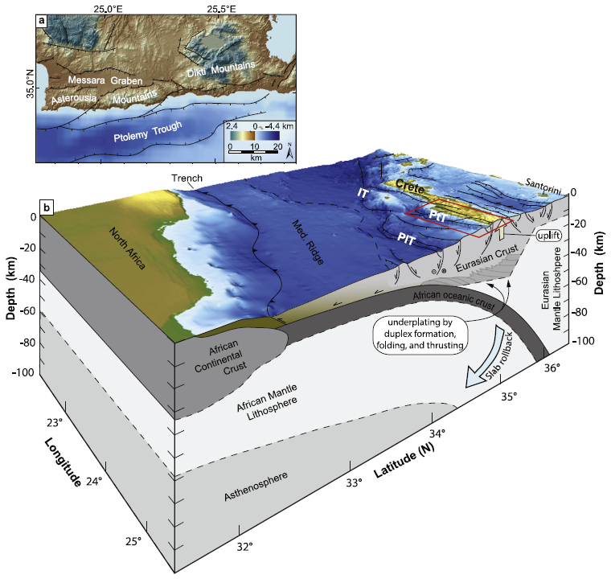
Ptolemy trough is a graben or half-graben. Possibly extension of Messara graben.
Crete formed by underplating within a viscous orogenic wedge.
Extension occurs in the upper part of the wedge, while underplating continues to drive uplift.

Slide 9
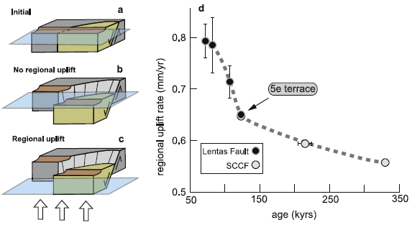
Uplift and Extension Model
Initial extension drops hanging wall below sea level and footwall just above.
Regional uplift keeps hanging wall below level.
Regional uplift + extension bring both above sea level.
Continued underplating and uplift results in apparent accelerated uplift rate.
Uplift rate matches the regional uplift rate from terraces throughout Crete.

Slide 10
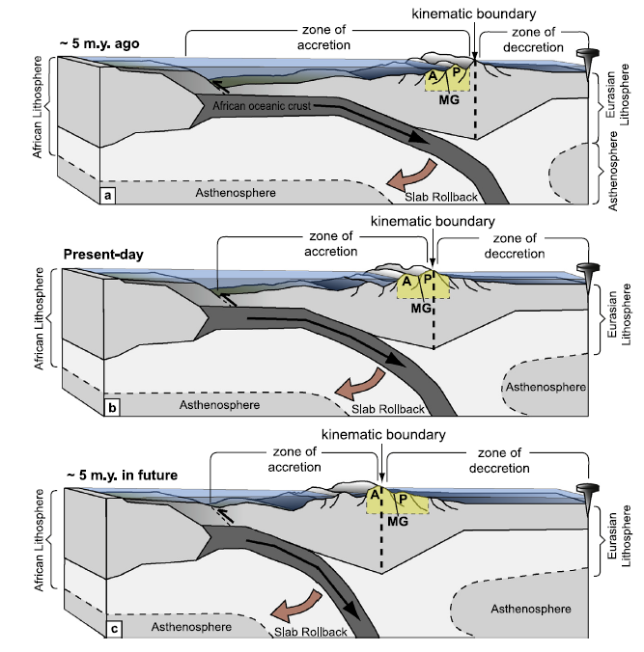
Uplift rate has generally increased in Crete since ~2 Ma.
As African Plate subducts, forearc carried through orogenic wave of uplift.
Crete is currently travelling through orogenic wave.
Neogene turbidites correspond to pre-uplift deposition.
Wave will continue propagating to south as slab rolls back.

