Slide 1
Deformation on and around Crete

Slide 2
Cretan deformation can be fundamentally tied to 3 broad events that are fundamentally related to subduction.
1.Oligocene HP-LT metamorphism caused by compression and nappe stacking
2. Extension along low angle detachment faults leading to exhumation of HP-LT units
3. Current deformation consists of extension in E-W direction w/ large amounts of uplift overall, possibly a result of N-S underplating

Slide 3
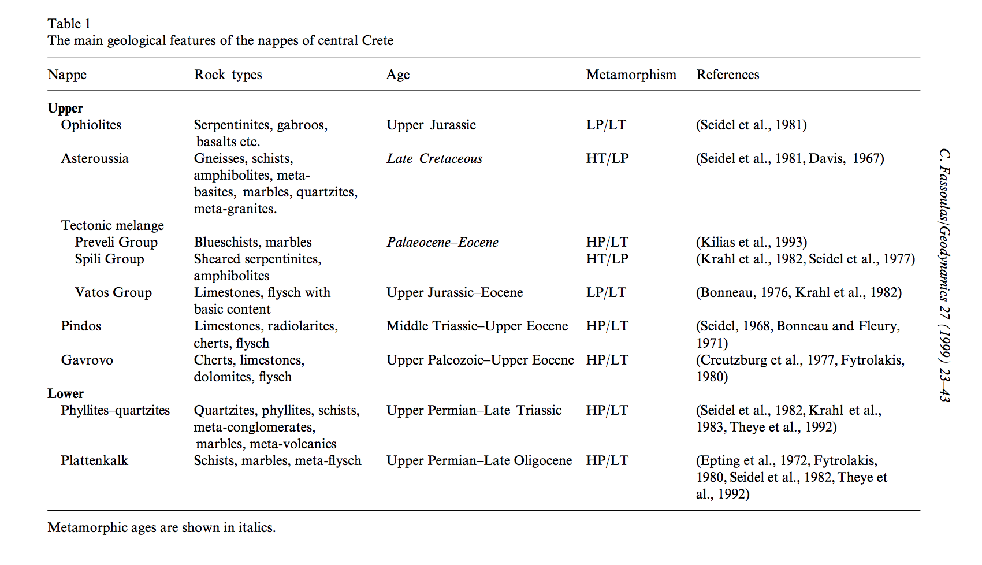
Fassoulas, 1999

Slide 4
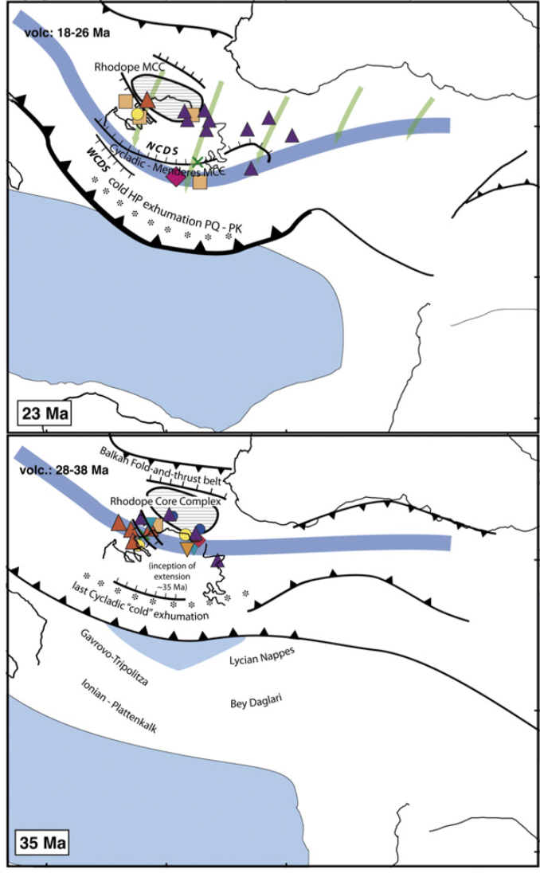
1.Oligocene HP-LT metamorphism caused by compression and nappe stacking
Compression in Oligocene occurred before strong curvature and roll back of the subduction zone, note the two future cretan blocks yet to be accreted 35 Ma
Jolivet et al., 2013

Slide 5
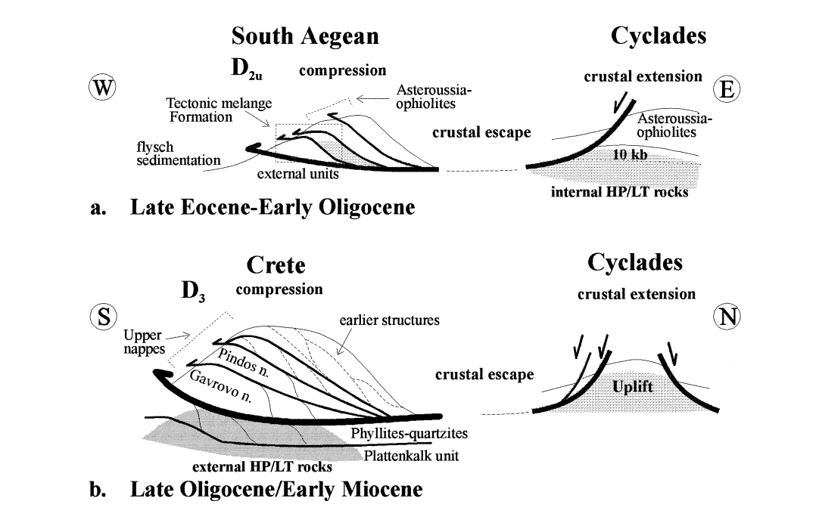
1.Oligocene HP-LT metamorphism caused by compression and nappe stacking
Units divided into those that underwent HP-LT metamorphism and units that have not experienced metamorphism
Fassoulas, 1999

Slide 6
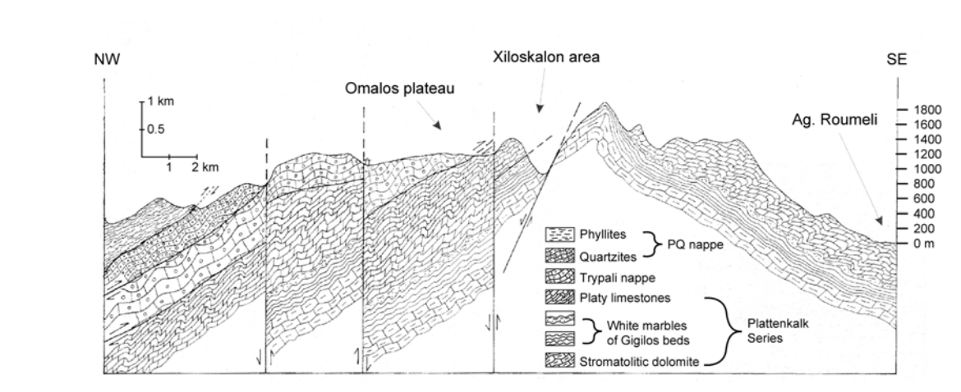
Outcropping of HP/LT units and their structure
1.Oligocene HP-LT metamorphism caused by compression and nappe stacking
Units divided into those that underwent HP-LT metamorphism and units that have not experienced metamorphism
Figure 22, Rahl Field Guide

Slide 7
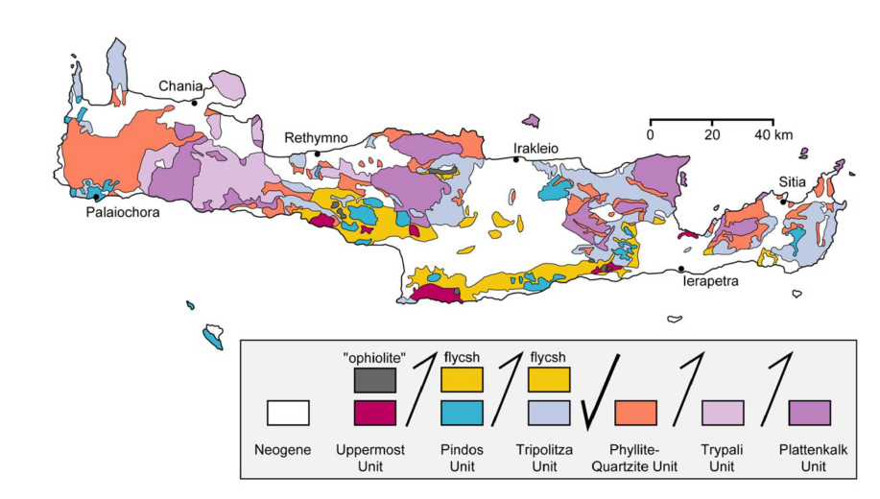
1.Oligocene HP-LT metamorphism caused by compression and nappe stacking
Units divided into those that underwent HP-LT metmorphism and units that have not experienced metamorphism
Rahl Guide

Slide 8
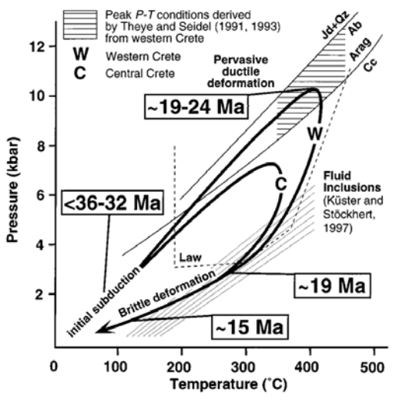
1.Oligocene HP-LT metamorphism caused by compression and nappe stacking
Western Crete under went higher grade metamorphism
Rahl Guide

Slide 9
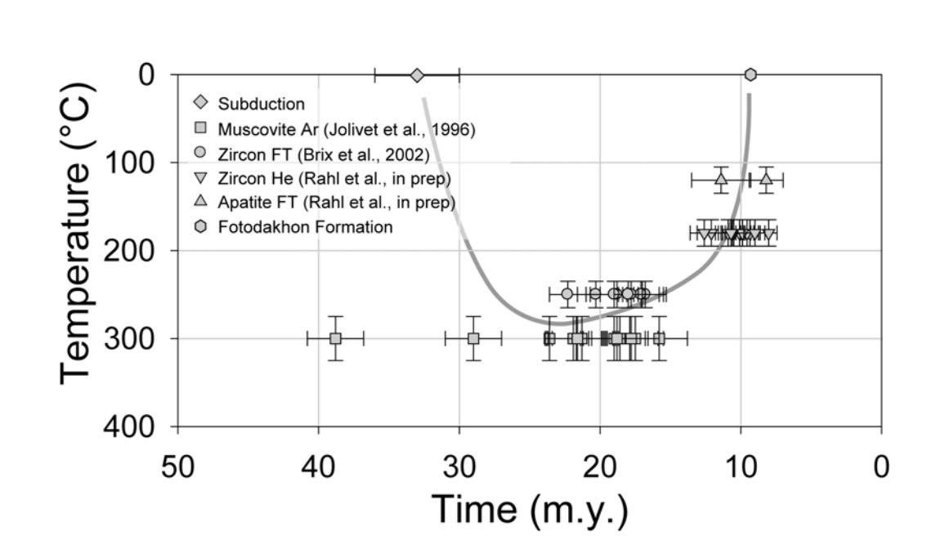
Temperature Evolution of Phyllite/Quartzite Unit
Rahl Guide

Slide 10
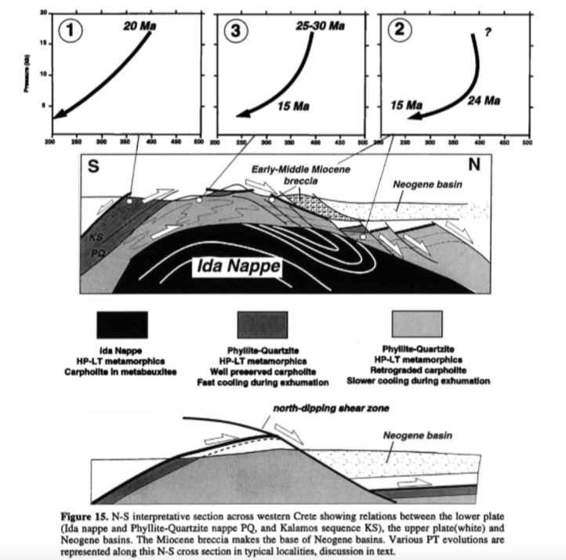
2. Extension occurred along low angle detachment faults leading to exhumation of HP-LT units
Jovilet et al., 1996

Slide 11
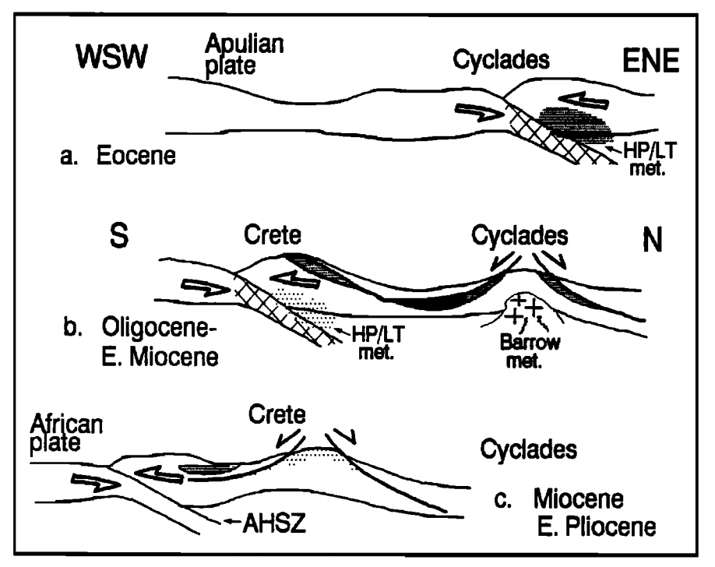
2. Extension occurred along low angle detachment faults leading to exhumation of HP-LT units
Cycle of deformation similar to that of the Cyclades
Fassoulas et al., 1994

Slide 12
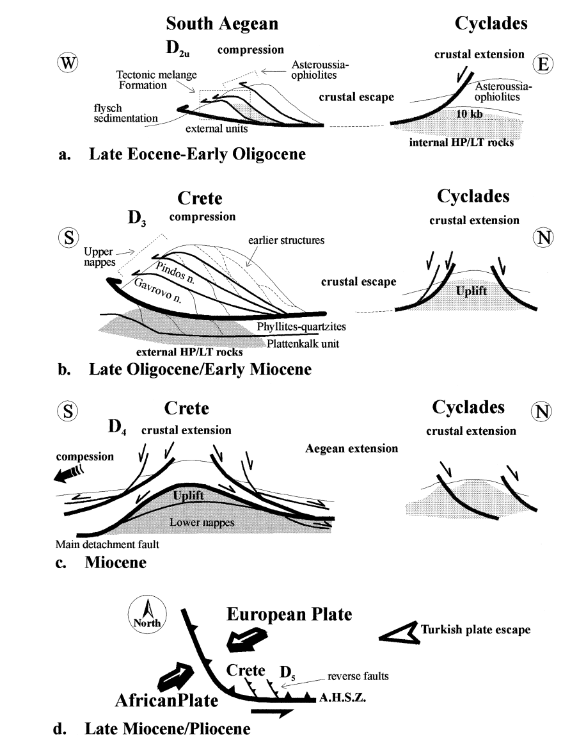
2. Extension occurred along low angle detachment faults leading to exhumation of HP-LT units
Cycle of deformation similar to that of the Cyclades
Fassoulas, 1999

Slide 13
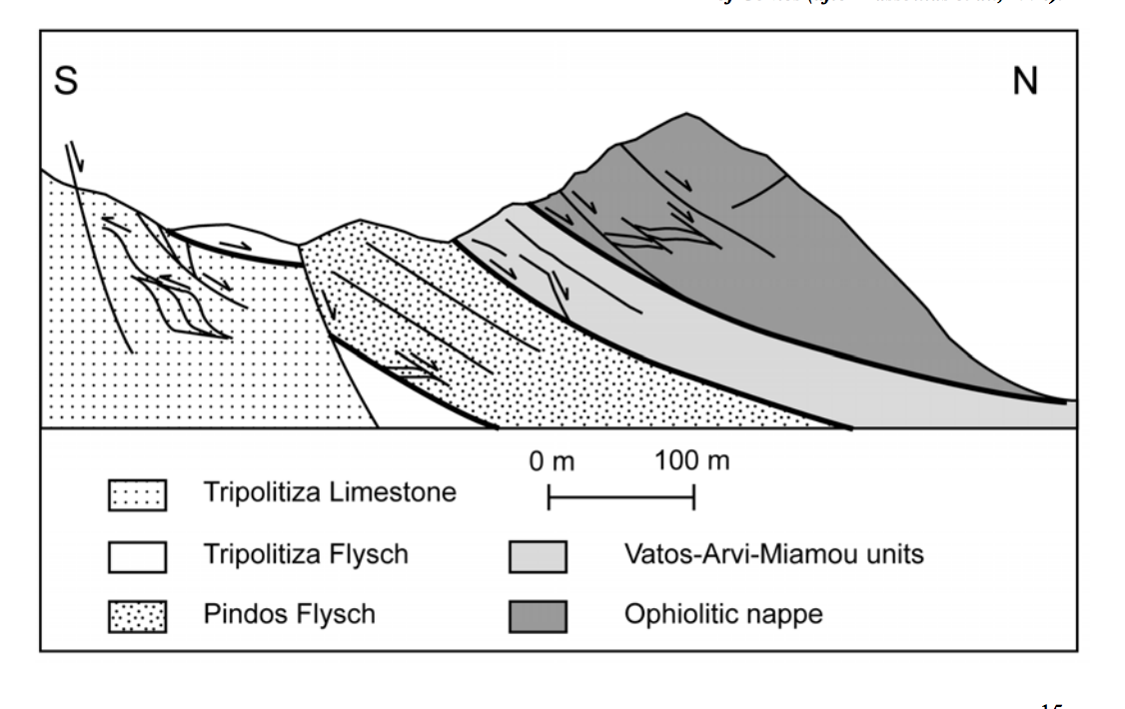
2. Extension occurred along low angle detachment faults leading to exhumation of HP-LT units
Fig. 10, Rahl Guide

Slide 14
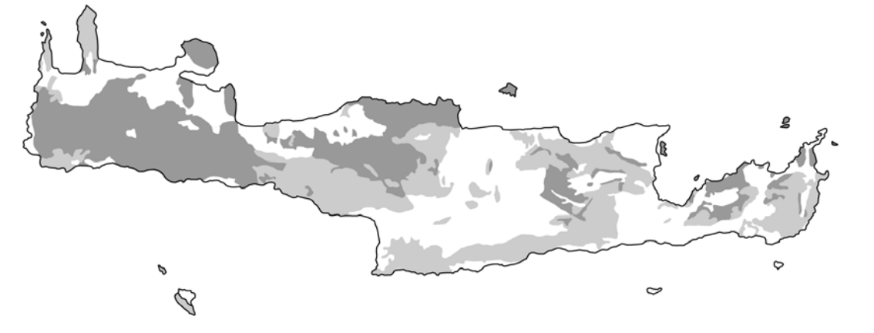
Dark Grey - older HP-LT metamorphic units below detachment, Light Grey - unmetamorphosed units above detachment
2. Extension occurred along low angle detachment faults leading to exhumation of HP-LT units
This extension superimposed sub and supra detachment rocks against each other
Rahl Field Guide

Slide 15
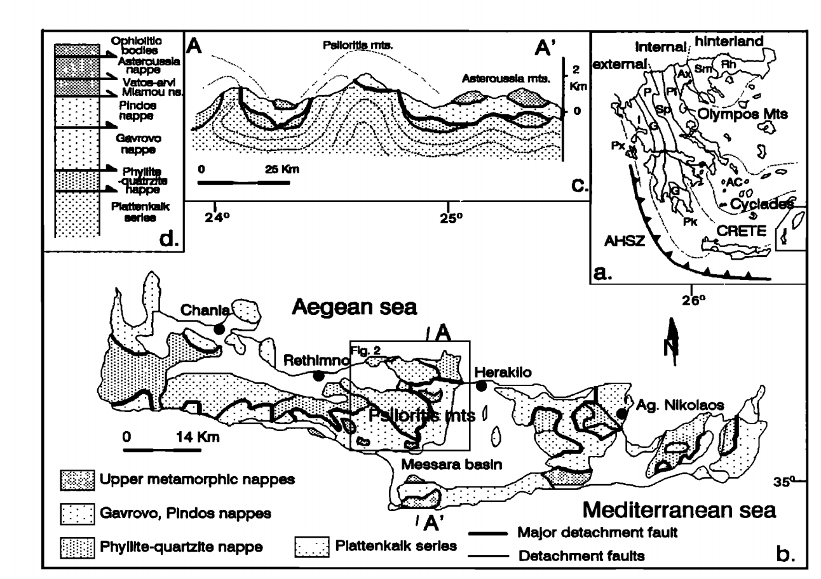
2. Extension occurred along low angle detachment faults leading to exhumation of HP-LT units
Observation of supradetachment rocks on both sides of HP/LT rocks indicates possible coaxial deformation with top to S and top to N style extension
Fassoulas et al., 1994

Slide 16
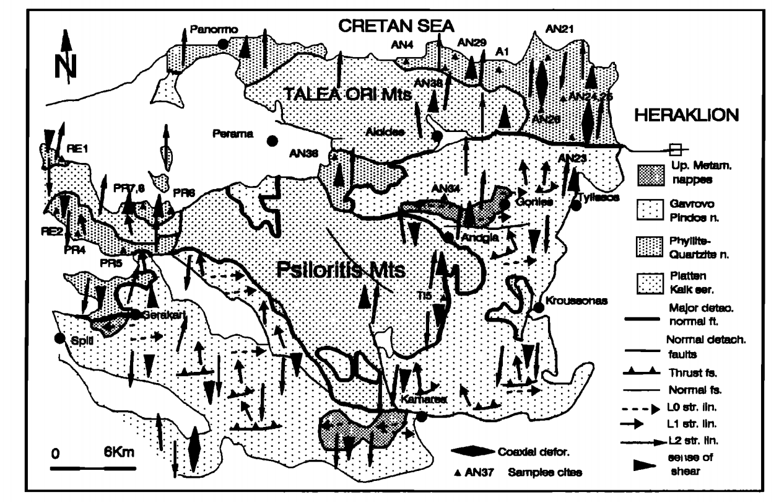
Sense of shear occurs in both directions
Fassoulas et al., 1994

Slide 17
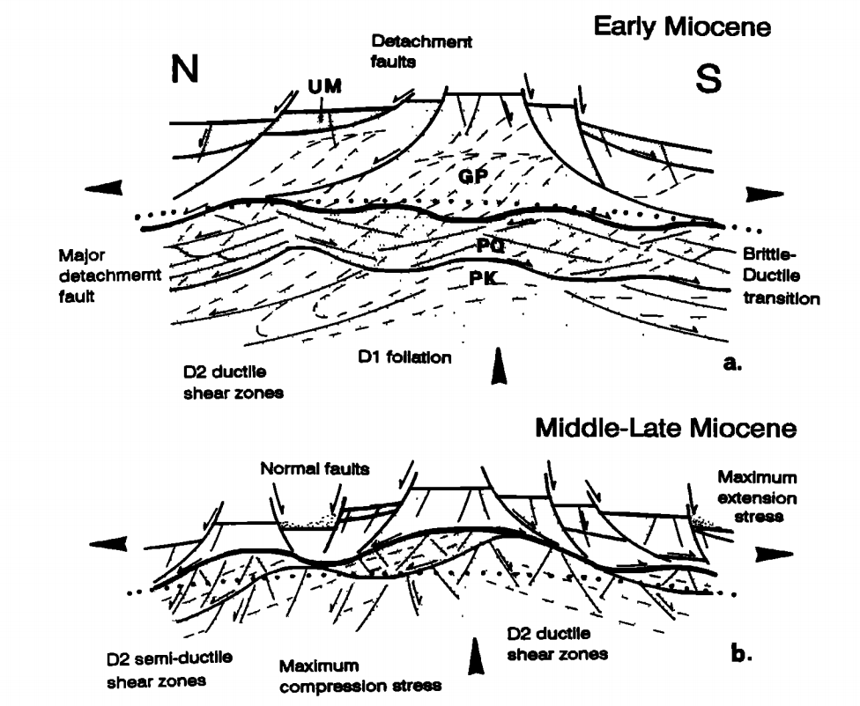
2. Extension occurred along low angle detachment faults leading to exhumation of HP-LT units
Brittle extension occurred in the upper portion of the crust while ductile shear zones developed at deeper depths
Fassoulas et al., 1994

Slide 18
3. Current deformation consists of extension in E-W direction w/ large amounts of uplift overall, possibly a result of N-S underplating
Gallen et al., 2014

