Slide 1
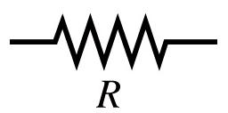
Engaging Student Resistance
Shane Hall, shaneh@uoregon.edu
Teaching Effectiveness Program, tep@uoregon.edu
Shane Hall, shaneh@uoregon.edu
Teaching Effectiveness Program, tep@uoregon.edu
S

Slide 2
“A college– at least insofar as it offers real benefits– is less a collection of programs than a gathering of people”
How College Works (2014)
Cambliss & Takacs

Slide 3
“Just as the holistic movement in medicine calls for doctors to treat patients, not symptoms, student-centered teaching requires us to teach students, not content.”
Susan Ambrose, 2007

Slide 4
“Belonging”
We can design courses to be
inclusive
Greg Walton: Success in college is
tied to “belonging”
Learning starts with
“disorienting dilemmas”
SR?
Tools:
UO Blogs,
Wise criticism,
Groupwork,
Discussion
Race, gender, of faculty
influence student responses
Students carry negative self-perceptions
Notes:
“Tep’s Belonging series of events is the first part of our three part signature series, titled “High Impact Change”. This series, which will run through not only next term but also next year, is focused on three disporportionately important and topical issues in higher education today. The question of “belongining,” on “doing” and “asking. It is funded by the Wayne Morris Center. Touch on Belonging series take-aways or questions. Announce future Belonging events.
Give narrative “arc” of Belonging Event Take aways that predicate what we’ll discuss today.
Walton: Success in college is pegged to belonging, students seek out and take advantage of academic opportunities (mentorship, services, etc, when they feel they “belong”).

Slide 5
What is resistance?
What behaviors constitute resistance?
How do we study it?
Where does resistance come from?
Why do we care about it?
Notes:
Stop here to allow free write or discussion as needed. End with segue “well, as we can see we have a lot of ideas about this, and I’d like to move us forward by suggesting that finding what answers are most useful for us as individuals, departments, schools, communities depends largely on the lenses we bring to this topic.” IN electricity– resistance is a measurement of difficulty power meets when trying to force its way through a circuit.

Slide 6

What lens(es) to use?
Motivation
Misbehavior
Rebellion
Development
Defense
Transformation

Slide 7
Problem
Process
Misbehavior
Transformation
Motivation
Defense
Rebellion
Developmental

Slide 8
“Overcoming”
“Policing”
“Coping”
“Combating”
“Responding”
“Engaging”
“Leveraging”
“Embracing?”

Slide 9
Caveats and pitfalls

Slide 10
Love
Social relations
Financial stress
news
commitments
You
It’s Not Just
Other learning!
Physical environment
trauma
Notes:
Many factors influence students conscious and semi-conscious decision.
Don’t plan your whole course around it!
Plan and put energy into responding to “Process” SR, and manage “Problem” SR

Slide 11
Students have the right to resist
We can’t force students to learn
We can only make the case for learning and give opportunity and support for learning.
We can also be students’ allies in advocating for policies and changes that allow students to learn. (and help us teach!)

Slide 12


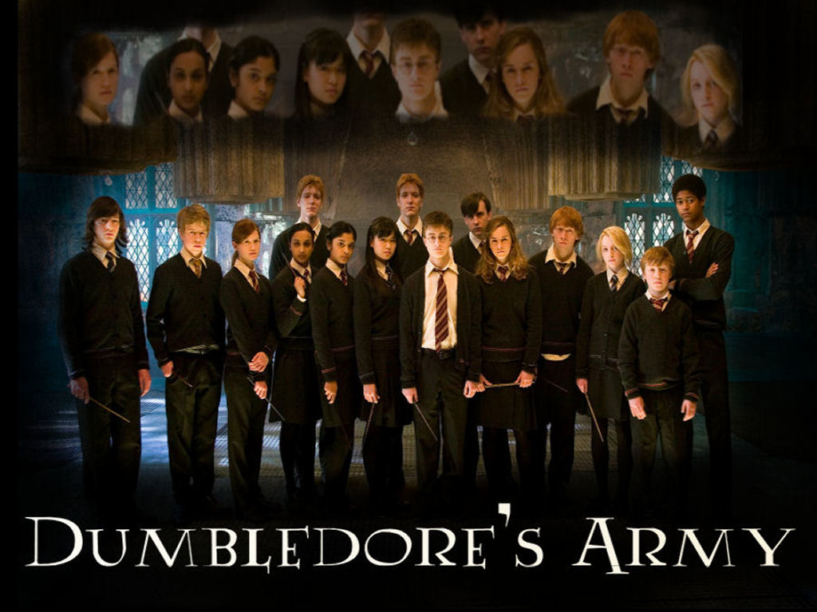
When is resistance justified?
Don’t be a Umbridge, Snow, or Vader

Slide 13
From Problem to Process:
“The ground zero of resistance to learning is the fear of change.
And learning, by definition, involves change.”
Stephen Brookfield, The Skillful Teacher

Slide 14
Motivation and Transformation
Motivation
Misbehavior
Rebellion/disobedience
Developmental
Defense
Transformation

Slide 15
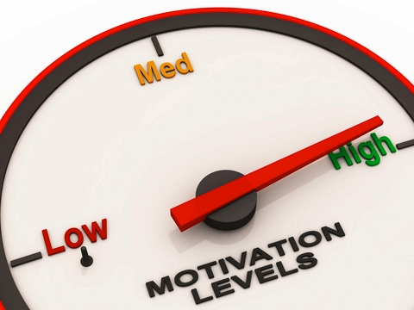
What Is Motivation?
“The level of enthusiasm and the degree to which students invest attention and effort in learning.”
Brophy, J. E. (2004). Motivating students to learn. Mahwah, NJ: Erlbaum.

Slide 16
What is the Process of Motivation?
Environment
Expectancy
Motivation
Goal-directed behavior
Learning and Performance
LEADS TO
SUPPORTS
Value
Ambrose, S.A., Bridges, M.W., DiPietro, M., Lovett, M.C., and Norman, M.K. (2010). How learning works: Seven research-based principles for smart teaching. San Francisco: Jossey-Bass.

Slide 17
How Do these Factors Interact in terms of Student Behaviors?
Ambrose, S.A., Bridges, M.W., DiPietro, M., Lovett, M.C., and Norman, M.K. (2010). How learning works: Seven research-based principles for smart teaching. San Francisco: Jossey-Bass.

Slide 18
Transformative Learning
Disorienting Dilemma
Practice taking new perspectives
Reintegration
Reflection
Learning

Slide 19
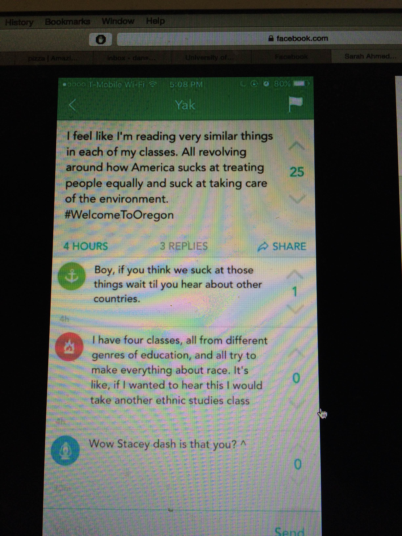
Example

Slide 20
Who/what is being resisted?
Instructor
Content
Methods
Peers

Slide 21
Sources
Poor self-image as learner
Fear of the unknown
Normal ebb and flow
Disjunction of learning and teaching modes
“I’m not smart enough.”
“Who will I become?”
“I’m exhausted.”
“I’m really not interested in what my ‘partner’ has to ‘share’”

Slide 22
More sources?
Relevance
Inappropriate challenge
Threatened identity
“I’ll never need to do derivatives again, so why now?”
“So easy… so boring.”
“Wait… how do you write a dissertation?”
“Who am I? Where am I?”

Slide 23
Mitigating Resistance
Be explicit about your teaching choices
Set and maintain high, meaningful standards
Model passion, thoughtfulness, and respect
Normalize discomfort and resistance
Know yourself and your students
Adapted from Siedel & Tanner (2013), Brookfield (2015)
, Beeman (2015), Titus (2000)

Slide 24
Adapting to Resistance: SEAC
Sort Out
Engage
Adjust/Affirm
Continue
Assess cause(s) of SR
Acknowledge, respond
Change or justify the course of learning
Resume learning Reevaluate SR/changes

