Slide 1
Aníshaash tímash skuulitpamáyay (Yakama).
Anishaash shapalalp’át timash sapisquataash (Warm springs)
Anišáaš šapalalp̓át timaš sapsiq̓ʷataš (Ɨ́matila)
Making flashcards (English)

Slide 2
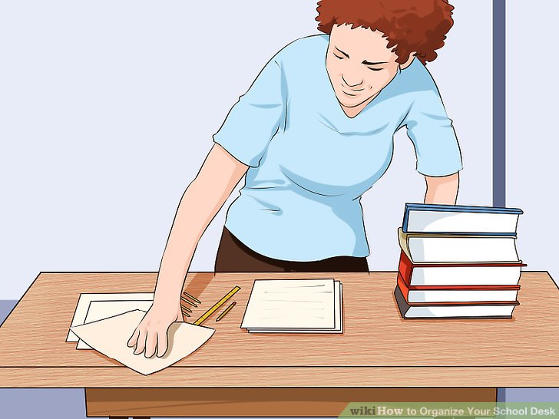
Ímałakshaash kkanaywitpamá.
itk’ukshaash kutkutpama.
Imałaakšaaš kutkutpama.
I am clearing a workplace.

Slide 3
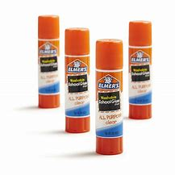
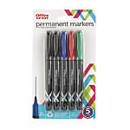
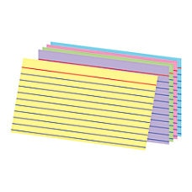
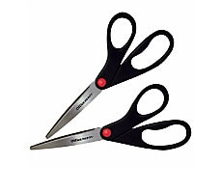
Áskawishaash patúnpatun: tímash, píkchash, sɨ́nwit, saalit’áwaaas, shapáwach’akt ku timat’áwaas.
Naik’ukshaash tuntunwi’anitpama: timash, shapalalp’at, s’nwit, saalit’áwas, shapáwach’akawas, ku timat’awas.
Nayk̓ukšaaš timaš, Sapalalput, Sinwit, Salit̓awas, Šapawač̓akawas, timat̓awas.
I am gathering supplies: cards, pictures, words, scissors, glue and writing utensils.

Slide 4
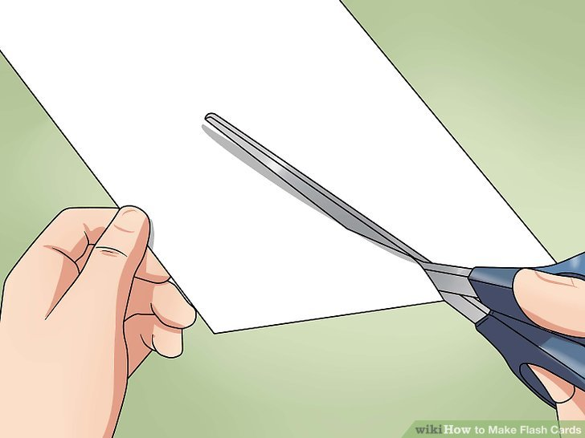
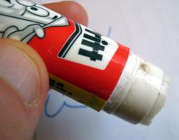
Ásaalishaashnan píkchash kush shapáwach’aksha tímashpa.
Saalishaash shapalalp’at ku shapáwach’aksha timashpa.
Sapalalpatnaaš saališa ku inaš sapawačakša timašpa.
I am cutting out the pictures and I am gluing them on the card.

Slide 5
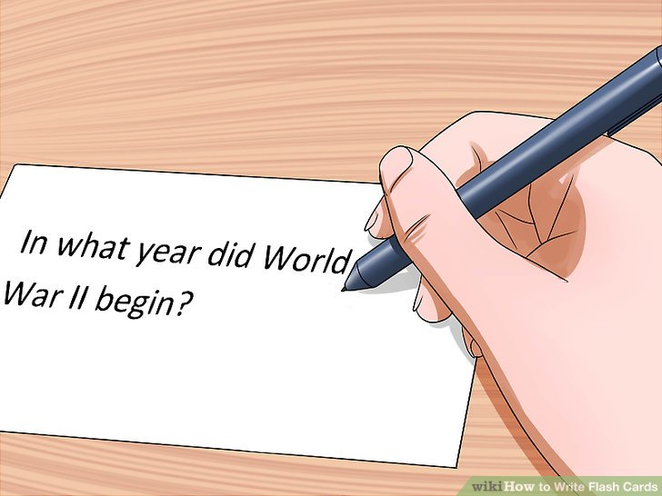
Átimashaash sɨnwit tímashpa.
Timashaash s’nwit timashpa.
Timašaaš sinwit timašpa.
I am writing the words on the card.

Slide 6
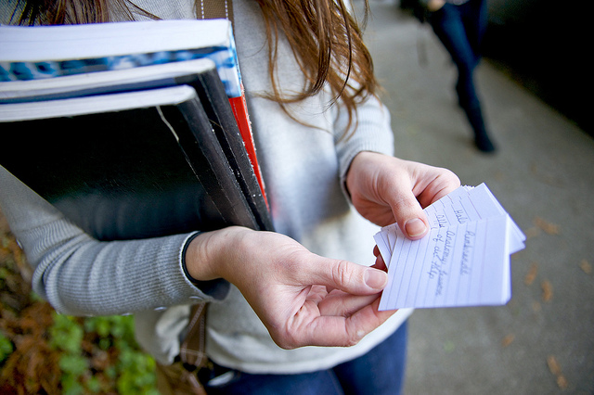
Wilíilawishaash timash skuulitpamáyay.
Awililawishaash shapalalp’átnina ichishkiin s’nwitki skulitpamayai.
Ititamašaaš šapalalpat timašpa skuulitay.
I am studying the cards for class.

Slide 7
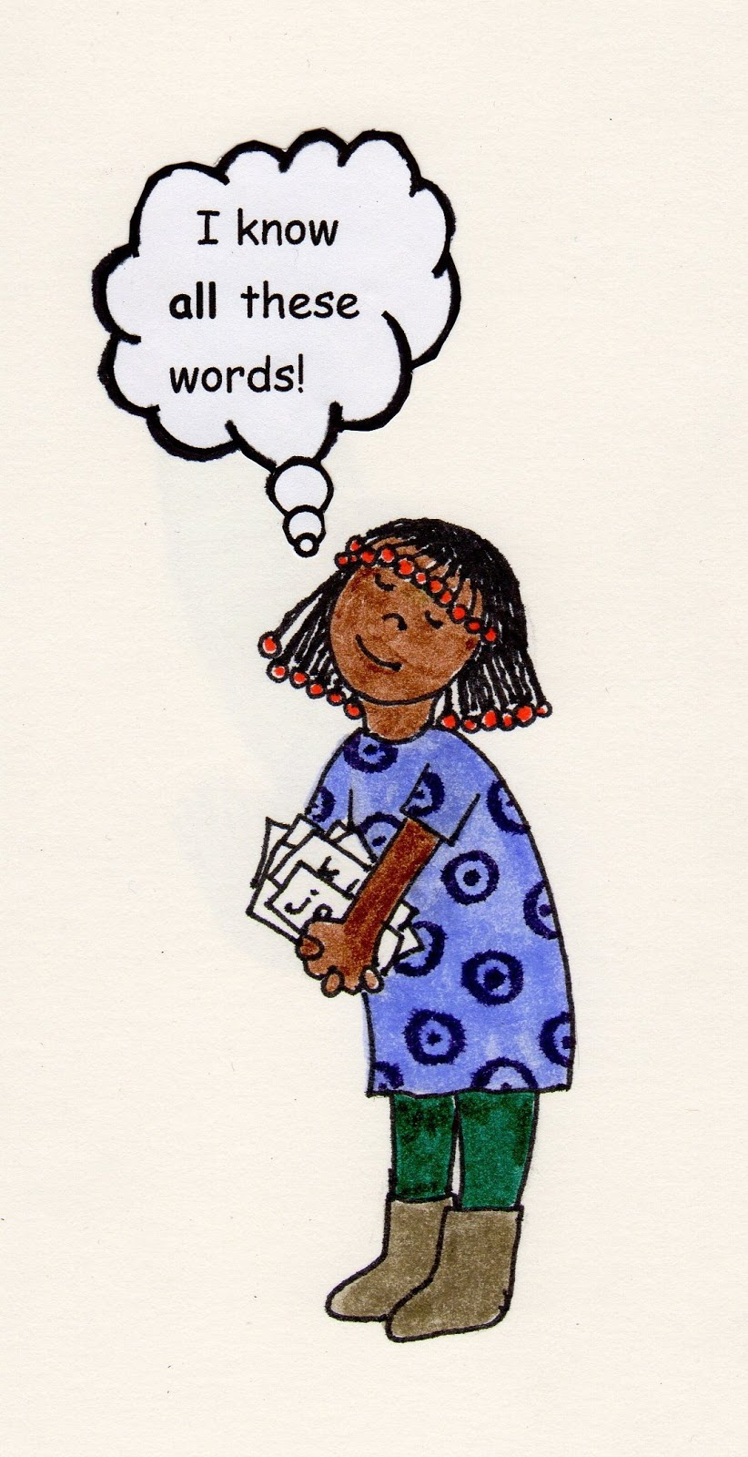
Rose Miller
Lorraine Suppah
Aaliyah Dick
Sharon Kuneki
Sia Aronica

