Slide 1
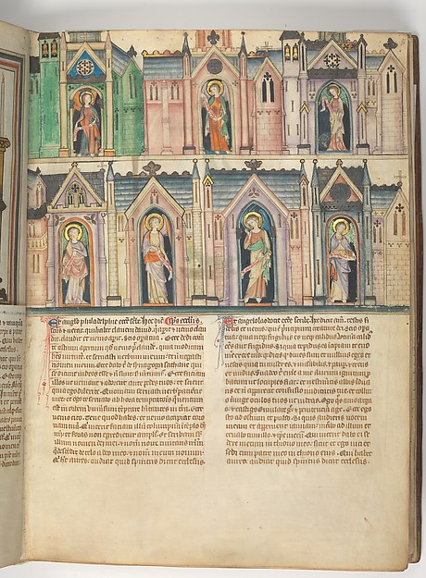
Churches and Scrolls
Diana Engel
Notes:
Manuscript of the Apocalypse, MET, 14th C
Revelations Ch. 1-7= addressing the 7 churches, scenes of worship, Christ opening the 7 seals, finally silence at the opening of the 7th seal.

Slide 2
Koester, Ch. 2 “Christ and the Churches”
Revelation
Highly symbolic disclosure
Enhance understanding and stimulate thought
Prophecy
Divine communication
Commitment and faithfulness
Letter
Group reading
Notes:
Koester presents the book as a revelation, a prophecy, and a letter.
Revelation- Highly symbolic disclosure to enhance understanding and stimulate reflection and thought
Prophecy- Divine communication to John on God’s commitment to punish those who don’t repent and promise those who do/already follow God; along with message of faithfulness to follow God despite hardship
Letter- Indicates the mode of communicating revelations. To be read aloud to a group

Slide 3
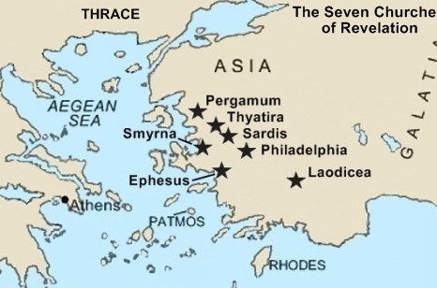
Notes:
Open letter.
Why these?
Koester says- Revelation often uses 7 to convey completeness. The 7 churches represent the whole church.
General layout by Koester- Address from Christ, Words of rebuke and encouragement, Summons to listen and promise to the conqueror

Slide 4
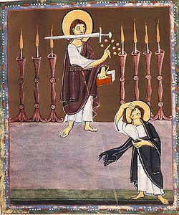
Ephesus, Pergamum, Thyatira
Oppose falsehoods
Maintain faith and love
Notes:
All 3 had to deal with opposing falsehoods. Distinguishing between acceptable and unacceptable Christian practices. Adopt pagan society to survive? John says no.
Ephesus- did pretty good job. Pergamum- Tolerated Balaam (eat food sacrificed to food, fornication). Thyatira- allowed Jezebel (eat meat sacrificed to idols, fornication).
Threatened with removal of the lampstand
Bamburg Apocalypse, 11th Century

Slide 5
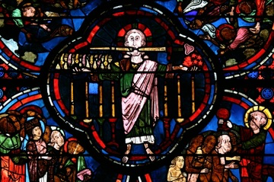
Smyrna, Philadelphia
Poor in wealth and power
Maintain strength and faithfulness
Notes:
Christians were suffering from poverty and affliction. Likely harassed by non-Christians.
Not participating in society which often included pagan rituals
God’s message to remain strong until the end, and they won’t suffer. Will be with Christ if they persevere.
Bourges Cathedral stained glass

Slide 6
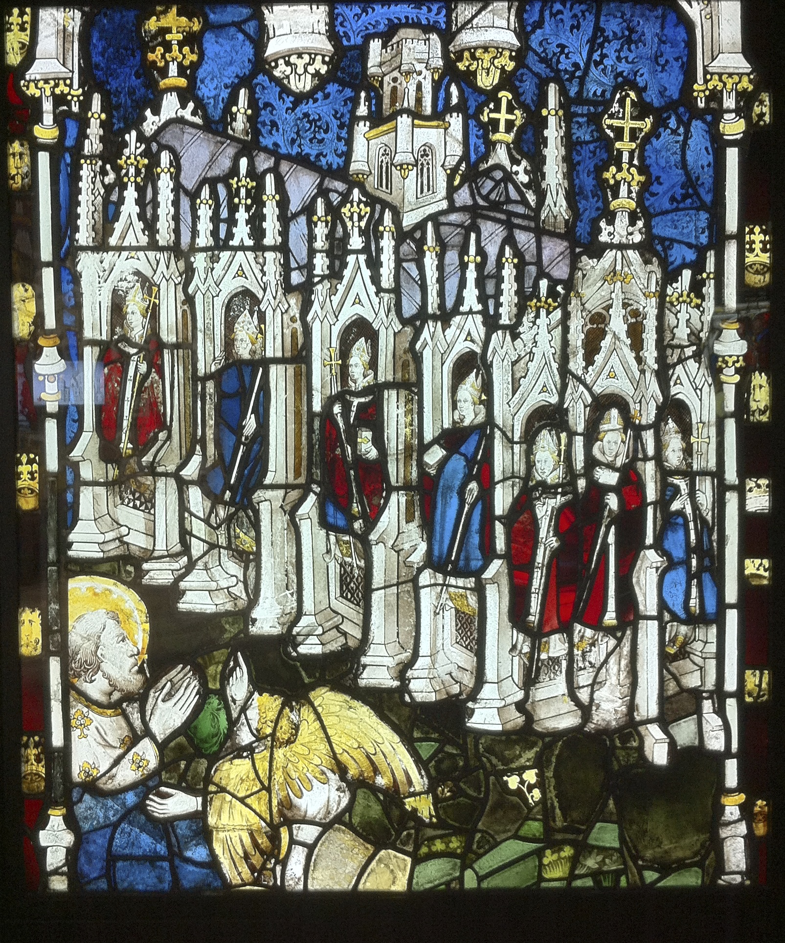
Sardis, Laodicea
Physically wealthy, spiritually poor
Complacency
Incomplete obedience
Shutting out Christ
Notes:
lots of wealth, but they have little faith. On the brink of death
Complacency- mistaken security in the relationship with Christ
Incomplete obedience- lack strong faithfulness
Invite in Christ/God. Those who follow and persevere with be dressed in white with God
York Minster, 12th-15th C, York

Slide 7
Koester, Ch. 3 “The Scroll Unsealed”
Enactment of Christ’s promises
Cyclical format
Begin and end with worship
God’s centrality and otherness
Bestow authority
All creation praises
Notes:
Also deals with faithfulness. See the enactment of Christ’s promises that were described in the first chapters. The chapters 4-7 are in a cyclical format, begins with worship and ends with worship. Events are in the middle.
God is center, not humans. All creation oriented towards praising him. The true sovereignty. Also stresses that God isn’t exactly human. Attempts to describe him like a human but it creates more mystery than clarity about his appearance.
God bestows authority. The elders surrounding God get their authority not from earthly power but from him. Counters Roman displays of authority. Urge Christians to view God’s authority as true and Roman authority as false.
When the lamb/Christ appears, the surrounding hosts shift their praises to him, but God remains central and the true authority. The lamb/Christ is extending the blessing God gave the tribes of Israel to the whole world by his death.

Slide 8
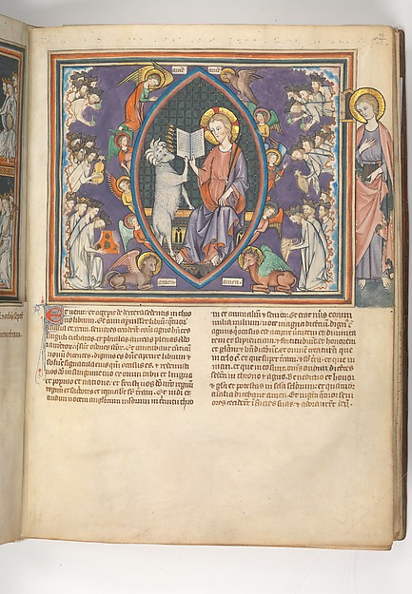
Seven Seals
“the Lion of the tribe of Judah”
“a Lamb, standing as if it had been slaughtered”
Notes:
Right hand of God holds a scroll with 7 seals. Asks, who is worthy to open it. Initially no one.
Then Jesus. Quotes describing Jesus, taken from Koester
The seals and their events are not really predictions. According to Koester, more like larger realities, symbolic and representative. Don’t identify a single periods
Supposed to threaten their well being. No one will be safe from the judgment of God.
Manuscript of the Apocalypse, 14th C

Slide 9
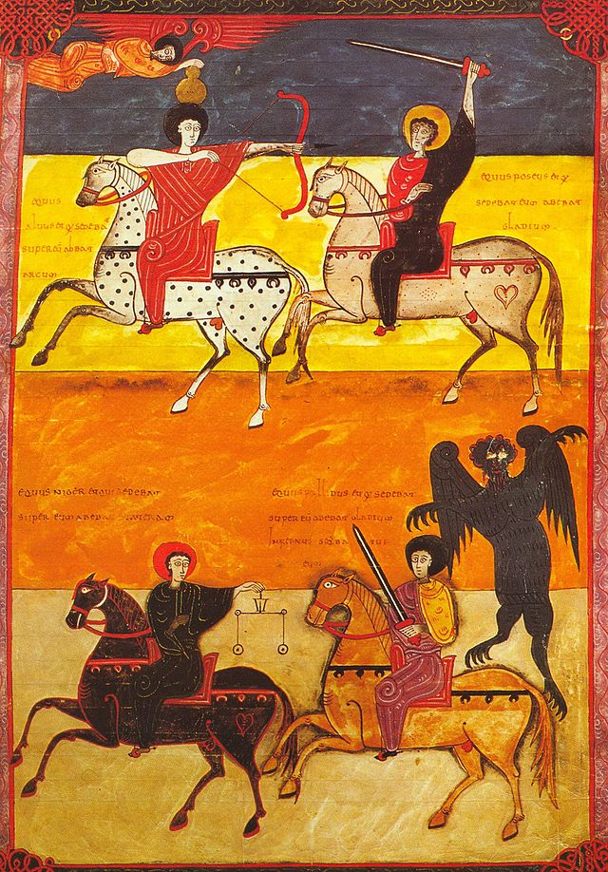
The Four Horsemen
Conquest
Violence
Hardship
Death
Notes:
1st 4 seals
Conquest- bow, warns against striving for prosperity through the empire, limited security
Violence- sword, warns of false security provided by the Romans
Hardship- scales, limits of economy to guarantee wealth and prosperity
Death- green horse, followed by Hades, heightens the previous horsemen’s effects, a force beyond human control
Spanish manuscript

Slide 10
God?
Dualistic role
Inflicts yet, restrains
Multiple forces
Not explaining evil
Disturbing the complacent
Reassuring the oppressed
Notes:
Readers often wonder where God is in the destruction. He’s not really inflicting it, but he’s not independent of it either. Multiple forces at work, creates confusion over who’s controlling
Visions in Revelations aren’t meant to explain evil forces. Supposed to reveal and bring faith. Unsettle those in false security. Reassure the oppressed that their suffering won’t last forever.

Slide 11
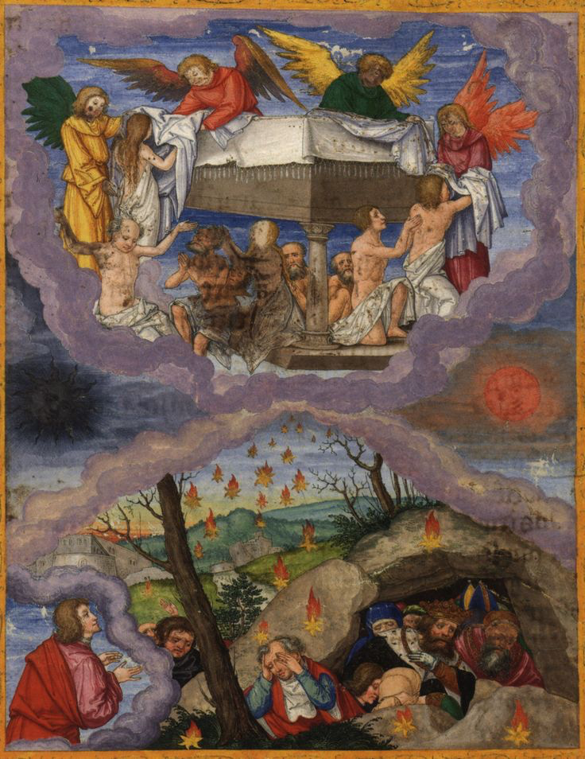
Fifth and Sixth Seals
Martyrs in heaven
Suffering on earth
Notes:
5th and 6th seals disturb perceptions of security and peace on earth. Those suffering on earth- heaven. Those prospering on earth- suffering from judgment
Martyrs wait below the altar, at rest, with white robes (purity) Also call out for justice, but have to wait till others come.
Those on earth- dark sun, moon to blood, warning of coming of divine wrath. Against compromising faith to attain security on earth. Try to hide from God by calling mountains to fall on them- futility of seeking refuge with rich and powerful
Ottheinrich Bible, 1425

Slide 12
The Redeemed
Sealing the 144,000 redeemed
Belong to God
Protection
Who are they?
Twelve tribes of Israel
Symbolic, completeness
Notes:
Standing before God, singing praises. Sealed on the forehead as God’s people. Indicates they belong to God and protection from affliction
Says the people are from the 12 tribes of Israel. But Koester says not to take it literally. Contrasting accounts, John also says he saw a countless multitude. The number symbolizes completeness

Slide 13
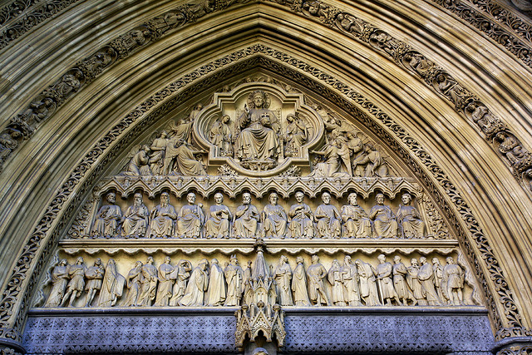
Revelation 7
Silence
Confidence in God
Protection for the redeemed from God
Notes:
The loud praises become silent.
Previous chapters take away readers confidence in earthly security, this chapter reassures confidence in God. Believers can persevere.
Westminster Abbey, north portal

Slide 14
Warren Carter, “Accomodating ‘Jezebel’ and Withdrawing John: Negotiating Empire in Revelation Then and Now”
Notes:
Addresses the problem Christians faced, and still face, about how to appropriately live in society while maintaining Christian values. Lays out and analyses the contrasting teachings of Jezebel and John, who are both Christian, but advocate different lifestyles. Jezebel preaches active participation in imperial life, while John preaches separation.
Since Revelation is written from the point of view of John, Jezebel’s views are not mentioned except to illustrate negative practices. This presents her as someone leading Christians away from the righteous life. Carter suggests that, contrary to John’s description of her, she wasn’t purposely preaching against Christian beliefs. She was providing a way of living in imperial society with the genuine belief they were following Christian doctrines.

Slide 15
Jezebel’s arguments
Survival
Social Reputation and Evangelism
Theological Knowing
Biblical Examples of Blessed Imperial Participation
Recent Events
Notes:
Participation necessary for survival. Economic activity was often intertwined with pagan cult activities. Needed to participate in economic activity to survive. So pagan activities associated with survival is ok
Related to survival in society. Although honoring pagan gods was not required, refusing to do so can create resentment and hostility. So refusal isn’t a good strategy for evangelism and survival of Christianity. Active participation may be more effective.
Rooted in the idea that true Christians would know that God is the only true god. Know that idols are worthless so they weren’t really worshiping them when they made offerings to pagan gods. Able to participate in society because idols held no power over them.
Examples of characters that participated in imperial life with God’s blessing. Joseph, Jeremiah.
Recent events may have made Rome seem like God’s chosen kingdom. So if Rome is the focus of God’s blessing, social and cultural participation is worthy of God’s blessing.

Slide 16
John’s Arguments
Power
Worship
Under God’s Judgment
Under the Devil’s Control
Societal Distance and Withdrawal
Faithful Endurance
Ultimate Triumph
Notes:
Argues against Jezebel while also promoting distance and disassociation.
Jesus is a victim of Rome’s destructive power. But, Rome isn’t supreme. God is supreme, Rome is subject to God. Also Rome’s rulers are often labeled as “kings of the earth”, which is used as a negative label. Claiming God’s supreme power counters Jezebel’s claim that Rome is the most powerful.
Talks about who is worthy to receive worship. Revelation says no one is can take God and Christ’s place. Christ’s death made him worthy of worship. Participating in cult activities undermines God’s power.
According to John, God is condemning the Roman empire. Participation in what God condemns draws God’s wrath- the empire is not neutral, like Jezebel advocates. 3 sequences of visions- seven seals, seven trumpets, and downfall of great whore Babylon- support that Rome is under God’s judgment and contrast Jezebel’s neutral/benevolent empire.
Empire is under the devil’s control. Under devil’s control, devil and empire become one, control through the 2 beasts. The power behind Rome’s throne is the devil, Jezebel and followers can’t see that.
Christians should practice societal withdrawal, against Jezebel’s societal inclusion. Illustration of mark of the beast against mark of God. Participating in imperial society- mark of the beast. Withdrawing from society- mark of God.
Practicing societal distance is hard. Although John doesn’t offer a solution, he does acknowledge the hardship and difficulties. Stresses faithful endurance
God’s ultimate triumph. Concludes Revelation with seven visions of God’s victory. Encourage Christians to be faithful

Slide 17
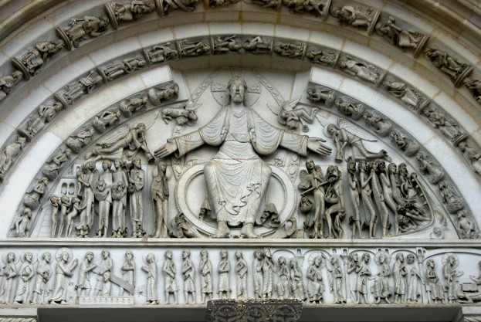
Churches today
Poses difficulties for Christians today to withdraw from society
Similarities between Jezebel and John
Notes:
Jezebel- says Christ embraces Roman culture
John- says Christ rejects Roman culture
Difficult for modern church members to withdraw- prevalence of material comforts in life
Similarities- John leaves a lot of unanswered questions about how to actually live life, John is still involved with empire (imitation of imperial language, borrowing from court practices to describe God’s empire)
Very complicated. Positions oppose each other, but still have similarities. So it’s difficult to look at modern life through Revelations. Need continuous and evolving dialogue in faithful and respectful communities.
Vezelay Tympanum, 1130

