Slide 1
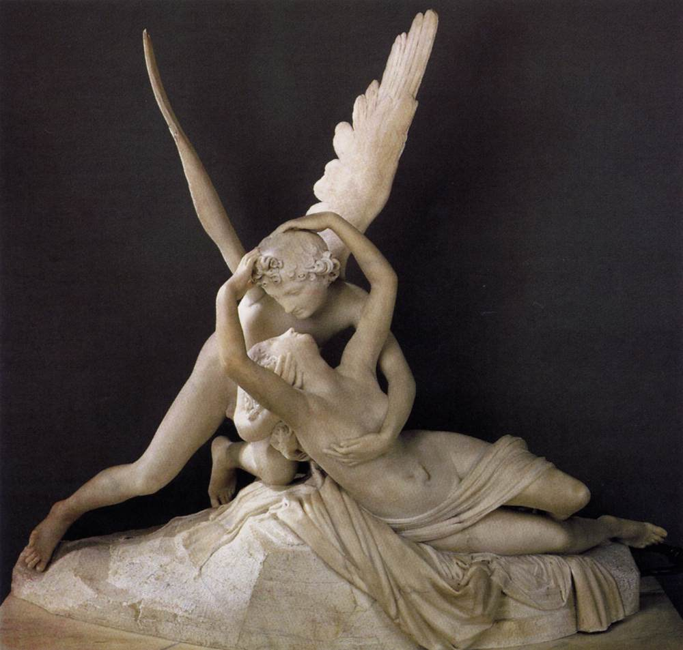
The Tale of Cupid and Psyche

Slide 2
Background
Prevailing assumption is that Apuleius was retelling a story which already existed.
Caution towards viewing "Written" and "Oral" as categories completely separate and insulated from each other.
  Cupid and Psyche is even cast as "an old wives tale" and the Ass bemoans how he has no means of writing it down.
"The focus of our thinking about the Apuleian narrative should shift from where it came from to where is going."

Slide 3
Plot Summary
Introduction:
  Jealousy of Venus (4.28-31)
  Marriage and death (4.32-35)
Part 1:
  Locus amoenus (5.1-4)
  Attack of the sisters (5.5-20)
  Betrayal and revelation (5.21-24)
Interlude:
  Wanderings and revenge (5.25-27)
  Venus (5.28-31)
  Wanderings and prayer (6.1-5)
Part 2:
  Venus and Mercury (6.6-8)
  Surrender, acceptance of tasks (6.9-20)
  Resolution (6.21-24)

Slide 4
Inconsistencies in Storytelling
Venus:
  Comments on Cupid.
    Not innocent -> Innocent -> Not innocent
  Comments on Psyche
    Acknowledging her beauty -> calling her ugly.
Sisters:
  Splendid marriages (4.32) -> Bars and chains (5.9).
Pleasure:
  Boy (5.11) - > Girl (6.24).

Slide 5
Curiosity
“Psyche trained her gaze insatiably and with no little curiosity on these her husbands weapons” (93).
“But once she was back in the light of the world and had reverently hailed it, her mind was dominated by rash curiosity” (111).

Slide 6
Fortune
“See that the girl is seized with consuming passion for the lowest possible specimen of humanity, for one who as the victim of Fortune has lost status, inheritance and security…” (76).
“Sweetest Psyche, fond wife that you are, Fortune grows more savage and threatens you with mortal danger” (82).
“Fortune, how blind and harsh and unjust you are!” (84).
“Fortune is aiming her darts at you from long range and, unless you take the most stringent precautions, she will soon engage with you hand to hand” (86).
“Psyche was aghast at this second shipwreck devised by Fortune” (102).

Slide 7
Platonist Preoccupations
“Psyche’s separation from, and ultimate reunion with, cupid is an allegory for the soul’s restless aspiration to attain the divine, as Plato depicts in his Phaedrus”
Sisters: Worldly restraints of the soul as it seeks the divine.
Psyche grabs Cupid’s heel.
  Attempt at clinging to the divine.
Psyche becomes immortal.

Slide 8
Discussion Questions
The Tale of Cupid and Psyche is told by the old maiden to the captive girl in order to calm her anxieties. However, P.G. Walsh notes in his introduction that Cupid and Psyche seems to be directed more towards the character of Lucius. He argues that it serves as the projection into myth of the sin, sufferings, and redemption of Lucius (xxv). In what ways does this model fit what we have already read in the first half of Lucius’ tale? Furthermore, how do the themes of curiosity and Fortune compare between Lucius’ narrative and the narrative of Cupid and Psyche?
There are several instances where certain characters observe religious practices throughout the tale. Psyche’s activities at Ceres and Juno’s shrines are prime examples of this (6.1-5). How then does the myth of Cupid and Psyche demonstrate the Roman conception of the divine? After thinking back onto Rives’ insights on Roman cults, especially his ideas on the mobility of worshipers and gods, can we see any of his ideas playing out in this story?

