Slide 2
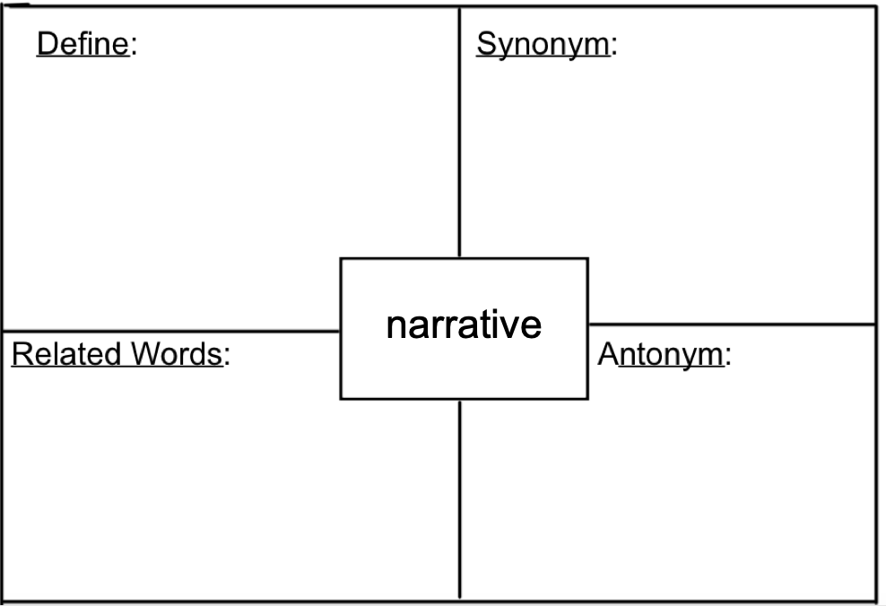

Slide 4
Group Discussion: How does this quote show bias?

Slide 11
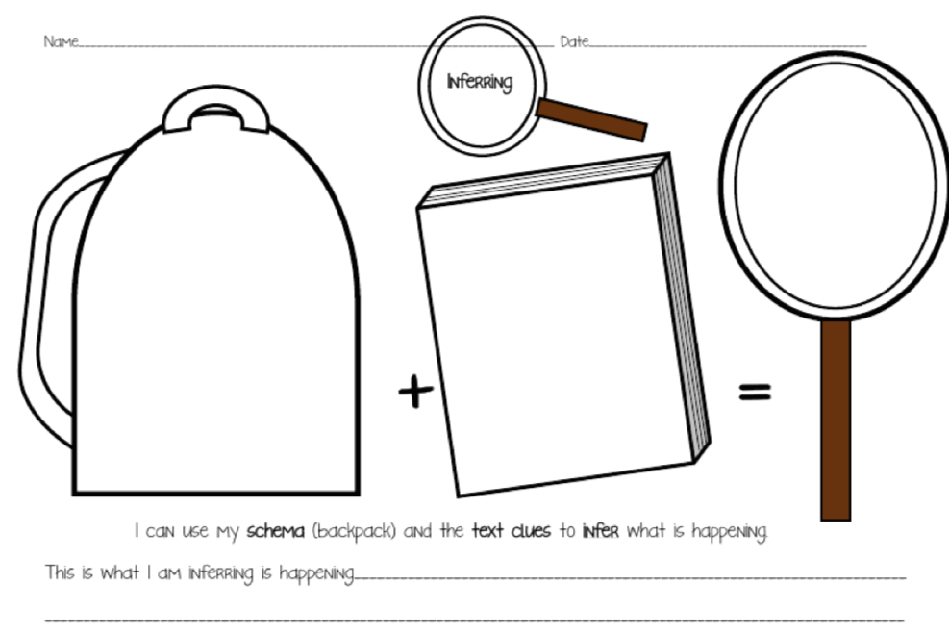

Slide 13
