Slide 1
Oregon Supported Living Programs: Arts & Culture
A Marketing Proposal by Michele Sinclair

Slide 2
Organizational Summary
Workshops offered:
Photography
Yoga
Fiber Arts
Dance
Music
Gardening
Cooking
Person – centered
Themed workshops
Open studio hours with resident artist → all materials provided
Gallery openings → %50 back to artist

Slide 3

Strategy 1: Social Media
Vimeo: Seeing is believing.
OSLP Outlet: Set no limits.
Facebook: Surprise others daily.

Slide 4

Strategy 2: Collateral
Artist cards: Be personal.
T-shirts and tote bags: Reach out.
Bumper stickers and buttons: Let others see.

Slide 5
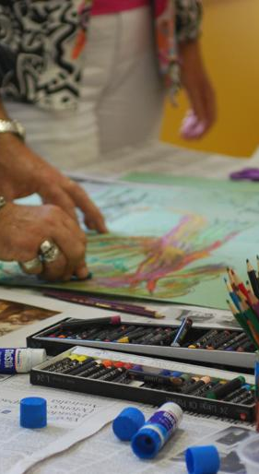
Strategy 3: Education
Traveling outreach program
Workshop preview
Collateral delivery

Slide 6
Projected Outcomes:
1. Attract more participants
2. Cultivate demand for community room artists
3. Broaden audience base
4. Increase attendance rates at gallery openings
4. Create and sustain substantial online presence

