Slide 1
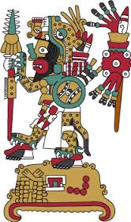
Making a Family History Codex
Tamara Weiss
5th Grade Art

Slide 2
Unit Overview
Day 1- Study of culture and personal identity
Day 2- Group culture
Day 3- Intro to Mesoamerican cultures and diversity
Day 4: Intro to Mixtec calendar
Day 5: Reading codices
Day 6: Family codex (sketch draft)
Day 7: Family codex (begin final draft)
Day 8: Look at use of colors in Mixtec Codices
Day 9: Continue drawing/ painting codex
Day 10: Finish codex, share with class

Slide 3
HOMEWORK ASSIGNMENT
Family History
Grandparent/ Guardian 1
Name:
Date of Birth:
Place of birth:
Parent/ Guardian 1
Name:
Date of Birth:
Place of birth:
You
Name:
Date of Birth:
Place of birth:
(Optional)
Grandparent/ Guardian 2
(Optional)
Name:
Date of Birth:
Place of birth:
Grandparent/ Guardian 2
Name:
Date of Birth:
Place of birth:

Slide 4
Calculate Calendar Name
Partner with math teacher to work out the calendar names
images: http://www.ancientscripts.com/mixtec.html

Slide 5
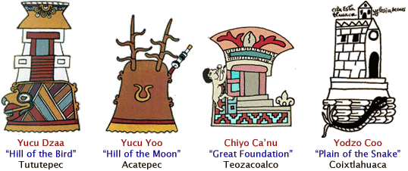
Mixtec Place Glyghs
images: http://www.ancientscripts.com/mixtec.html

Slide 6
Create Your Own Place Glyph
What places are in your family history?
What do the names sound like?
What do the names mean?
3) What landmarks, important features does the place have?
4) How could you draw pictures to show these sounds or meanings?

Slide 7
Place Glyph Example
Philadelphia
Meaning:
Landmarks/features:
Drawing:

Slide 8
Place Glyph Example
Philadelphia
Meaning: brotherly love
Landmarks/features:
Drawing:

Slide 9
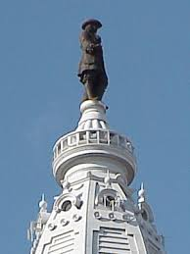
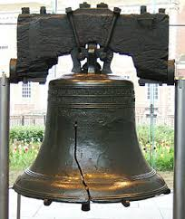
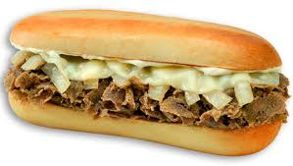
Place Glyph Example
Philadelphia
Meaning: brotherly love
Landmarks/features:

Slide 10
Place Glyph Example
Philadelphia
Meaning: brotherly love
Landmarks/features:
Drawing:

Slide 11
Can you read this place glyph?

Slide 12
Can you read this place glyph?
Los Angeles

Slide 13
Can you read this place glyph?
Los Angeles

Slide 14
Can you read this place glyph?
Los Angeles
Kansas City

Slide 15
Sketch family codex including place glyphs, calendar names and major life events

Slide 16
Colors of the Codices
What colors do you notice?
Where do you think these colors came from?

