Slide 1
Traditional vs. Industrial Candle Manufacture

Slide 2
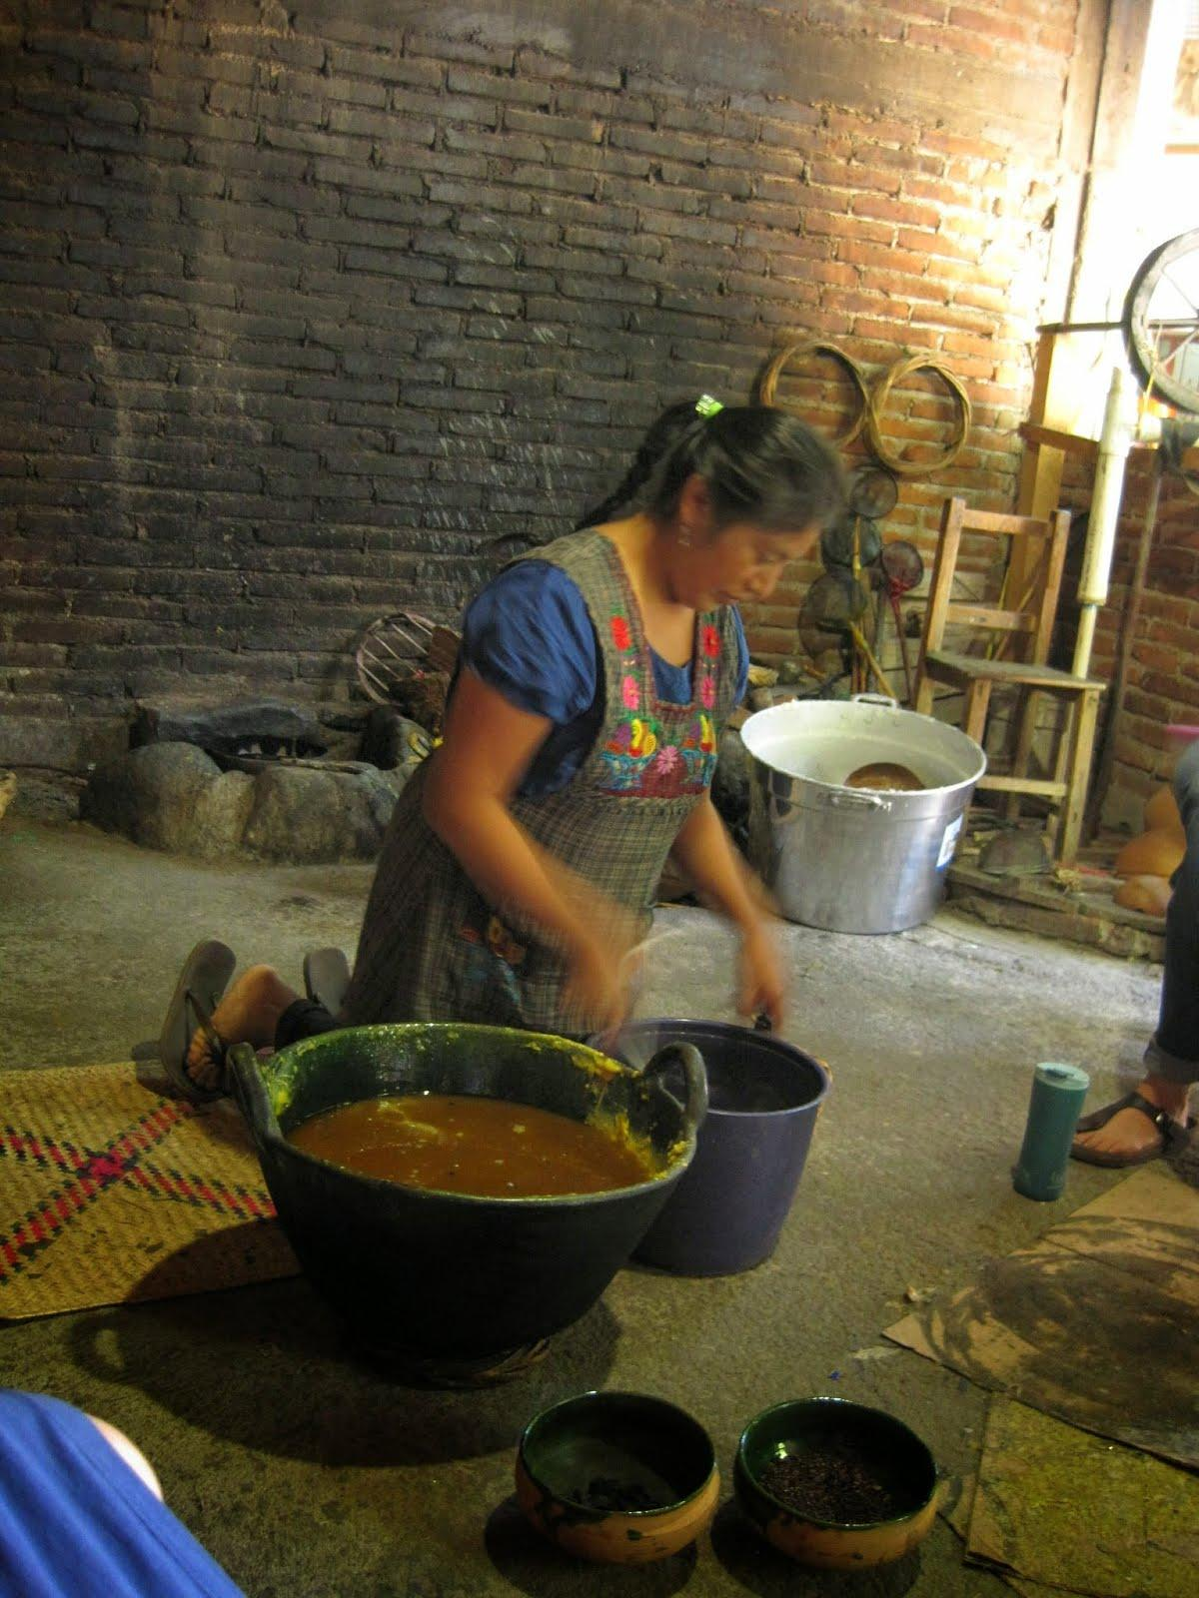
Notes:
Sophia Ruiz Lorenzo, expert traditional candle maker, Teotitlan del Valle
The iron pot has been heated over a wood fire, and is now a liquid.
Photo by Sarah Horwitz 7/14

Slide 3
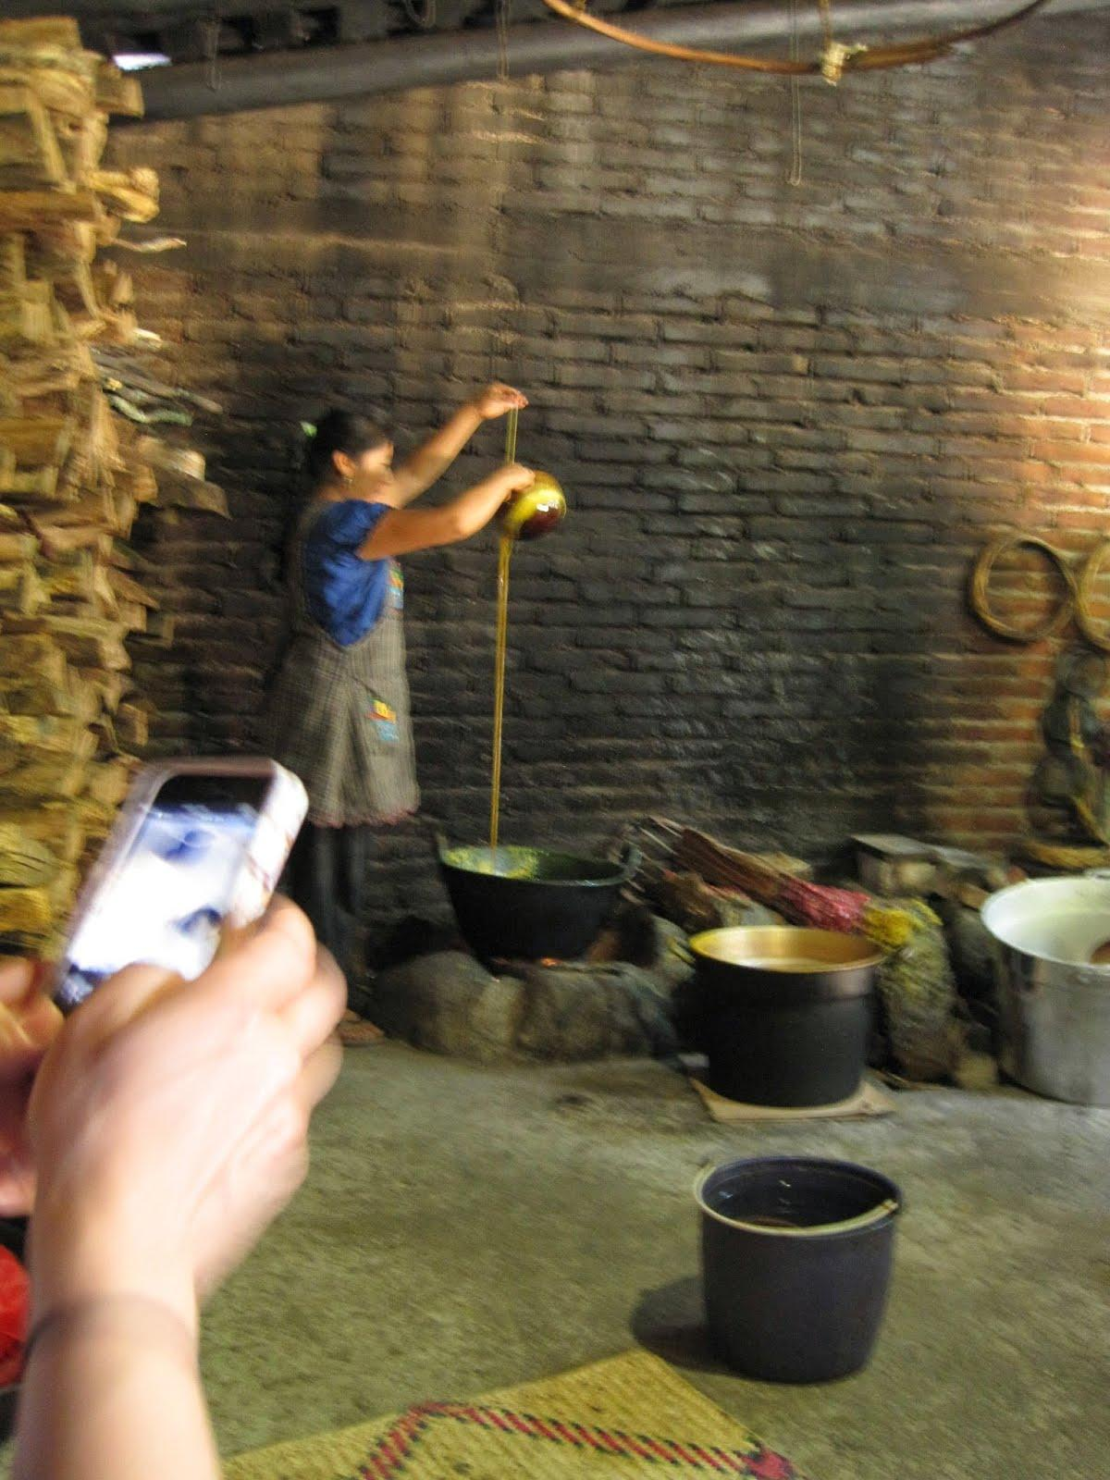
Notes:
Sophia dips our some liquid wax and pours it down over the wick, again and again. Slowly a candle forms.
Sophia Ruiz Lorenzo, expert traditional candle maker, Teotitlan del Valle
Photo by Sarah Horwitz 7/14

Slide 4
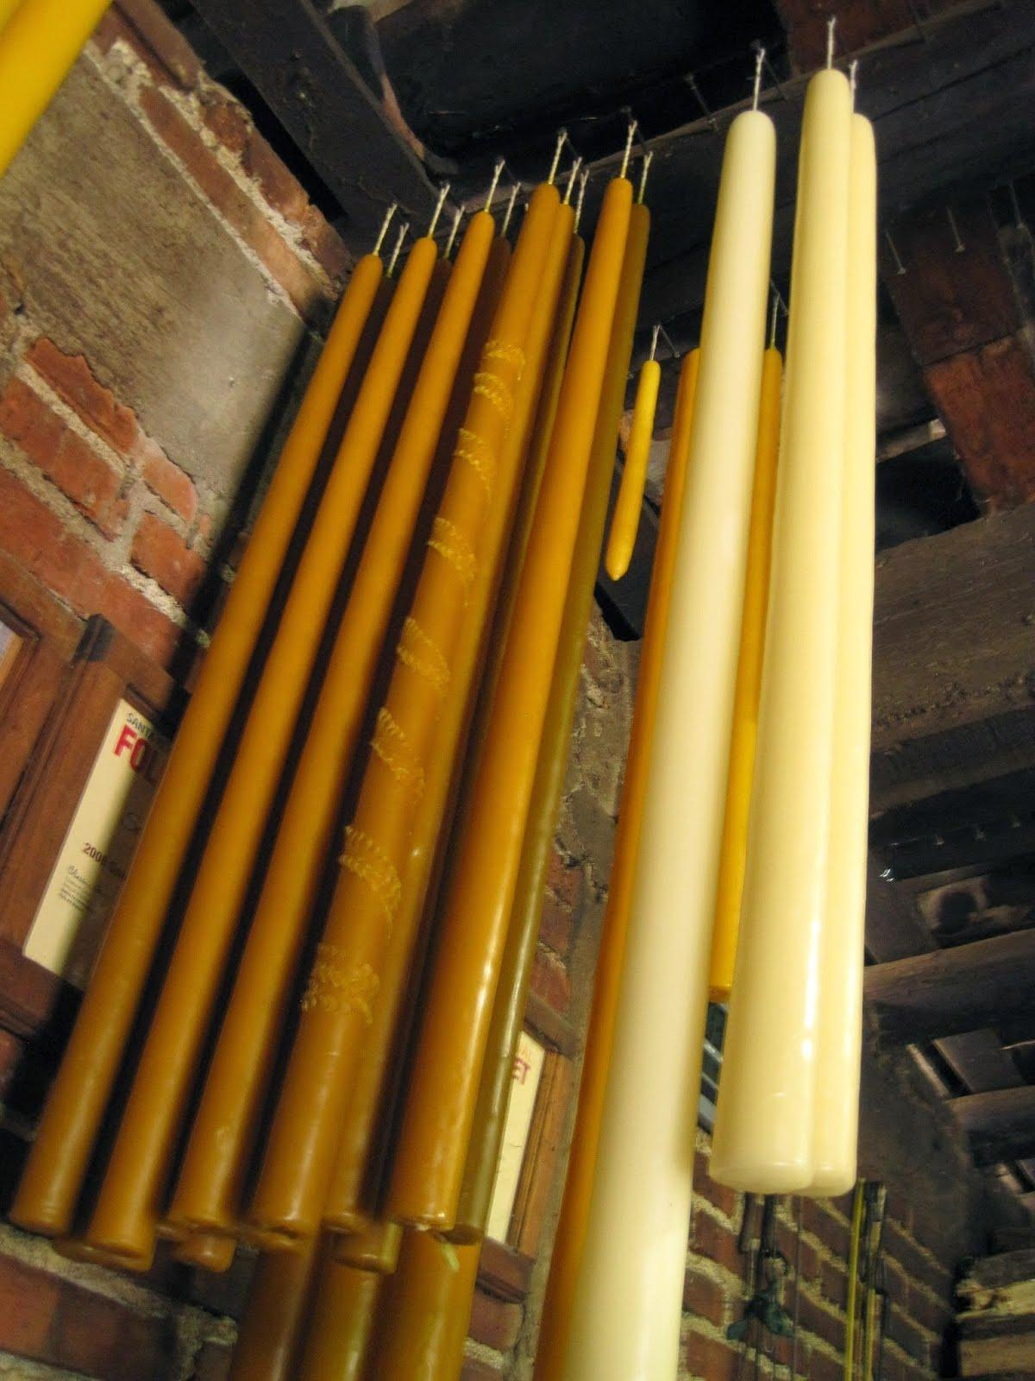
Notes:
Finished candles. Sophia Ruiz Lorenzo, expert traditional candle maker, Teotitlan del Valle
Photo by Sarah Horwitz 7/14

Slide 5
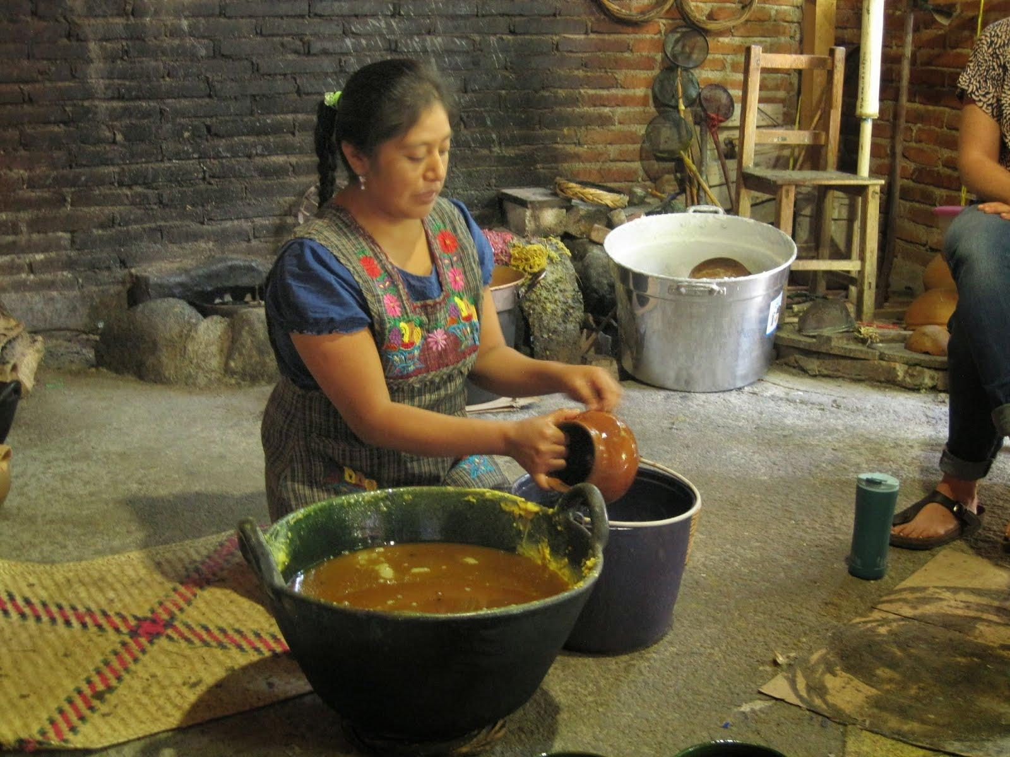
Notes:
To decorate the finished candles, Sophia first licks the outside of a clay pot, then dips in in the hot wax, then dips it in cold water. She peels the thin circle of wax from the pot.

Slide 6
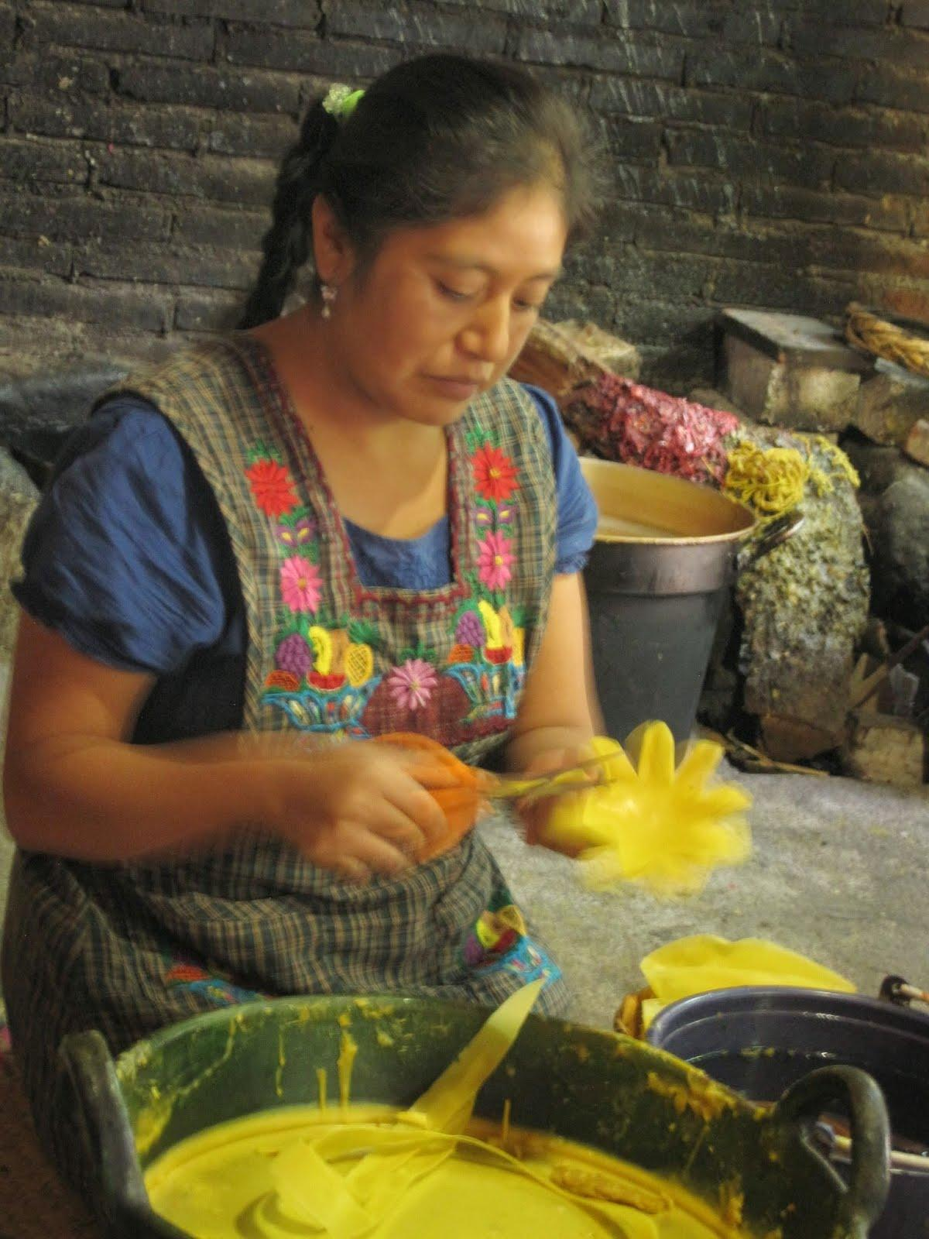
Notes:
After she has many thin sheets of wax, Sophia uses a scissors to cut the sheets into petals. Sophia Ruiz Lorenzo, expert traditional candle maker, Teotitlan del Valle
Photo by Sarah Horwitz 7/14

Slide 7
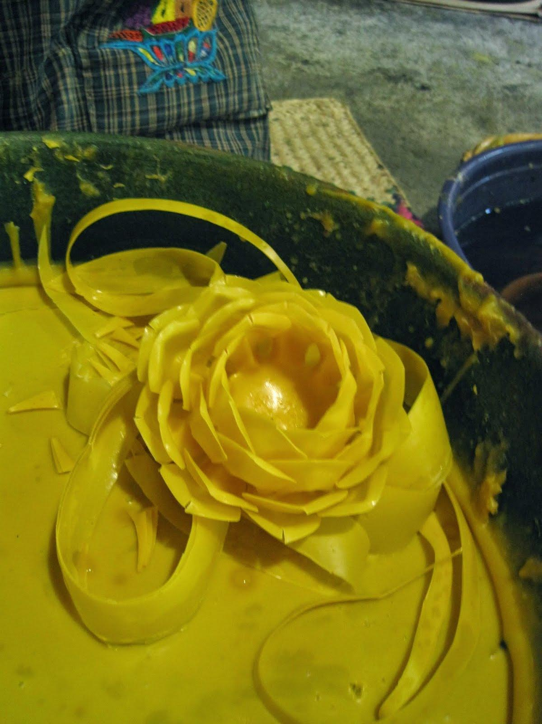
Notes:
She stacks each sheet inside another, and slowly builds a bees-wax rose. Sophia Ruiz Lorenzo, expert traditional candle maker, Teotitlan del Valle
Photo by Sarah Horwitz 7/14

