Slide 1
Symbolism in Songs, Quilts, and More
By Marina Outwater
NEH
Oaxaca, Mexico
2014

Slide 2
The Hobo Code
What is a hobo?
What does it mean to be transient?

Slide 3
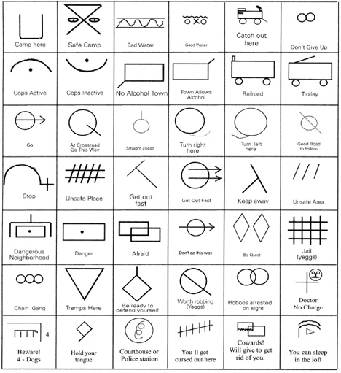
“The pictographic Hobo Code is a fascinating system of symbols understood among the hobo community. Because hobos weren’t typically welcomed (and were often illiterate), messages left for others in the community had to be easy for hobos to read but look like little more than random markings to everyone else to maintain an element of secrecy. The code features certain elements that appear in more than one symbol, such as the circles and arrows that made up the directional symbols. Hash marks or crossed lines usually meant danger in some form.”
http://weburbanist.com/2010/06/03/hoboglyphs-secret-transient-symbols-modern-nomad-codes/

Slide 4
Make your own School Code
Design a School Code using ten different symbols.

Slide 5
The Underground Railroad
What do you already know about the Underground Railroad?
Use who, what, where, when, how, and why to help you answer this question

Slide 6
Quilt Codes: Used by slaves as a guide to freedom
http://home2.fvcc.edu/~cgreig/final/blocks.html In block form
http://home2.fvcc.edu/~cgreig/final/story.html In story form
http://page.reallygoodstuff.com/pdfs/154227.pdf
Really Good Stuff’s Underground Railroad Quilt Guide with included pattern templates

Slide 7
Make your own coded quilt
Design a quilt that tells a coded story, possibly the story of the route you follow to school from your house, or of an important memory.

Slide 8
Pathways to Freedom: Underground Railroad
http://pathways.thinkport.org/flash_home.cfm
Great website about secret language of songs and quilts
http://www.cic.gc.ca/english/multiculturalism/black/black_white_codes.asp
Shows images of quilt designs and interprets the meaning for slaves
http://www.scholastic.com/teachers/book/patchwork-path#cart/cleanup
Summary of The Patchwork Path: A Quilt Map to Freedom
http://www.scholastic.com/teachers/book/sweet-clara-and-freedom-quilt#cart/cleanup
Summary of Sweet Clara and the Freedom Quilt

Slide 9
Follow the Drinking Gourd
This is an old song that supposedly also helped slaves escape North to freedom.
http://quest.arc.nasa.gov/ltc/special/mlk/gourd2.html
Access this explanation of the lyrics
http://pathways.thinkport.org/secrets/gourd1.cfm
http://pathways.thinkport.org/secrets/gourd2.cfm
Access another explanation and then words to the song (listen to it here too)

Slide 10
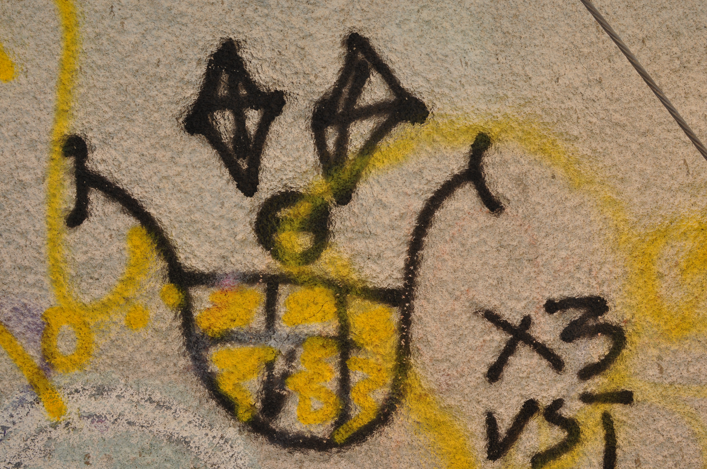
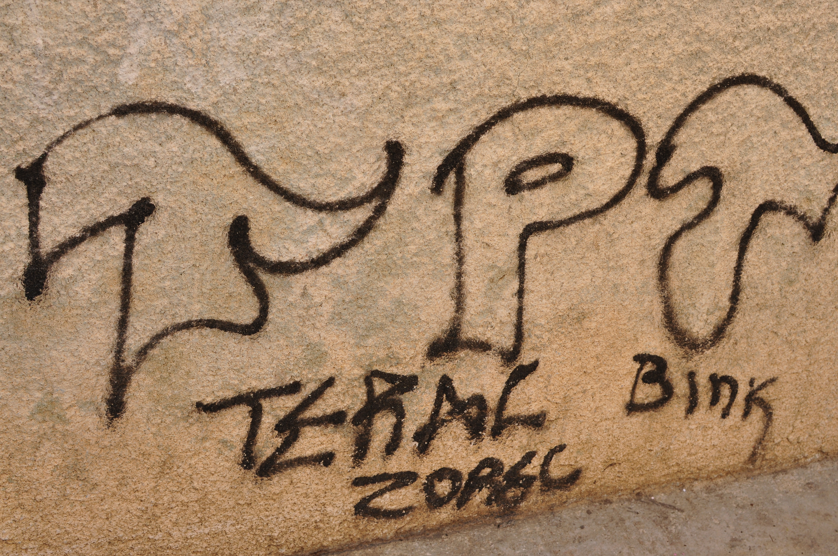
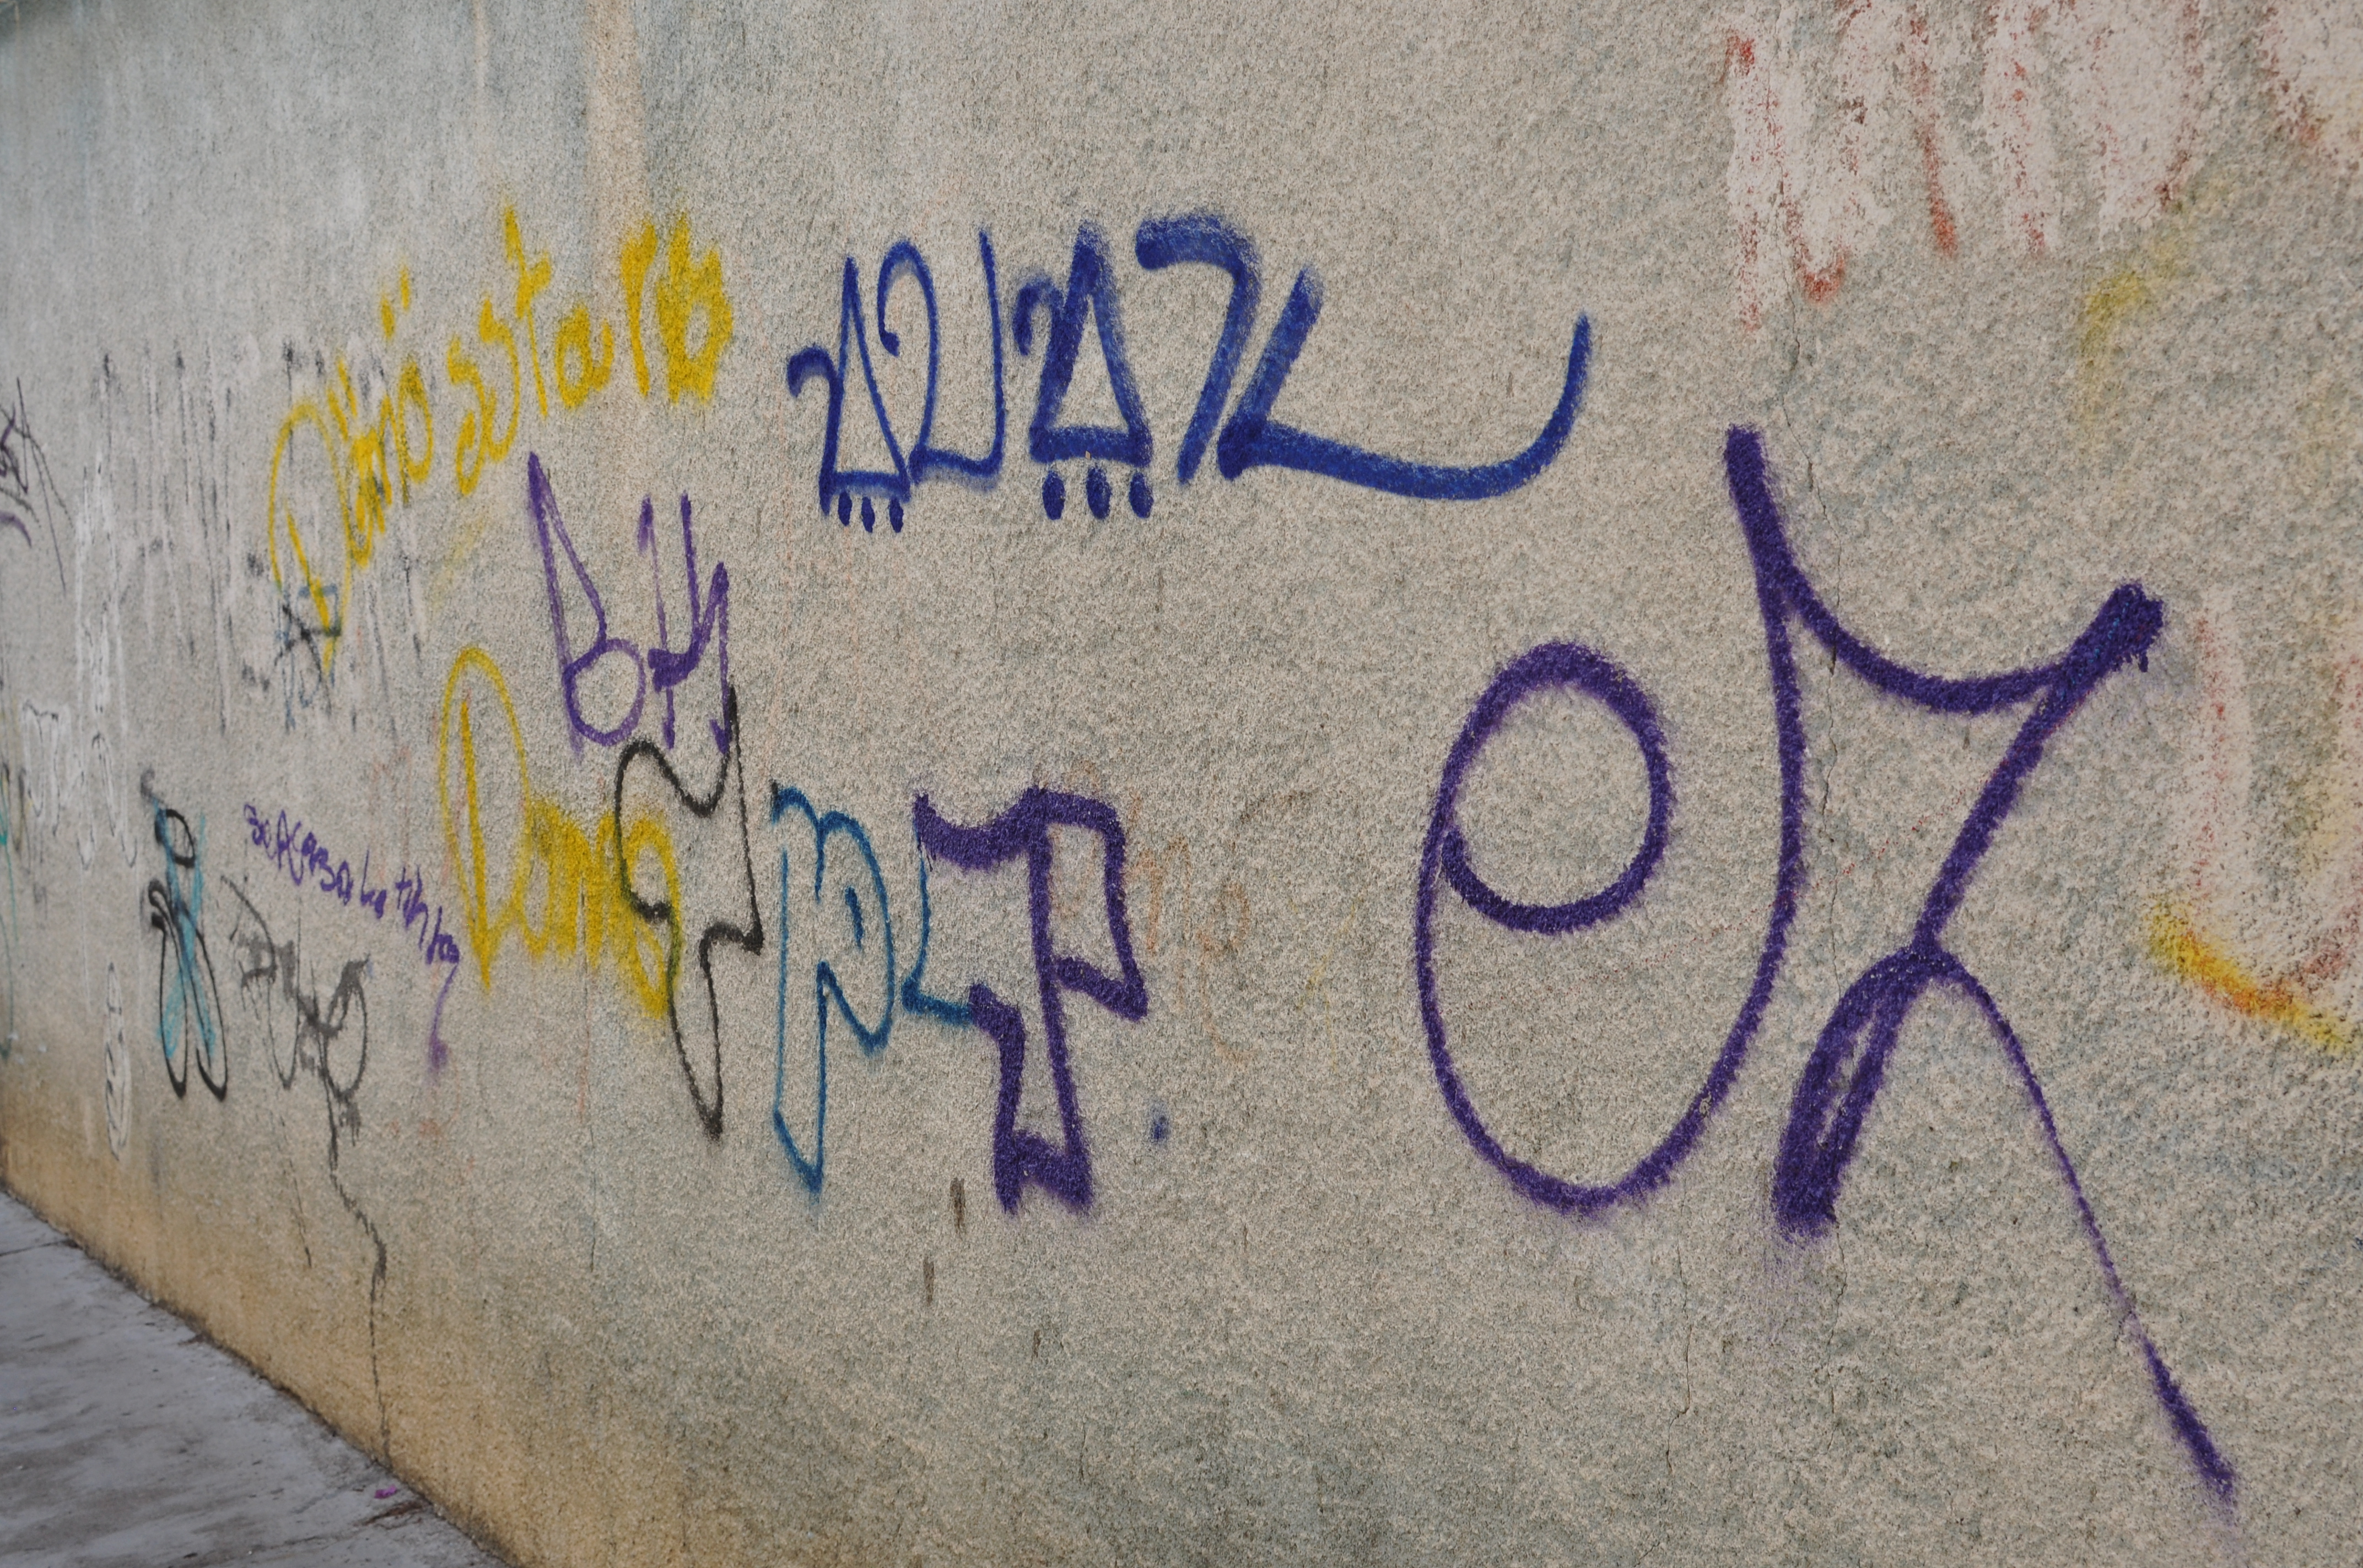
Gang Codes
Gangs use codes all the time. Graffiti, clothing and letters to prison inmates are all encoded. Find out more about LA gang symbols in the website below.
http://www.oncentral.org/news/2012/03/07/know-your-graffiti-disses-threats-and-mexican-mafi/
Possible examples of gang graffiti in Oaxaca, Mexico 2014

Slide 11
http://www.amazon.com/Symbols-Signs-Signets-Pictorial-Archive/dp/0486222411/ref=pd_sim_b_67?ie=UTF8&refRID=0G9RYHA3CW42A4PHBKVT
A link to purchase a book Symbols, Signs, and Signets
http://www.amazon.com/Signs-Symbols-DK-Publishing/dp/0756633931/ref=pd_bxgy_b_img_z
A link to purchase a book Signs and Symbols
http://www.amazon.com/Dictionary-Symbolism-Cultural-Meanings-Behind/dp/0452011183/ref=pd_sim_b_9?ie=UTF8&refRID=0RXMX2SX6CXS6J1J12YW
A link to purchase a book Dictionary of Symbolism: Cultural Icons and the Meanings Behind Them

