Slide 1
Project Perspective:
Who am I? Who are you?

Slide 2
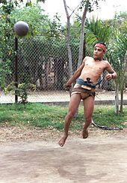
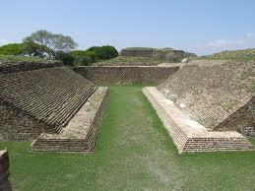
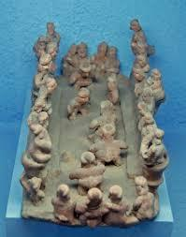
Spaniard at a ballgame post-conquest
Modern Ullama Player:
Sinaloa
Ballcourt at Montealban, Oaxaca
Fired clay representation
of ballgame

Slide 3
Game, Theatre, Ceremony
The mesoamerican ballgame was a ‘sport’ with political and religious associations and implications played since ~1,400 B.C.E.
The ball was made of rubber and was struck with the hips or buttocks
The game was a festive occasion but may also have settled political disputes and occasionally ended in the ritual sacrifice of a player or players

Slide 4
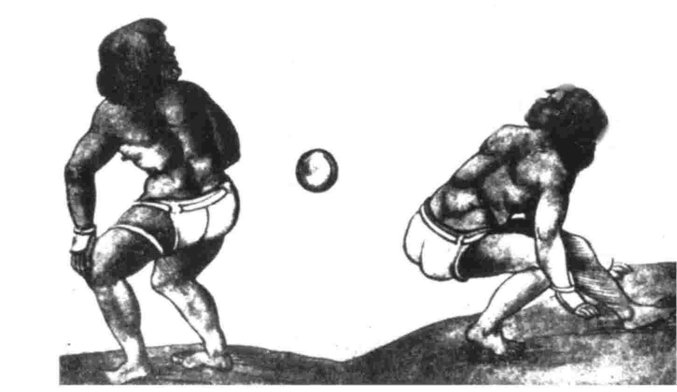
Spaniard at a ballgame
Two players sent to the court of Charles V by Hernando Cortes

Slide 5
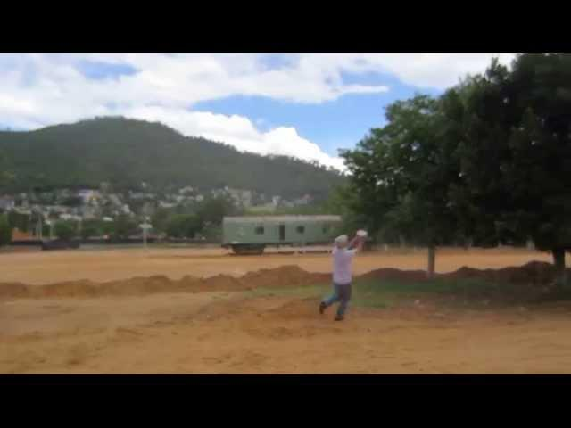
Diego Duran at a Ballgame
“It was a highly entertaining game and
amusement for the people, especially-for
those who held it to be a pastime or
entertainment. Among them there were those
who played it with such skill and cunning that
in one hour the ball (lid not stop bouncing
from one end to the other, without a miss, [the players]
using only their buttocks [and knees], never touching it with the
hand, foot, calf, or arm. -- Diego Duran, Codex Duran
http://www.penn.museum/sites/expedition/the-rubber-ball-game/

