Slide 1
Oaxaca’s Street Art
By Marina Outwater
NEH
Oaxaca, Mexico 2014

Slide 2
What is street art? What is graffiti?
Write for a few minutes in response to these two related questions.
Think about the following words as you write:
Legal/illegal
Vandalism
Urban
Protest
Public
Famous

Slide 3
Historical Figures
The street art in Oaxaca often features historical figures.
Who is the person and how is he/she represented?
What do you think the creator wants you to know about the person or the historical events surrounding that person?
Why are these figures represented in the street art of 2014?
What do they tell us about the intersection of the past and the present in Oaxaca?

Slide 4
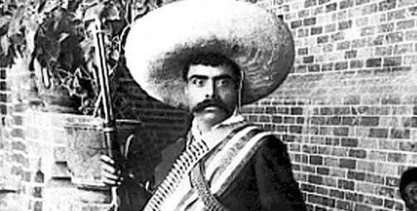
Emiliano Zapata
Notice his rifle and the bandoleros (strings of bullets) across his chest. Notice his big hat.
http://www.mexicodesconocido.com.mx/assets/images/notas_2011/zapata.jpg

Slide 5
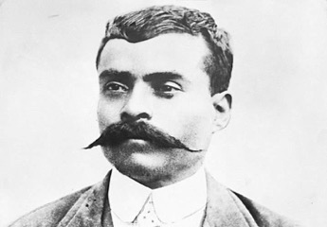
Emiliano Zapata
http://english.bicentenario.gob.mx/images/ImgBio/grandes/emilianoZapata.jpg
What do you think it means that his eyes are gouged out?

Slide 6
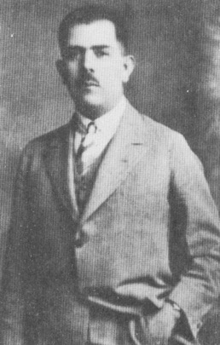
Lazaro Cardenas
He was the Mexican president of the 1930’s who is famous for redistributing significant amounts of land back to communities and also the “collective ejido” concept of farms. He had finally enforced (to some extent) the Constitution of 1917, which grew out of the Mexican Revolution of 1910.
http://www.latinamericanstudies.org/lazaro-cardenas/cardenas-9.jpg

Slide 7
Governor Ulises Ruiz
Why do you think he has horns?

Slide 8
Social Protest
A lot of the walls in Oaxaca are covered in writing, social protest for the most part.
What events are written about?
What tone is taken? What is the attitude expressed?

Slide 9
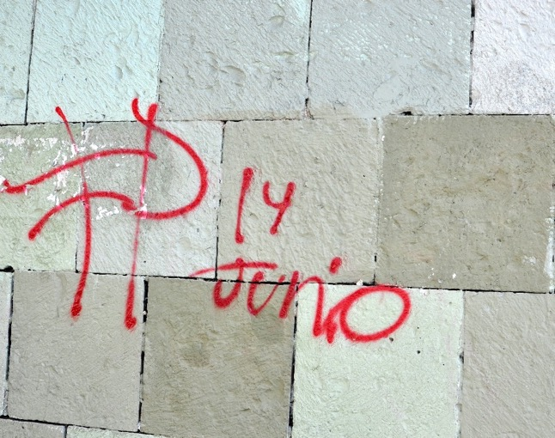
June 14th is never forgotten

Slide 10
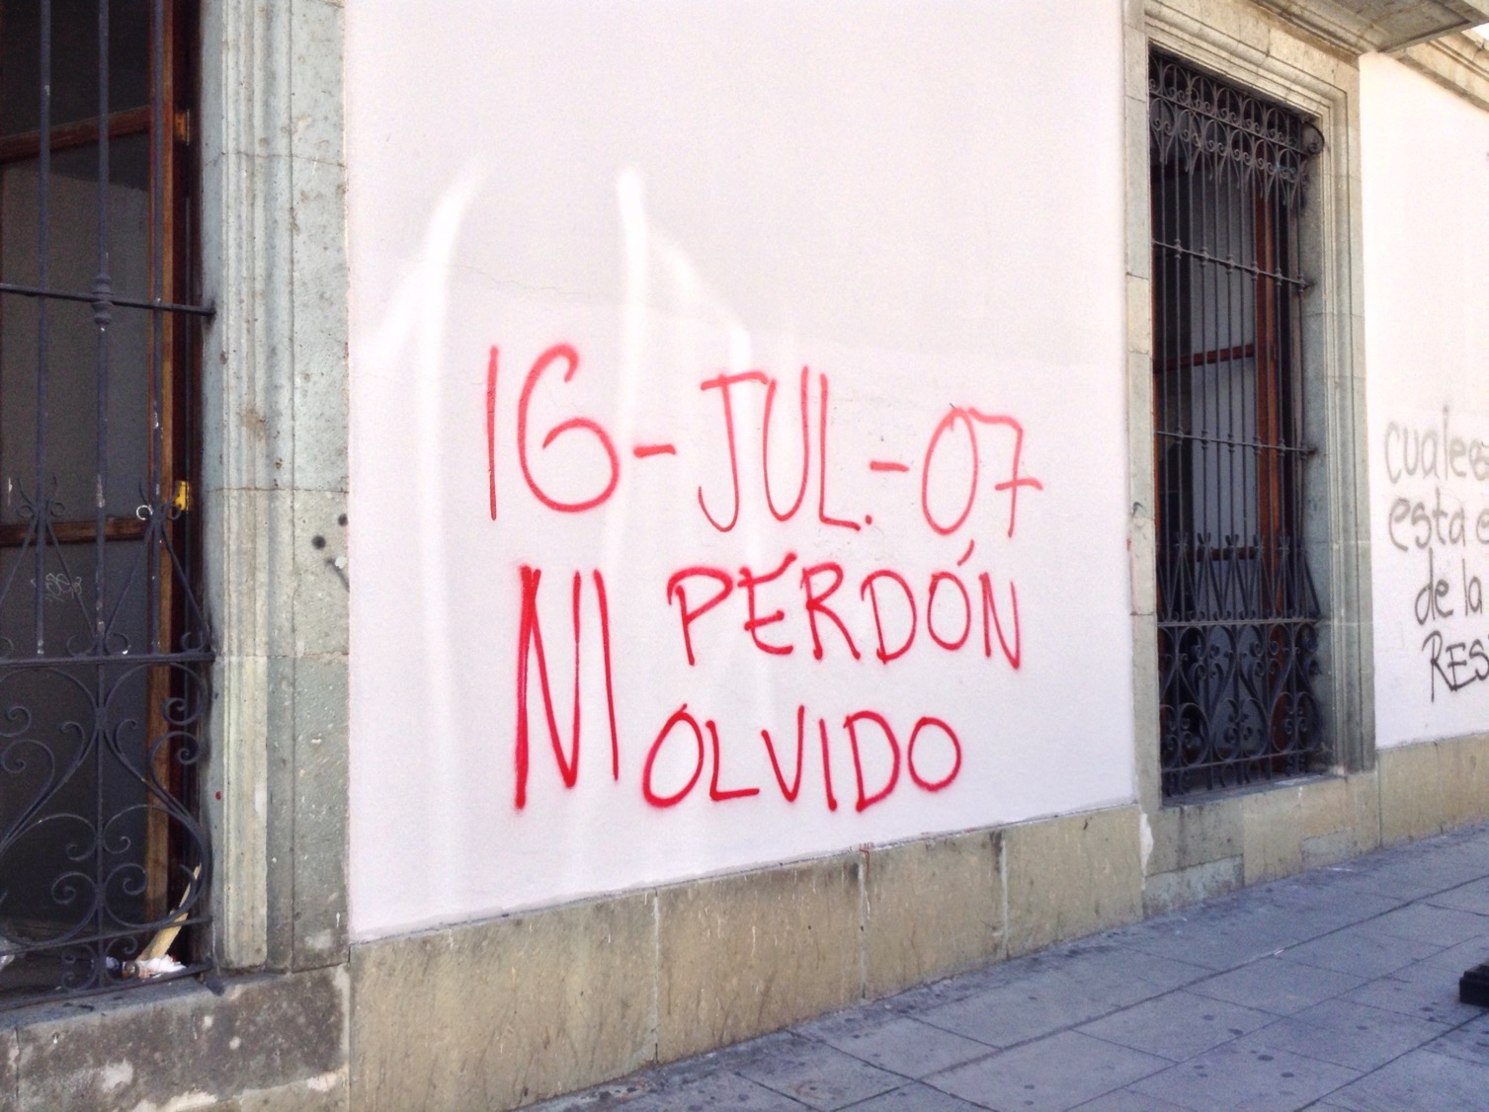
July 16, 2007
Forgiveness or oblivion
Find out what happened on that date:
http://www.washingtonpost.com/wp-dyn/content/article/2007/07/16/AR2007071601598.html

Slide 11
Release political prisoners

Slide 12
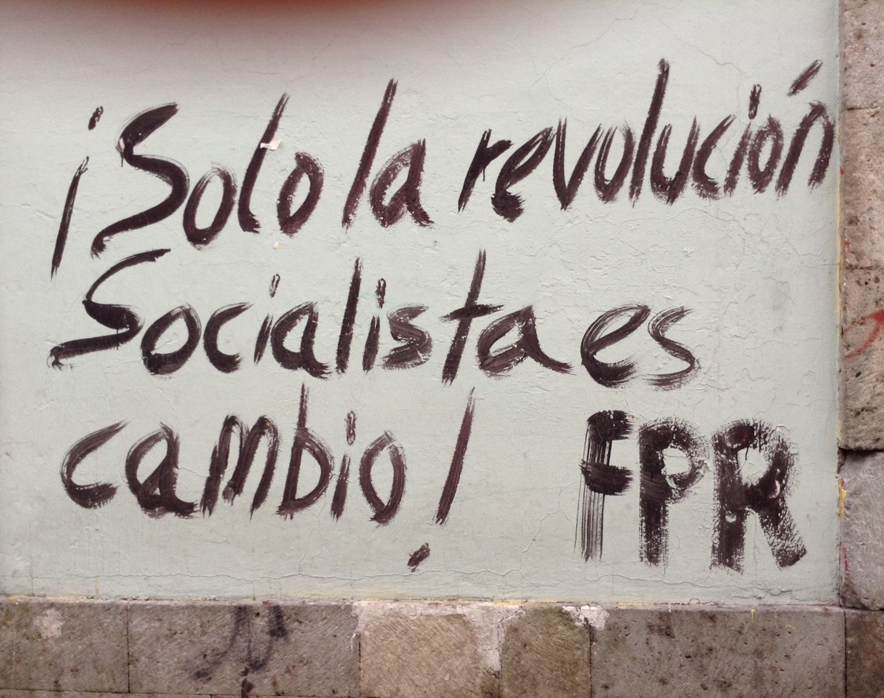
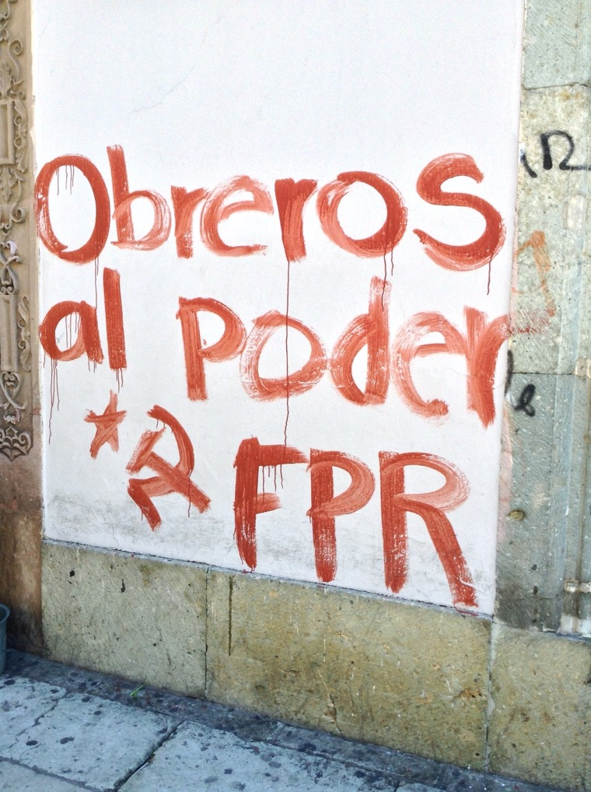
Workers to power Research about FPR
Only socialist revolution is (ie. brings real) change!

Slide 13
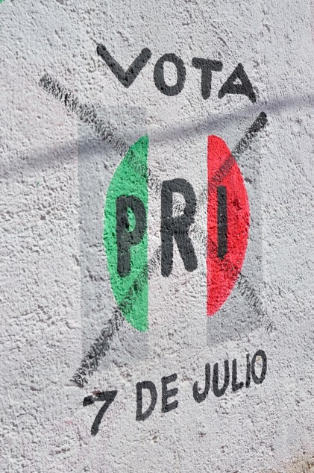
No More PRI
Who is PRI? Why are they disliked?

Slide 14
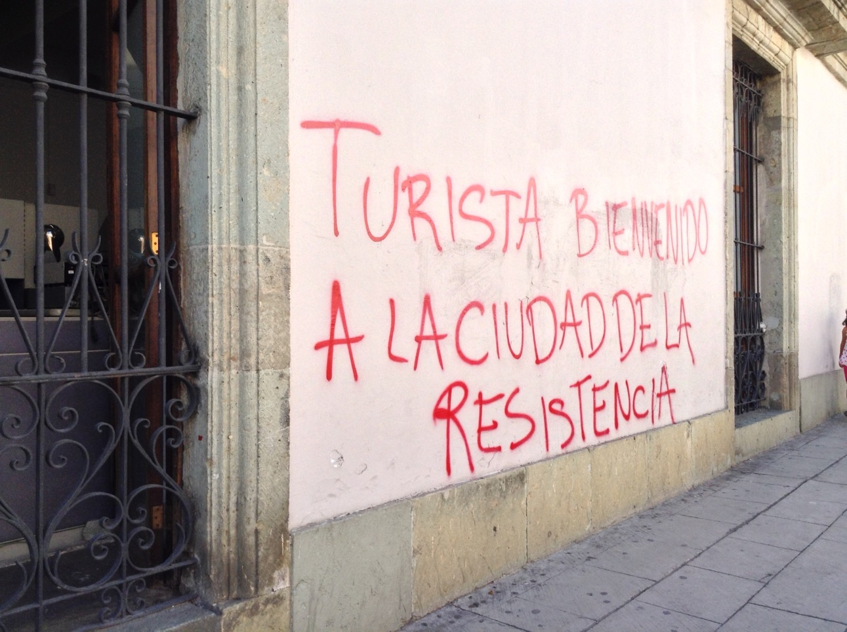
Welcome tourists to the city of resistance

Slide 15
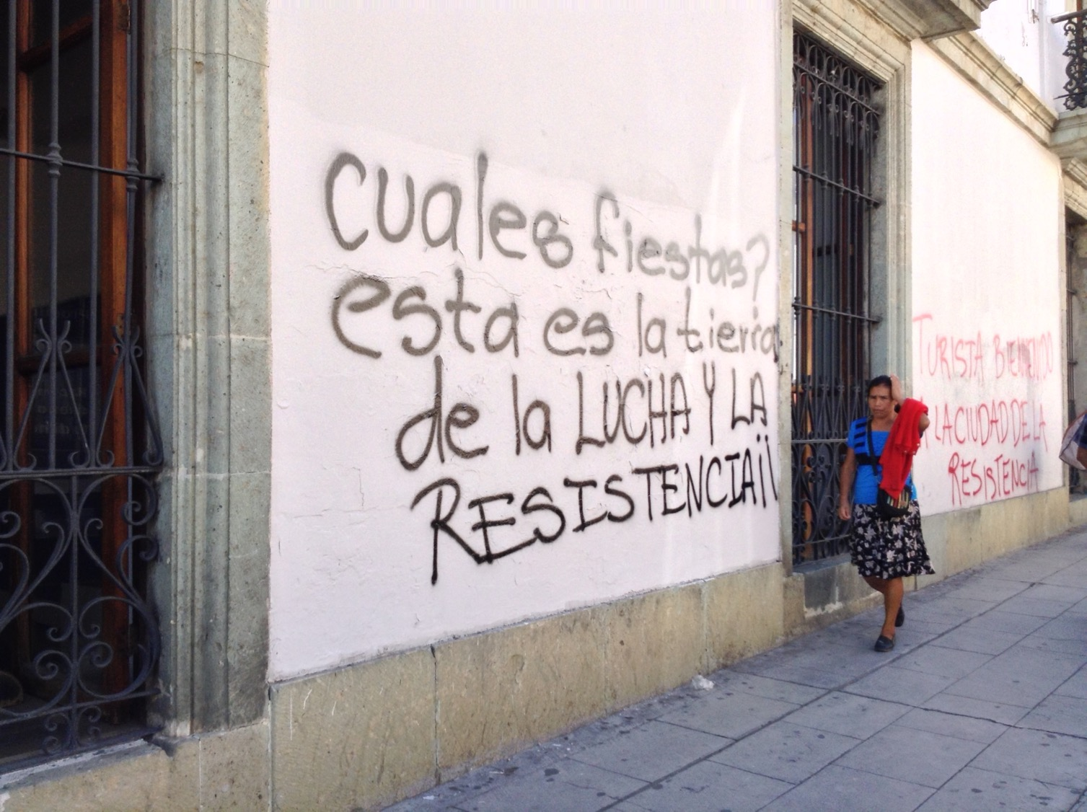
Which party?
This is the land of struggle and resistance

Slide 16
How would the cities be in another life?

Slide 17
Muera la FIFA: Death to FIFA
This was written during the World Cup soccer tournament in Brazil.
Atenco Oaxaca en Pie de Lucha:
Attention Oaxaca in struggle

Slide 18
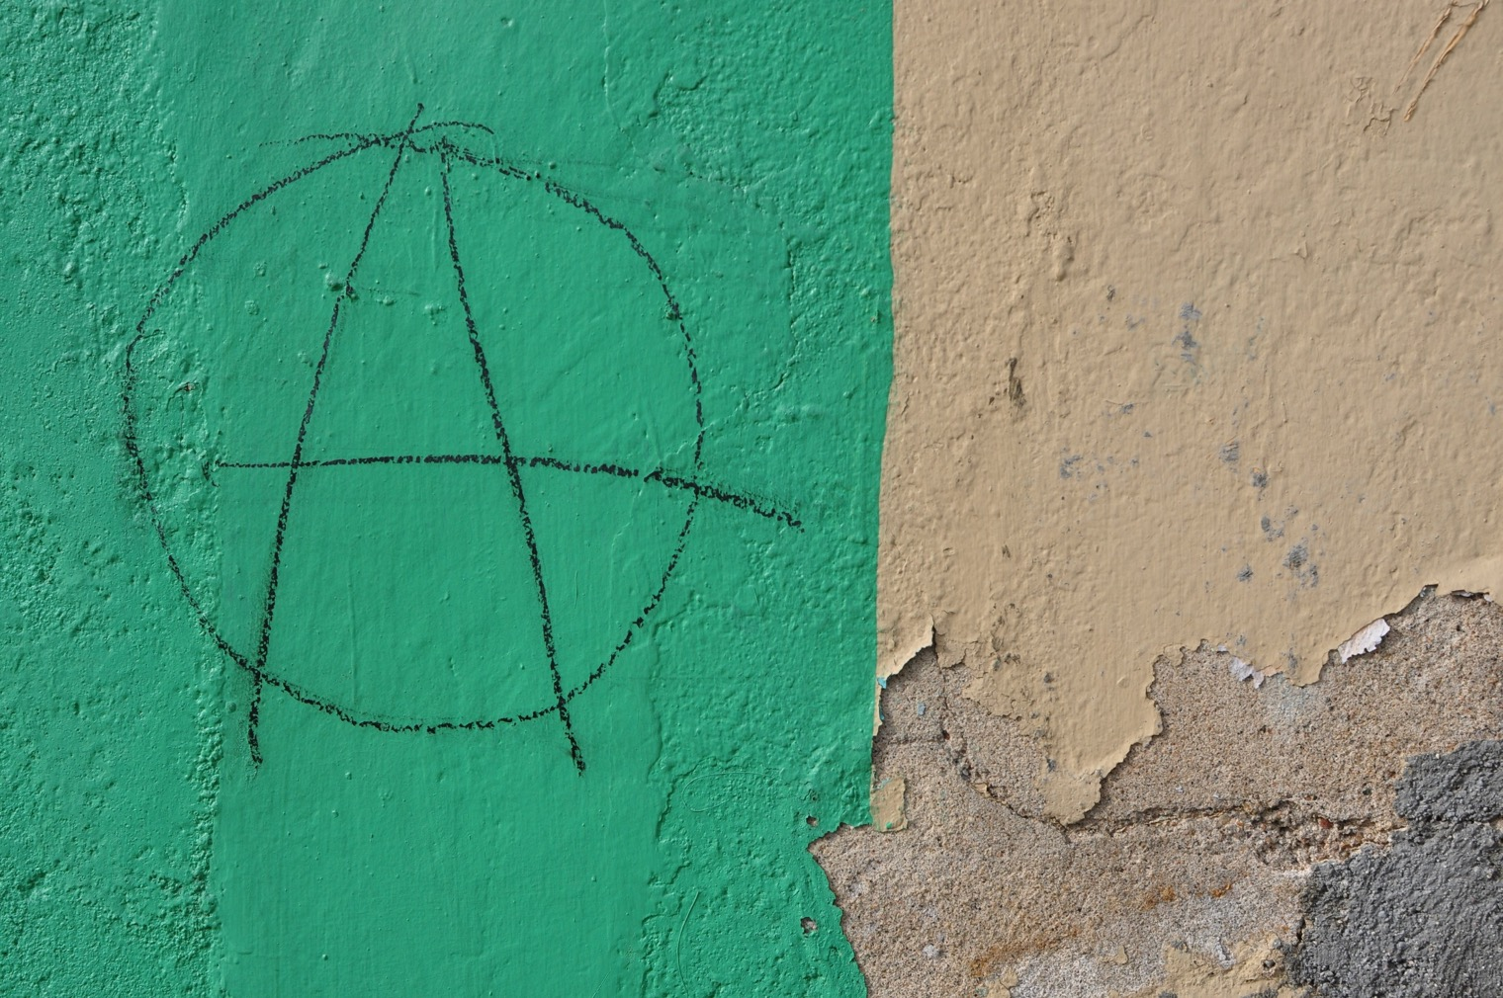
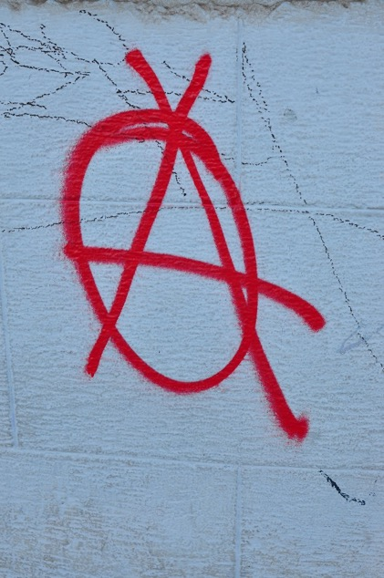
What does this symbol represent?

Slide 19
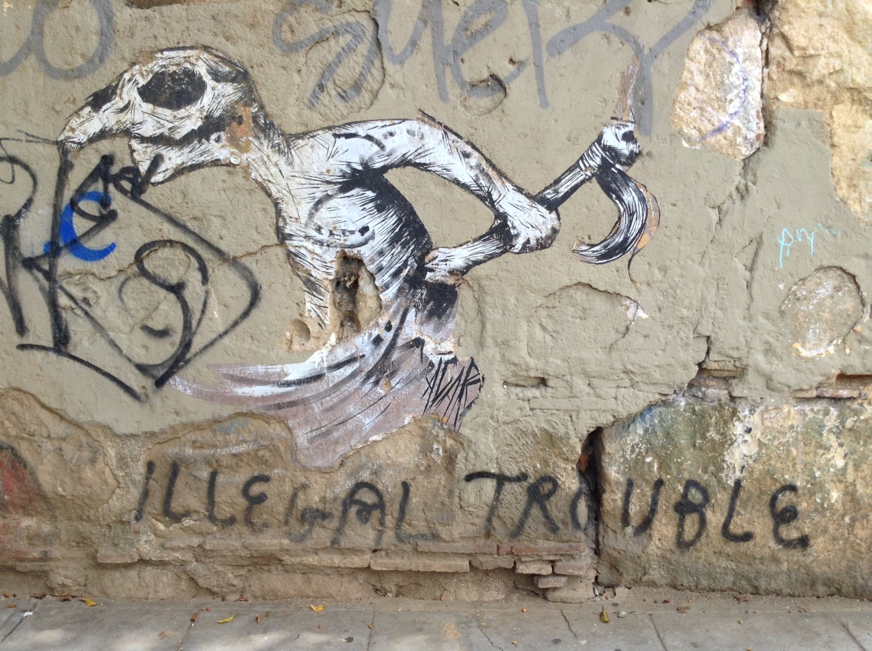

Slide 20
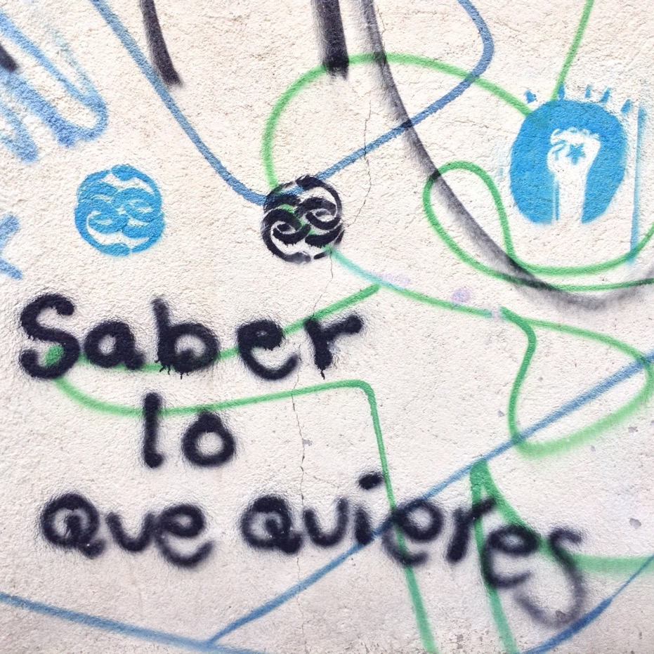
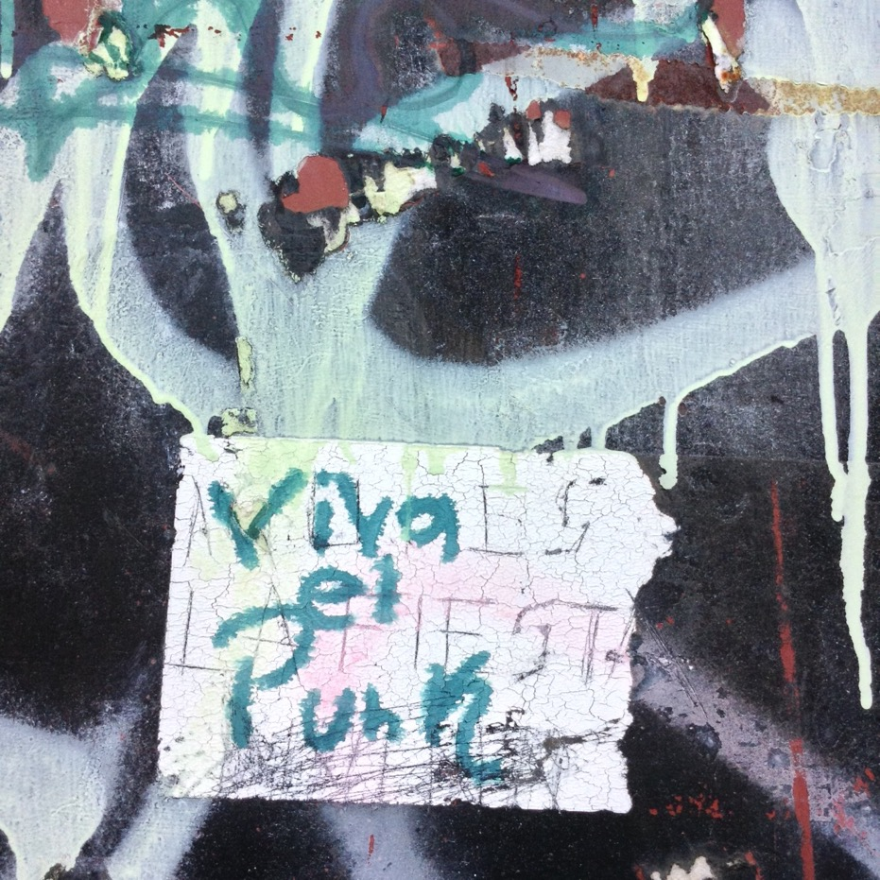
Know what you want
Long live punk

Slide 21
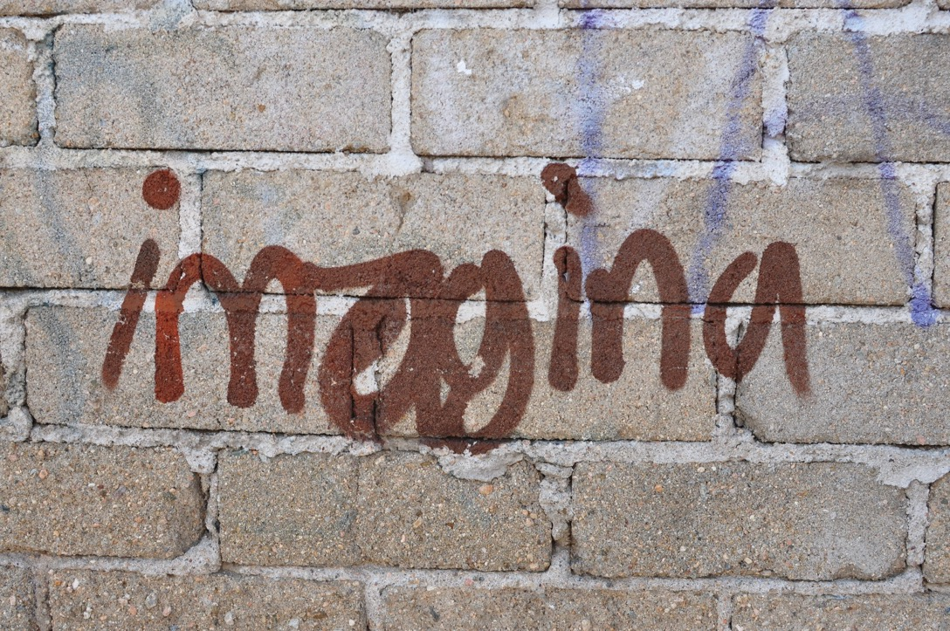
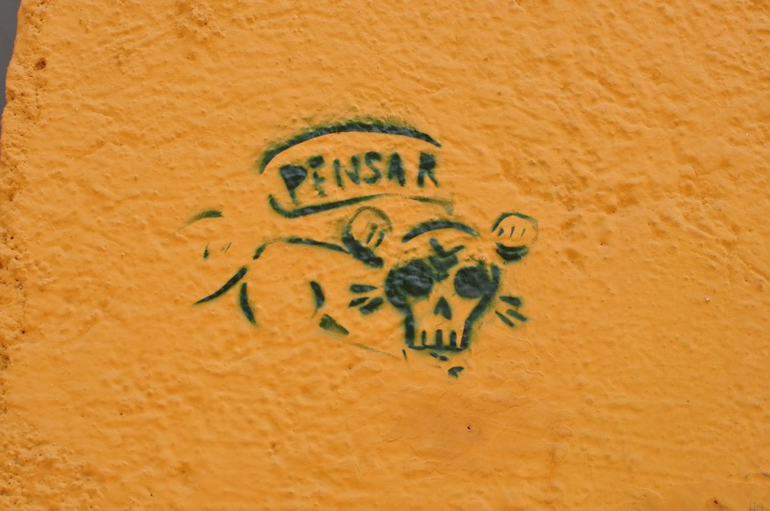
Think
Imagine

Slide 22
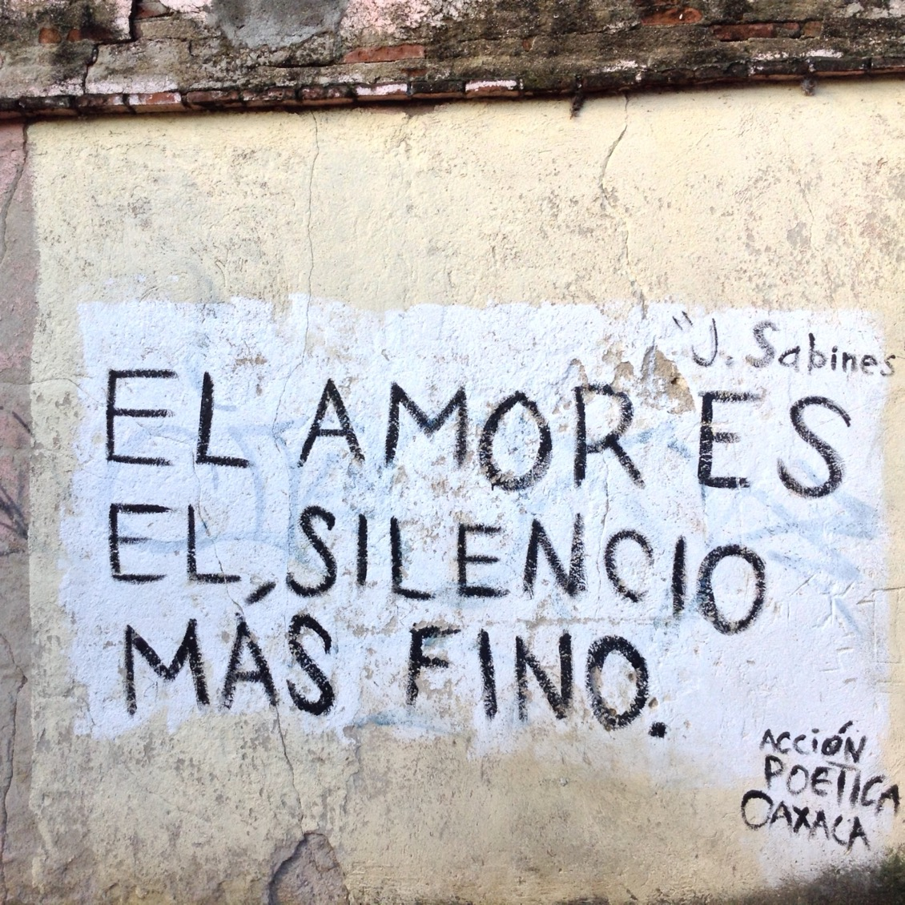
Love is the finest silence

Slide 23
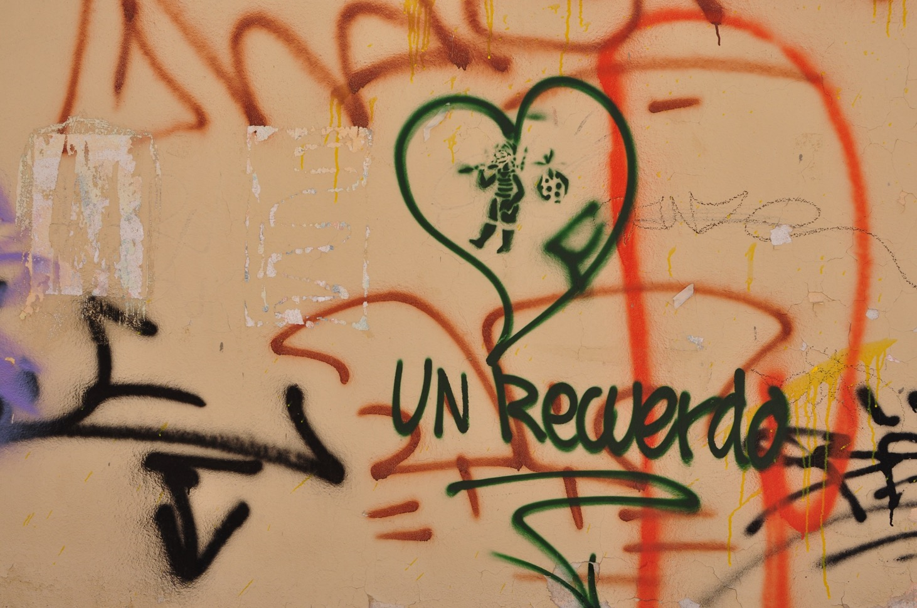
A memory

Slide 24
A Creative Blend of Old and New
There are some amazing murals and street art that mix aspects of old Mexico with those of new Mexico.

Slide 25
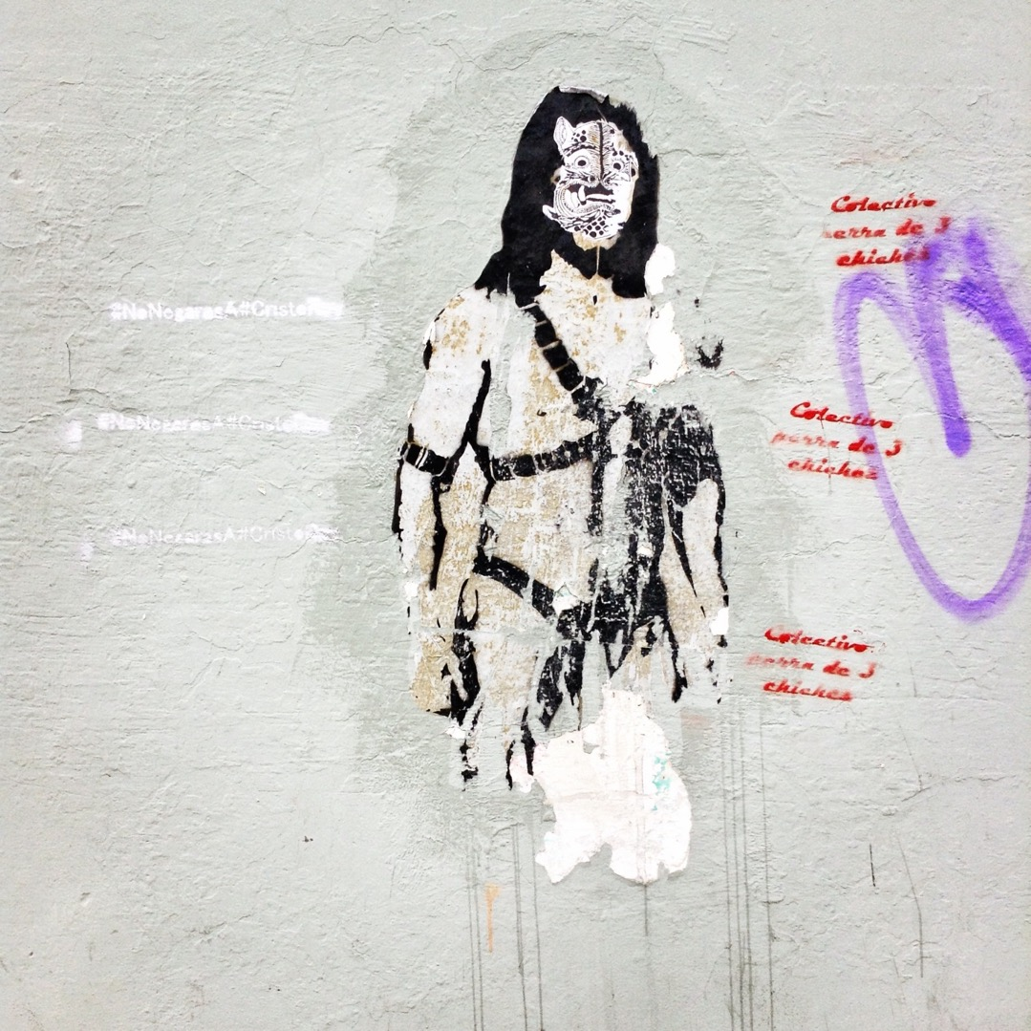
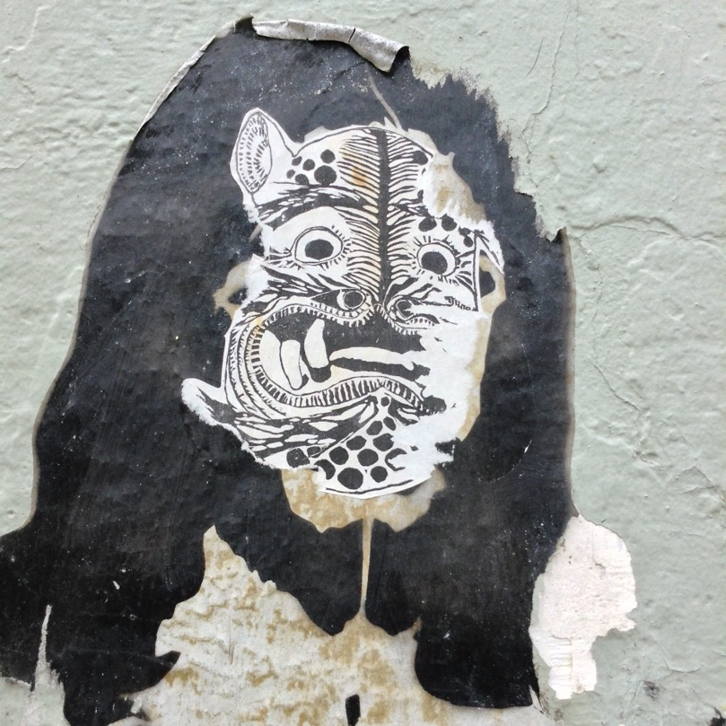

Slide 26
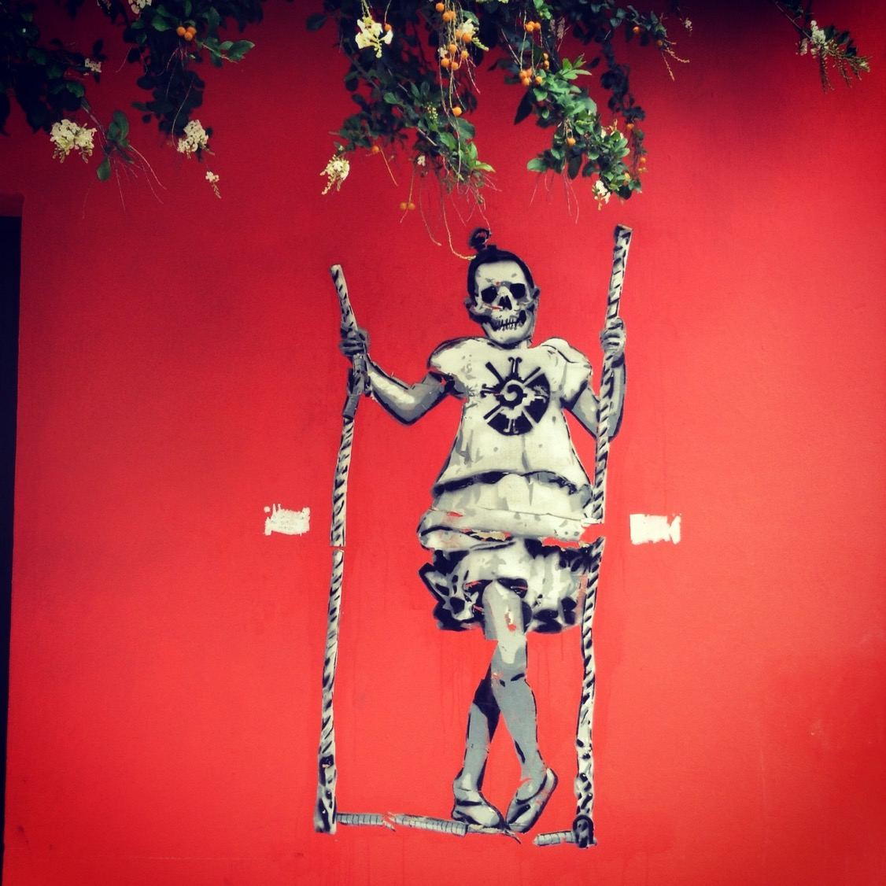

Slide 27
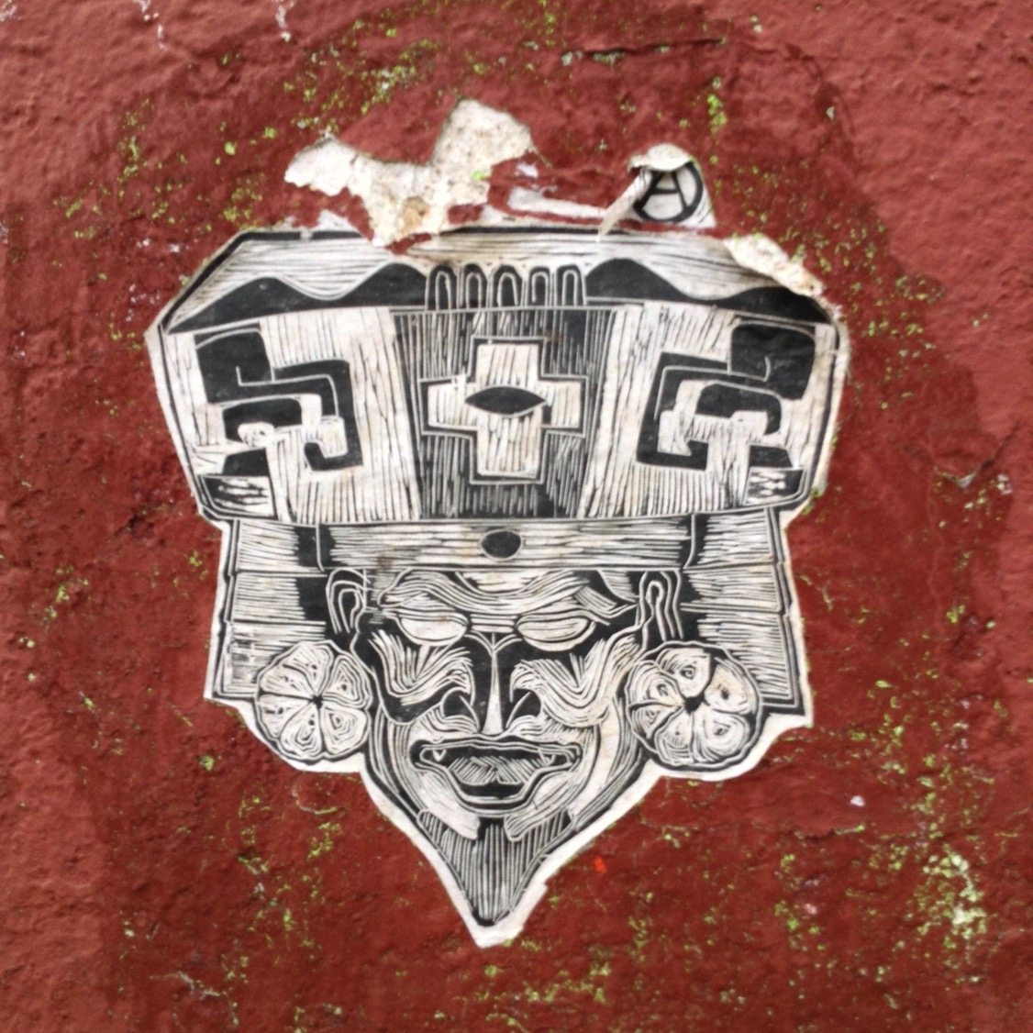

Slide 28
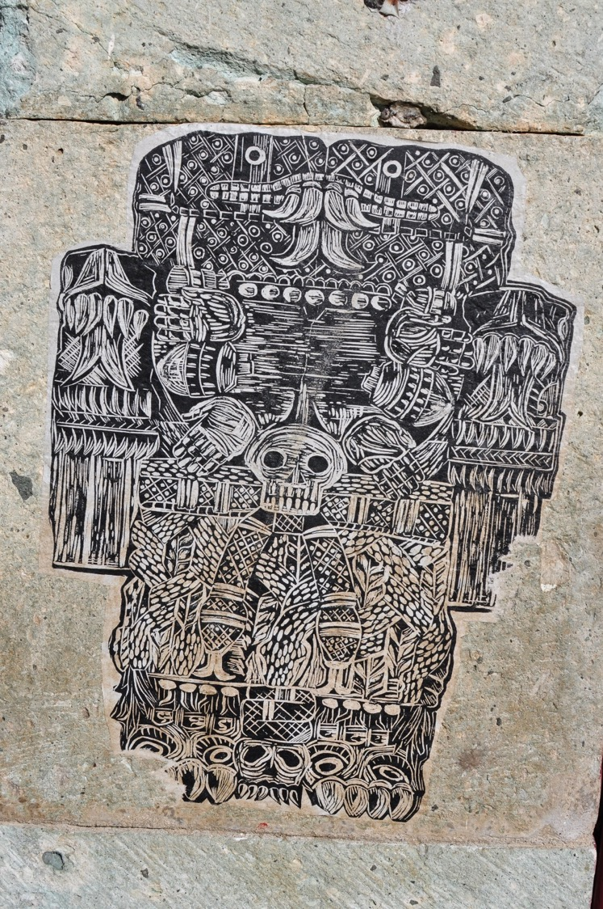

Slide 29
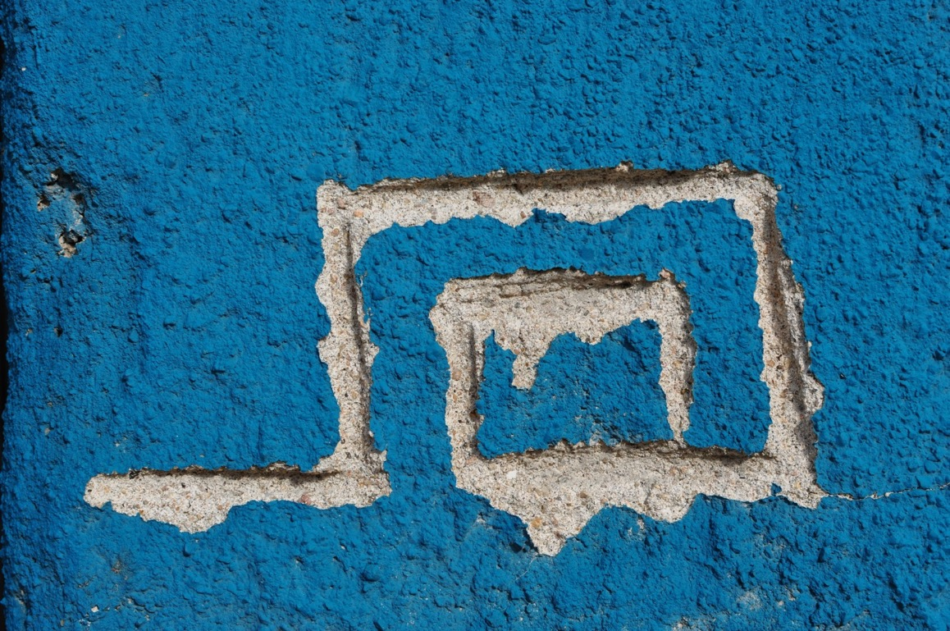
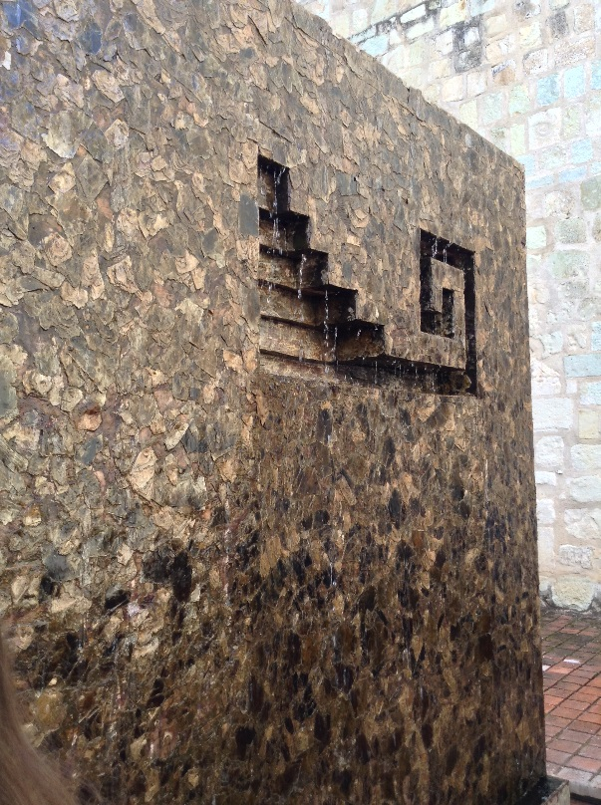
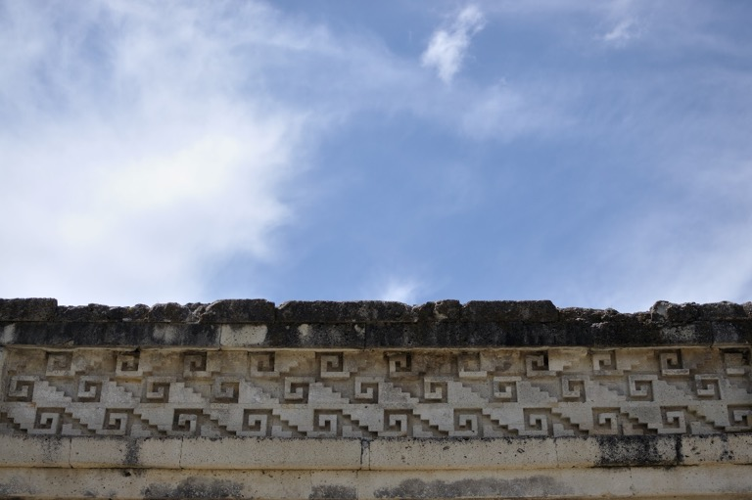
Mitla

Slide 30
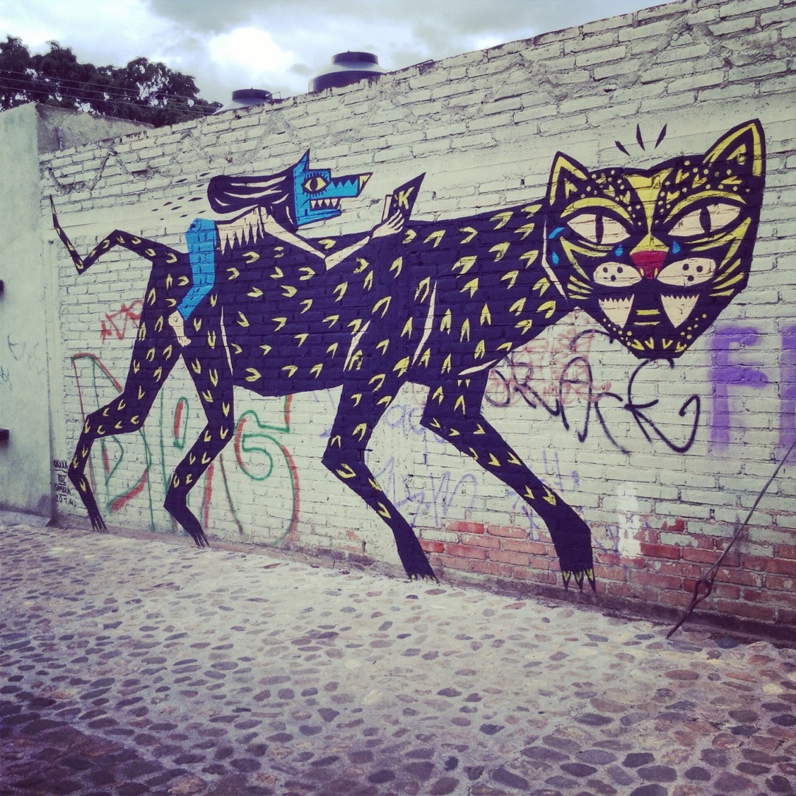

Slide 31
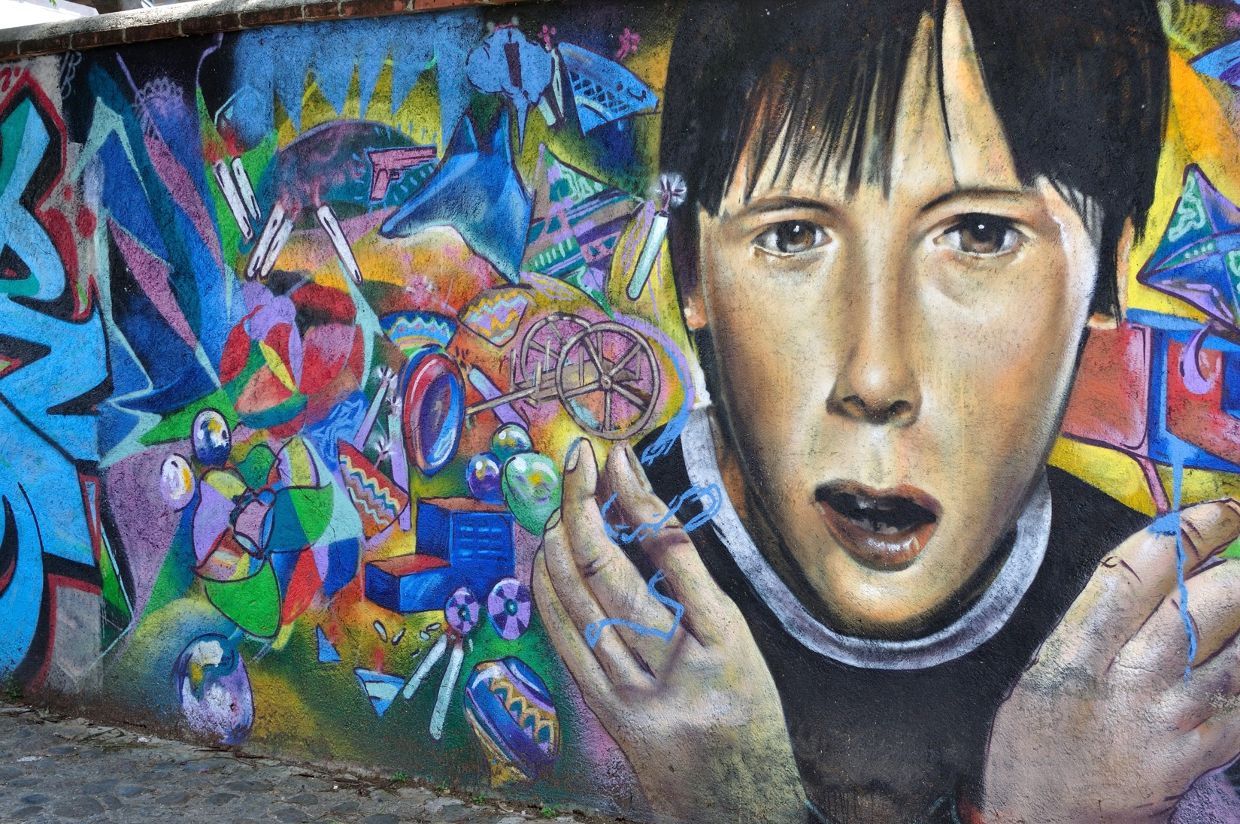

Slide 32
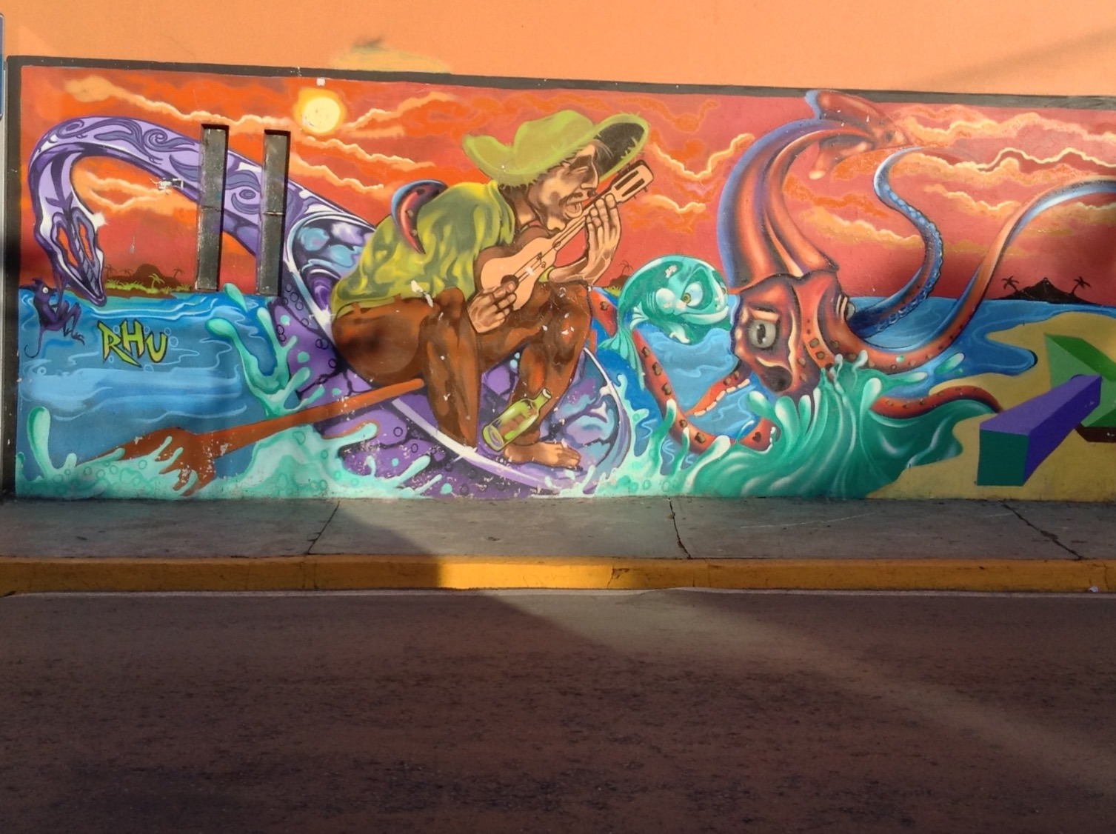

Slide 33
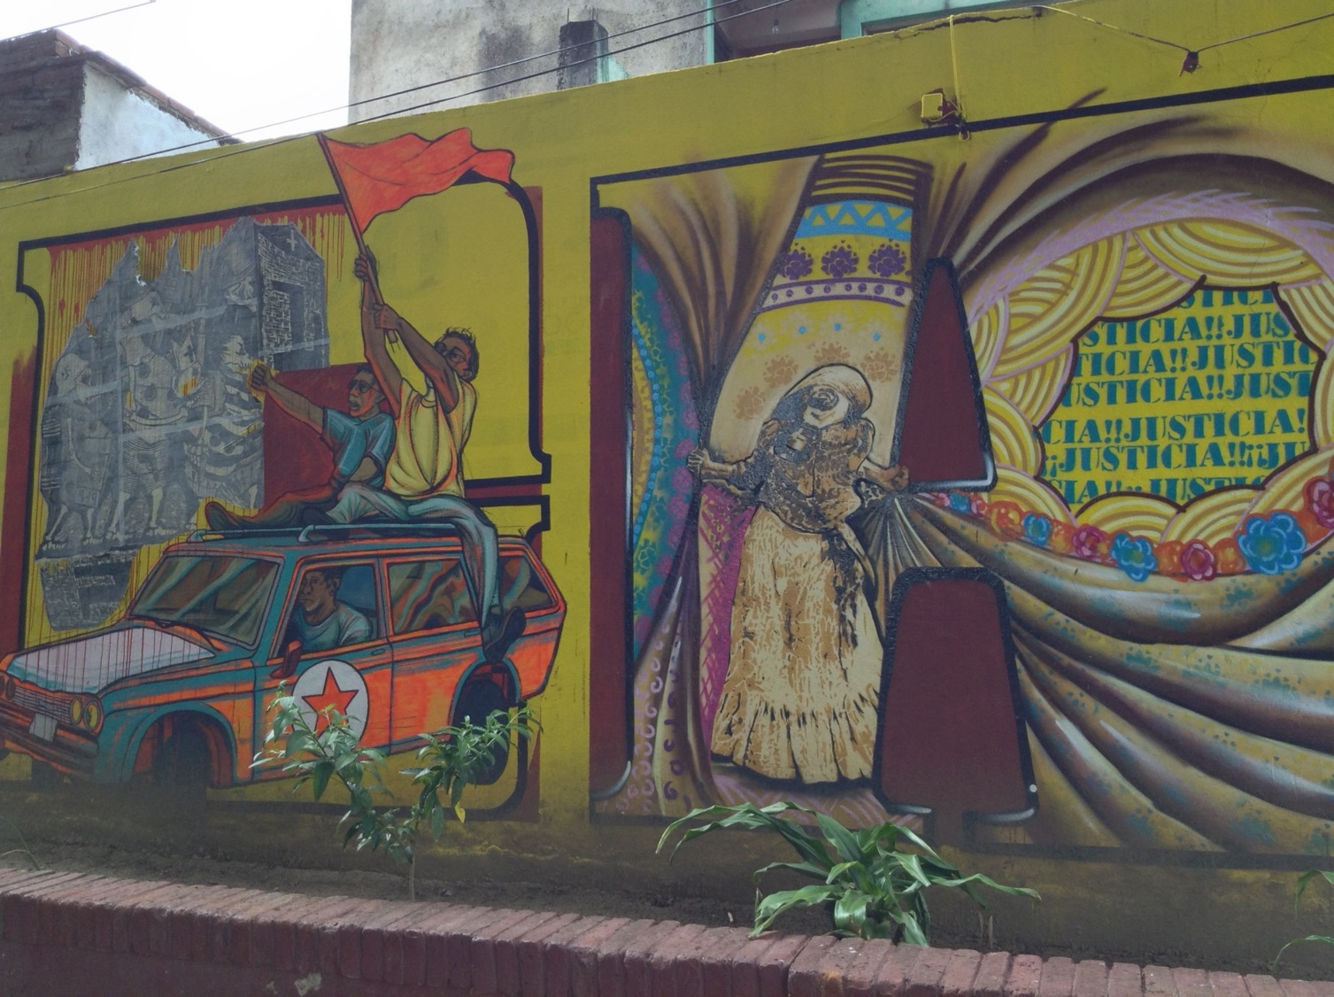

Slide 34
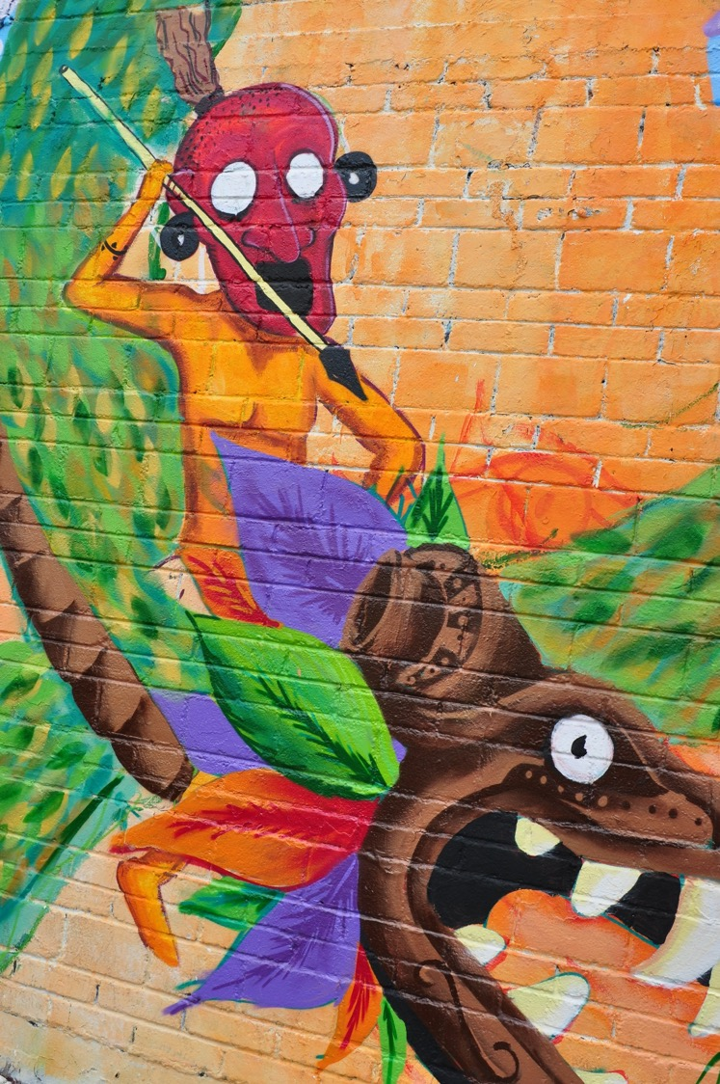

Slide 35
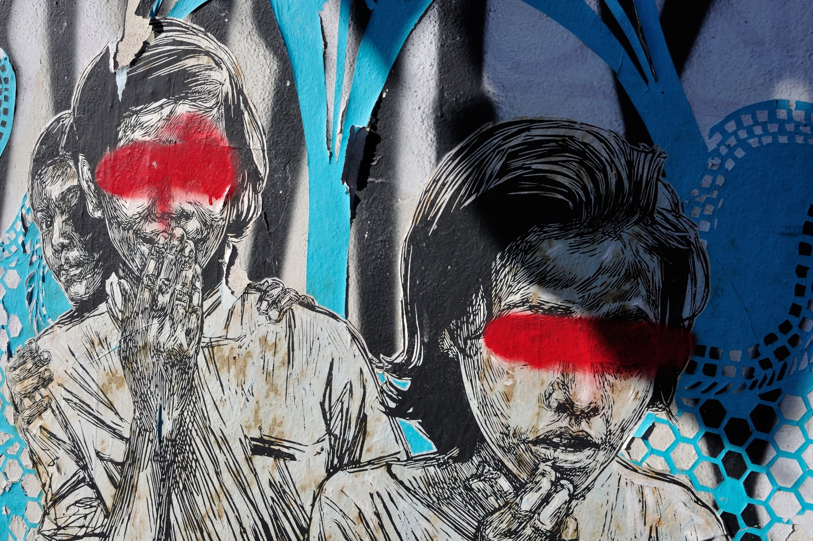

Slide 36
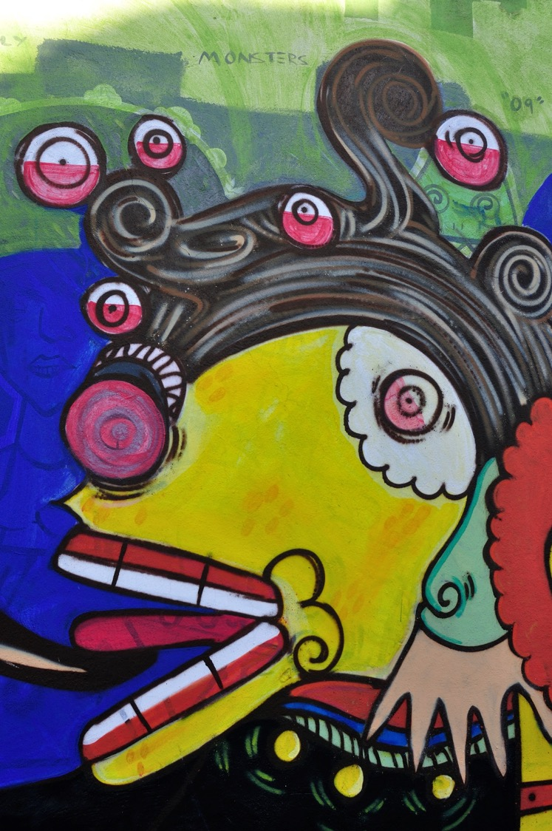
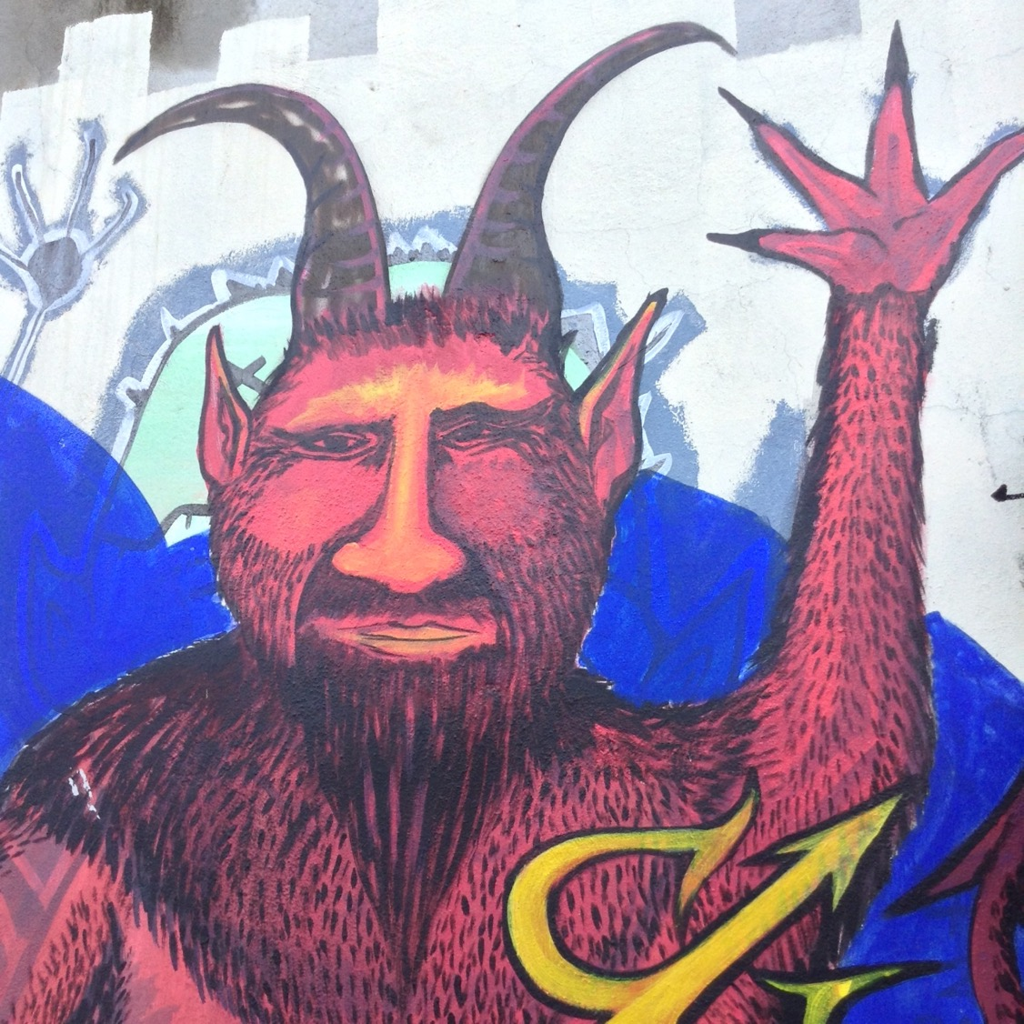

Slide 37
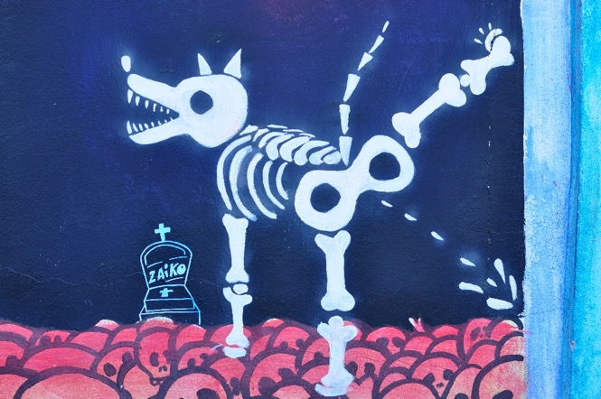
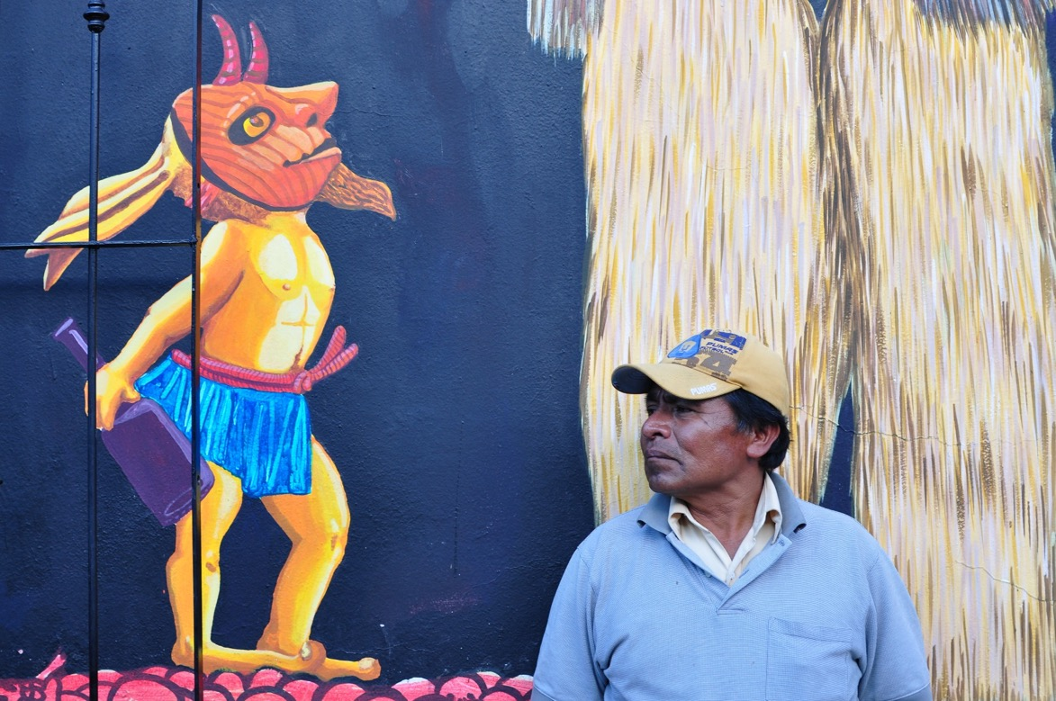

Slide 38
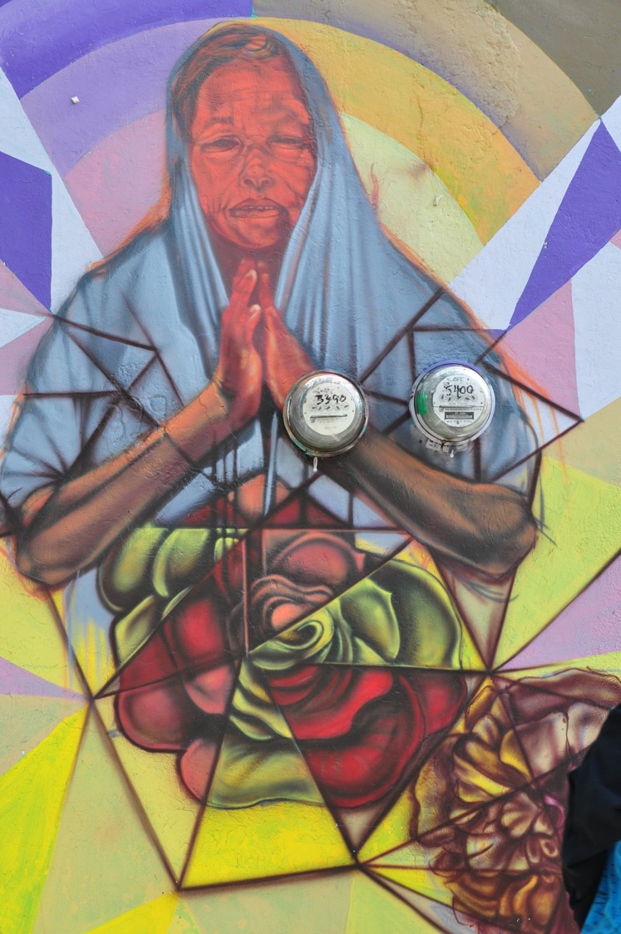

Slide 39
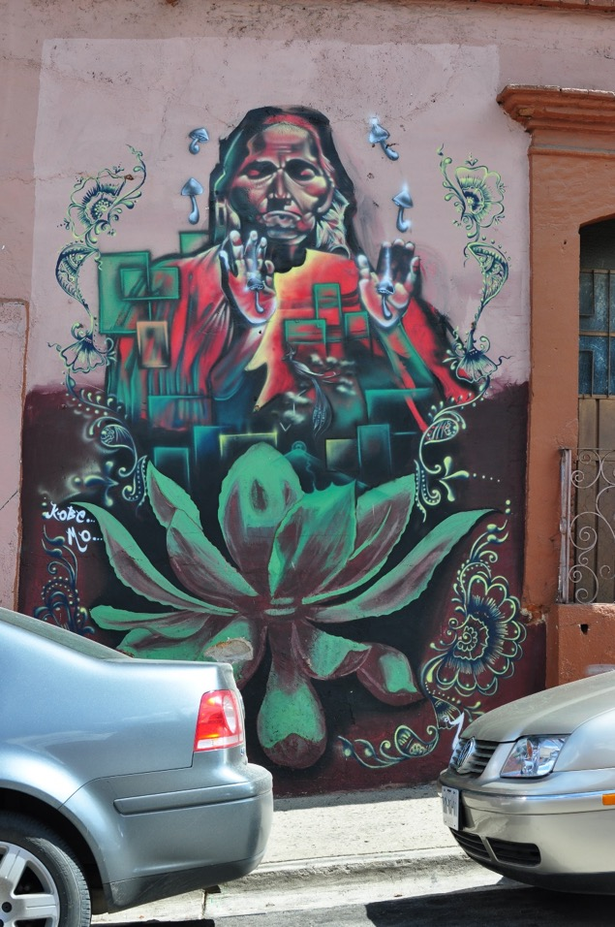
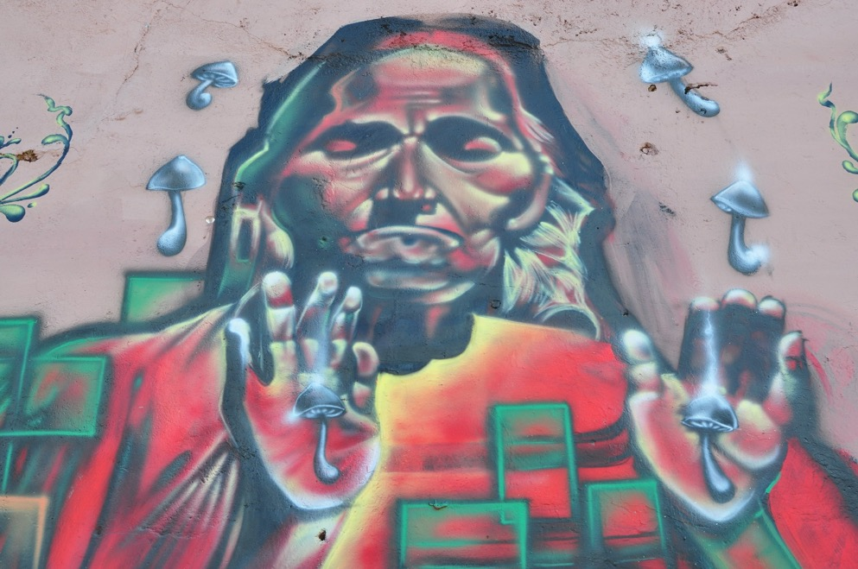

Slide 40
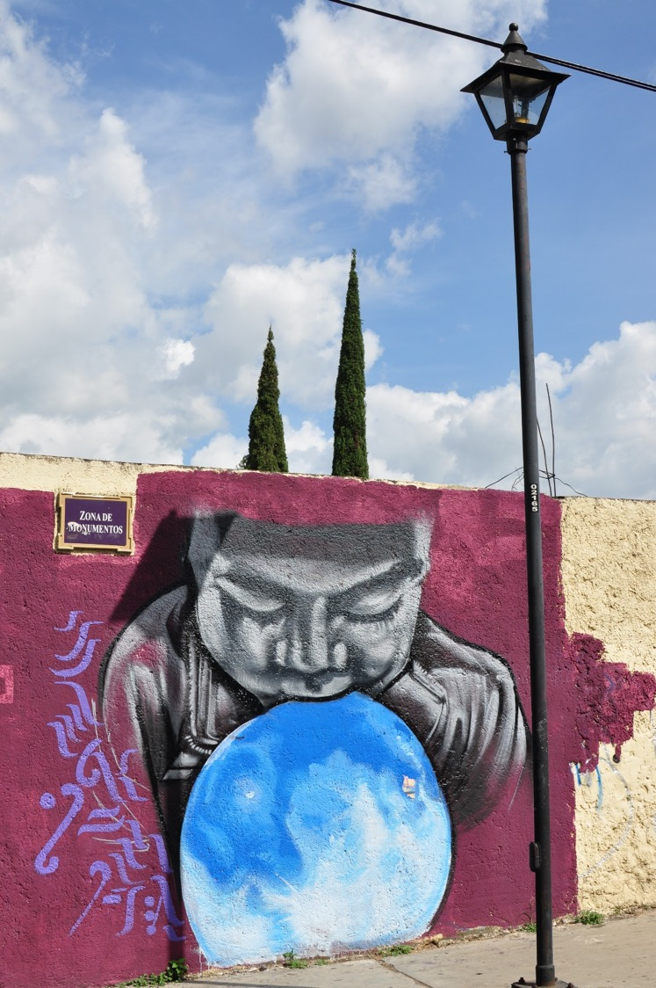

Slide 41
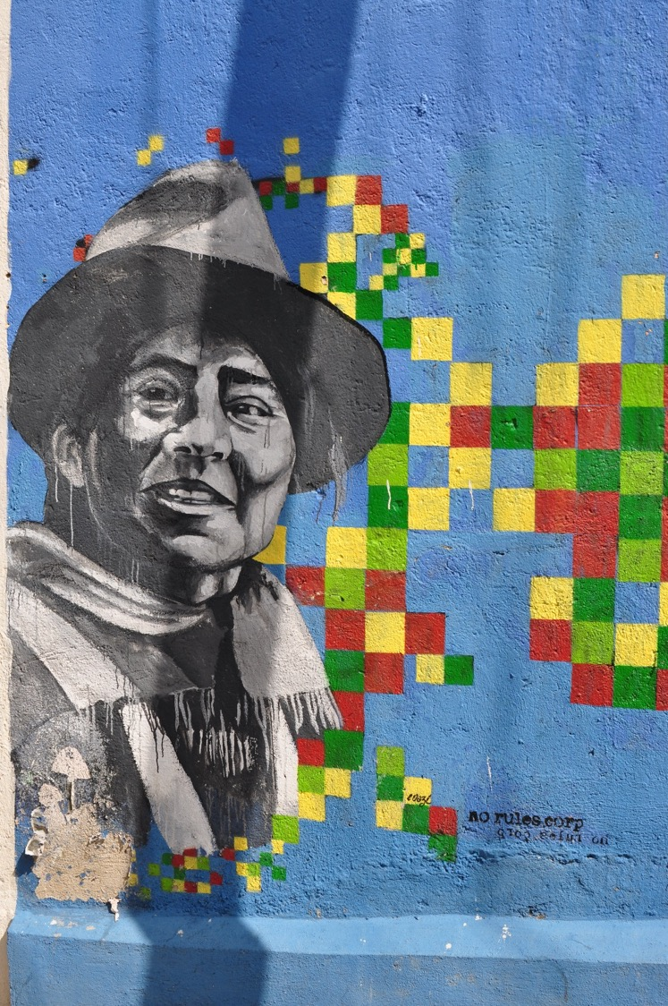
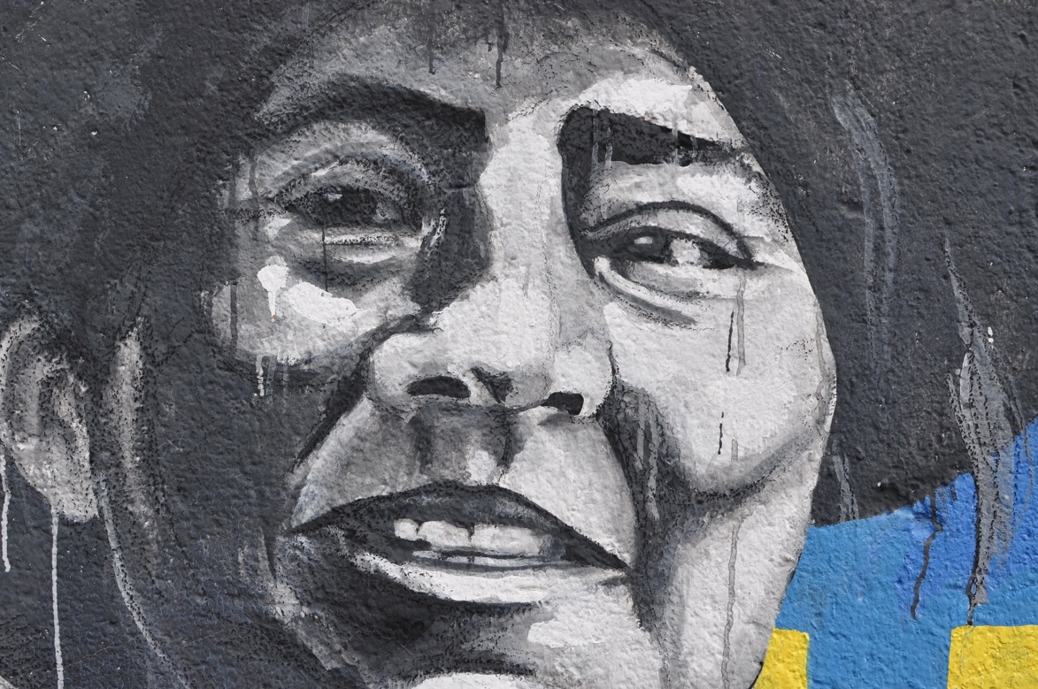

Slide 42
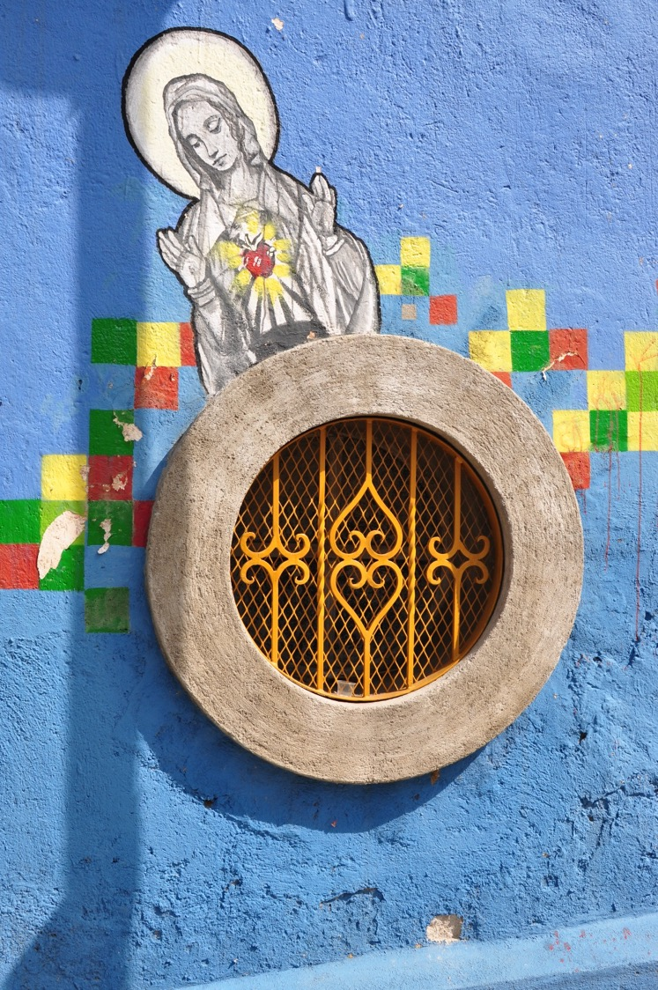
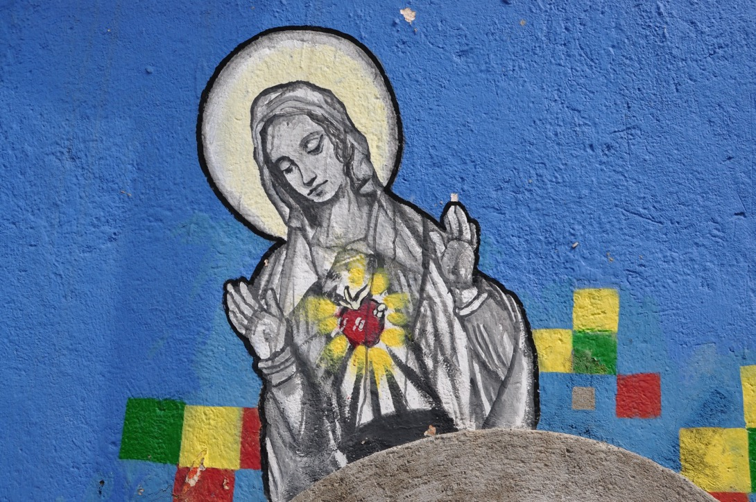
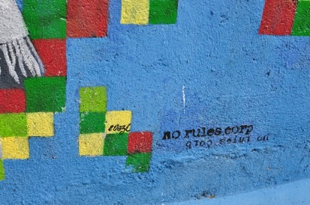

Slide 43
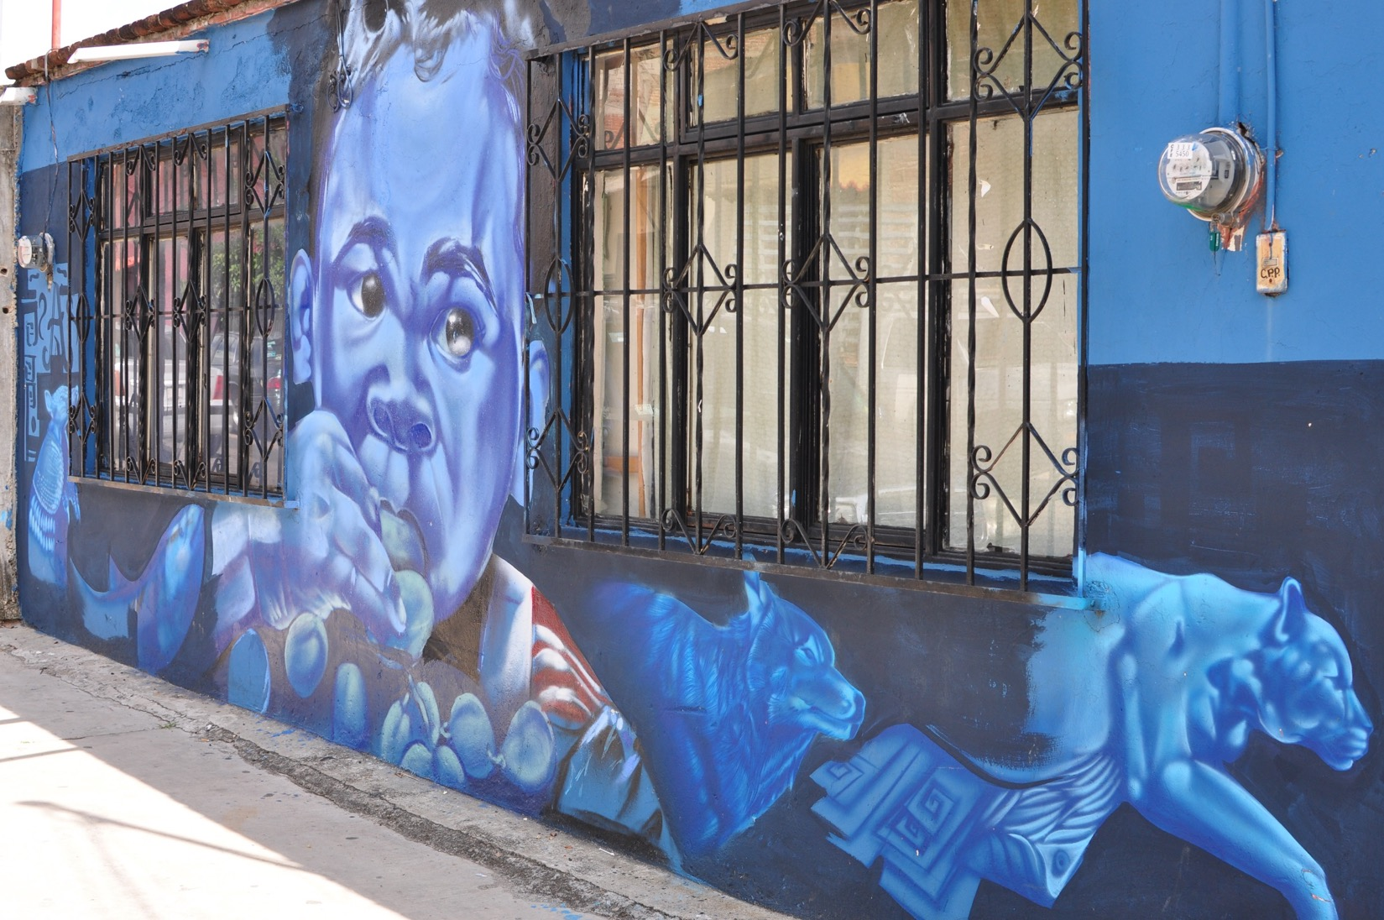

Slide 44
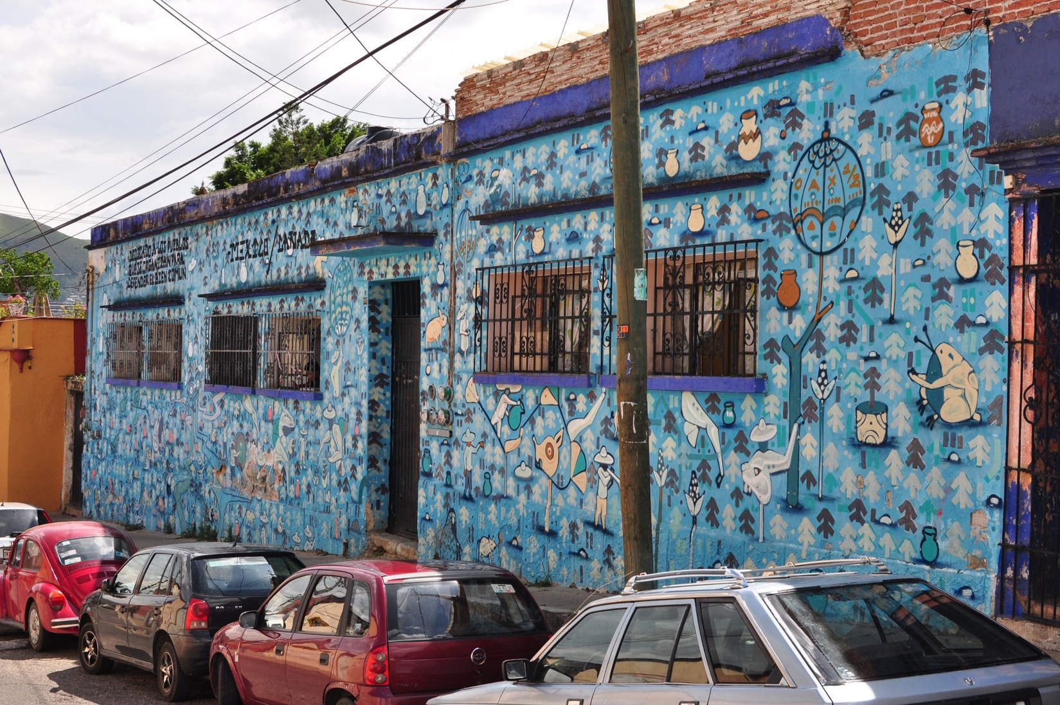

Slide 45
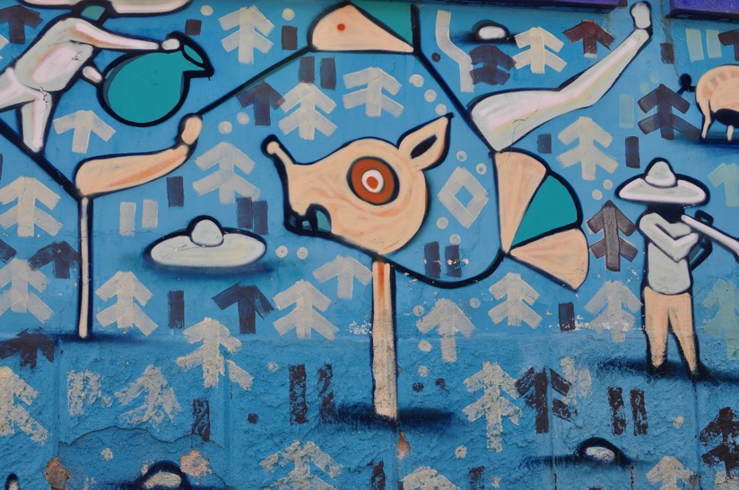
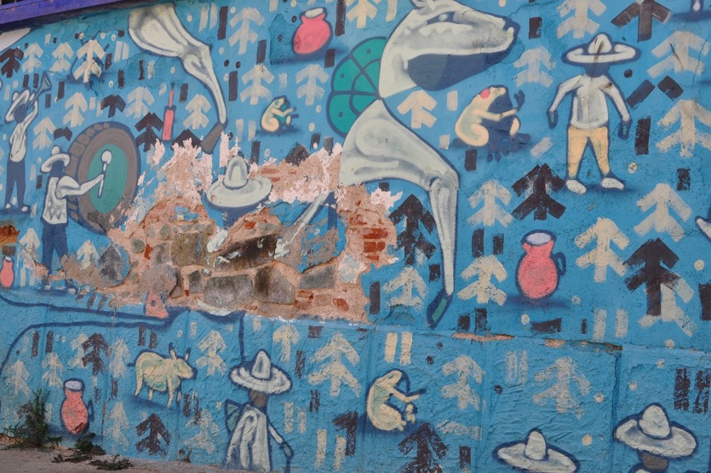

Slide 59
This man is cleaning the walls.

Slide 60
http://www.graffiti.org/faq/spigelman_graffiti.html
Symbolic Subversion and the Writing on the Wall
http://www.graffiti.org/faq/graffiti-is-part-of-us.html#Graffiti_as_Art_Public_Perception_and_Consumption
Cement or Canvas: Aerosol Art & the Changing Face of Graffiti in the 21st Century
Anthropology Honors Thesis, 2001 © Copyright 2001 Bradley J.
http://www.amazon.com/Protest-Graffiti-Mexico-Louis-Nevaer/dp/0979966647/ref=pd_cp_b_0
A link to purchase the book Protest Graffiti Mexico: Oaxaca

Slide 61
http://www.pbs.org/itvs/storm-that-swept-mexico/
A video about the Mexican Revolution. Biographies about Zapata, Cardenas, Porfirio Diaz, and the other faces of the revolution.
http://www.notablebiographies.com/Ca-Ch/C-rdenas-L-zaro.html
A short biography of Lazaro Cardenas
http://www.biography.com/people/emiliano-zapata-9540356#synopsis
A comprehensive biography of Emiliano Zapata
http://web.eecs.utk.edu/~miturria/project/zapata.html
Informative examination of Zapata and his ideology and his involvement in the Mexican Revolution

Slide 62
http://faceofoaxaca.uoregon.edu/timeline/
Excellent resource by Lynn Stephen about
the teacher’s movement with videos and
timelines
http://secure.pmpress.org/index.php?l=product_detail&p=47
A link to purchase the book Teaching Rebellion: Stories from the Grassroots Mobilization in Oaxaca

Slide 63
http://www.amazon.com/Design-Motifs-Ancient-Pictorial-Archive/dp/0486200841/ref=pd_sim_b_5?ie=UTF8&refRID=0E4NPPR2A74Y2JH6ND8A
A link to purchase the book Design Motifs of Ancient Mexico
This would be helpful so the students can identify some design motifs in the street art
http://www.amazon.com/Designs-Pre-Columbian-Mexico-Pictorial-Archive/dp/0486227944/ref=pd_sim_b_2?ie=UTF8&refRID=0G9RYHA3CW42A4PHBKVT
A link to purchase the book Designs From Pre-Columbian Mexico
This would be helpful so the students can identify some design motifs in the street art

Slide 64
All photographs copyright Marina Outwater 2014

