Slide 1
Day 1: What is culture?
Possible definitions?
Notes:
Break students into groups of 4-6. Give up to five minutes for the group to come up with a definition of “culture”. At the end of the five minutes, have students read out their definitions. Discuss--be sure to keep all student comments positive. Work on coming up with a usable definition, but be aware that it may not be complete yet. The class will have the chance to rework the definition.

Slide 2
What are the elements of culture?
Come up with at least 5
Notes:
Continue in groups. Give up to five minutes for the group to come up with a list of the elements of culture. There should be a minimum of five elements. At the end of the five minutes have students share their lists. Discuss--be sure to keep all student comments positive. Be sure to transfer a finished list to wall post so students can have access to it for research project. Teacher: note the elements being listed- are there biotic components present in the list?

Slide 3
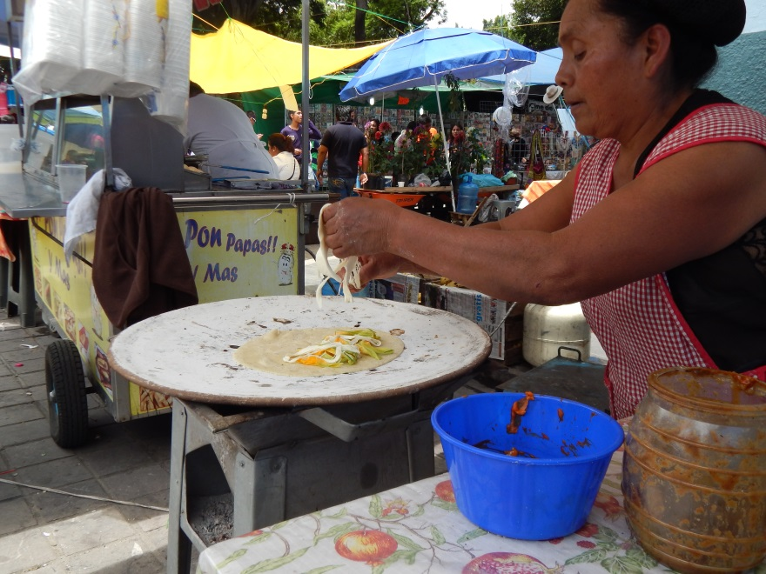
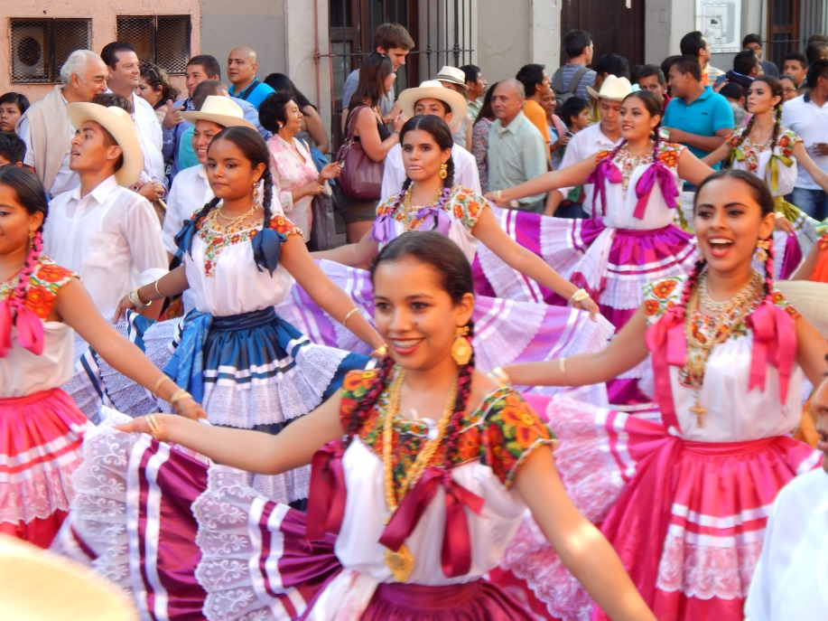
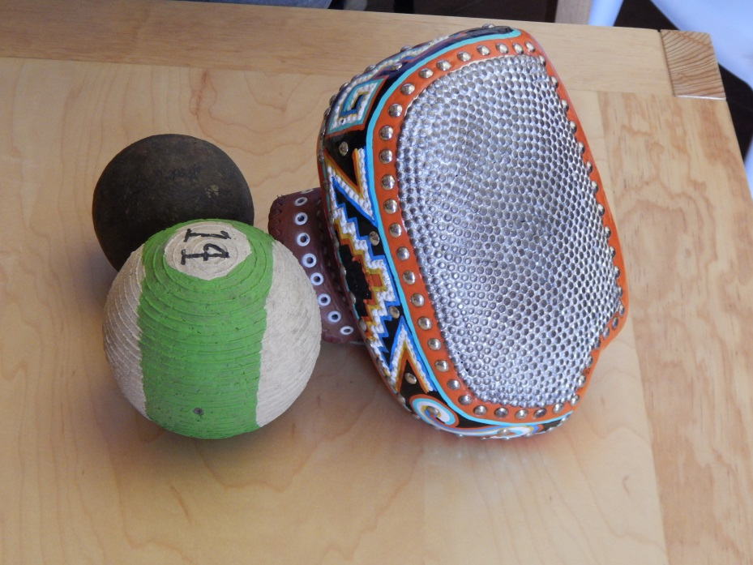
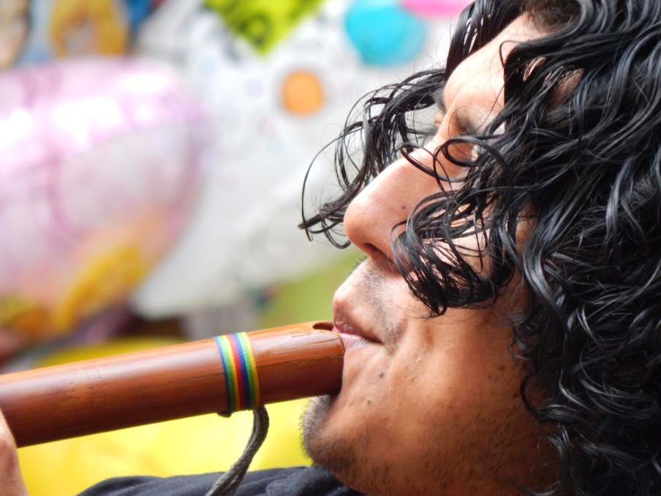
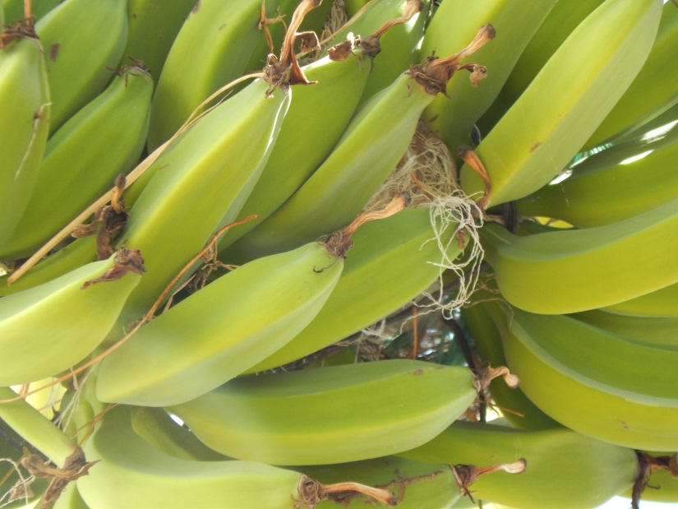
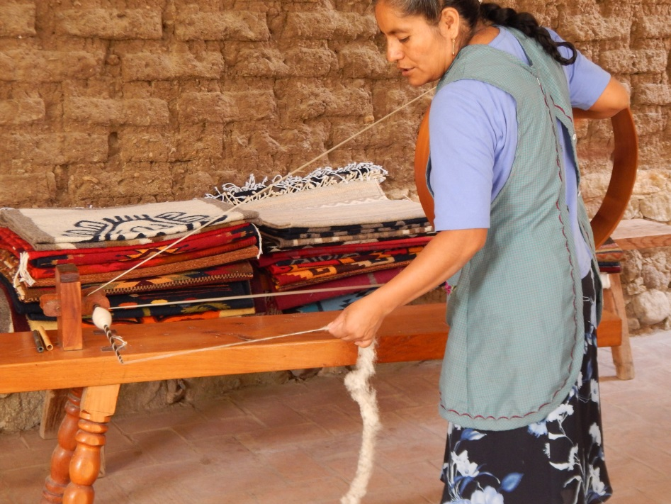
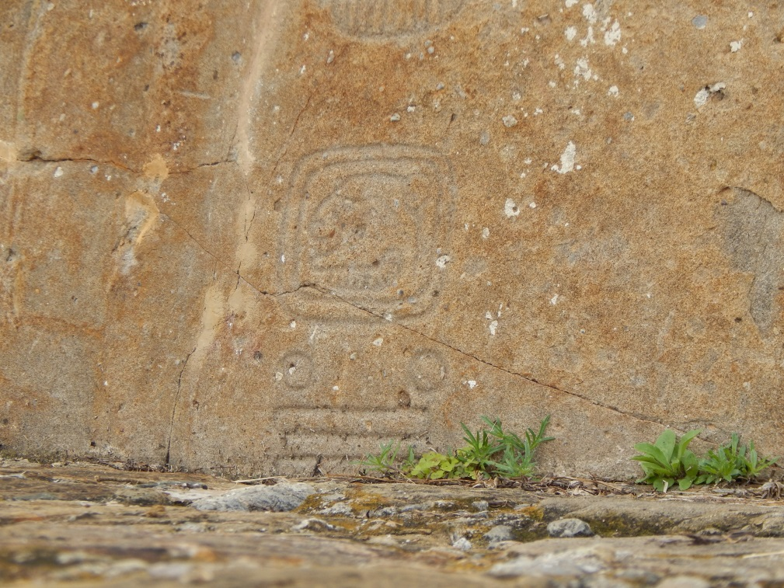
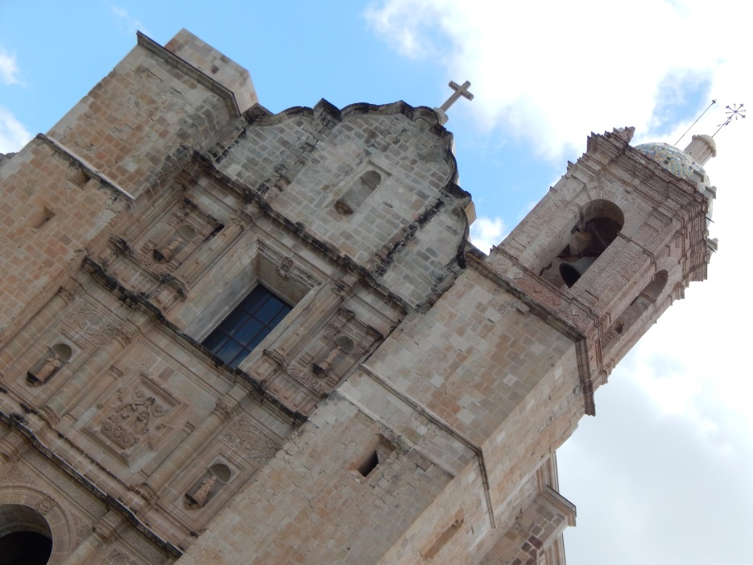
Notes:
These pictures are only meant to be seen as examples--allow students to ask questions and explore but try not to lead them to answers.

Slide 4
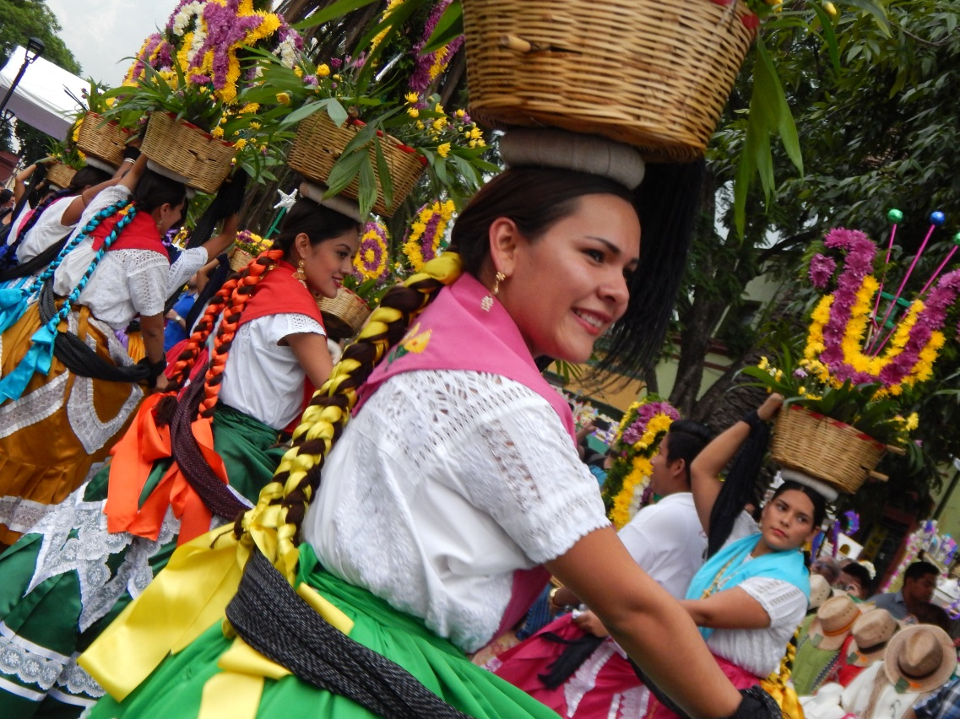
The organization of culture
Where does it come from?
How is it passed down/continued over generations?
Notes:
Collect ideas, stir conversation. The point of this discussion is to allow students to recognize that cultural influences are all around them.

Slide 5
7 Elements of Culture
Social Organization
Customs and Traditions
Language
Arts & Literature
Religion
Forms of Government
Economic Systems

Slide 6
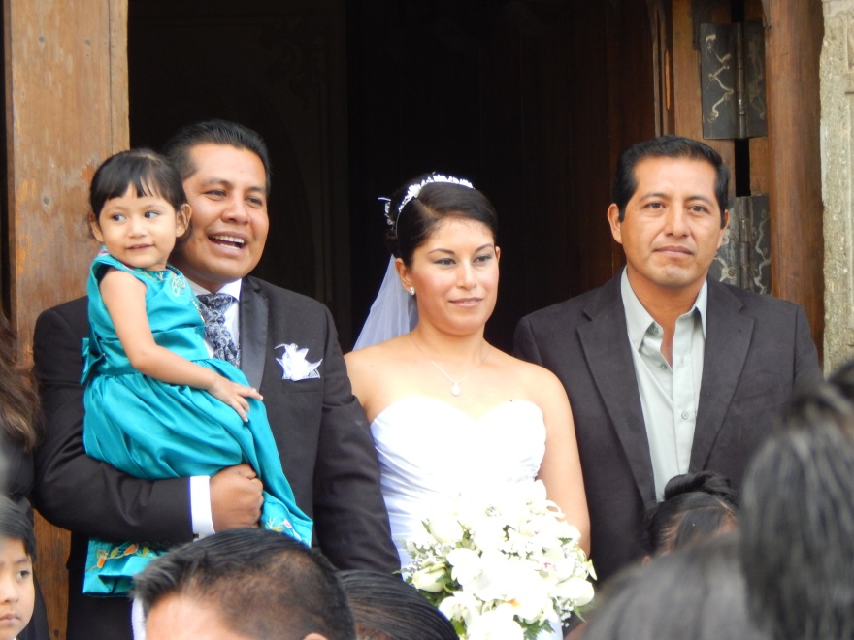
Social organization
Creates social structure by organizing into small units to meet basic needs of the people
For cultural development, family is the most important social unit
Family patterns
Nuclear
Extended
Patriarchal
Matriarchal
Other patterns
Kinship
Clan
Social classes
Social mobility
Notes:
Family patterns
Nuclear family- wife, husband, kids; typically found industrialized societies
Extended family- Several generations in one household. Parents, kids, grandparents, aunts, uncles. Usually in developing nations.
Patriarchal- family where the oldest male makes the decisions
Matriarchal- family where the oldest female makes all the decisions
Kinship= concept that everyone is related to someone; specific rules exist (i.e. uncles can’t marry nieces)
Clan= people within an ethnic group who claim to be descended from a common ancestor
Social Classes= rank people according to status in society; can be based on financial, occupation, heredity, education grouping
Social mobility= chance to move up and down the social ladder

Slide 7
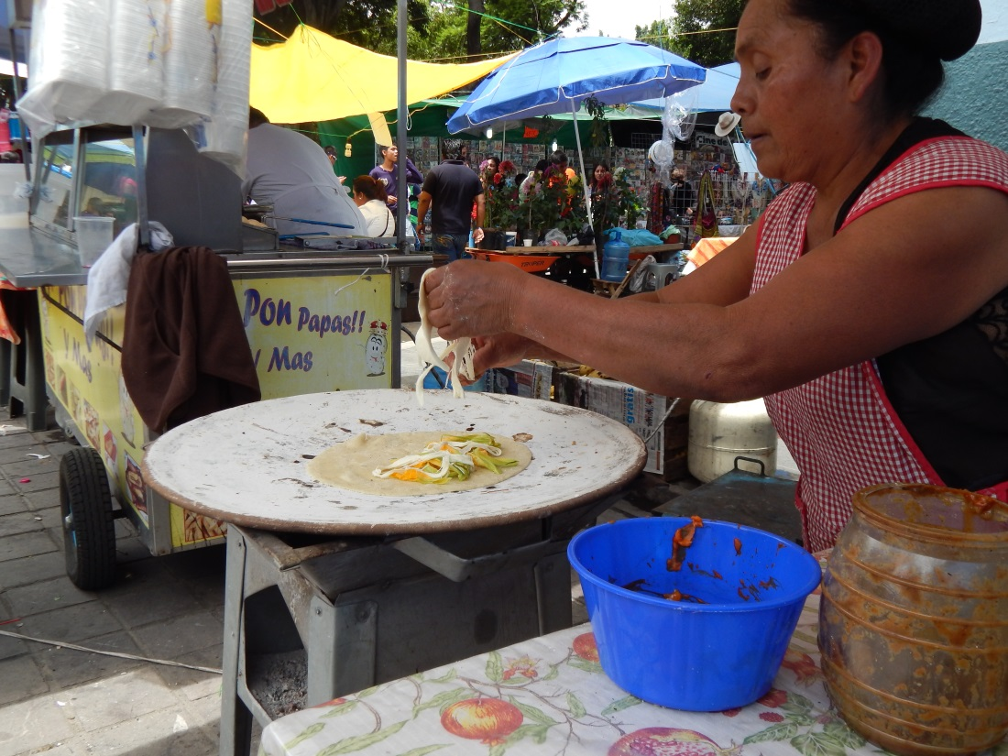
Customs & traditions
Rules of behavior are enforced by social pressures or by written laws
Include:
- Basic moral values
- Language
- Clothes
- Foods
- Education
- Occupation
- Celebrations

Slide 8
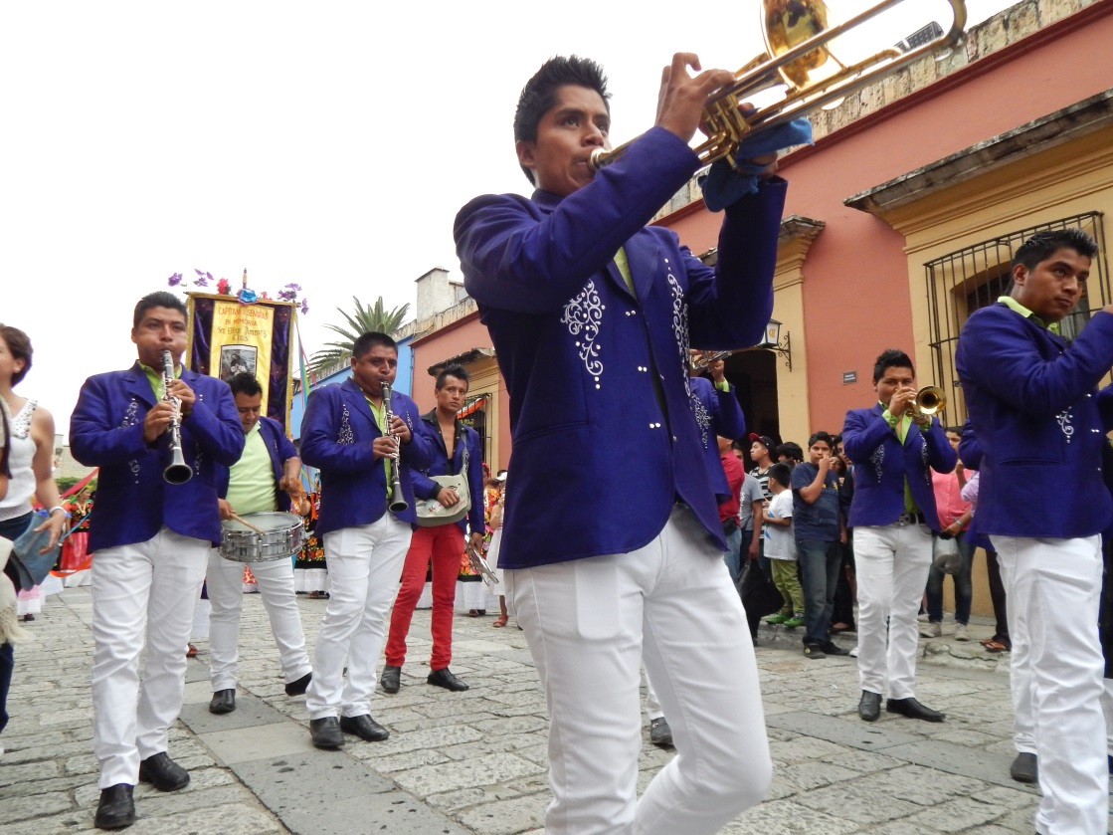
Arts & Literature
Products of human imagination that teach us about cultural values.
Includes:
Painting
Sculpture
Music
Drawing
Theatre
Literature
Architecture

Slide 9
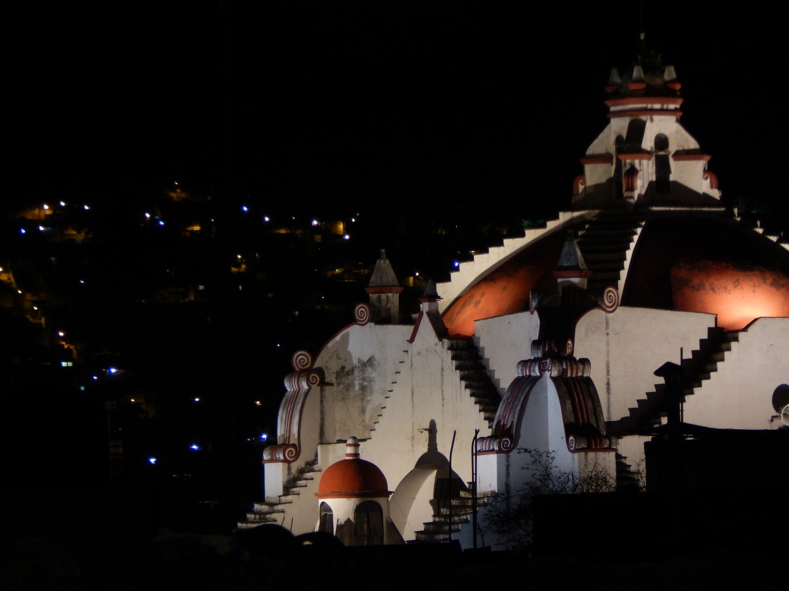
Religion
Helps people answer the basic questions about the meaning of life
Supports the values of a culture
Helps shape morals & ethics
Monotheism
Polytheism
Animism
Notes:
Monotheism- belief/worship of 1 god
Polytheism- belief/worship of more than 1 god
Animism- belief that everything in nature has a spirit

Slide 10
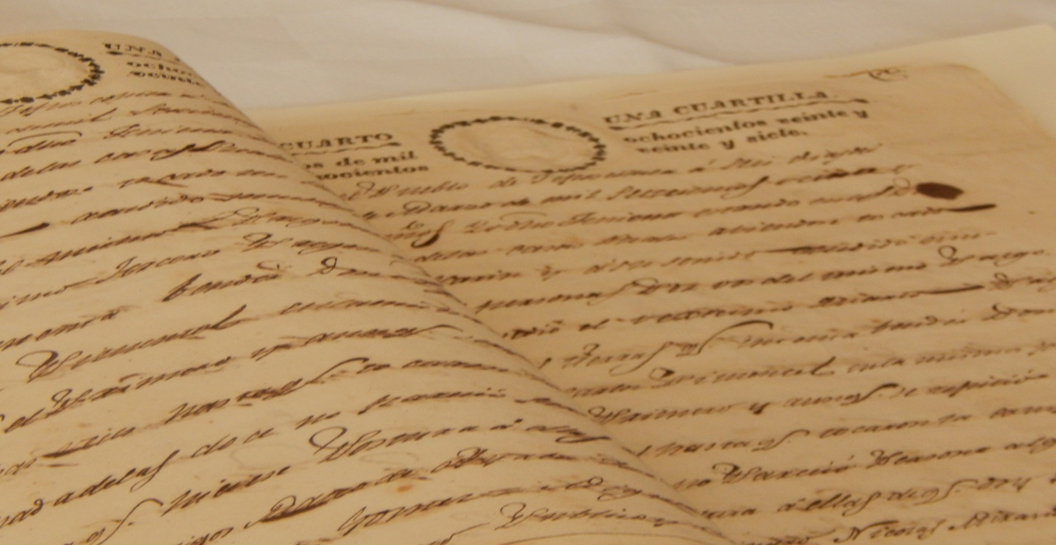
Language
Cornerstone of Culture
Culture is passed through language
All cultures must communicate
Language reflects a culture’s identity
Languages can have different dialects
Notes:
Remember- “language” does not mean “written word”
Different dialects can help show relatedness of cultural development

Slide 11
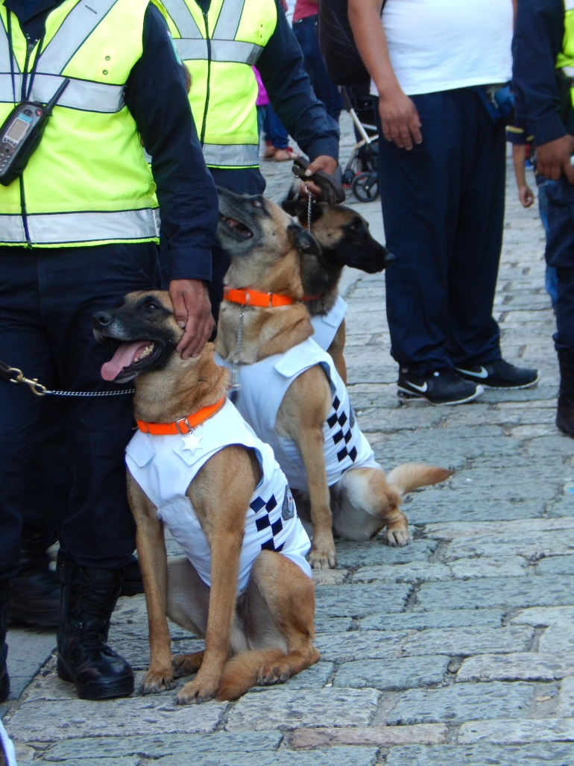
Forms of Government
Government is designed to provide for the common need
Keeping order in society & protecting it from outside threats
Types of Government include:
Democracy
Republic
Dictatorship
Monarchy
Aristocracy
Corporatocracy
Notes:
Democracy- the ppl have supreme pwr. Gov’t acts by & w/ their consent
Republic- ppl choose the leaders who will represent them
Dictatorship- a ruler (or grp acting as 1) holds pwr by force. Often uses military to stay in office.

Slide 12
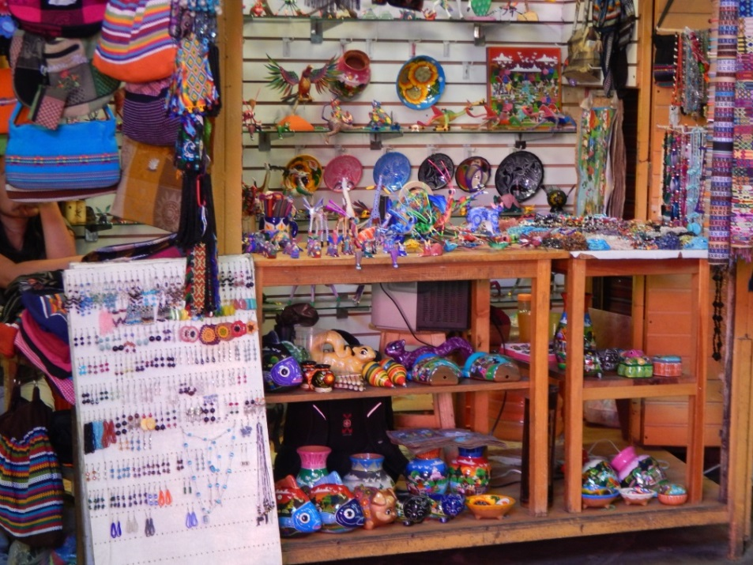
Economic Systems
How people use limited resources to satisfy their wants & needs
Three questions:
What goods & services should we produce?
How should we produce them?
For whom should we produce them?
Common Forms
Traditional economy
Market economy
Command economy
Mixed economy
Notes:
Traditional economy- people produce most of what they need to survive. Hunting/gathering or farming/herding societies.
Market economy- individuals answer the economic questions by buying & selling goods & services
Command economy- government controls what goods are produced, how they are produced & what they cost. Individuals have little economic power
Mixed economy- individuals make some decisions & government makes others

Slide 13
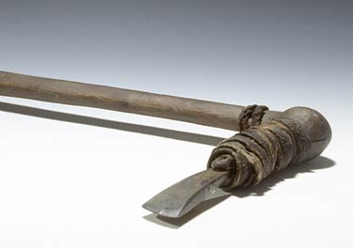
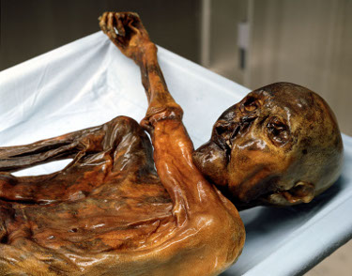
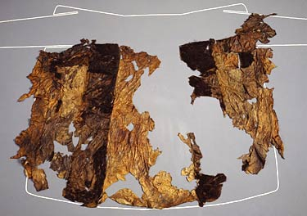
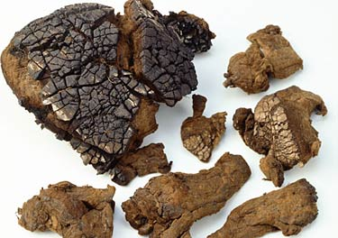
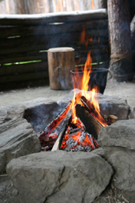
Day 2: Otzi and Culture

Slide 14
Our goal today is to examine pieces
of evidence and make inferences from them.
In other words, we’ll look at some of what we know about Otzi by what was found to determine something about his culture at the time of his death.

Slide 15
Introduction
Otzi is a well-preserved natural mummy of a Copper Age man from about 3300 BC.
On September 19, 1991 two German tourists climbing in the Ötztal Alps, near the border between Austria and Italy discovered a frozen body emerging from the glacier.
This frozen body would become known as the Iceman, and be one of the most exciting scientific discovery of its time.

Slide 16
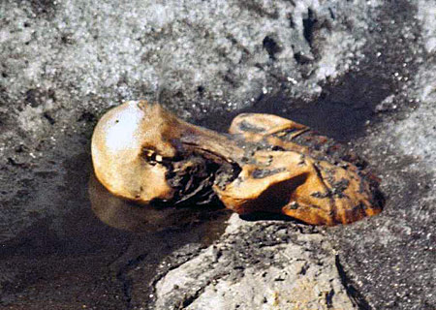

Slide 17
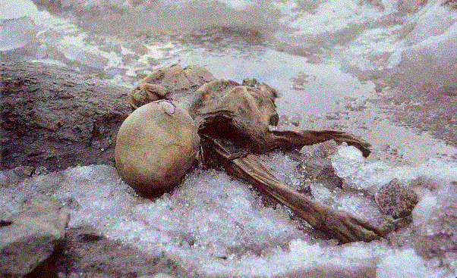

Slide 18
The Body
Ötzi was:
male
approximately 1.65 meters (5 ft 5 in) tall
weighed about 50 kilograms
was about 45 years of age.
The body has been extensively examined, measured, X-rayed, and dated.
Tissues and digestive system contents have been examined microscopically, as have the items found with the body.

Slide 19
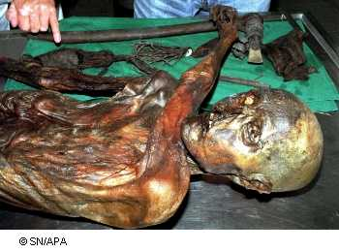

Slide 20
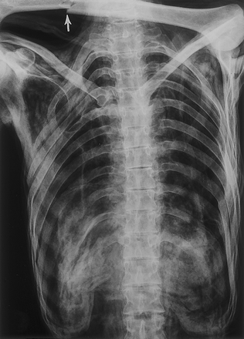

Slide 21
The Body – Stomach Contents
Analysis of Ötzi's intestinal contents showed his last meal contained red deer meat and was eaten around eight hours before his death.
The digestive system also had some grain as well as roots and fruits. The grain was a highly processed wheat bran known as einkorn, quite possibly eaten in the form of bread.
Also, pollen grains were discovered. The pollen was very well preserved, indicating that it had been fresh (a few hours old) at the time of Ötzi's death, which places his death in the spring. Additionally, layers of different pollen help indicate Ötzi's movements.

Slide 22
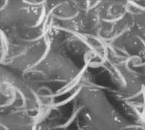
The Body - Health
Ötzi had whipworm, an intestinal parasite.
During CT scans, it was observed that three or four of his right ribs had been broken.
His fingernail (only one was found) indicates he was sick three times in the six months before he died.
Notes:
At this point, students should begin to be able to discuss some of the inferences that can be made. What does the fact that Ötzi had whipworm indicate? The broken ribs?

Slide 23
The Body - Tattoos
Ötzi had more than 50 tattoos on his body. These consisted of simple dots and lines on were found on his lower spine, behind his left knee, and on his right ankle.
Using X-rays, it was determined that the Iceman may have had arthritis in his joints.
It has been suggested that the tattoos may be related to acupuncture.
Notes:
Discussions around homeopathic medicines- were there specialized roles in society?

Slide 24
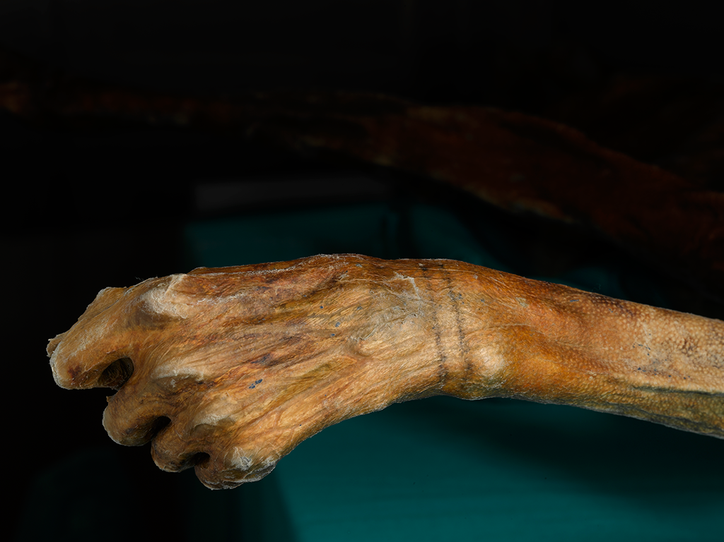
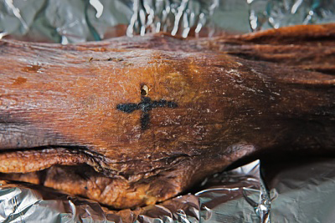
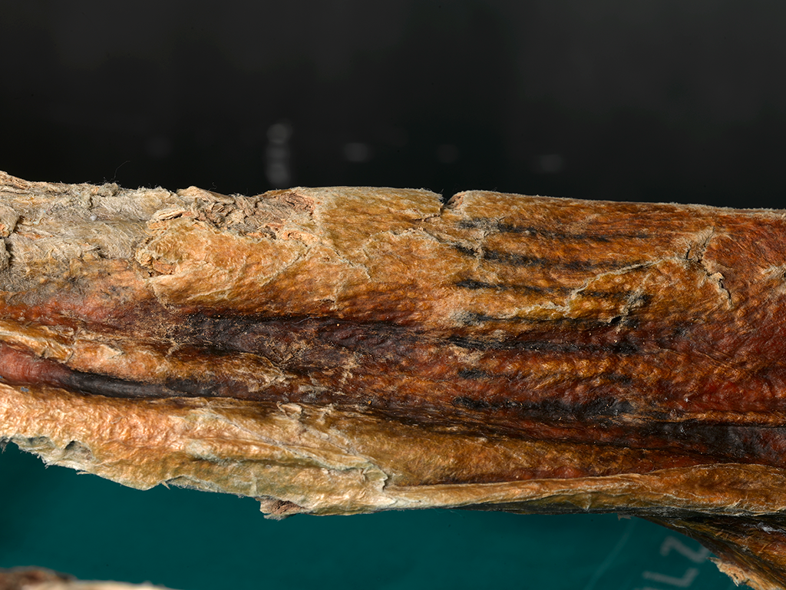
Notes:
Tattoos found on Otzi

Slide 25
Clothes
Ötzi's clothes included:
a coat made of woven grass
a belt
a skirt made of leather
a bearskin cap
a shoe made of bearskin for the soles, deer hide for the top panels, and a netting made of tree bark; soft grass in the shoe and functioned like socks.
Notes:
The clothing allows for discussions of the knowledge gained by previous generations- how did he know to use these items? Did he make them?

Slide 26
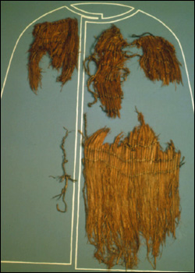
Notes:
Cape/coat, skirt

Slide 27
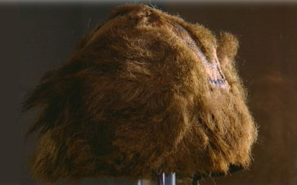
Notes:
Cap

Slide 28
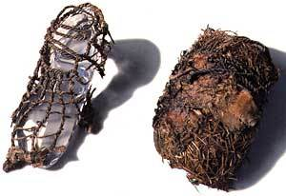
Notes:
Shoe

Slide 29
Clothes
The coat, belt, and loincloth were made of strips of leather sewn together with sinew.
His belt had a pouch sewn to it that contained useful items: a scraper, drill, flint flake, and a dried fungus to be used as tinder.
His shoes were waterproof and wide, designed for walking across snow
Notes:
Dried fungus- medicine?
Shoes indicate he knew he was travelling, as does the flint

Slide 30
Items Found with the Iceman
Unfinished Bow
Copper Axe
Backpack
Ibex bones
Two birch containers
Dagger with scabbard
Retoucher
Belt pouch and contents
Two pieces of fungi
Tassel with marble bead
A net of grass string
Quiver and arrows

Slide 31
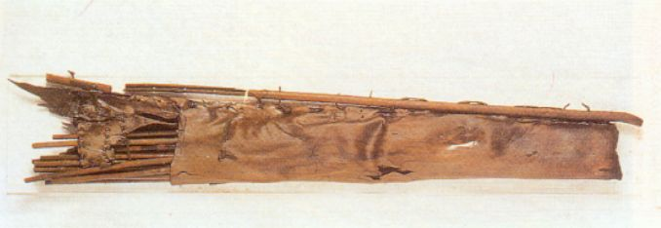
Unfinished Bow, Quiver & Arrows
Long bow with quiver
Quiver had 2 arrows ready to use and 12 partly completed shafts

Slide 32
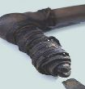
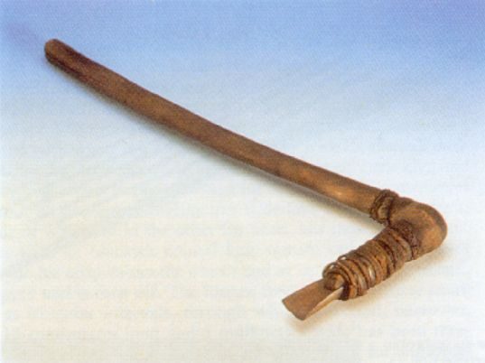
Copper Axe
Skin bound the copper blade to a handle made of yew.
This is the only prehistoric axe ever found intact.
Made scientists re-examine the use of metals in human history

Slide 33
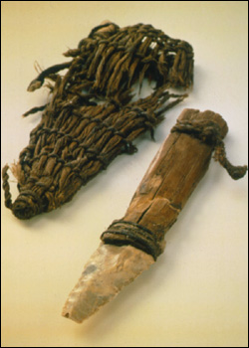
Dagger with scabbard
Ash wood handle bound with animal sinew with flint blade.
Scabbard of grass cord and leather strap

Slide 34
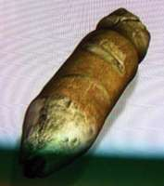
Retoucher
Like a stubby pencil. Stag antler set into wooden handle. Used to sharpen flint tools.

Slide 35
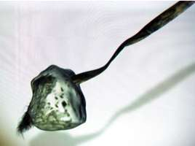
Birch fungi
Antibiotic

Slide 36
Questions…..
Who was Otzi?
What was his occupation?
What was he doing in the mountains?
What can Otzi teach us about society in Europe during the Chalcolithic (Copper Age) period?
How did he die?

Slide 37
Day 3: Research project
Culture and the Living World
Notes:
Title slide

Slide 38
You will research and create both a written report and class presentation on two or more elements--one plant, one animal--of the living world that has influenced the development of your own culture.
Notes:
Use the word “biotic” when referring to living elements

Slide 39
Questions to consider-
What was/were the important agricultural crops tied to the development of your culture?
What role did the domestication of animals play in the development of your culture?
Where do you see these plants and animals in the arts- paintings, stories, other various art forms?
Notes:
These slides represent the intersection of the living world and culture. Students should begin to understand that much of the foundation of the cultures were based on relationships with the flora and fauna that early societies relied upon. Students are not only researching biological phenomenon, but doing it in a historical and cultural context.

Slide 40
More questions:
Where did these plants and animals originate? (Were they endemic to the environment, or were the imported from elsewhere?)
Are there any cultural customs or traditions that were built around these?
Do these still exist today?
Notes:
Next set of slides- these begin to bring the student to current times- how did culture become complicated? Also, by understanding the origins of the species being researched, students have the opportunity to study endemic vs. nonnative species. This may overlay a historical aspect to their studies- what other people may have influenced the development of that student’s culture?

Slide 41
More questions:
Are these plants and animals still prevalent in your culture?
If not, why do you think this is?
Are there any issues surrounding these plants and animals currently?
How does your culture deal with these issues?
Notes:
More of a focus on time- bridging the past to the present. This part of the research also allows students to learn about what current issues might be facing species within their own ancestral environments, and link any scientific advancements and/or issues facing the use of these species.

Slide 42
You will research and create both a written report and class presentation on two or more aspects of the living world that has influenced the development of your own culture.
Your assignment:
One minimum 3 page research paper
Identify at least one plant and one animal species that are a part of your cultural development
12 point, Times New Roman font
Single spaced
1” margins
Address a minimum of SEVEN (7) of the questions raised
Include a reference page (does not count toward the three)
Presentation
Five minute PowerPoint or Prezi presentation based on the paper you wrote
Notes:
Handout needed- include all questions given within the slides as well as grading rubric

