Slide 1
Project Perspective:
Who am I? Who are you?

Slide 2
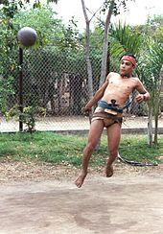
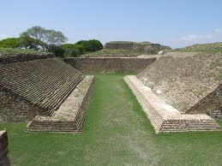
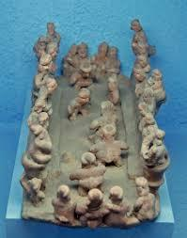
Priest at the Ballgame
Modern Ullama Player:
Sinaloa
Ballcourt at Montealban, Oaxaca
Fired clay representation
of ballgame

Slide 3
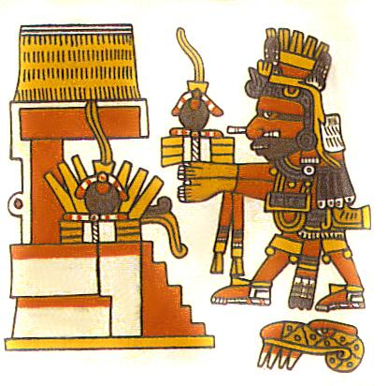
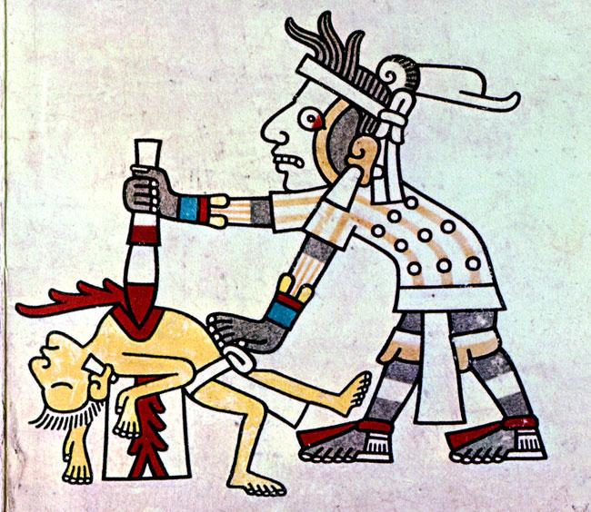
Priest at the Game
Priest with sacrificial heart(?).
Codex Xiuhtecuhtli, Codex Borgia

Slide 4
Ceremony: The ballgame also had religious associations. It re-enacted the myth of the hero twins vs. the Lords of Death
"Well I think it's absolutely a metaphor for how Mesoamericans view the world. When you look at one of the great creation stories in Mesoamerica - the Popol Vuh - there are twins. Their names were Xbalanque and Hunahpuh. They were ball players, they lived in the underworld, and they played ball with the lords of death. Regardless of who was playing the game it re-emphasised how Mesoamericans viewed themselves in the cosmos and in relation to the gods. So they were playing out a game of gods and the lords of death every time they took to the ball court."
E.M. Whittington, BBC Radio Transcript

Slide 5
Myth of the Twins at Xibalba
The story begins with the Hero Twins' father, Hun Hunahpu, and uncle, Vucub Hunahpu, playing ball near the underworld, Xibalba. The lords of the underworld became annoyed with the noise from the ball playing and so the primary lords of Xibalba, One Death and Seven Death, sent owls to lure the twins to the ballcourt of Xibalba, situated on the western edge of the underworld. Despite the danger the brothers fall asleep and are captured and sacrificed by the lords of Xibalba and then buried in the ballcourt. Hun Hunahpu is decapitated and his head hung in a fruit tree, which bears the first calabash gourds. Hun Hunahpu's head spits into the hands of a passing goddess who conceives and bears the Hero Twins, Hunahpu and Xbalanque. The Hero Twins eventually find the ballgame equipment in their father’s house and start playing, again to the annoyance of the Lords of Xibalba, who summon the twins to play the ballgame amidst trials and dangers. In one notable episode, Hunahpu is decapitated by bats. His brother uses a squash as Hunahpu's substitute head until his real one, now used as a ball by the Lords, can be retrieved and placed back on Hunahpu's shoulders. The twins eventually go on to play the ballgame with the Lords of Xibalba, defeating them. However, the twins are unsuccessful in reviving their father, so they leave him buried in the ballcourt of Xibalba.

Slide 6
Game, Theatre, Ceremony
The mesoamerican ballgame was a ‘sport’ with political and religious associations and implications played since ~1,400 B.C.E.
The ball was made of rubber and was struck with the hips or buttocks
The game was a festive occasion but may also have settled political disputes and did occasionally end in the ritual sacrifice of a player or players
Follow the link for awesomeness: Let's Play!

