Slide 1
Project Perspective:
Who am I? Who are you?

Slide 2
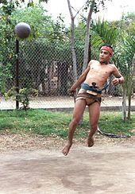
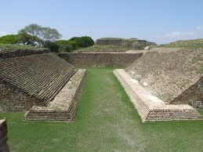
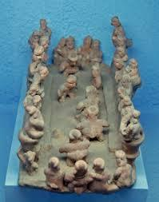
Aztec at the ballgame
Modern Ullama Player:
Sinaloa
Ballcourt at Montealban, Oaxaca
Fired clay representation
of ballgame

Slide 3
Game, Theatre, Ceremony
The mesoamerican ballgame was a ‘sport’ with political and religious associations and implications played since ~1,400 B.C.E.
The ball was made of rubber and was struck with the hips or buttocks
The game was a festive occasion but may also have settled political disputes and did occasionally end in the ritual sacrifice of a player or players
Follow the link for awesomeness: Let's Play!

Slide 4
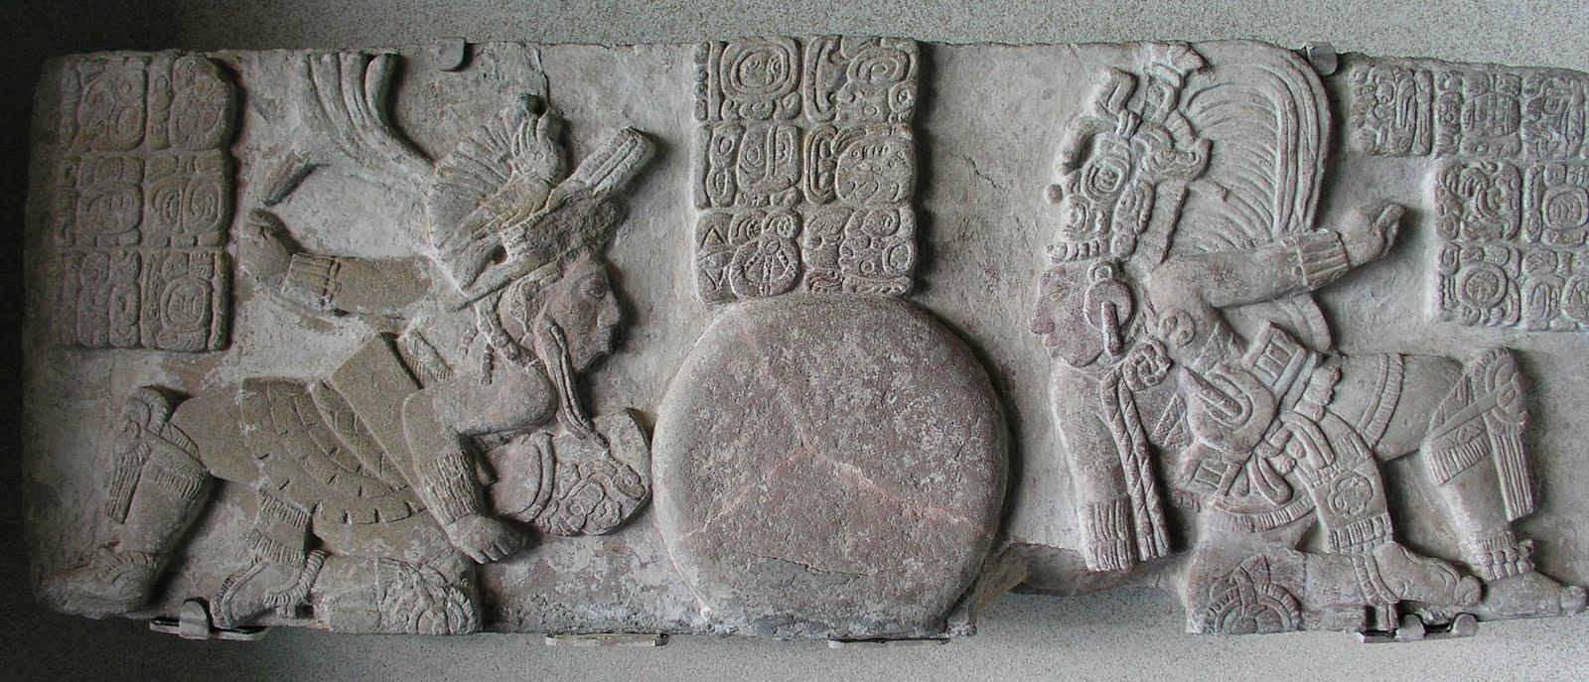
Political Implications
Rulers or surrogates of rulers sometimes played, possibly as exhibition, tribute, and-or to resolve conflicts.
Two Mayan kings square off in the Tonina ball panel

Slide 5
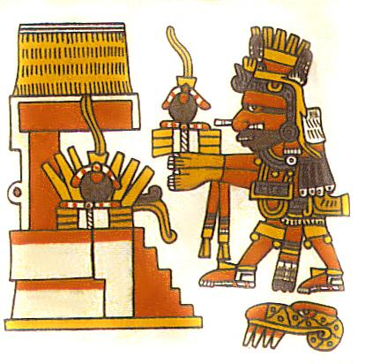
Politics and Ritual
‘Captives were often shown in Maya art, and it is assumed that these captives were sacrificed after losing a rigged ritual ballgame. Rather than nearly nude and sometimes battered captives, however, the ballcourts at El Tajin and Chichen Itza show the sacrifice of practiced ballplayers, perhaps the captain of a team. Decapitation is particularly associated with the ballgame—severed heads are featured in much Late Classic ballgame art and appear repeatedly in the Popol Vuh. There has even been speculation that the heads and skulls were used as balls.’
Sacrifice of a heart to the gods.

Slide 6
Ceremony:
The ballgame also had religious associations. It re-enacted the myth of the Hero Twins vs. The Lords of Death
"Well I think it's absolutely a metaphor for how Mesoamericans view the world. When you look at one of the great creation stories in Mesoamerica - the Popol Vuh - there are twins. Their names were Xbalanque and Hunahpuh. They were ball players, they lived in the underworld, and they played ball with the lords of death, regardless of who was playing that game. It re-emphasised how Mesoamericans viewed themselves in the cosmos and in relation to the gods. So they were playing out a game of gods and the lords of death every time they took to the ball court."
E.M. Whittington, BBC Radio Transcript
(for the complete myth talk to an Aztec priest.)

