Slide 1
Project Perspective:
Who am I? Who are You?

Slide 2
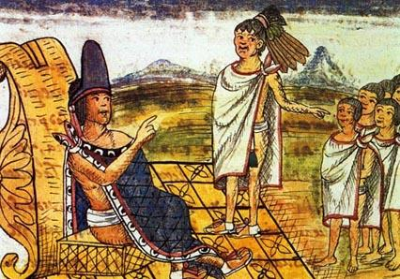
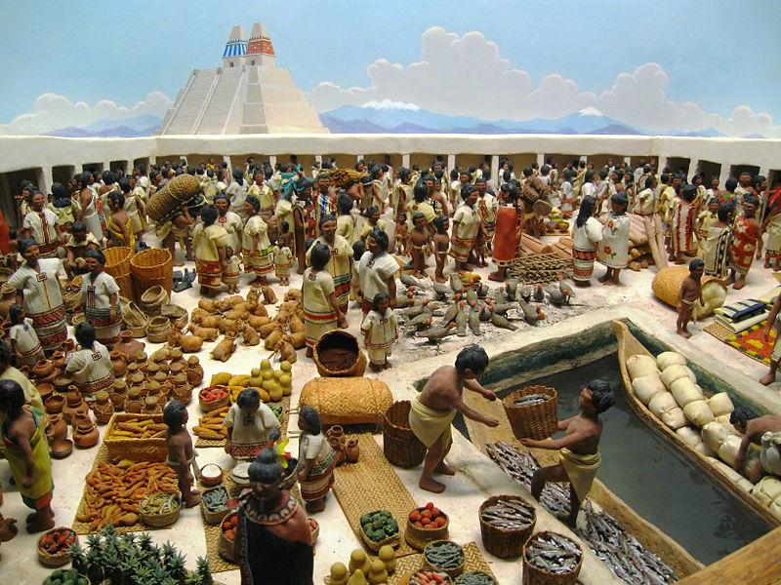
Mesoamerican Leader at the Market:
Codice Duran: Moctezuma at a market
Market at Tlatelolco as described by
Hernando Cortes in Five Letters.

Slide 3
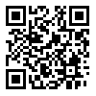
Market Description:
There is in this city a market, in which every day thirty thousand people are engaged in buying and selling, beside many other merchants who are scattered about the city.
The market contains a great variety of articles both of food and clothing, and all kinds of shoes for the feet; jewels of gold and silver, and precious stones, and ornaments of feathers, all as well arranged as they can possibly be found in any public squares or markets in the world.
There is much earthenware of every style and a good quality, equal to the best of Spanish manufacture. Wood, coal, edible and medicinal plants, are sold in great quantities.
-- Second Letter of HernandoCortes to Charles V

Slide 4
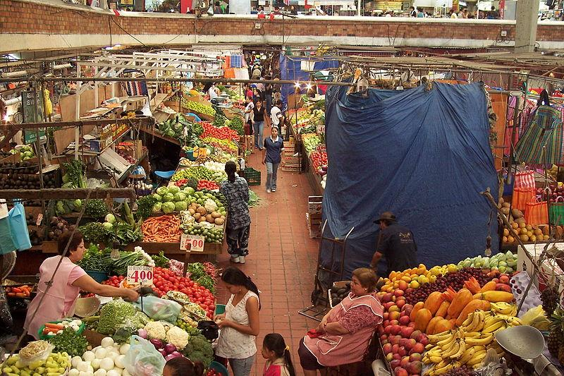
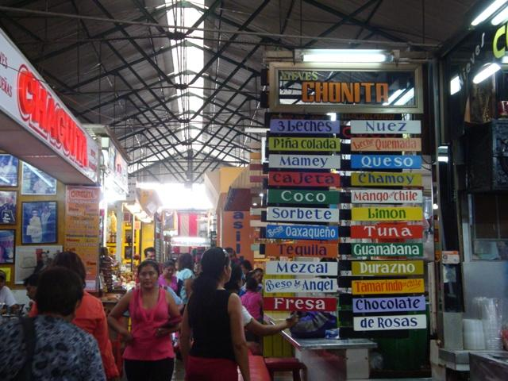
Modern Markets in Mexico:
Mercado de San Juan de Dios,
Guadalajara
Mercado 20 de Noviembre, Oaxaca

