Slide 1
Project Perspective:
Who am I? Who are you?

Slide 2
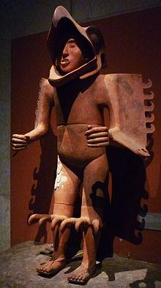
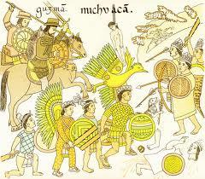
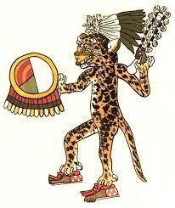
Mesoamerican Leaders at War
Eagle Warrior Scene of Battle, Codex Azcatitlan Jaguar Warrior

Slide 3
Aztec Warriors in Training
‘Warriors were essential to Aztec life and culture. At birth an Aztec boy would receive two symbols of being a warrior. A shield would be placed in his left hand, and an arrow would be placed in his right. After a short ceremony the boy's umbilical cord, shield, and arrow would be taken to a battlefield to be buried by a renowned warrior. These parts would symbol the rise of a warrior.’

Slide 4
Aztec Leaders at War
‘When formal training in handling weapons began at age fifteen, youth would begin to accompany the seasoned warriors on campaigns so that they could become accustomed to military life and lose fear of battle. At age twenty, those who wanted to become warriors officially went to war. The parents of the youth sought out veteran warriors, bringing them foods and gifts with the objective of securing a warrior to be the sponsor of their child. Thus, sons of high nobility tended to succeed more often in war.’

