Slide 1
Foods of Our Ancestors
Foods of Today

Slide 2
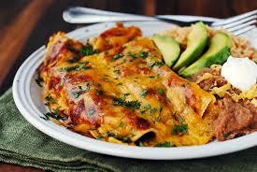
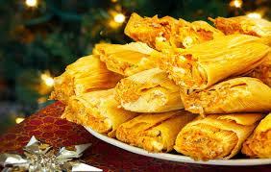
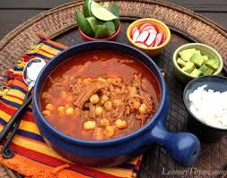
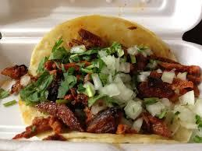

Slide 3
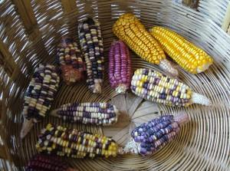
Notes:
Maize of different colors, Teotitlán del Valle (S. Wood, 2010)

Slide 4
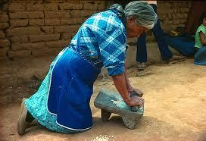
http://www.mexicolore.co.uk/aztecs/aztefacts/daily-grind

Slide 5
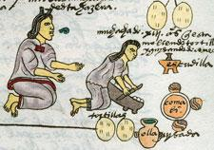

Slide 6
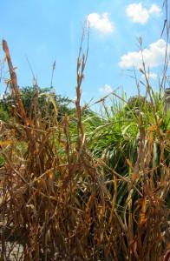
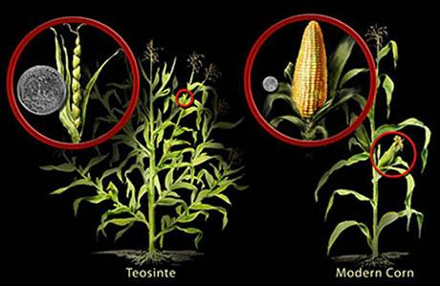
Native Americans of Mexico developed corn 10,000 years ago

Slide 7
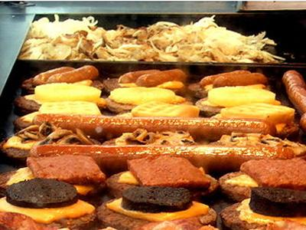
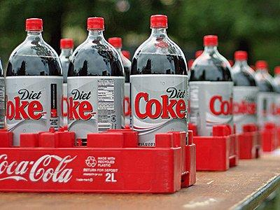
Corn in Everything!
http://www.businessinsider.com/everyday-foods-contain-corn-prices-soar-2012-7?op=1

Slide 8
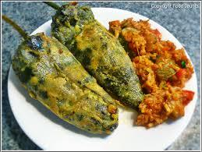
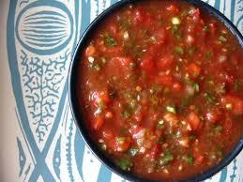
http://www.sci-news.com/biology/science-origins-chili-pepper-mexico-01870.html

Slide 9
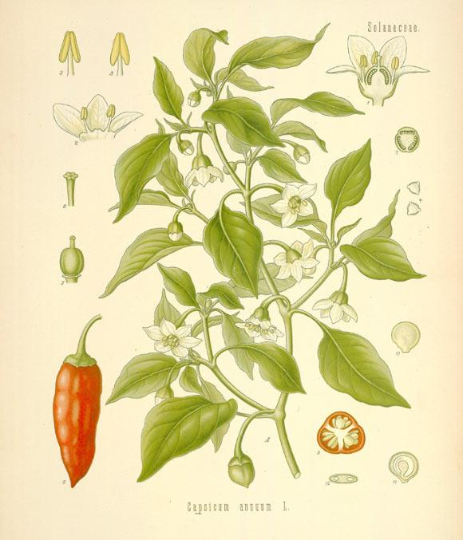
Chili Peppers Originated in Mesoamerica

Slide 10
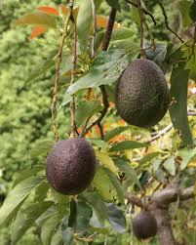
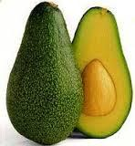
Avocado - Aguacate - Auacatl

Slide 12
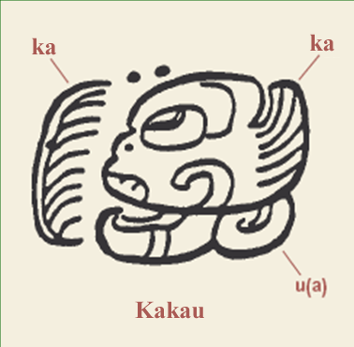

Slide 13
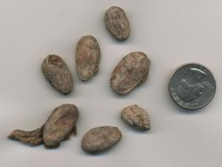
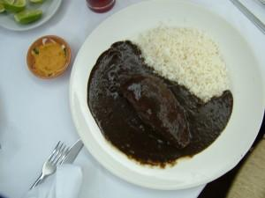
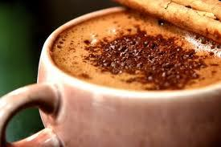

Slide 14
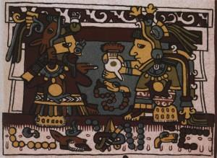
The Mixtec marriage of Lord Eight Deer and Lady Thirteen
The Mixtec marriage of Lord Eight Deer and Lady Thirteen

