Slide 1
Project Perspective:
Who am I? Who are you?

Slide 2
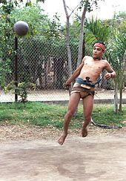
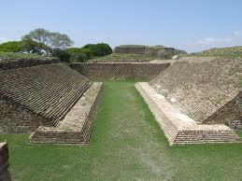
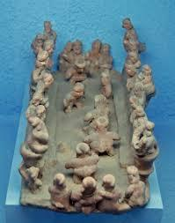
Artisan-Farmer at the Ballgame
Modern Ullama Player:
Sinaloa
Ballcourt at Montealban, Oaxaca
Fired clay representation
of ballgame

Slide 3
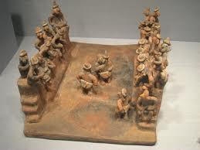
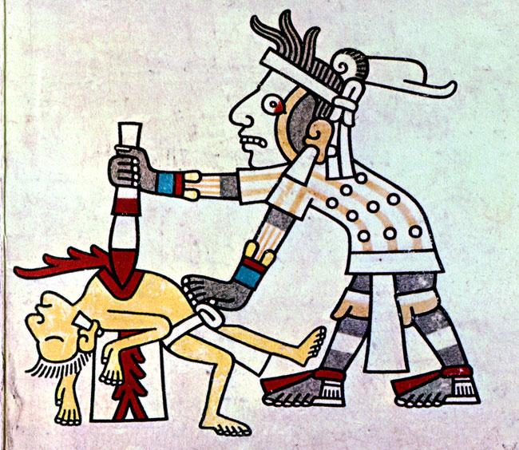
Artisan - Farmer at the Ballgame
Ballgame, State of Nayarit
The ritual end to a game

Slide 4
Game, Theatre, Ceremony
The mesoamerican ballgame was a ‘sport’ with political and religious associations and implications played since ~1,400 B.C.E.
The ball was made of rubber and was struck with the hips or buttocks
The game was a festive occasion but may also have settled political disputes and did occasionally end in the ritual sacrifice of a player or players

Slide 5
Artisan - Farmer at the Ballgame:
Although it is not always apparent from the stately scenes of kings and princes squaring off to either side of a single, oversized ball, Classic ballcourts were often crowded and noisy places, full of boisterous activity and the thunderous bounce of the ballgame ball, a dangerously heavy and occasionally unpredictable missile.
The noise in a masonry court would have been deafening, not least when the blaring trumpets of the pre-game show gave way to the staccato beat of maracas and bone rasps held by onlookers punctuated by the rhythmic thud of a ten pound ball (Coe 2003).
Marc Zender, Peabody Museum, Harvard University
http://www.mesoweb.com/pari/publications/journal/404/Sport.pdf
Follow the link for awesomeness: Let's Play!

