Slide 1
Project Perspective:
Who am I? Who are You?

Slide 2
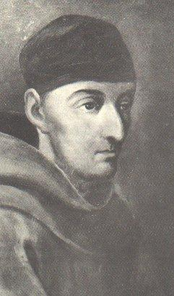
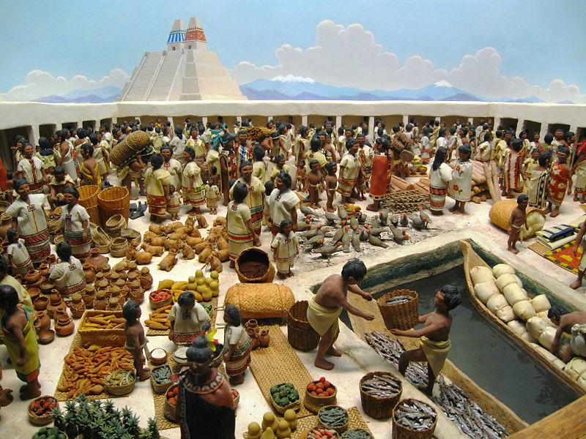
Cleric in the Market:
Market at Tlatelolco: Described by Hernando Cortes in Five Letters.
Bernardino de Sahagun

Slide 3
Bernardino de Sahagun describes the Market
And more:
[He sells] salted wide tamales, tamales bound up
on top, [with] grains of maize thrown in; crumbled,
pounded tamales; spotted tamales, pointed
tamales, white fruit tamales, red fruit tamales, turkey
egg tamales, turkey eggs with grains of maize;
tamales of tender maize, tamales of green maize,
brick-shaped tamales, braised ones; plain tamales,
honey tamales, bee tamales, tamales with grains of
maize, squash tamales, crumbled tamales, maize
flower tamales.
He sells meat tamales; turkey meat packets; plain tamales; tamales cooked in an earth oven; those cooked in an olla…grains of maize with chile, tamales with chile…fish tamales, fish with grains of maize, frog tamales, frog with grains of maize, axolotl with grains of maize, axolotl tamales, tamales with grains of maize, mushrooms with grains of maize, tuna cactus with grains of maize, rabbit tamales, rabbit with grains of maize, pocket gopher tamales.
--General History of the Things of New Spain

