Slide 1
Calendar Mathematics
In Mesoamerica

Slide 2
Calendar as Theme in Multiple Content Areas
Art - Have students make their own name glyphs
Astronomy - understanding how solar and divinatory calendars align
Math - Calculate day names
Literacy - understanding the history of written language, diversity of writing systems

Slide 3
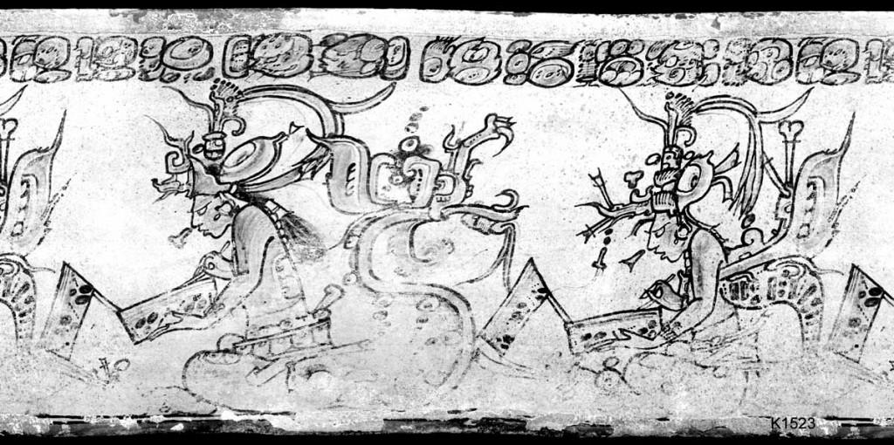
Record Keeping as part of Cosmovision
Notes:
Reading, Writing, Art, Science and Math were highly valued and intertwined in Ancient Mesoamerican cultures. Those who could do these things were part of the honored elite. Classic-Period Maya vase, showing Hero Twins of the Popol Vuh origin story writing in codices. K1523. (Justin Kerr, Mayavase Database)

Slide 4
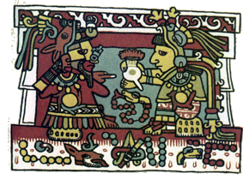
Lord 8 Deer and Lady 13 Serpent
Notes:
http://www.d.umn.edu/cla/faculty/troufs/anth3618/mamixtec.html
http://www.ancientscripts.com/mixtec.html People were (and are) named related to their day of birth, represented as a mathematical quantity, that date/ quantity providing powerful clues about a person’s character and fate.

Slide 5
Mathematical Practice Standards
Make sense of problems and persevere in solving them.
Reason abstractly and quantitatively.
Model with mathematics
Attend to precision

