Slide 1
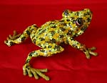
To Oaxaca and Beyond!
Craft making as a conduit of community cohesion and personal identity in Oaxacan culture
Rita Baker, Ph.D. Middle School Visual Arts
NEH Scholar 2014

Slide 2
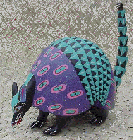
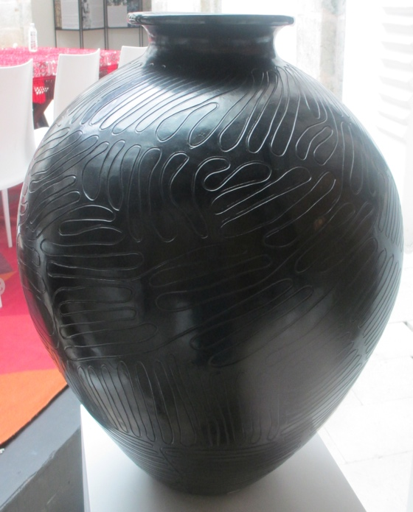
Three major crafts produced in Oaxaca
Alebrije
Weaving
Pottery

Slide 3
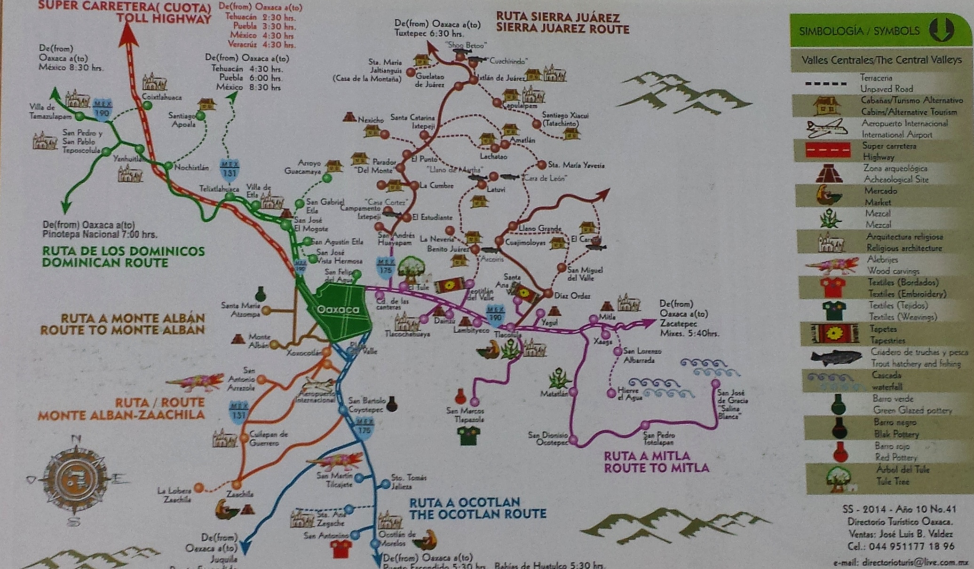
This project will focus on Teotitlan, Arrozola and Tlapazola which are major locations for craft production.

Slide 4
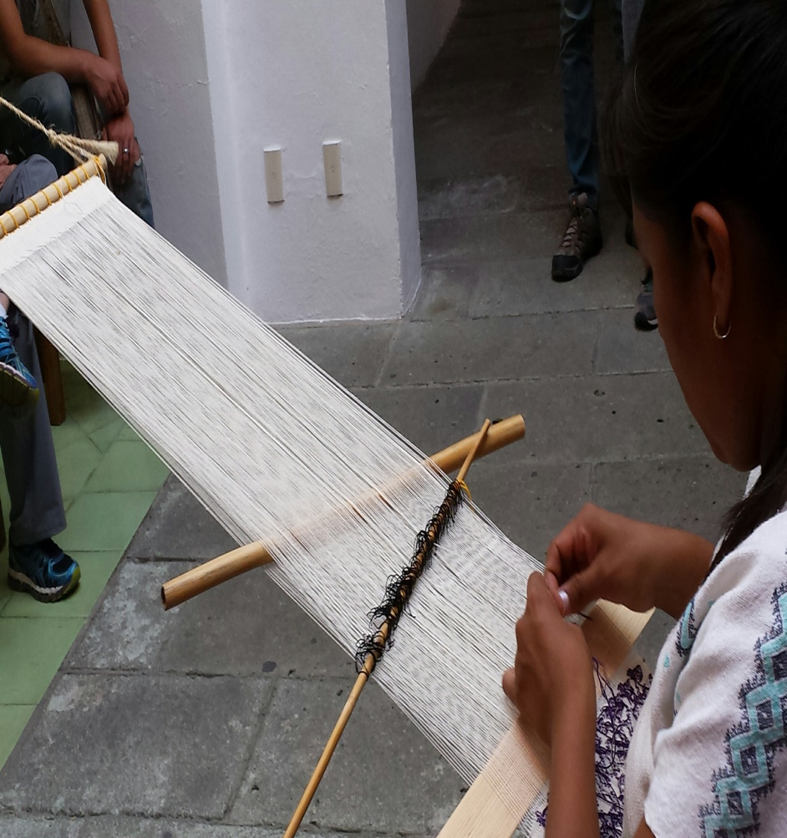
Weaving
Weaving dates back to the formative period. Early weaving was done using a backstrap loom, which is still used today.
The heddle is an invaluable tool that separates warp yarns.

Slide 5
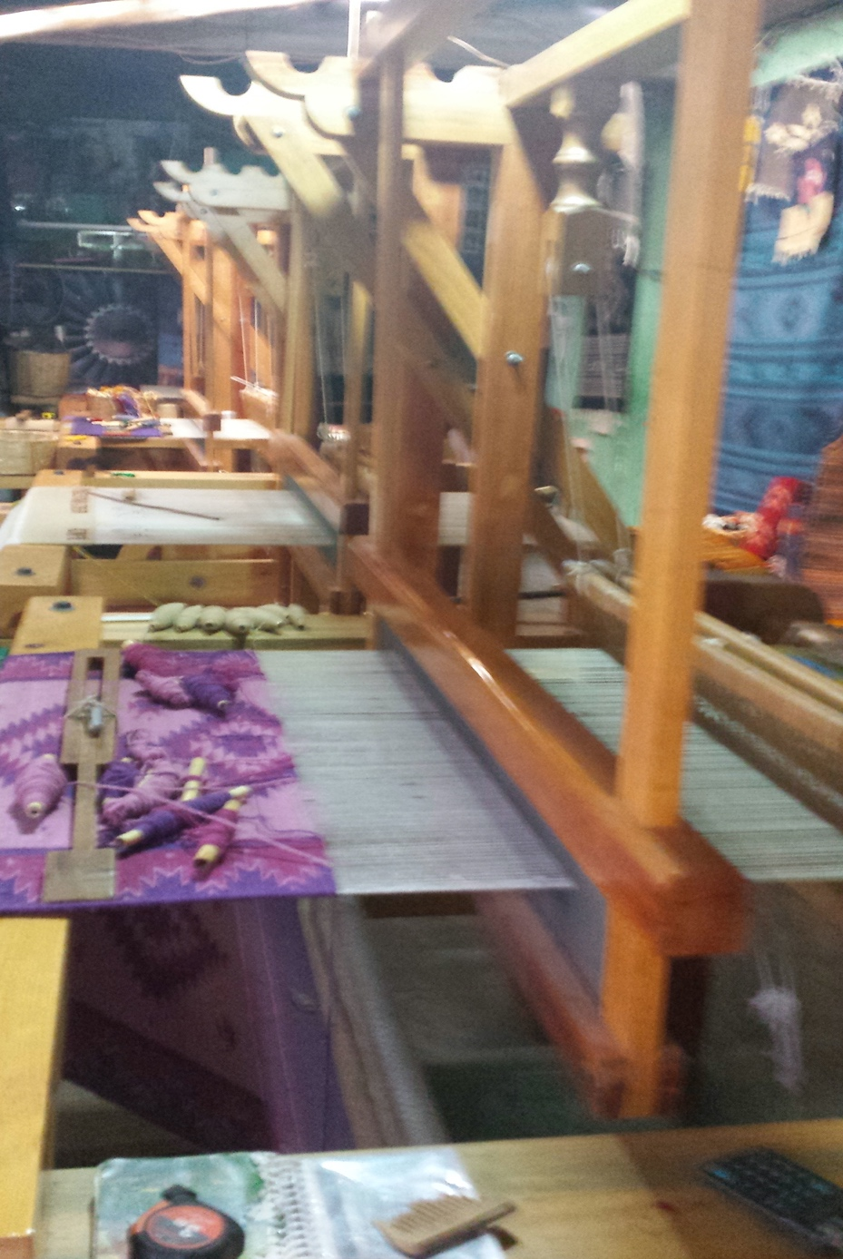
During the colonial era, wool and the pedal loom were introduced by the Spaniards which made it easier to weave and dye the fibers.

Slide 6
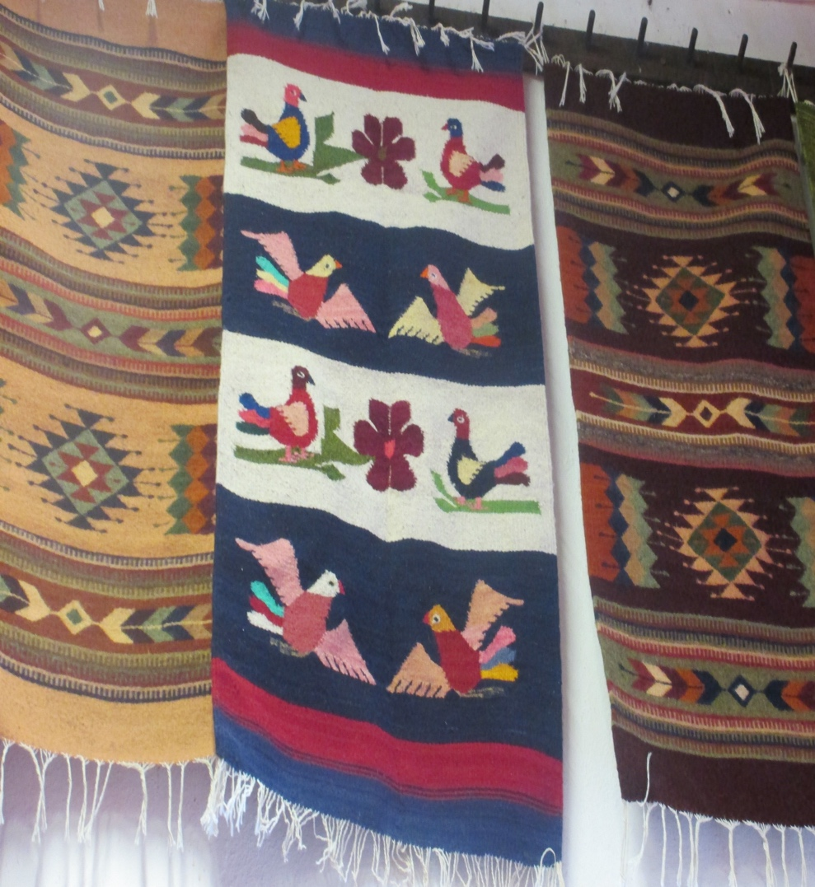
Teotitlan del Valle
Teotitlan is a tight-knit community known for its weaving.
Most households in the community engage in the craft and its members are renown for their skill and creativity.

Slide 7
Preparation
The fibers are washed to cleanse it of natural oils, and then the fibers are carded.
Sara Ruiz Lorenzo,
Teotitlan
Notes:
Play clip

Slide 8
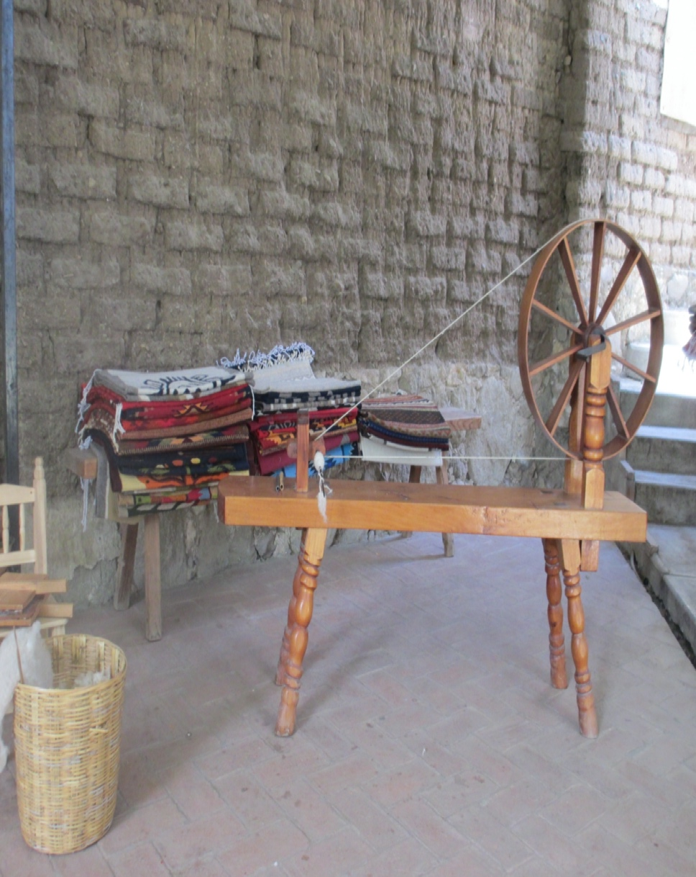
Once cleaned and carded the wool is spun into yarn on a spinning wheel.

Slide 9
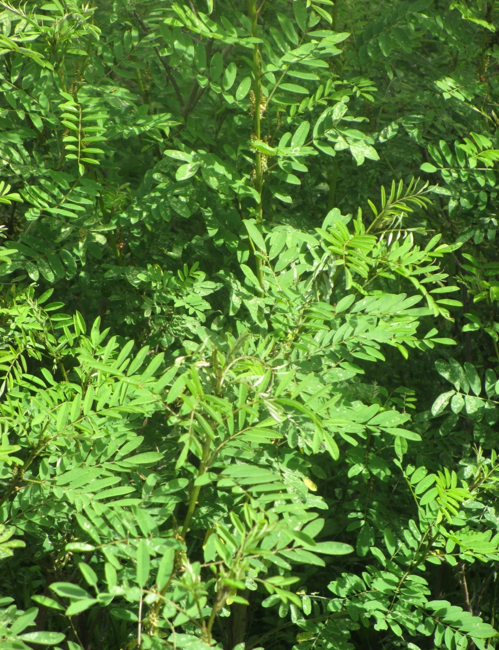
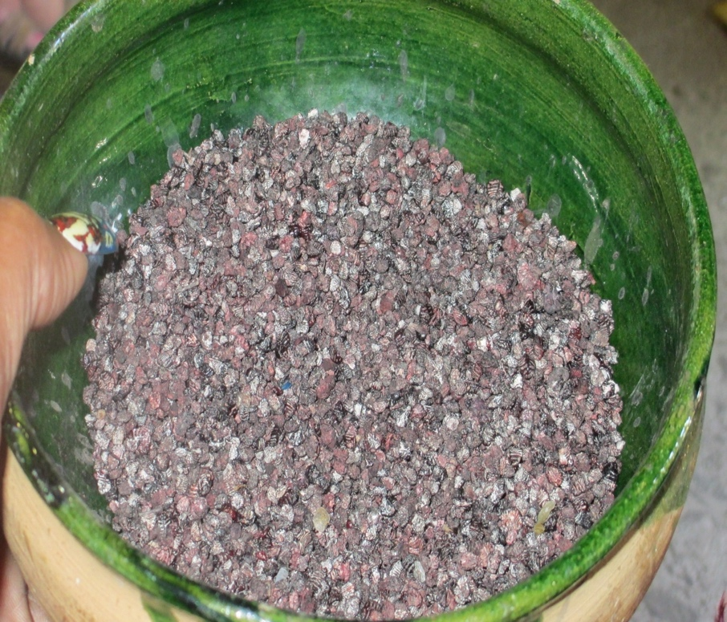
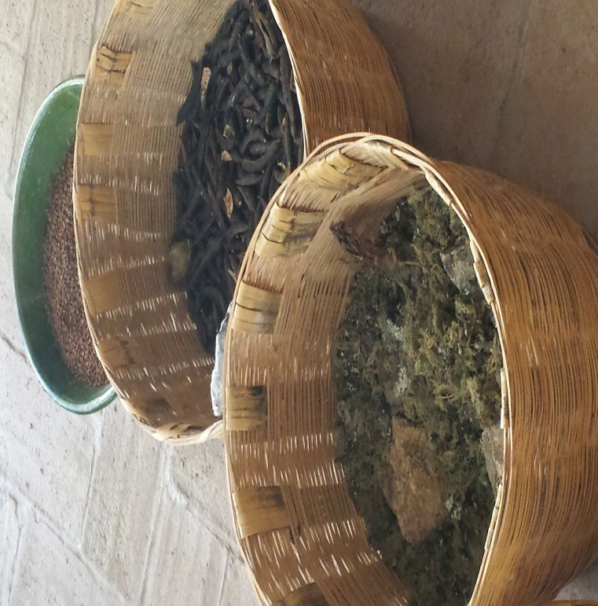
Blue Indigo
Cochineal
Yarns are dyed using natural plants and insects.
Marigold

Slide 10
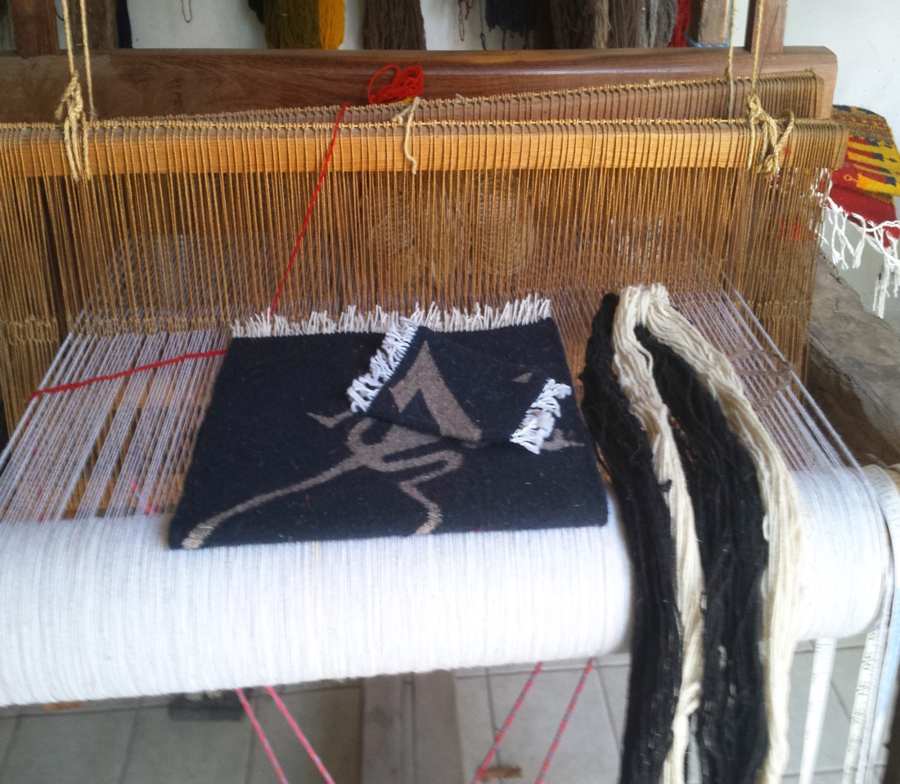
The loom is a wooden structure used for weaving.
Vertical yarns (warp) form the structure of the piece.
Weft yarns (horizontal) are woven over and under the warp to create cloth.
.
Left and right foot pedals control the lifting of vertical yarns, to allow the weft yarns to be woven through.

Slide 11
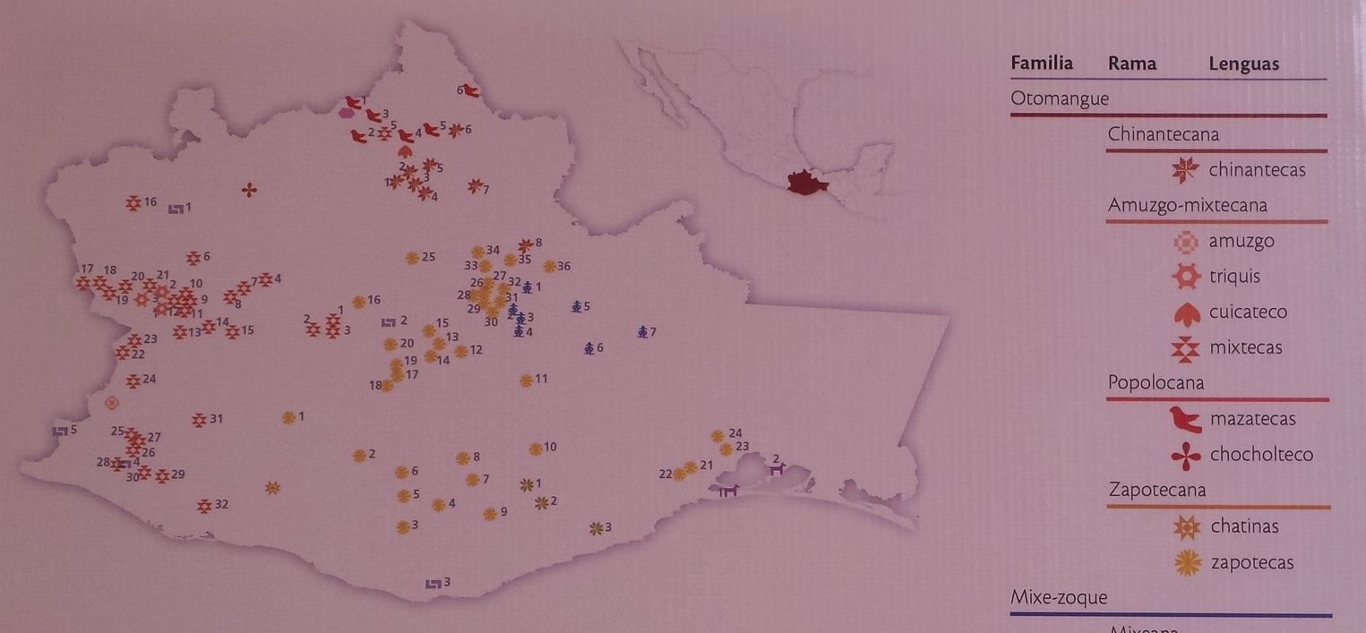
Community
Museo Textil de Oaxaca

Slide 12
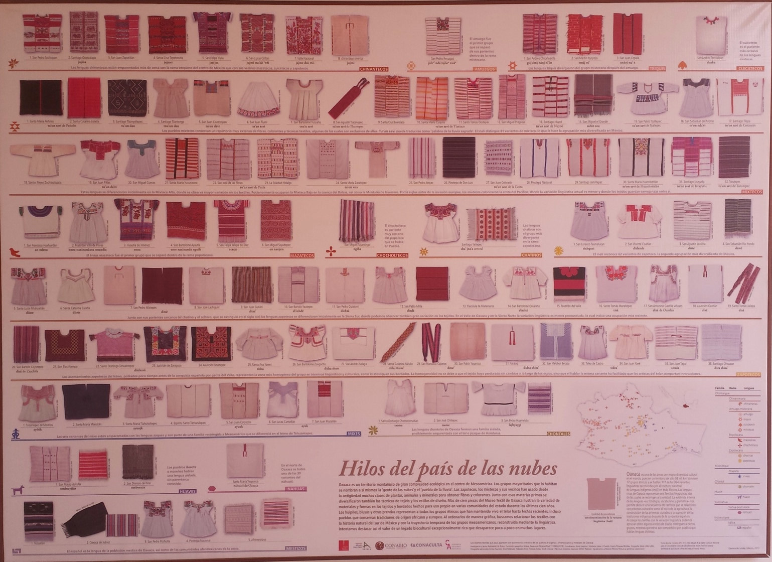
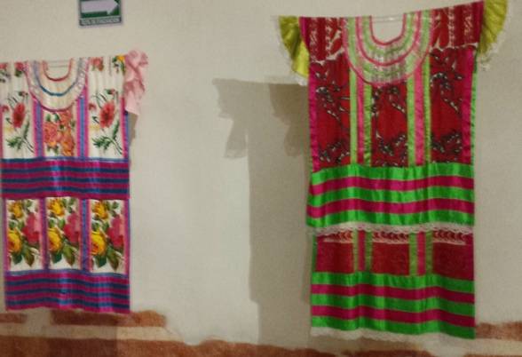
Museo Textile de Oaxaca
The textiles of each region or community are distinguishable by pattern, color, and design.

Slide 13
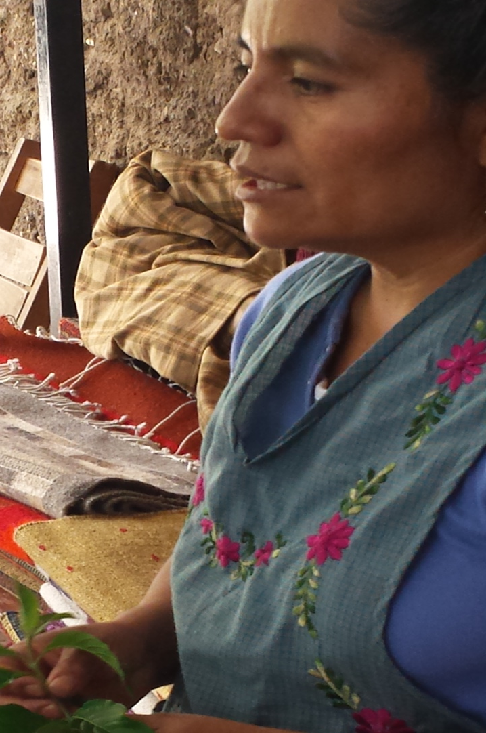
The Individual
Traditional ways of being are transferred within the family.
Preservation of culture is instilled at an early age.
Sara gave up her desires to be a dentist to continue the weaving tradition.
Family weaving secrets are closely guarded.
Sara Ruis Lorenzo, Teotitlan

Slide 14
Reflection:
Think of a time when you had to abandon a personal dream or desire. Discuss your feelings surrounding that experience.
In what ways are you identified as belonging to your family? Think of the ways in which you dress, eat, worship, etc.

Slide 15
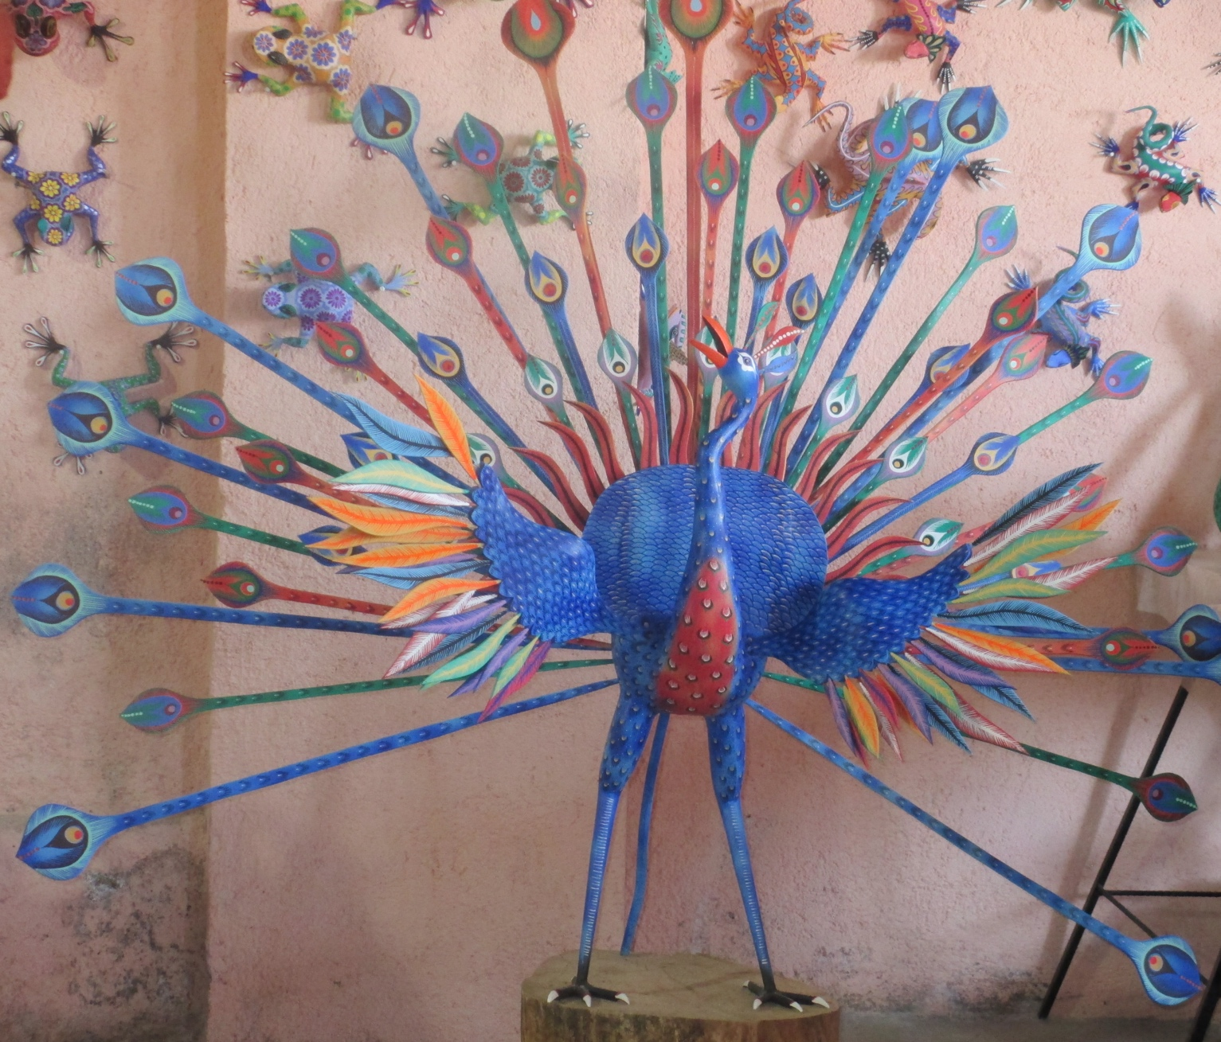
Alebrije

Slide 16
Alebrijes are sculptures produced in Arrazola.
The making of this craft dates back generations.
Alebrijes were originally made to be used as toys and for use in ceremonies and rituals.

Slide 17
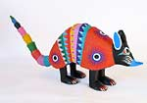
Inspiration comes from animals and the vibrant colors of festivals and fiestas.
Sometimes dreams form the basis for inspiration.
Every creation is one of a kind.

Slide 18
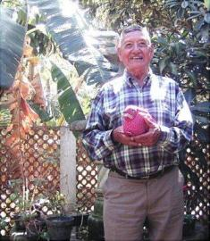
The Community
Manuel Ramírez carved alebrije creatures in the 1980s and was encouraged by tourists to do more.
Manuel Jimenez Ramirez, 1919-2005
Arrazola

Slide 19
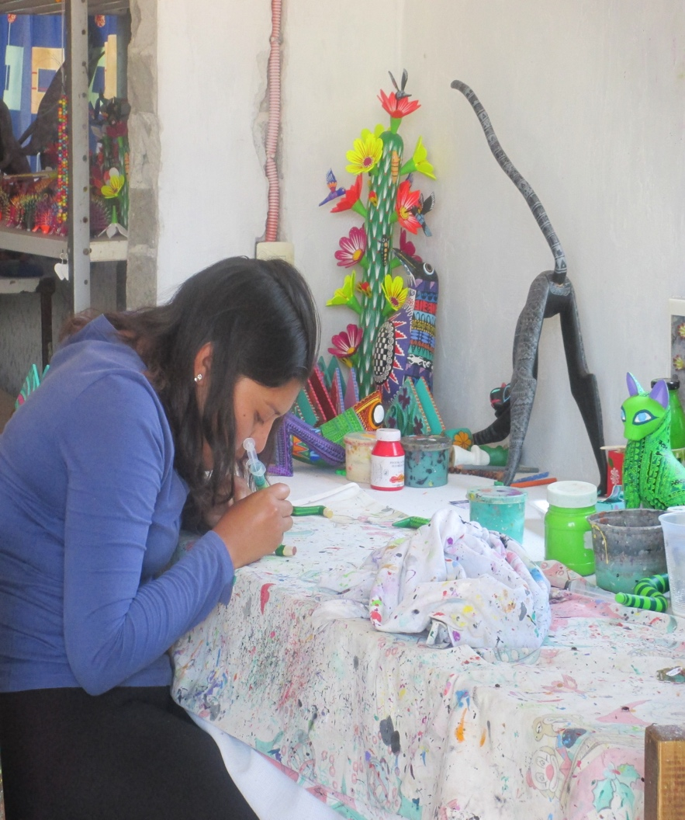
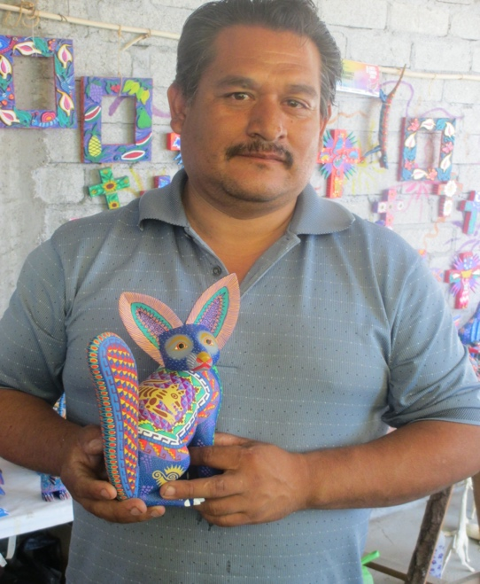
Other artists followed suit, and today, production of these woodcarvings has grown into a major industry in Oaxaca.

Slide 20
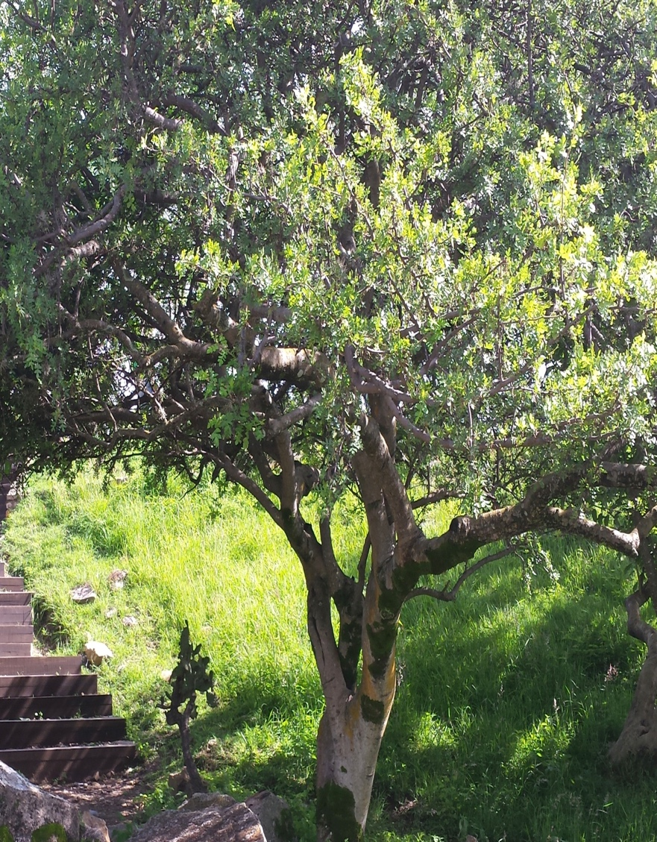
Preparation
The wood from the copal tree is used because it is lightweight and sands smoothly.

Slide 21
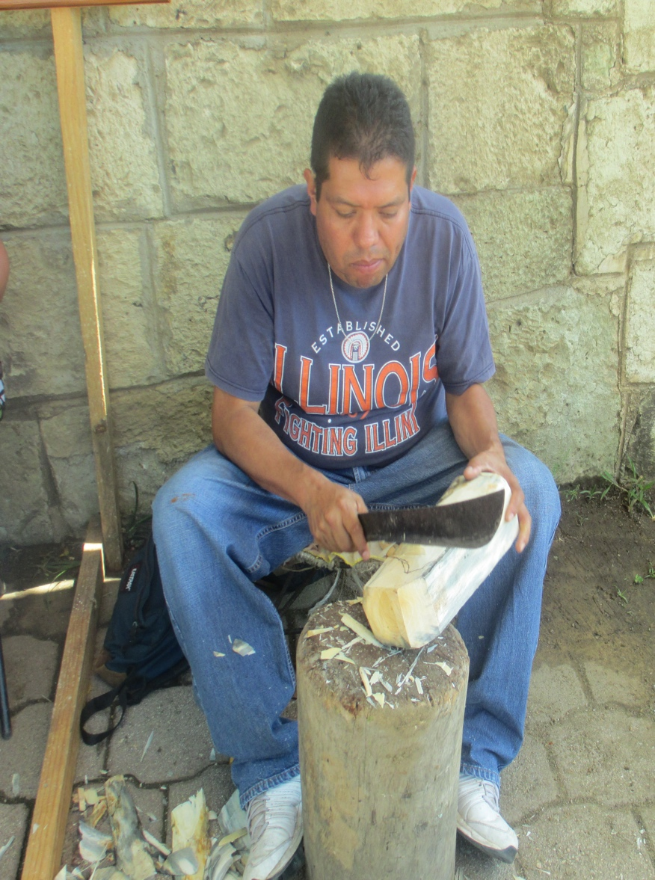
The Individuals
Producing the sculptures is a family affair.
The whittling is done by the men with knives and machetes.
Armando Carillo

Slide 22
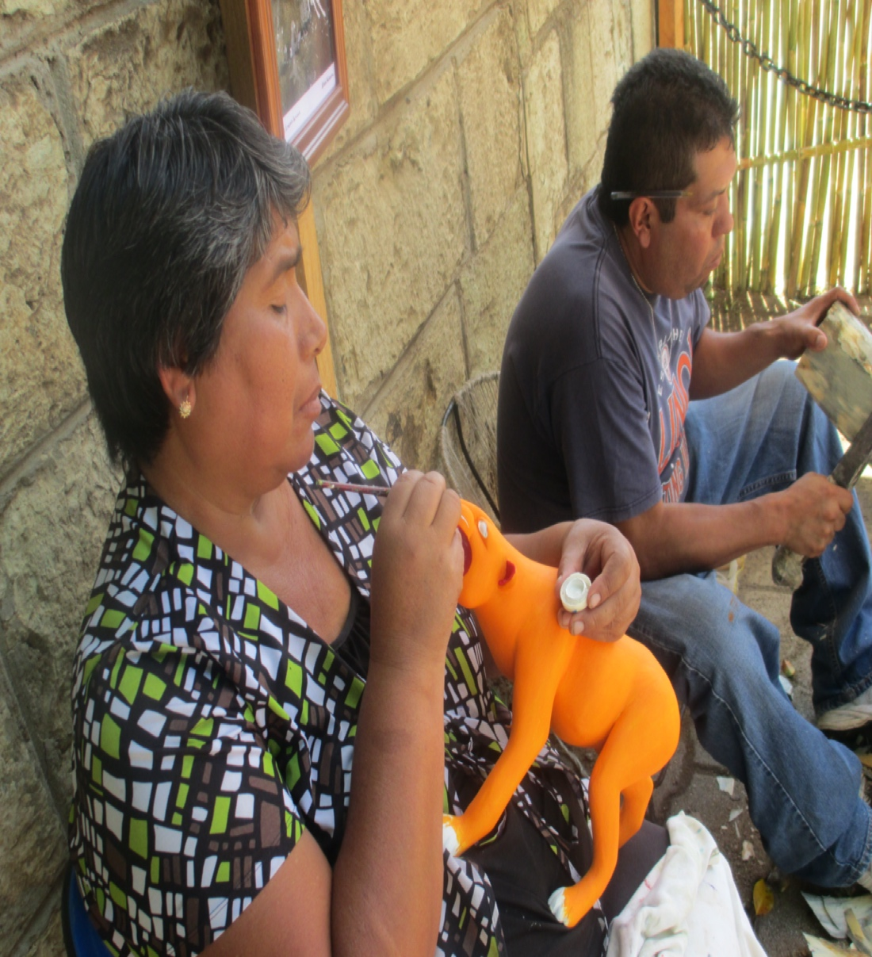
Mothers paint the sculptures while the children help with the sanding.
Only boys are taught to carve.
Señora and Señor Carillo

Slide 23
Reflection:
How is family closeness encouraged by alebrijes production?
Should girls be trained to sculpt? Explain your answer.
How did Manuel Jiménez benefit his community?

Slide 24
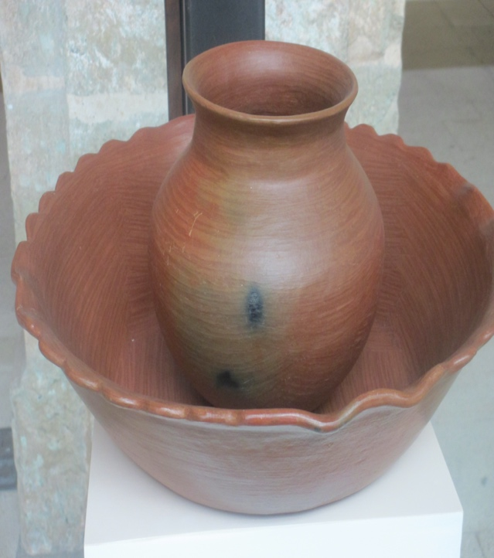
Pottery
Pottery is a modeling craft used to create a variety of functional and art objects.
Different types of clays and glazes are used, depending on the end use of the piece.
Pottery can be thrown on a wheel, hand formed, coiled, etc.

Slide 25
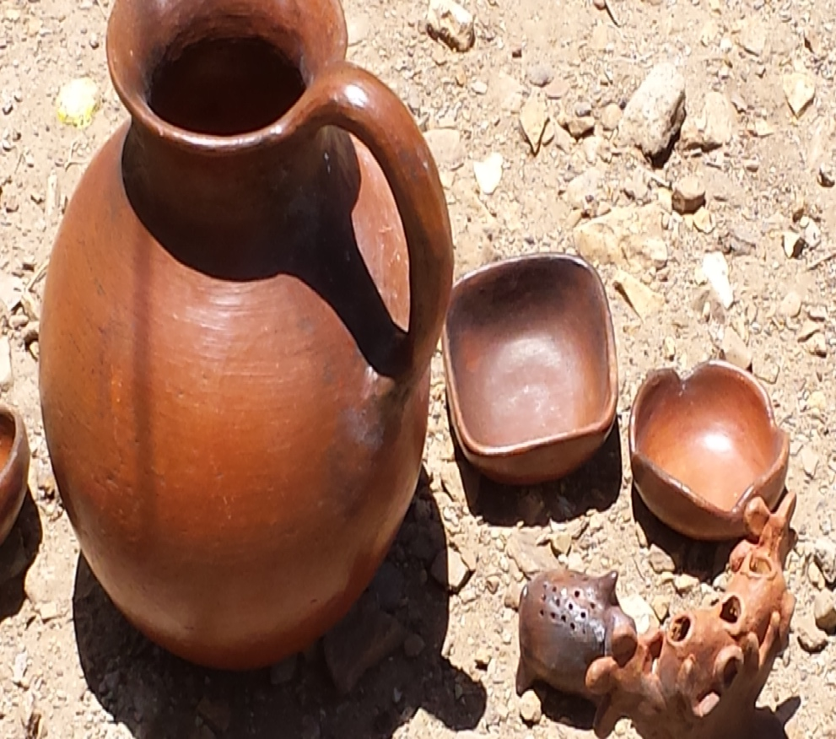
San Marcus Tlapozola
Pottery making in the area dates back at least 4,000 years.
Making functional wares is the main vocation for women in the area.
The objects are made to use and sell in other areas.

Slide 26
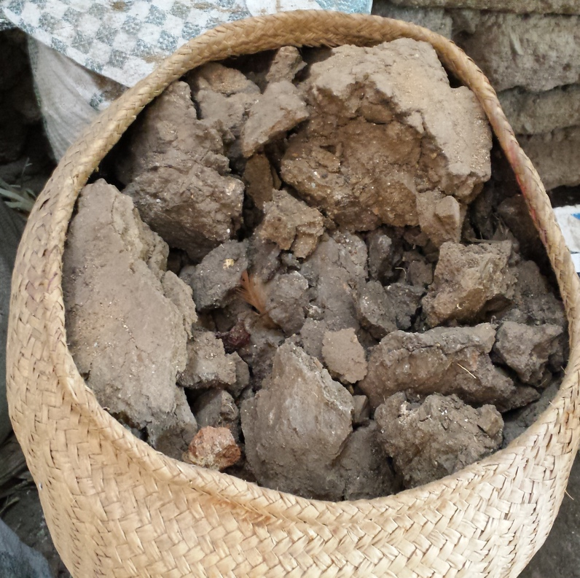
Preparation
The women must dig for the clay which is located beneath corn crops. For this reason, they can only get clay between January and May.
After it dries, the clay is dissolved in water and mixed by hand.
Tlapazola
Notes:
Marta said that they dig up the clay once a month and they take someone with them when they go.

Slide 27
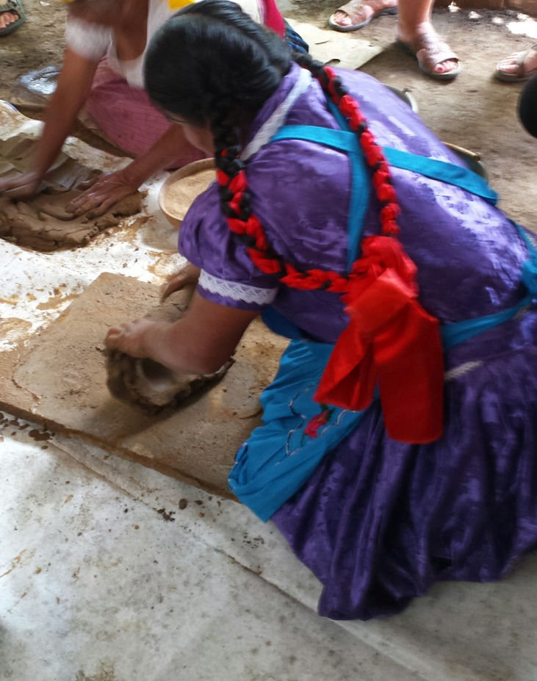
Using a straining tool, the clay is sifted to remove impurities and the good clay is put in a separate container.
Sand is then added to the clay in order to make the clay more durable.
Lastly, the clay is rolled into a thin sheet and rolled up and wedged to remove air bubbles.
Marta Antonio Martinez

Slide 28
The object is formed by using a corn husk to create the hole and pulling up the side walls while smoothing.
Virginia Gutiérrez
Notes:
Video clip

Slide 29
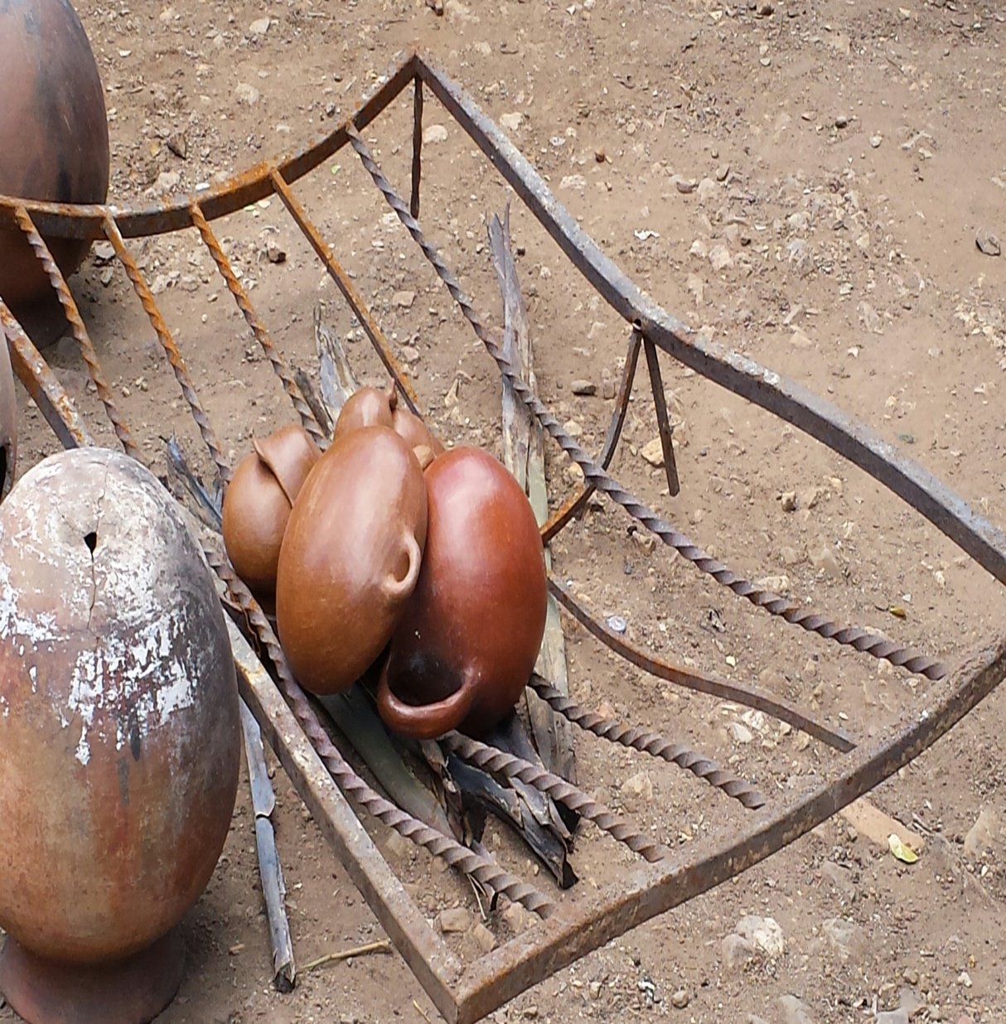
After additional layers of clay are applied, the objects are fired and burnished.

Slide 30
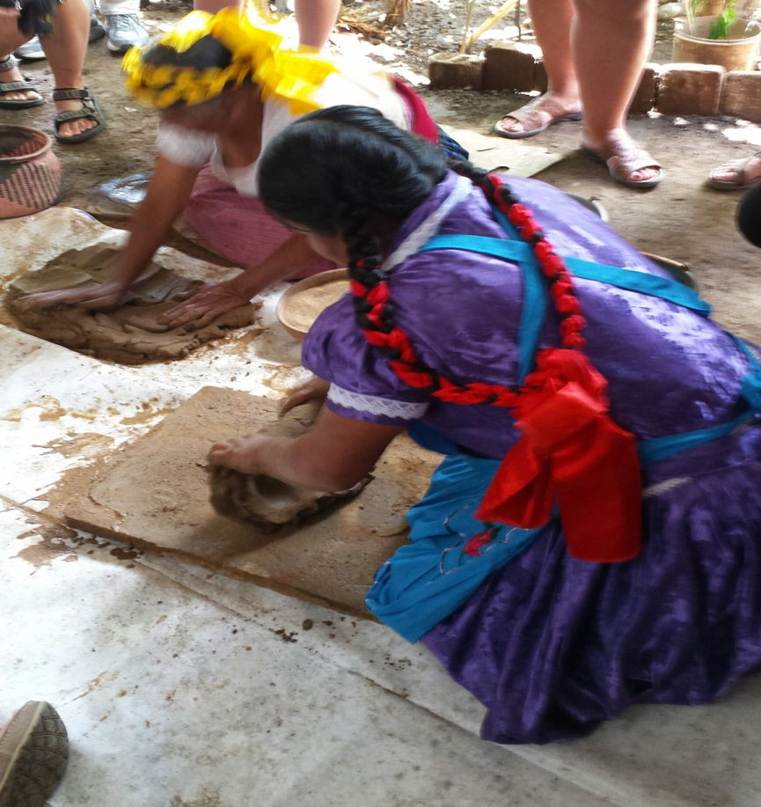
The individual
Pottery is done only by the women.
Girls learn the technique at an early age from their mothers.
It is not uncommon for women to move in with their in-laws after marriage and to see several generations within one household.
Virginia Gutiérrez
Marta Antonio Martínez

Slide 31
The community
Pottery is done by other members of the community, and each individual creates unique designs.
They do not share techniques or designs, and they are in competition when selling at the market.
Community members seem to come together when neighborhood dynamics change.

Slide 32
Discussion
What kind of information have you shared when working with classmates toward a common goal?
What are some challenges you could face when living with extended family?
Why are techniques closely guarded by community members?

Slide 33
Objectives
There are three craft making communities within the class. Based on what you have learned, join the group that you most identify with.
You will collaborate with other “family” members to produce the craft of that group (alebrije will require division of duties).
Along with the finished projects, you will turn in your observations of the process.
You will be graded on design, craftsmanship, and use of class time.

