Slide 1
Project Perspective:
Who am I? Who are you?

Slide 2
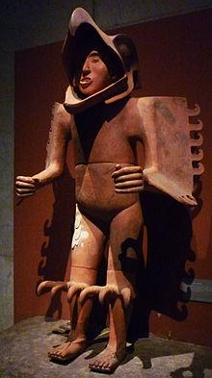
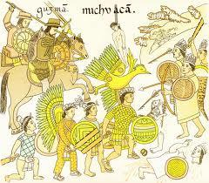
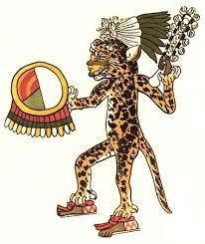
Artisans - Farmers at War
Eagle Warrior Scene of Battle, Codex Azcatitlan Jaguar Warrior

Slide 3
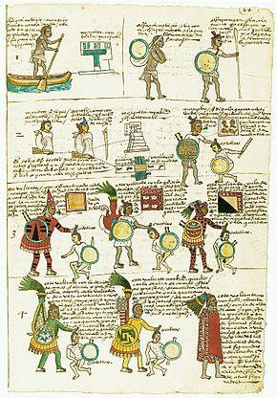
Aztec Warriors in Training
Warriors were essential to Aztec life and culture. ‘At birth an Aztec boy would receive two symbols of being a warrior. A shield would be placed in his left hand, and an arrow would be placed in his right. After a short ceremony the boy's umbilical cord, shield, and arrow would be taken to a battlefield to be buried by a renowned warrior.’ These parts would symbol the rise of a warrior.
Codex Mendoza

Slide 4
Aztec Warriors in Training
‘The sons of commoners were trained in the Tēlpochcalli "house of youth". At age fifteen boys would train to become a warrior. War captains and veteran warriors had the role of training the boys how to handle their weapons. This generally included showing them how to hold a shield, how to hold a sword, how to shoot arrows from a bow and how to throw darts with an atlatl. Boys in training were only considered real men when they captured their first warrior.’

Slide 5
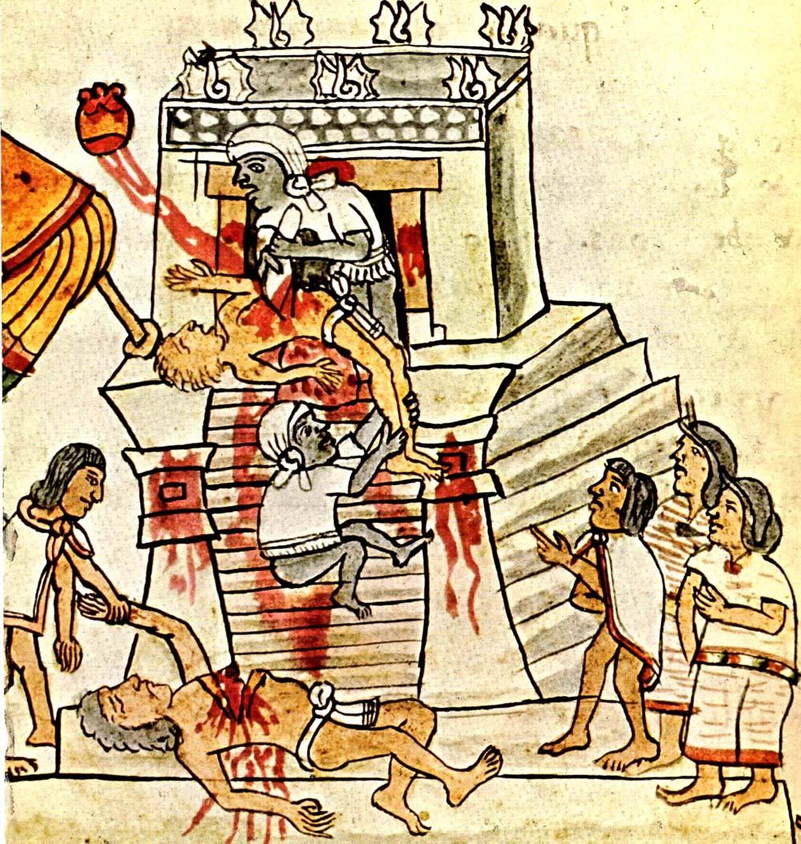
The Fate of a Captive:
The sacrifice of war captives was an important part of many of the Aztec religious festivals. Warfare was therefore one important way to obtain sacrifice offerings, appease the gods, and keep the natural forces of the Earth in balance.
Codex Magliabechiano

