Slide 1
Making Feedback on Student Work Meaningful and Manageable
UO Online/TEP "Remote Teaching Ideas" Workshop Series
May 11, 2020

Slide 2
Agenda
Welcome!
Chat Question
Pedagogy of Feedback
Breakout Rooms
Feedback Strategies & Tools
Instructor Feedback
Peer Feedback
Wrap-Up

Slide 3
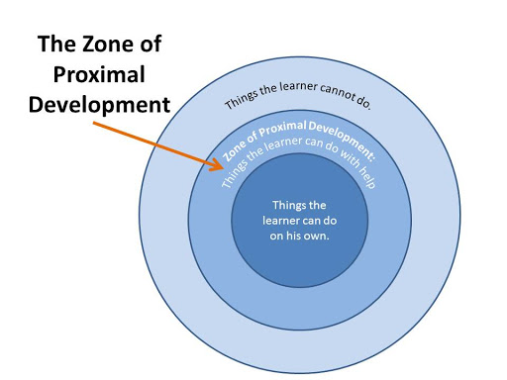

Slide 4
Instructor Spotlight

Slide 5
Breakout Rooms!
What strategies do you already use to manage the workflow of providing feedback to students?

Slide 6
Modeling Feedback with Announcements & Discussions

Slide 7
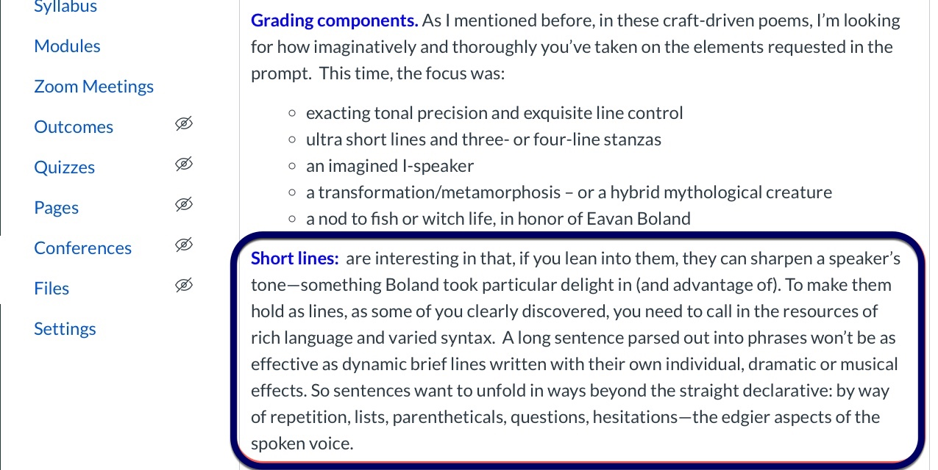
Global Feedback via Announcements

Slide 8
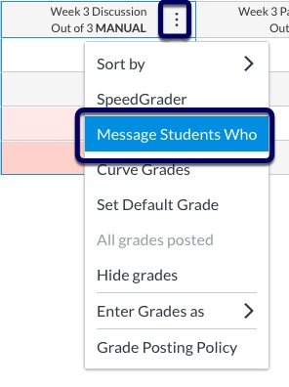
"Message Students Who..."

Slide 9
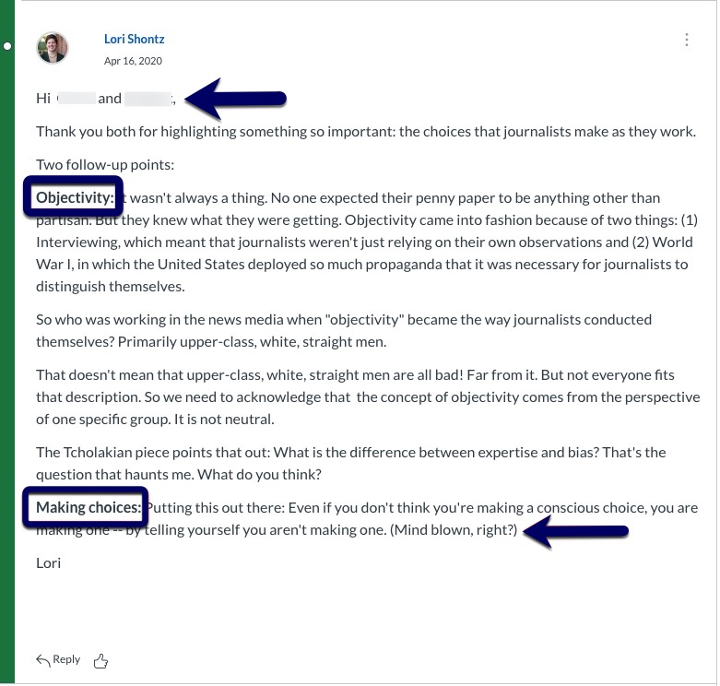
Feedback in Discussion

Slide 10
Feedback using Rubrics

Slide 11
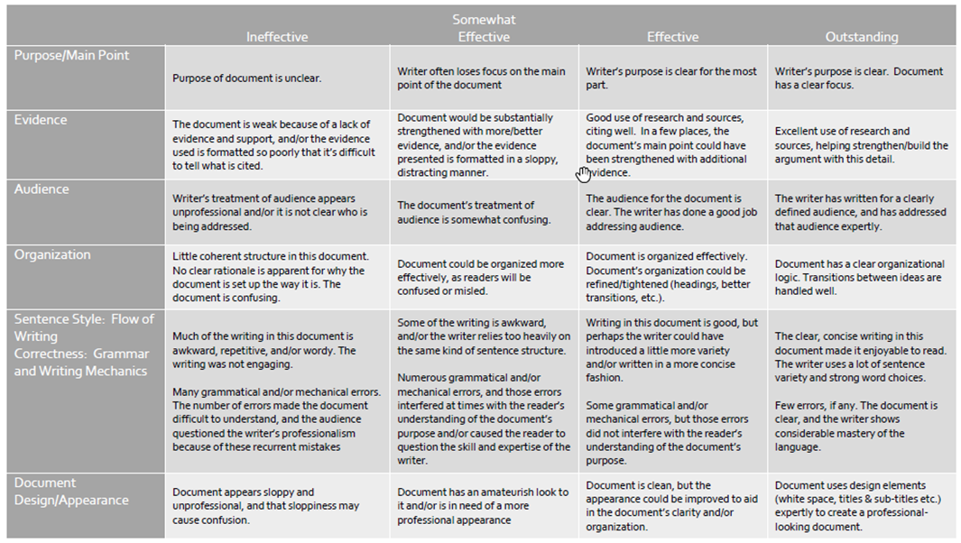
Rubric Structure

Slide 12
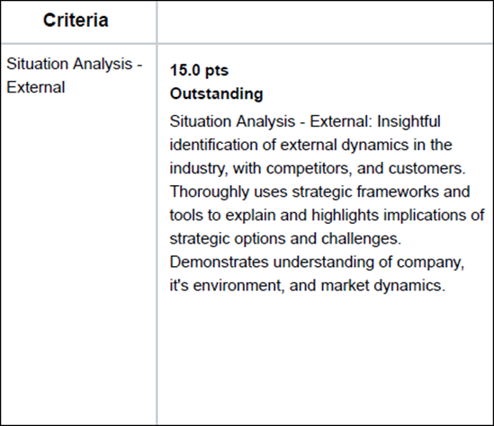
Provide clear expectations

Slide 13
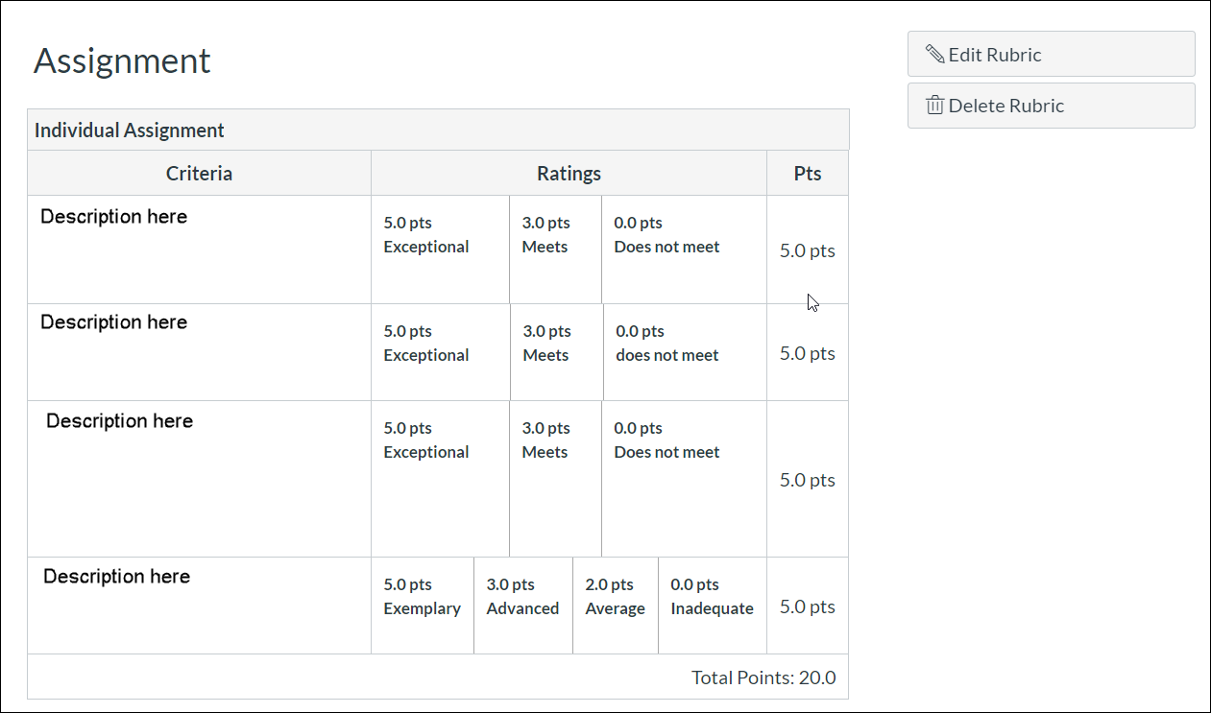
Canvas Rubric Tool

Slide 14
Feedback through Formative Quizzes

Slide 15
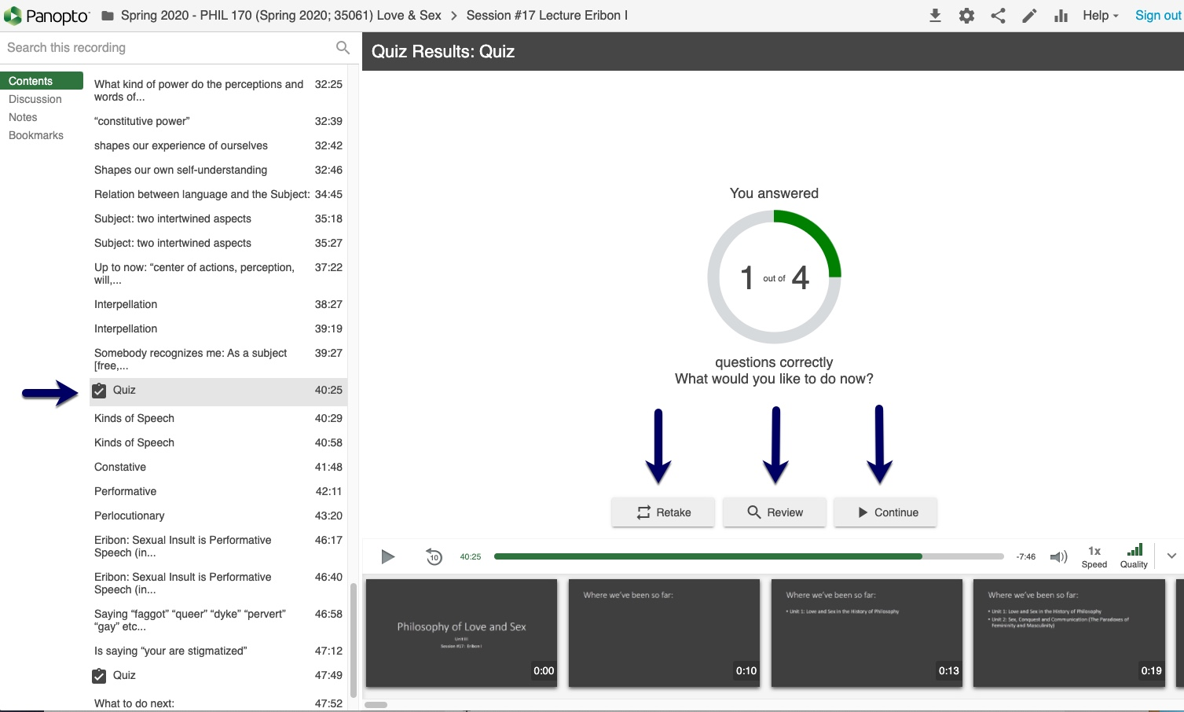
Formative Quizzes in Panopto

Slide 16
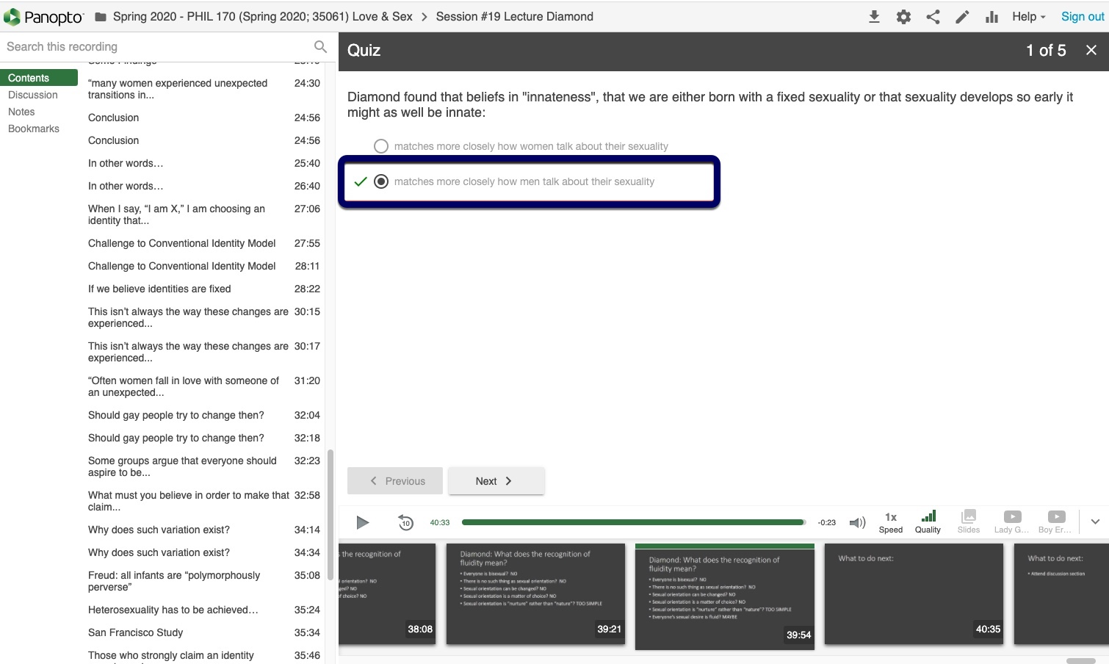

Slide 18
Peer Feedback

Slide 19
Peer Feedback: Benefits & Strategies
Enriches the learning experience
students learn by both giving feedback and receiving peer feedback
opportunity to teach metacognitive practices
Notes:
(It’s important for us to remember) Feedback isn’t just a task for instructors – providing and receiving feedback can be a powerful learning opportunity for students!
Giving constructive feedback is an important skill in the professional world; it is partly our responsibility to teach this skill to students, first by modelling and then by empowering.

Slide 20
Peer Feedback: Benefits & Strategies
Alternate means of engaging deeper thought
Round-out course engagement hours with peer feedback assignments

Slide 21
Peer Feedback: Benefits & Strategies
Practice building professional skills
written/verbal communication
constructive, objective evaluations
operating computer systems/software

Slide 22
Peer Feedback: Benefits & Strategies
Places more responsibility on the student
Can lighten professor’s load, especially in large classes
Can be rewarded (points in the Gradebook)

Slide 23
Peer Feedback: Benefits & Strategies
1 thing you like & 1 thing to improve
Provide a rubric for peer reviewers to follow
Consider anonymous feedback submissions

Slide 24
Peer Feedback: Venues
Canvas Discussions
Canvas Peer Review tool
Canvas Groups
Zoom

Slide 25
Peer Feedback: Venues
Canvas Discussions
focused & threaded discussions
add text, links, images, videos and more with Rich Content Editor

Slide 26
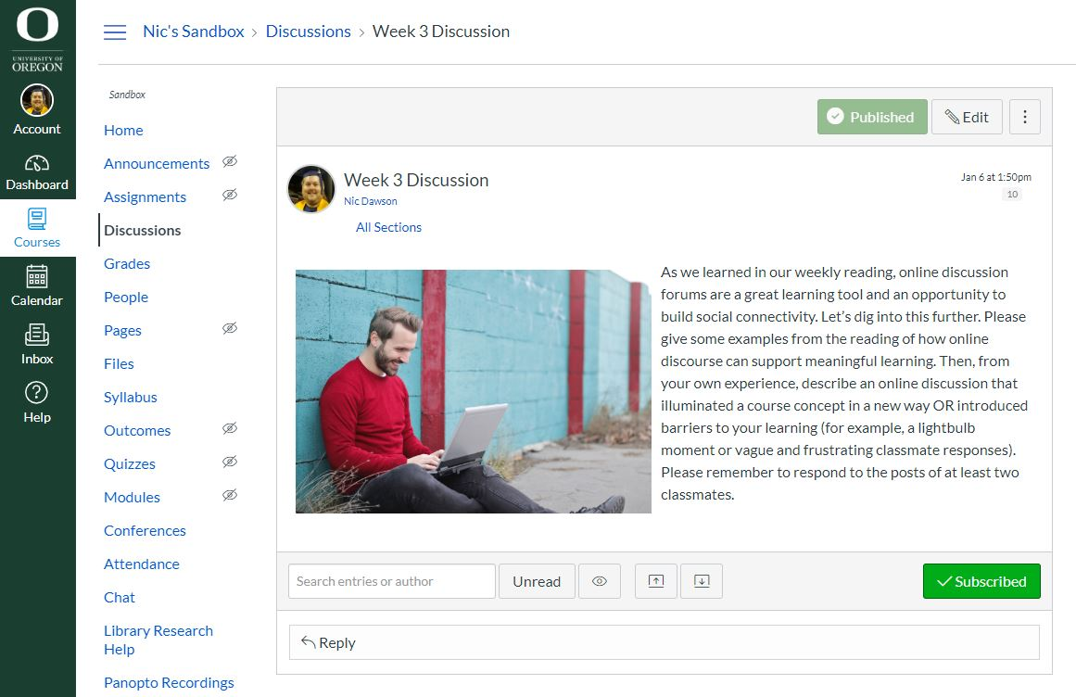
Canvas Discussions
focused & threaded discussions
add text, links, images, videos and more with Rich Content Editor

Slide 27
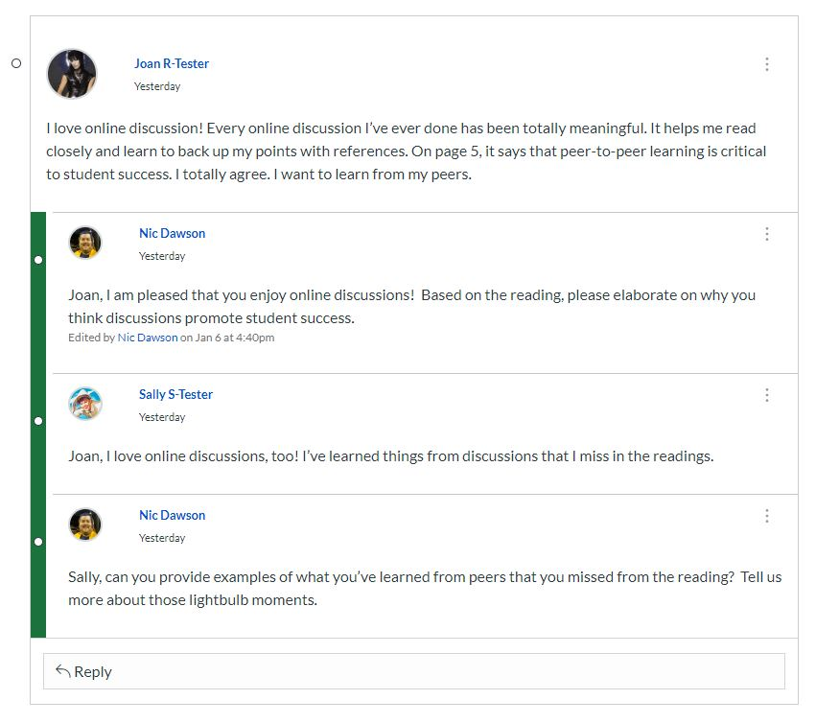

Slide 28
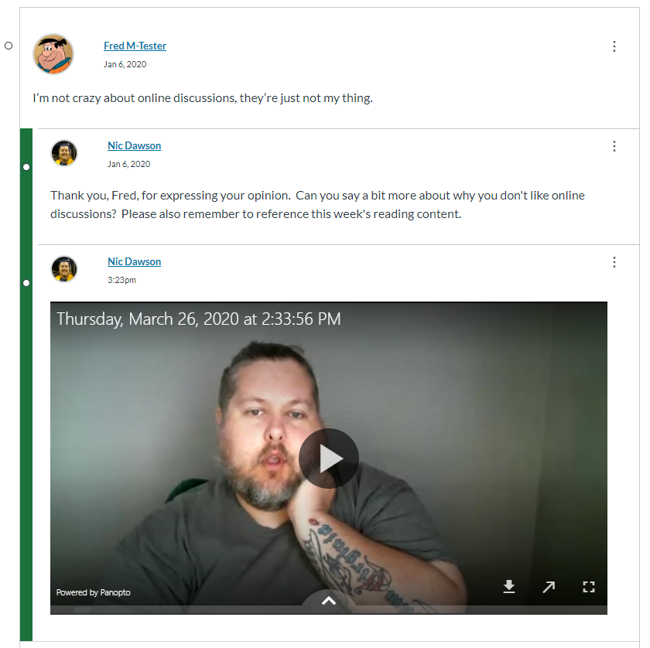

Slide 29
Peer Feedback: Venues
Canvas Peer Review Assignments
student-to-student feedback on assignment submissions
similar to SpeedGrader
students manually or randomly assigned
students must interact with the assignment rubric for points to appear in Gradebook

Slide 30
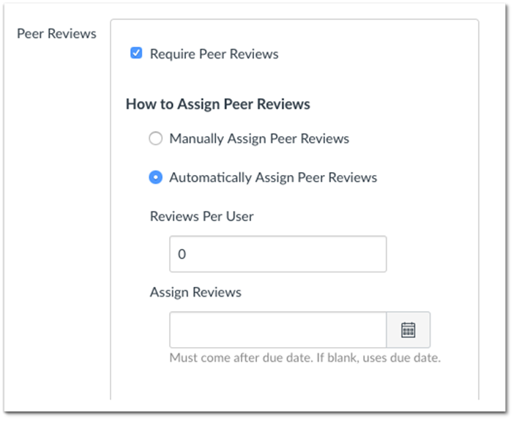

Slide 31
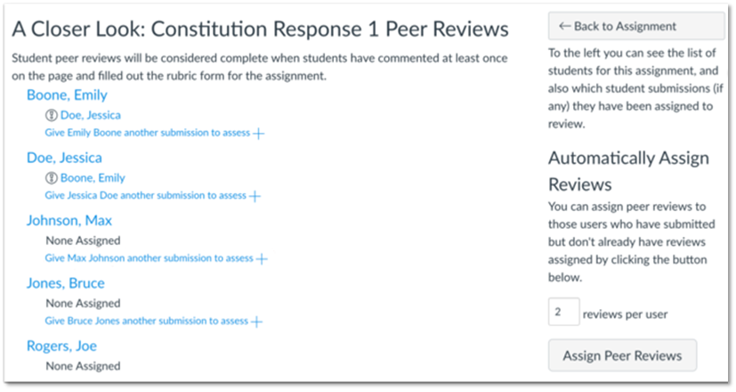

Slide 32
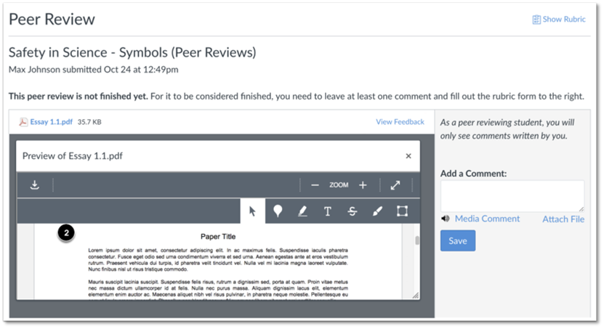

Slide 33
Peer Feedback: Venues
Canvas Groups
Collaborative tool for student projects, assignments, study groups
created by instructor or students

Slide 34
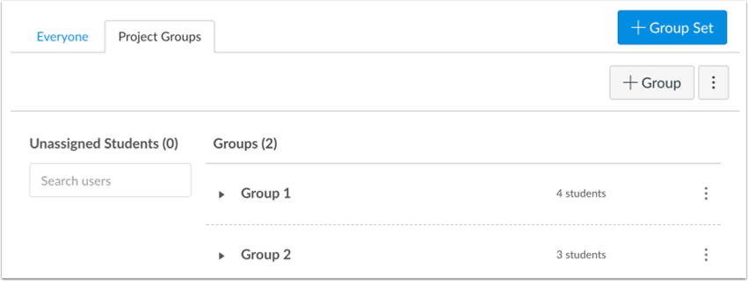

Slide 35
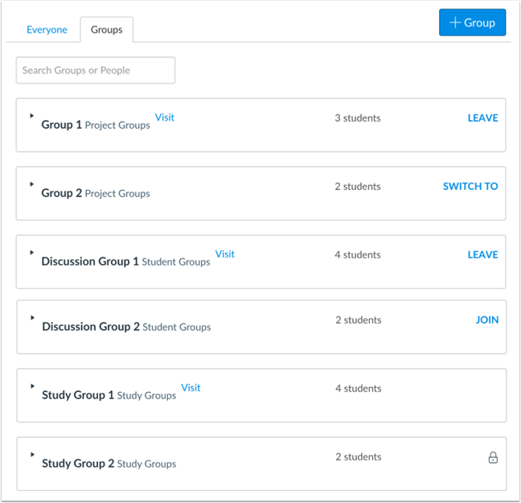

Slide 36
Peer Feedback: Venues
Zoom Breakout Rooms
provide live feedback to peers
students can be pre-assigned to rooms

Slide 37
Key Takeaways...
What key ideas will you take away from this time together? (Participant responses)
New avenues for feedback and student interaction
“Message Student Who….” Tool in Gradebook
Different ways to give comments and peer review assignments
Adding audio or video feedback to assignments for an additional personal touch
Canvas announcement used well for characterizing student performance on an activity

