Slide 1
Jordan Schwartz
Atlanta Shakespeare Tavern
AAD 617 | Winter 2017

Slide 2
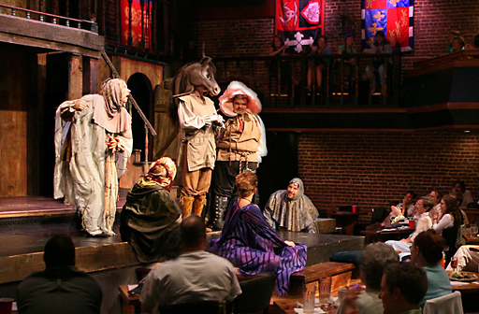
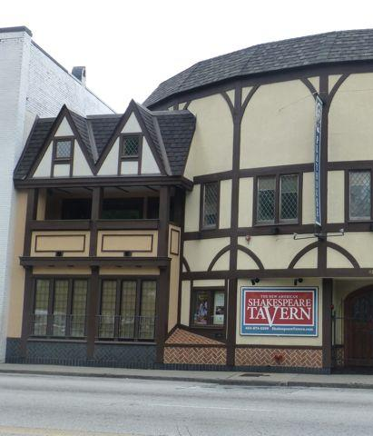
Atlanta Shakespeare Tavern - Founded 1984

Slide 3
Marketing SWOC Analysis
Strengths Variety of social media profiles Lots of things linked to their website Great programming | Weaknesses Ugly, messy website Not maximizing social media Missing the polish Need to engage with a younger audience
Opportunities More photos and videos! (Instagram and Snapchat) Free online website builders! More event advertising! | Challenges Staff time Balancing old and new patrons

Slide 4
My Recommendations
1.- Build a New Website on Squarespace
2.- Improve Instagram Aesthetic
3.- Advertise shows and events on Nearify
4.- Get a Snapchat

