Slide 1
OSLP Marketing Strategy Pitch
Lauren Wagner and Juliet Rutter

Slide 2

Intro
What we (two) understood from your previous presentations...
Strategies
  How these play into your needs
Tactics
  How to employ the strategies to achieve your goals
Evaluation
  How to see if the tactics are working

Slide 3
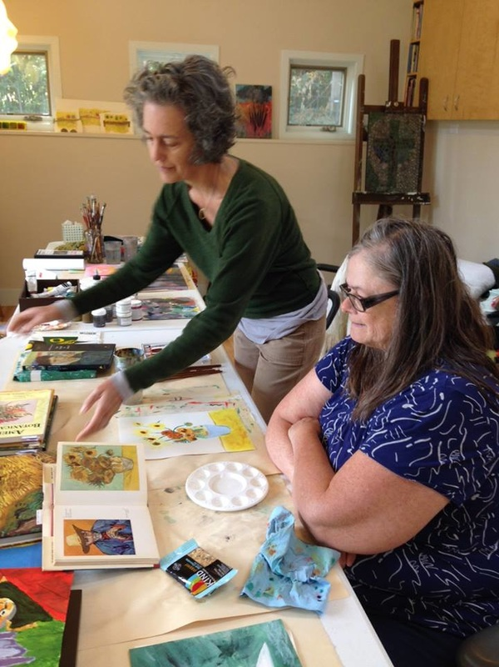
Strategies
Sales Promotion
  Create value for your art
Relationship Marketing
  Create value for your organization
Experiential Marketing
  Inspire people to continue to be involved

Slide 4
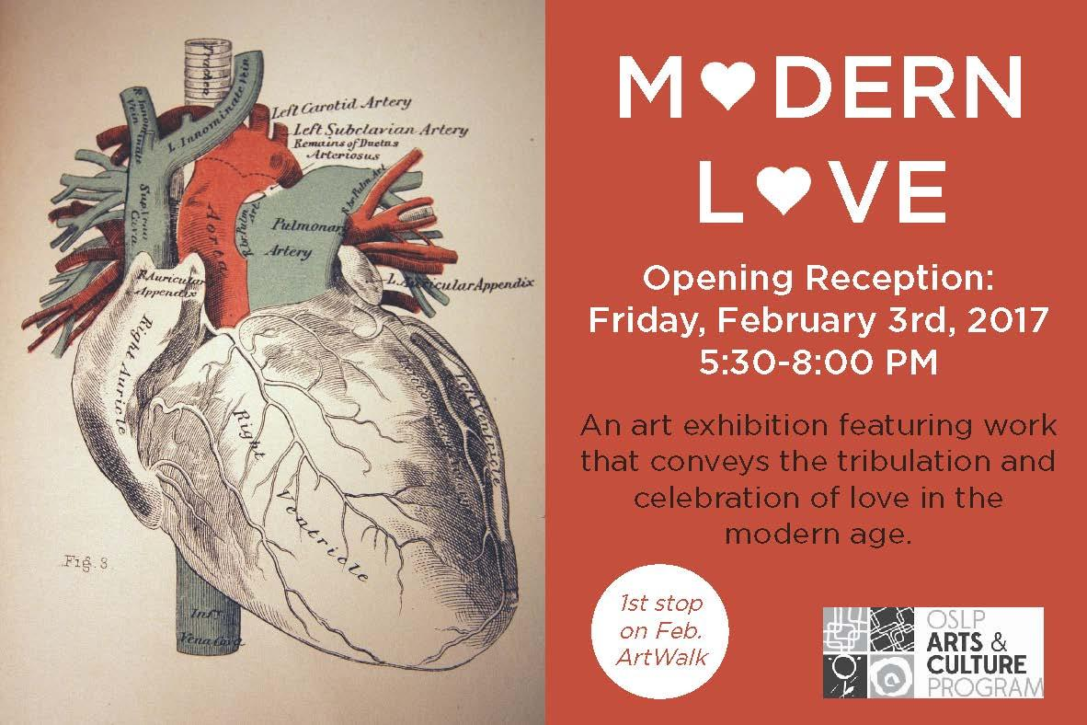
Tactics: Sales Promotion
Coupon Marketing
  groupon, punch cards
Dynamic Pricing
  early bird and late gambler
Renting out the Gallery
Testimonials
Auctions
  silent and not
Social Media/ Website Sales

Slide 5
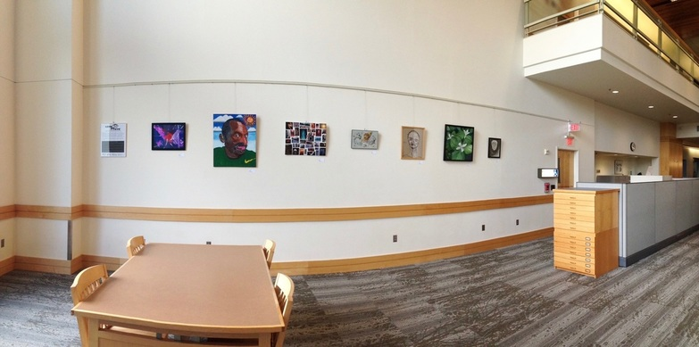
Tactics: Donor Cultivation
Tiered donation groups
  #1 will fund a student, #2 will fund a whole class, etc.
Donor acknowledgement
  on promotions and through events
Team-building opportunities for local businesses

Slide 6
Tactics: Audience Cultivation
Connecting various communities
Winery/brewery art collaboration/fundraiser event
Partner with other organizations that could be signed up for classes and/or a dual-mentorship approach (i.e. boys and girls club)
Alternate locations

Slide 7
Evaluation
Ratio Evaluation
Sales Volume
Donor/ Audience/ Volunteer Cultivation
Donor/Audience/Volunteer Retention
Surveys

Slide 8
Questions???
Questions?
Comments?
Points of interest?
Trivia?

