Slide 1
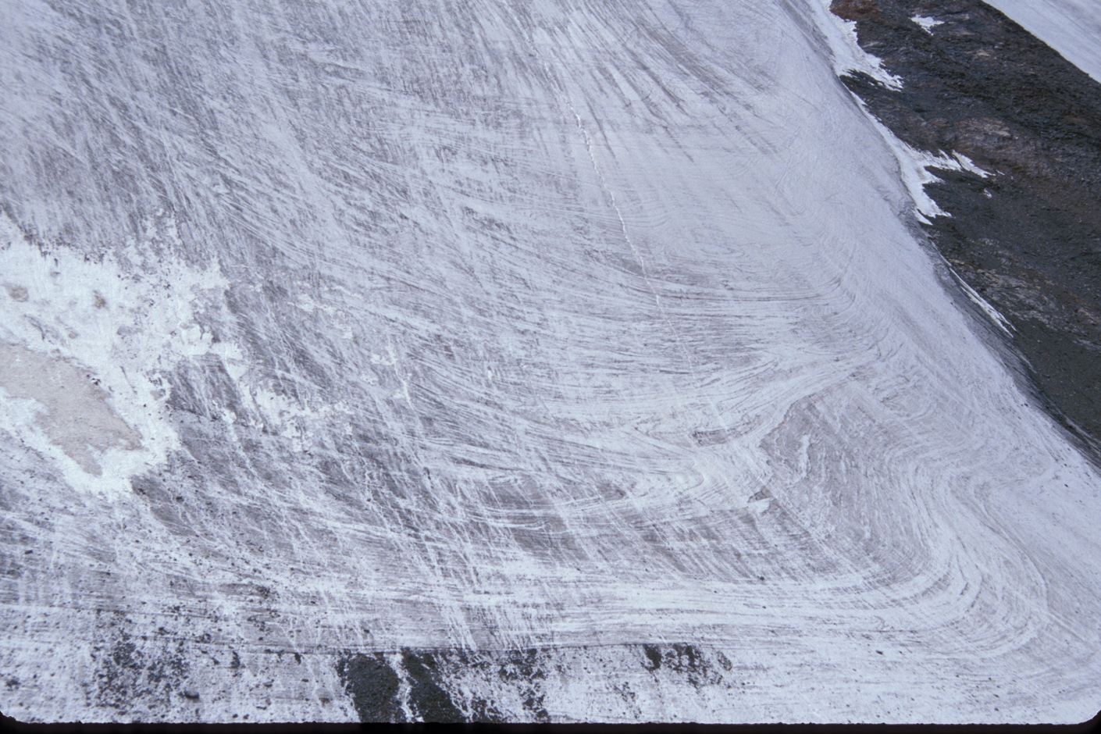
Copyright © Jeff Munro 2002
Notes:
Folds exposed in the terminus of Glacier #3, headwaters of the Urumqi River, Tian Shan, northwestern China.

Slide 2
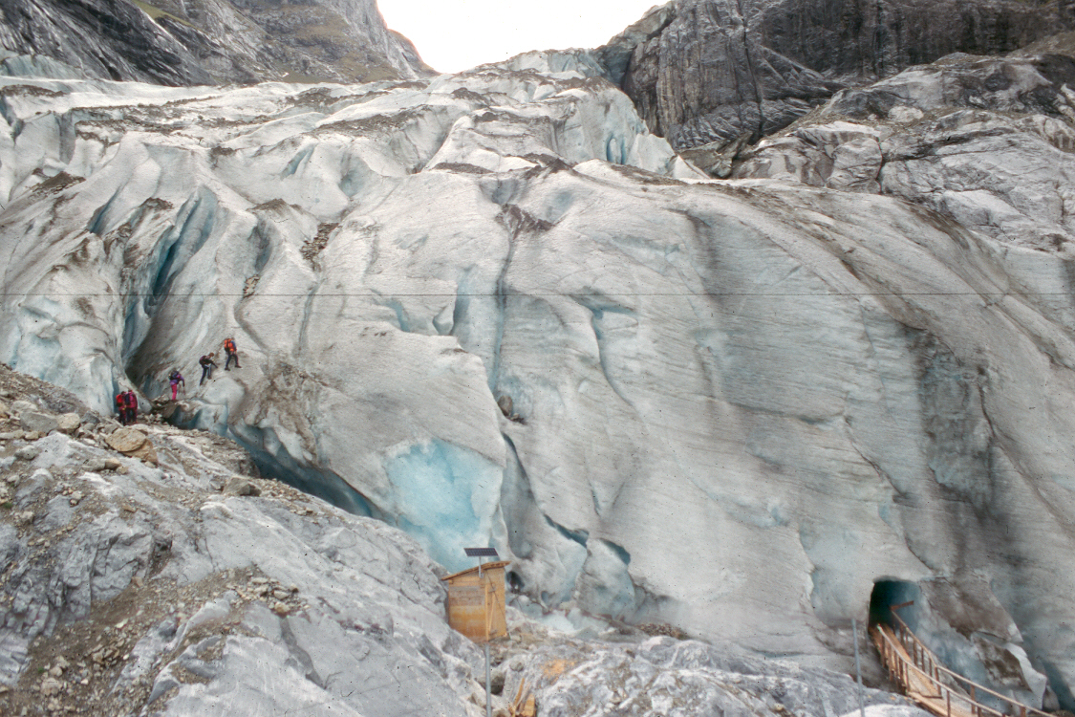
Copyright © Richard Kesel 2002
Notes:
Valley glacier in the Swiss Alps. The light blue is the base of the glacier (note cave).

Slide 3
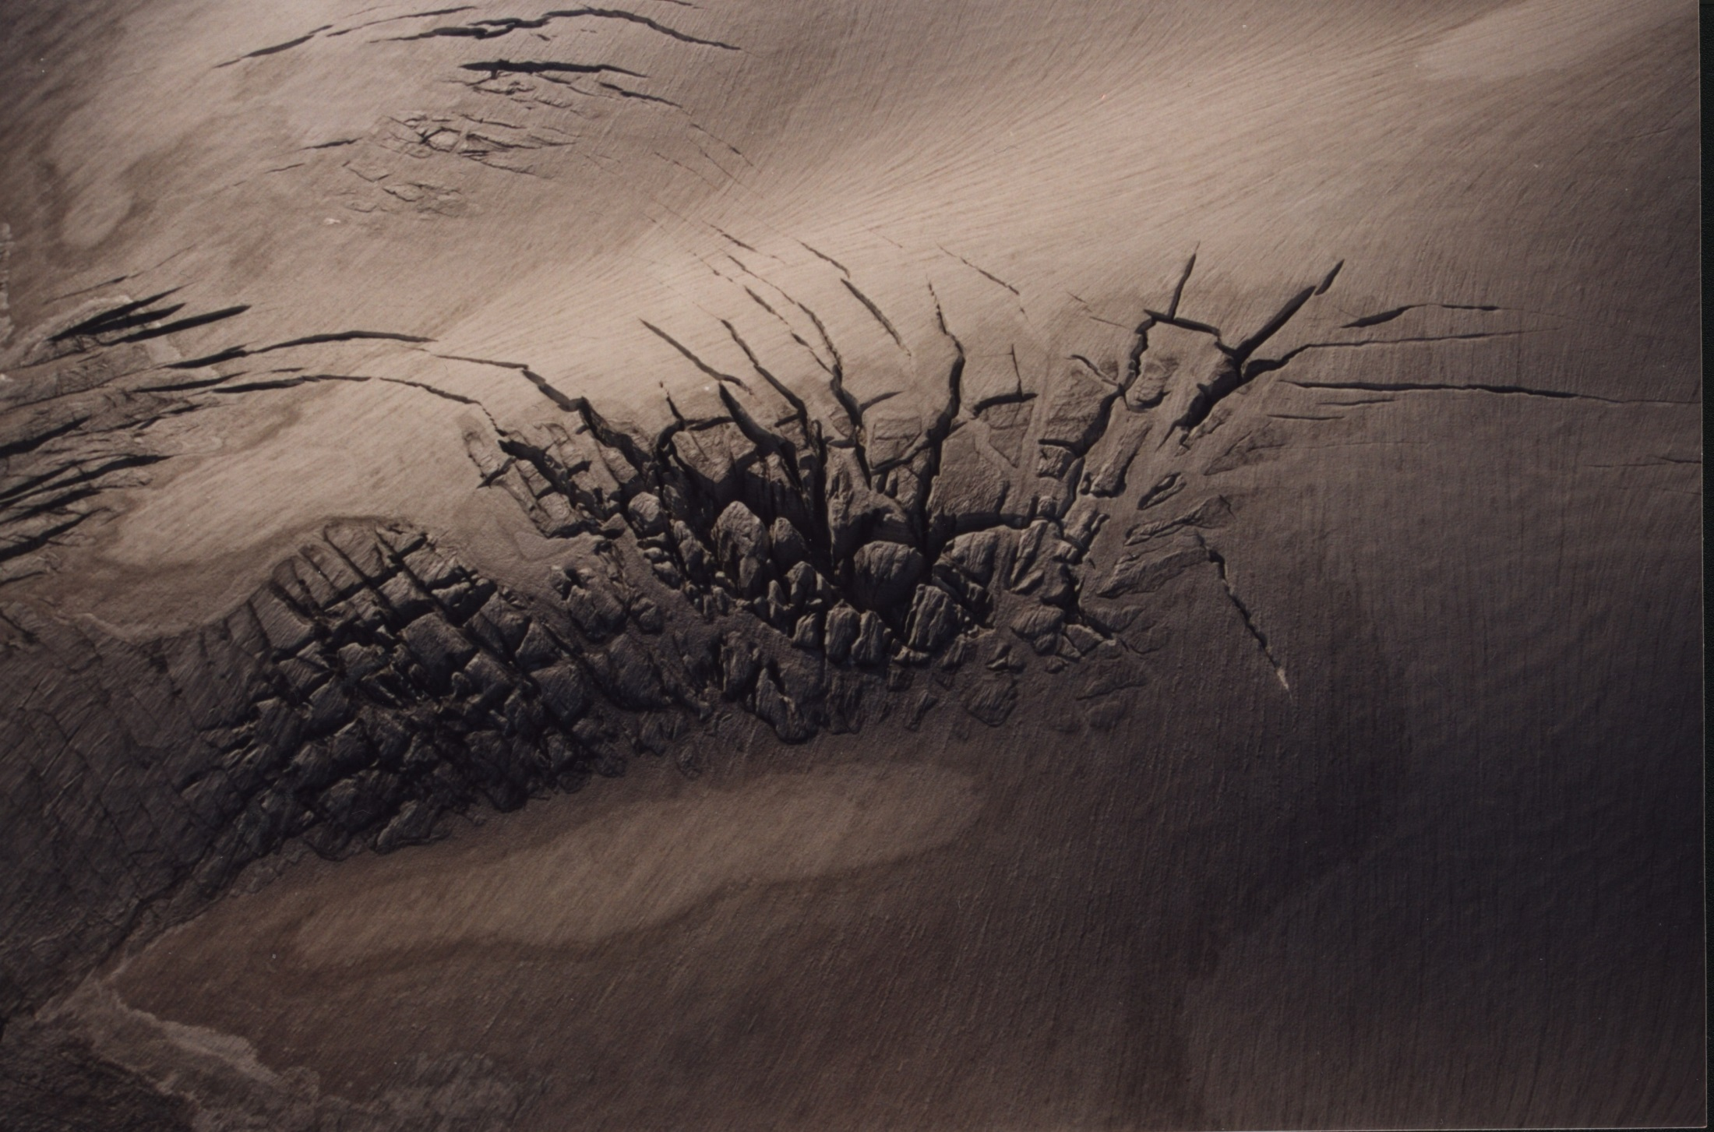
Copyright © Mariette Prent 2002
Notes:
Surficial crevasses – Kokanee Glacier, B.C.

Slide 4
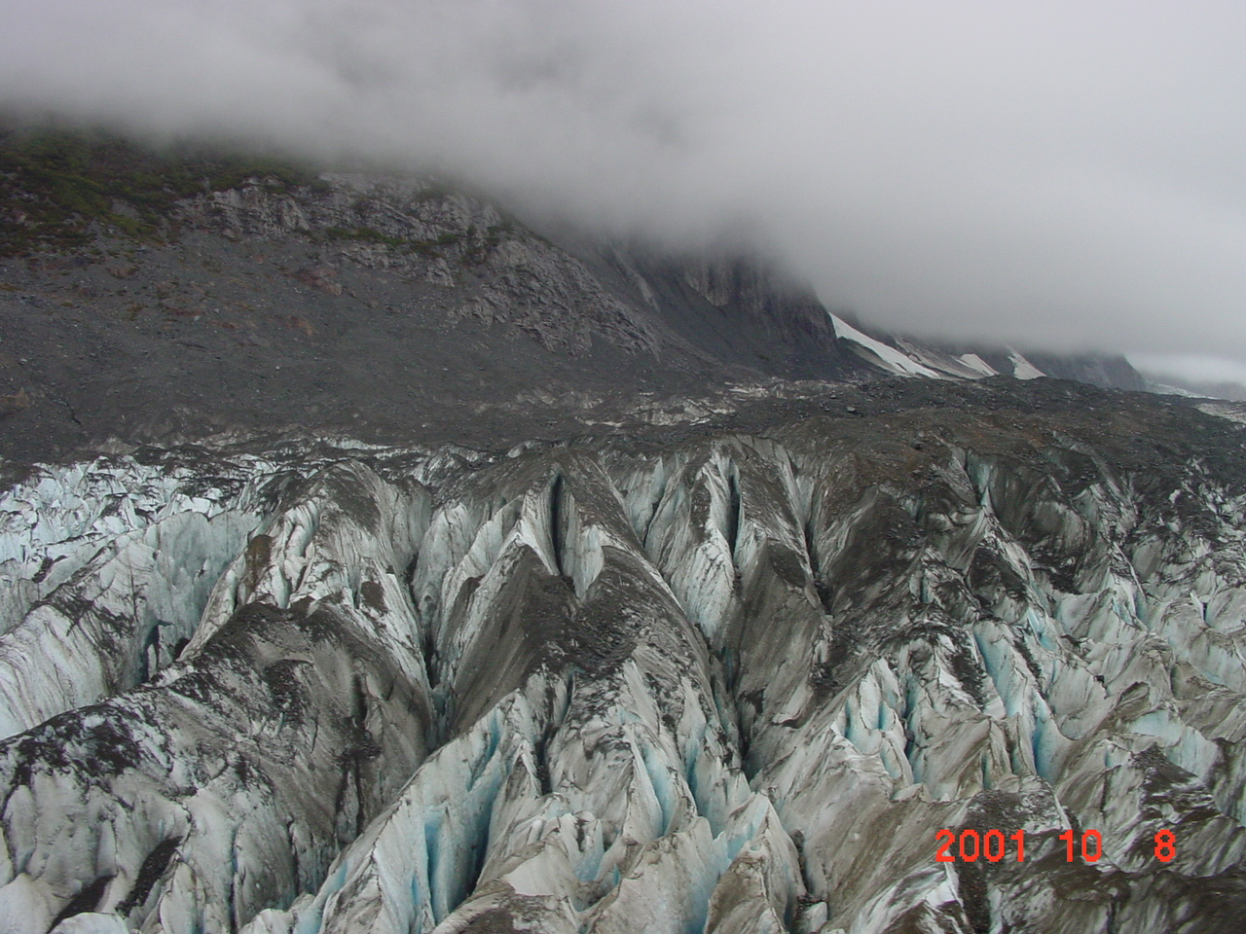
Copyright © Martin Geertsema 2002
Notes:
Crevasses on the Tulsequah glacier.

Slide 5
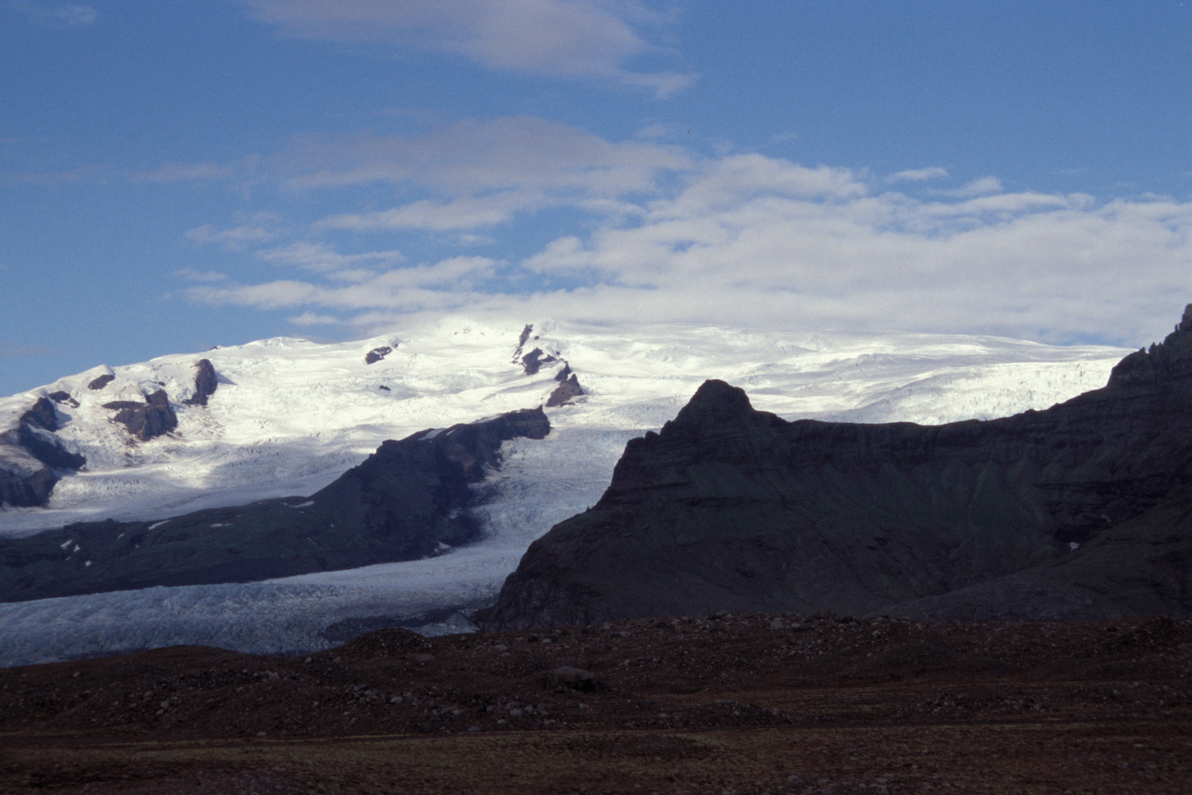
Copyright © Jeff Munro 2002
Notes:
Vatnajokull Ice Cap, Iceland.

Slide 6
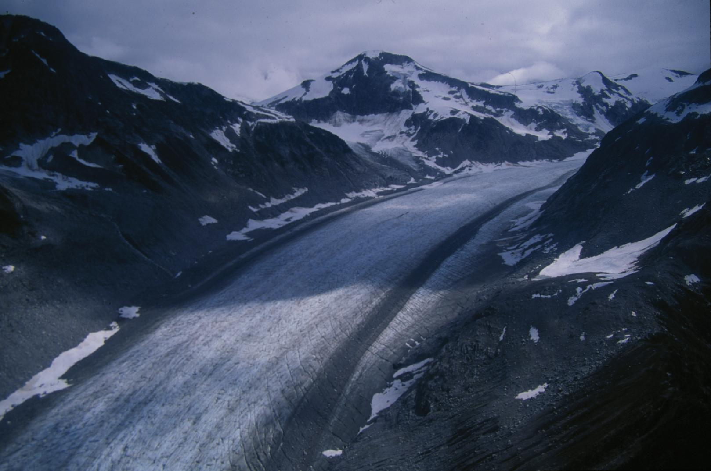
Copyright © Matthias Jakob 2002
Notes:
Lillooet Glacier, southwestern B.C., Canada.

Slide 7
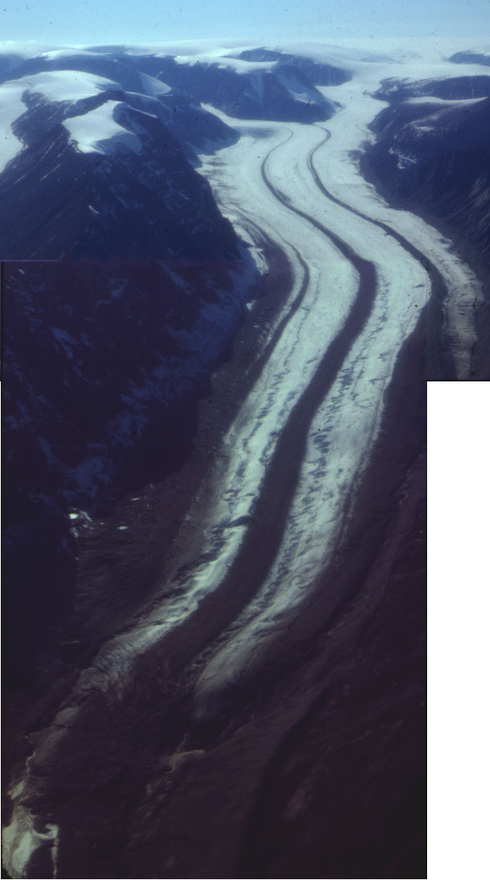
Copyright © William Locke 2002
Notes:
Outlet and moraines - panorama of outlet glacier from Penny Ice Cap, Baffin Island, Nunavut, Canada showing persistence of medial moraines to the glacier terminus. Note meandering supraglacial drainage.

Slide 8
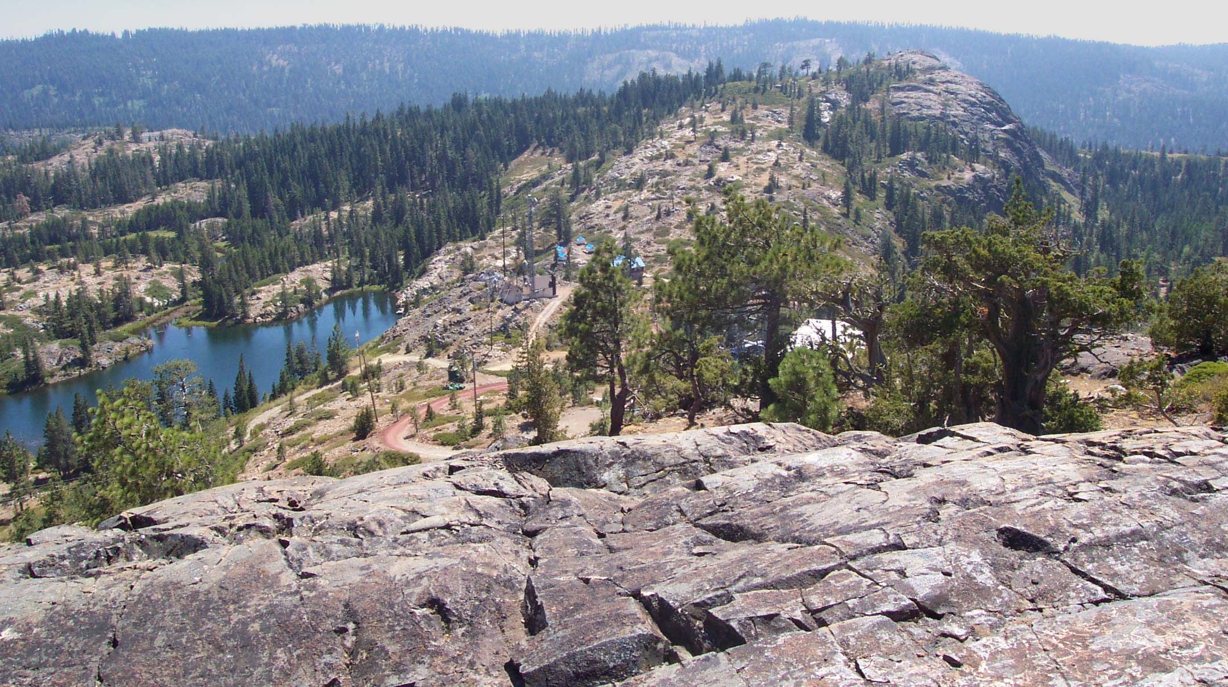
Copyright © Allan James 2002
Notes:
A roche moutonnee with strong asymmetry between gently sloping up-ice side and steeply sloping down-ice side. Ice was over the top of this hill and flowed from left to right. The asymmetry results from (1) higher pressure and pressure-melting on the up-ice side which keeps rock material at the base and enhances abrasion, and (2) lower pressure and freezing on the down-ice side encouraging plucking and quarrying. This example is Hill 6542 in South Yuba Canyon which was glaciated by late glacial maximum (Tioga) ice. View to south from Cisco Butte, which is also a roche moutonnee.

Slide 9
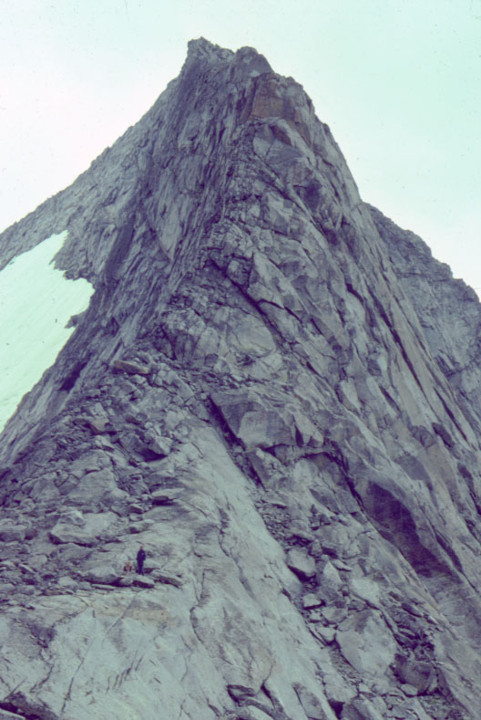
Copyright © William Locke 2002
Notes:
Arête - Side view of arête - Angel Pass, Wind River Range, WY. Note intersecting exfoliation joints with greater spacing inward. Person and dog in lower left for scale.

Slide 10
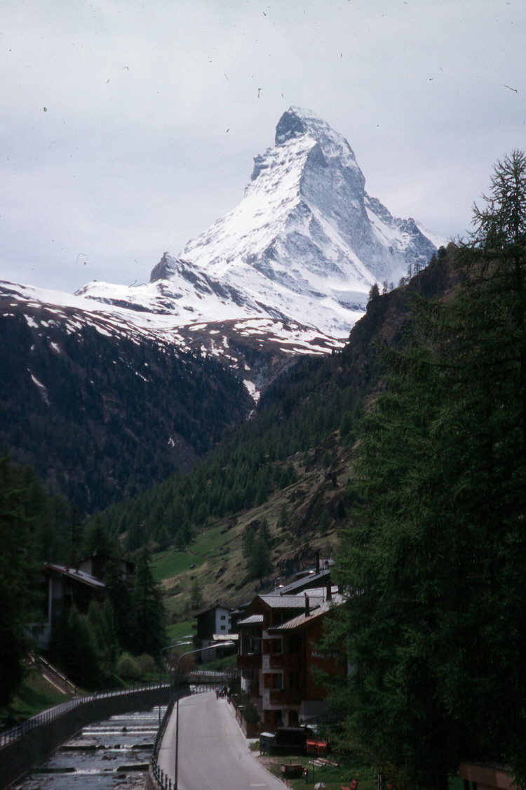
Copyright © Richard Kesel 2002
Notes:
The Matterhorn, Switzerland.

Slide 11
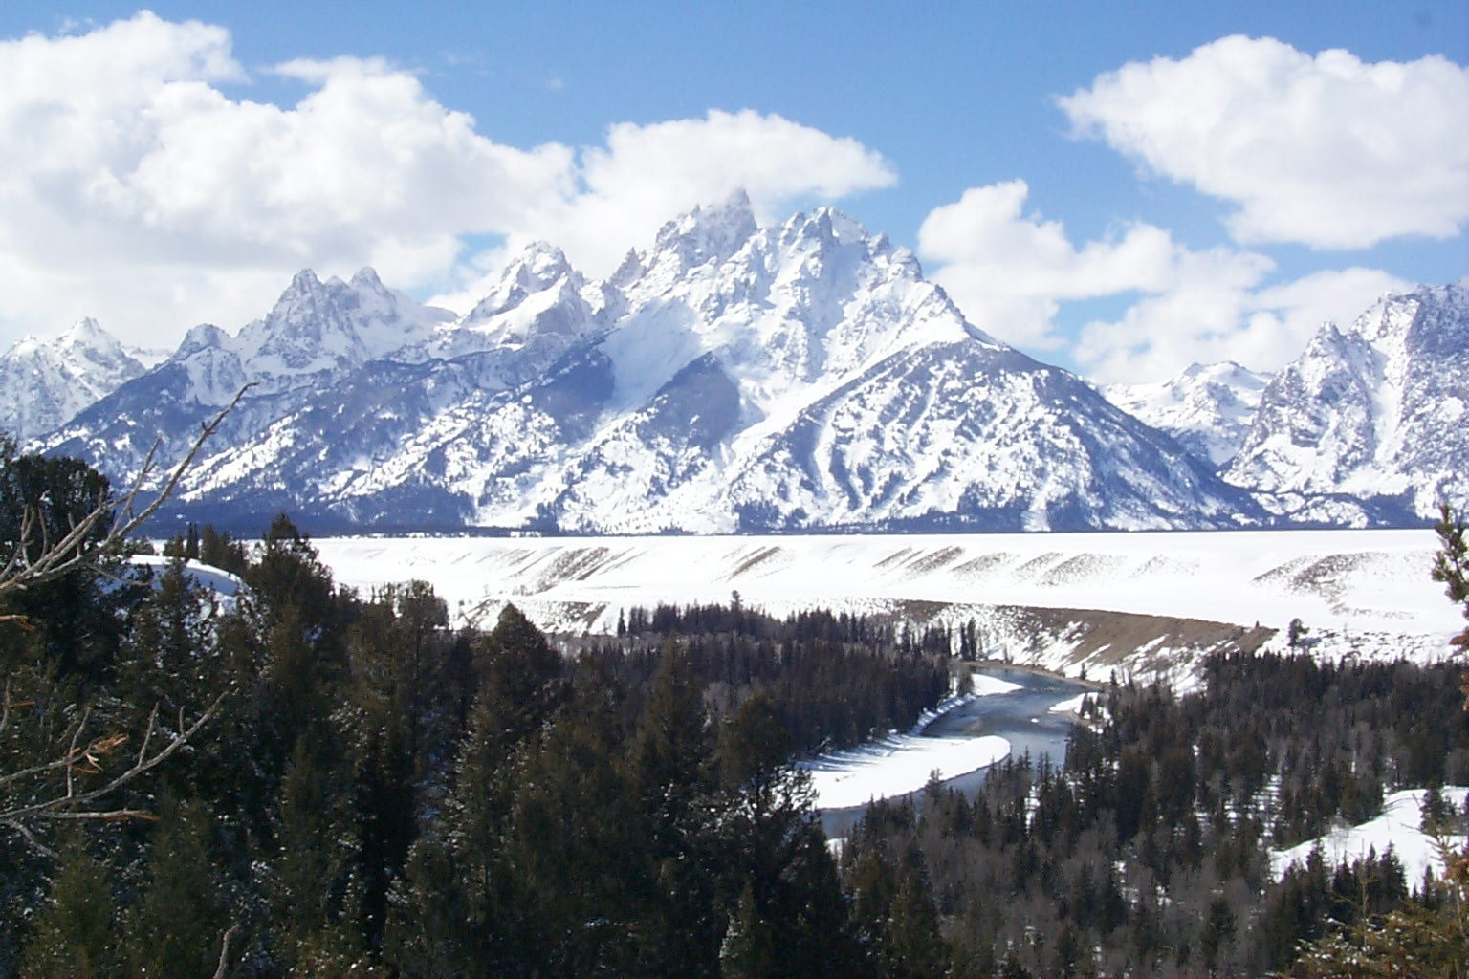
Copyright © Danny Vaughn 2002
Notes:
Glacial horn, aretes, hanging troughs, normal fault along the base of the Teton Mountains (fault block mountain) with a loess mantled outwash terrace formed along the Snake River in the foreground. Jackson Hole, Wyoming .

Slide 12
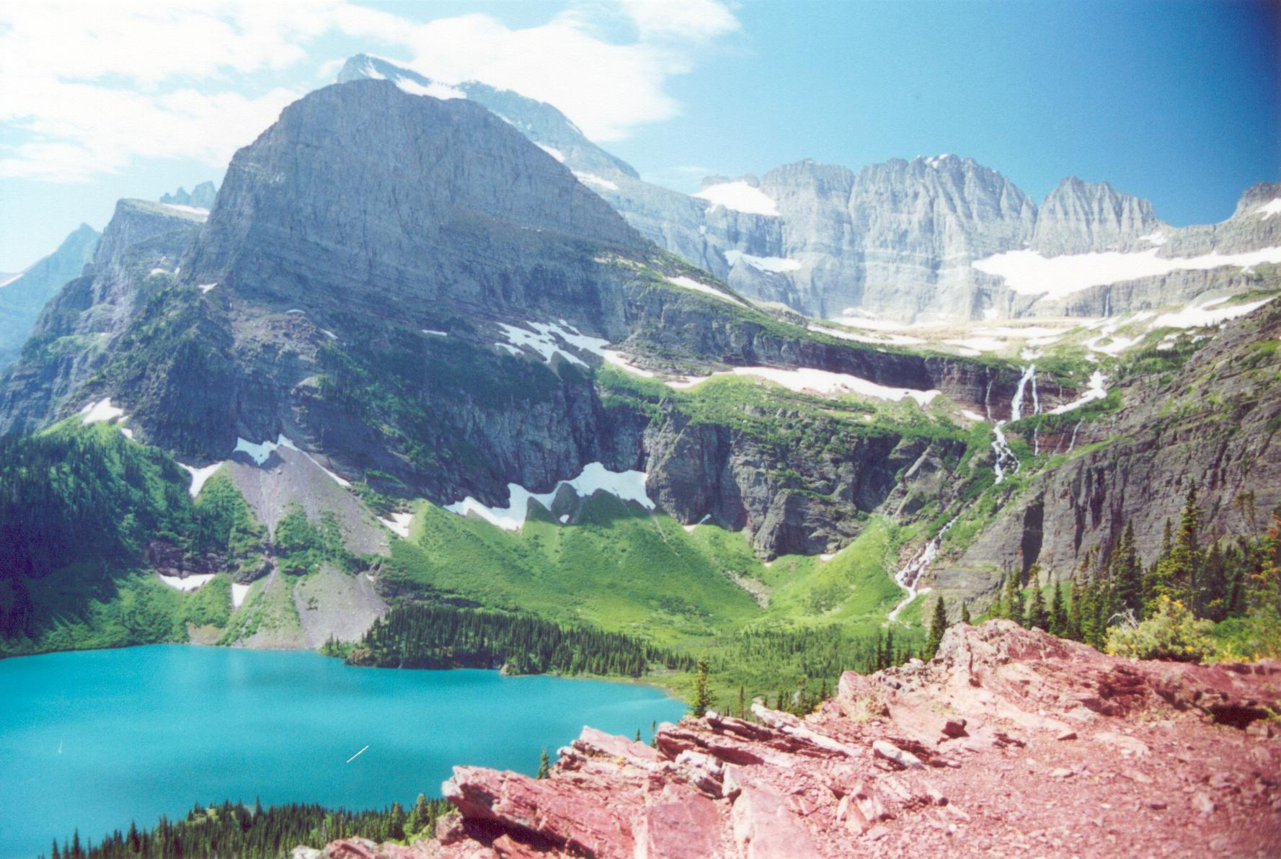
Copyright © Bob Andrle 2002
Notes:
Grinnell Lake with the Grinnell Glacier rock step, cirque, and headwall in the upper right, view from Grinnell Glacier Trail, Glacier NP.

Slide 13
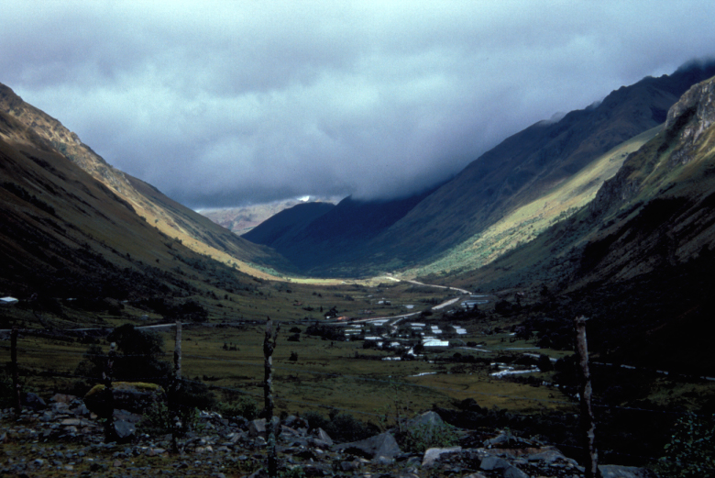
Copyright © Carol Harden 2002
Notes:
U-shape of the valley of the Tomebamba River, upstream and west of Cuenca, Ecuador. The valley shape (in addition to cirques and tarns and moraines upstream) provides evidence of glaciation, which occurred here during the Pleistocene. Active glaciers still exist at higher altitudes in Ecuador, including on the mountain Cayambe, which sits on the Equator.

Slide 14
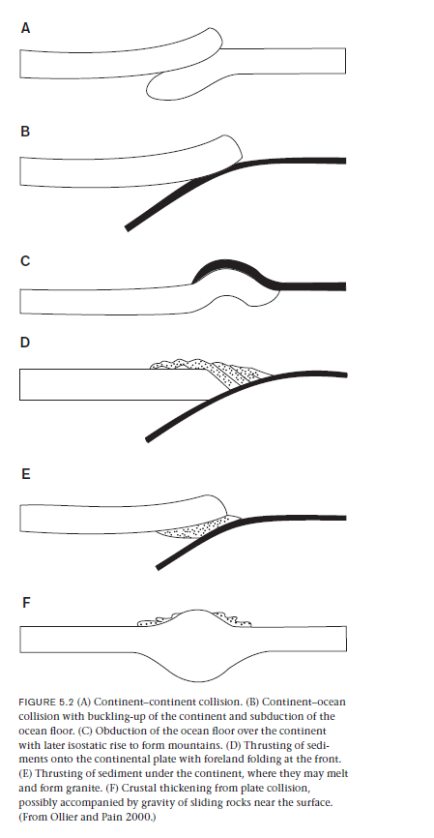
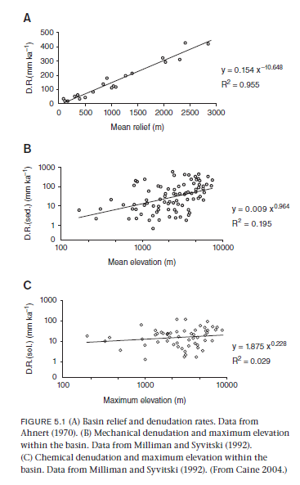

Slide 15
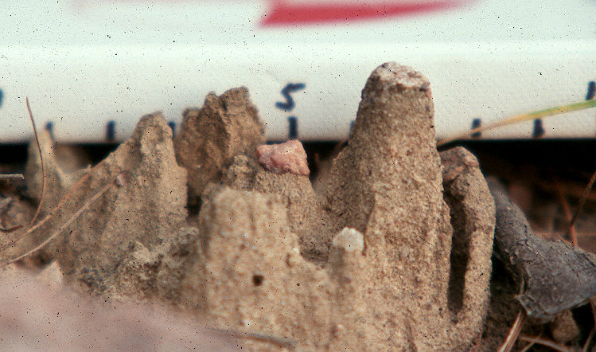
Copyright © Daryl Dagesse 2002
Notes:
Erosion pillars, Buckhorn, Ontario, Canada. These small scale erosional forms are the result of raindrop impact on a weakly consolidated, silty glacial diamict. The pebbles within the diamict protect the underlying sediment from raindrop impact, resulting in the formation of the pillars.

Slide 16
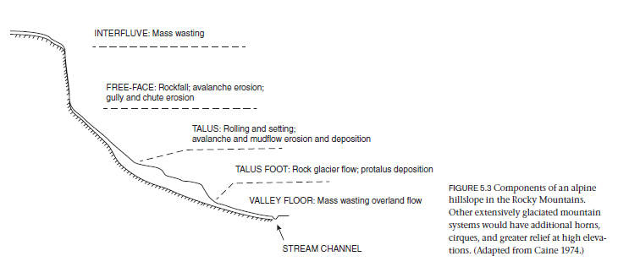

Slide 17
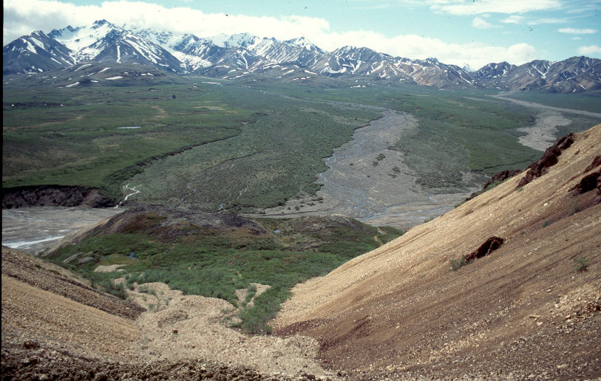
Copyright © Daryl Dagesse 2002
Notes:
Polychrome Mountains, Denali National Park, Alaska. This photo illustrates some of the common elements of a cold climate landscape, e.g. the debris flow in the foreground, the braided stream in the center, and the nivation hollows in the background (note that the photo was taken in June).

Slide 18
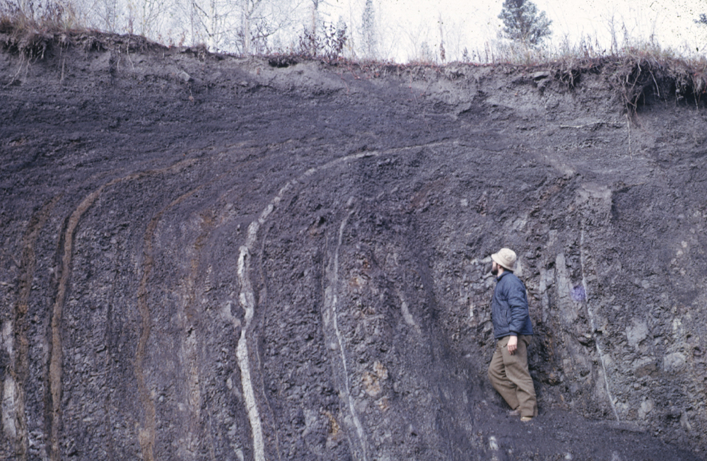
Copyright © Frank Nicholson 2002
Notes:
Down slope frost creep visually demonstrated in multi coloured shales with vertical bedding The surface slope is from left to right. Frost creep has bent the beds down slope, with an increasing amount of movement towards the surface. Section in borrow pit south of Dawson, Yukon, Canada.

Slide 19
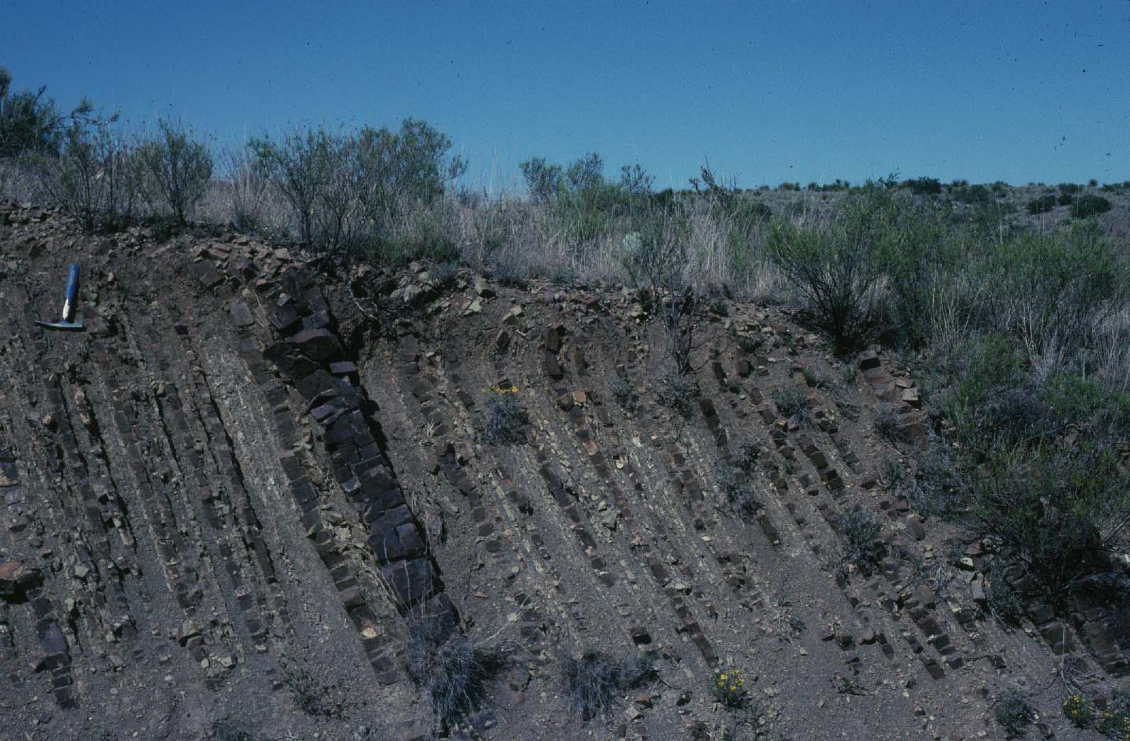
Copyright © Richard Hanson 2003
Notes:
Downslope tilting of steeply dipping sedimentary layers due to creep (near Marathon, West Texas).

Slide 20
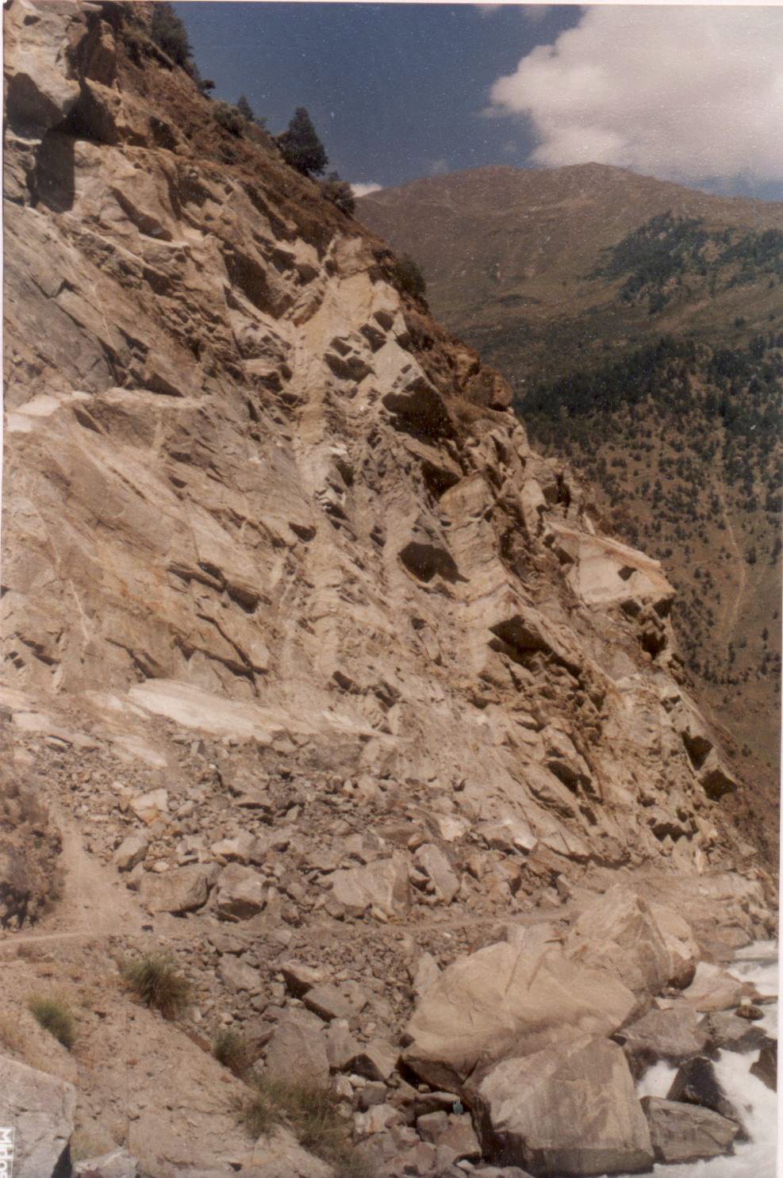
Copyright © Vikram Gupta 2002
Notes:
Rockfall due to wedge failures, Satluj Valley Higher Himalayas, India.

Slide 21
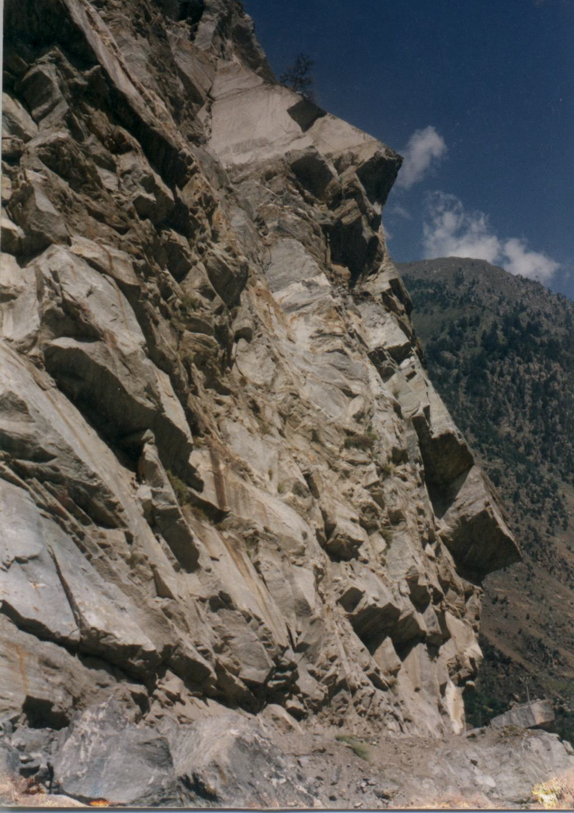
Copyright © Vikram Gupta 2002
Notes:
Rockfall due to wedge failures, Satluj Valley Higher Himalayas, India.

Slide 22
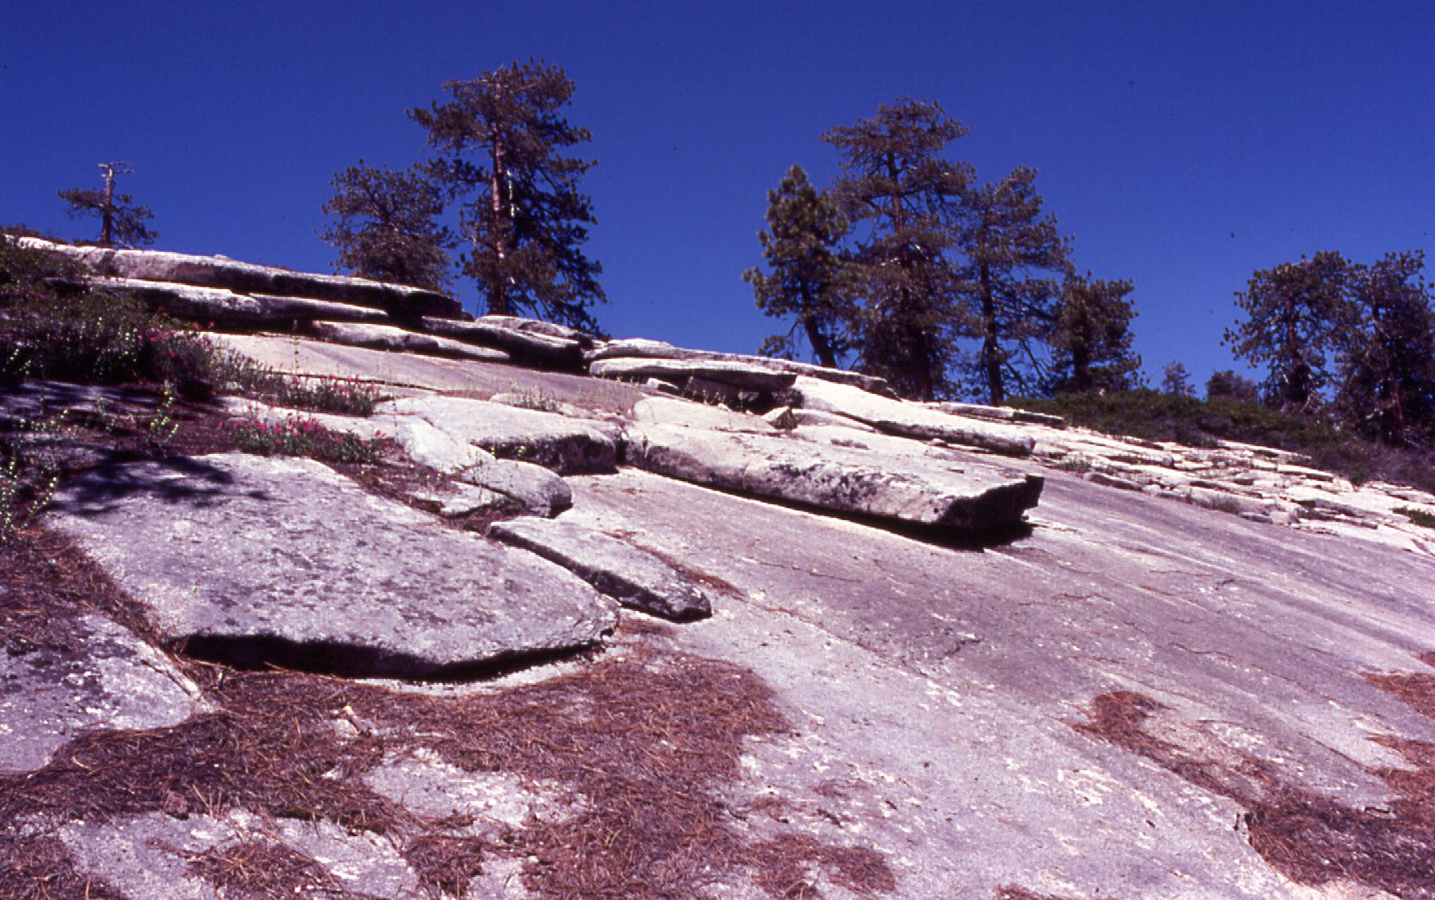
Copyright © Jeff Lee 2002
Notes:
Exfoliation, Sierra Nevada, California.

Slide 23
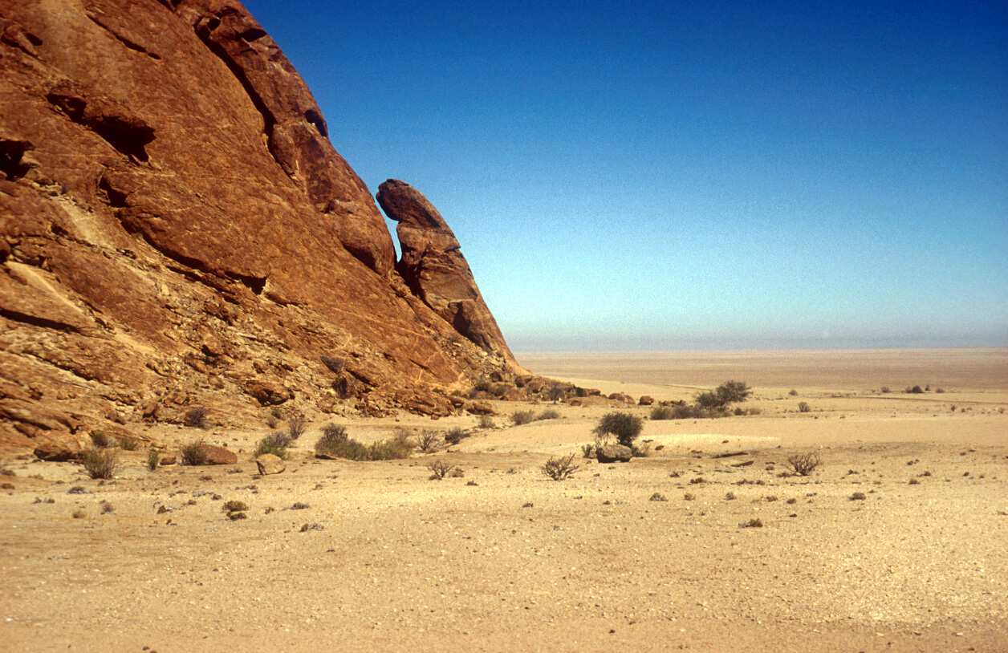
Copyright © Frank Eckardt 2002
Notes:
Exfoliation of granite, Namibia.

Slide 24
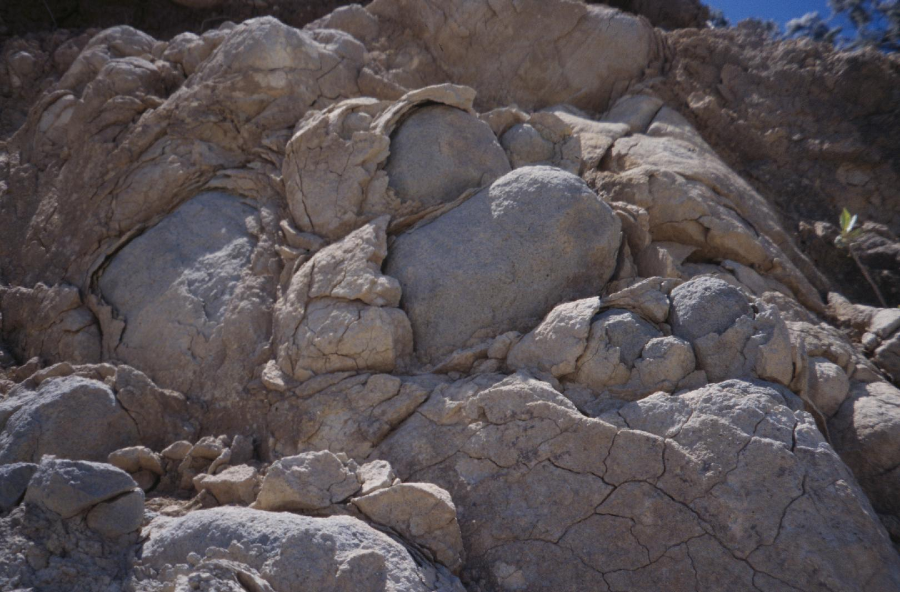
Copyright © Mike Slattery 2002
Notes:
Deeply-weathered profile with granitic corestones, Costa Rica.

Slide 25
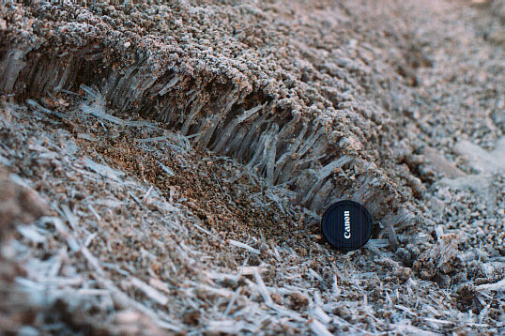
Copyright © Goncalo Vieira 2002
Notes:
Needle ice, Serra da Estrela (Portugal), Periglacial geomorphology.

Slide 26
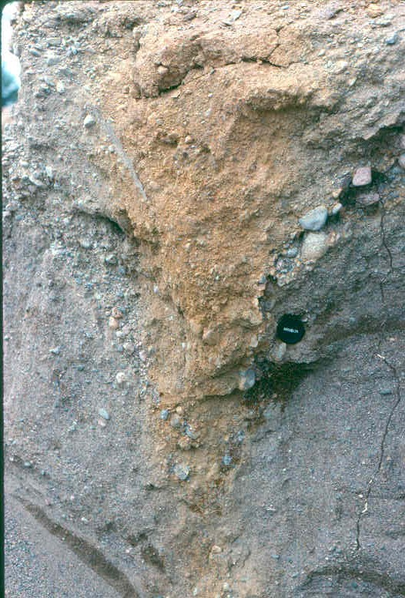
Copyright © Norm Catto 2002
Notes:
Port Blandford NF - ice wedge cast, Younger Dryas age (ca. 11000 14C years) developed in glaciofluvial gravel.

Slide 27
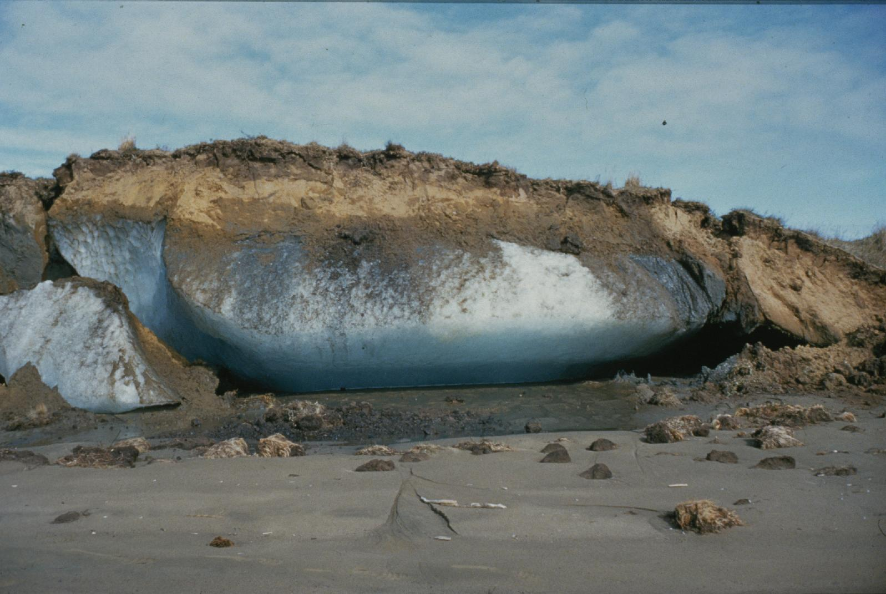
Copyright © Matthias Jakob 2002
Notes:
Ice lens in permafrost on the Coppermine River, Northwest Territories, Canada.

Slide 28
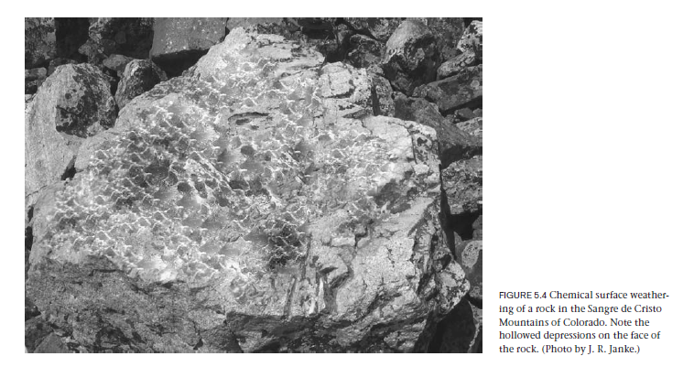

Slide 29
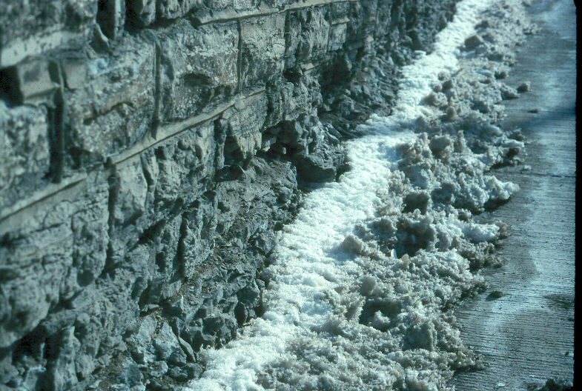
Copyright © Daryl Dagesse 2002
Notes:
Mechanical weathering, primarily by salt, but also freeze/thaw, Niagara Falls, New York. The local dolomitic limestone is often used as a building material in this area, in this case as a retaining wall along a heavily used roadway. The combination of exposure and the liberal use of de-icing salt (note the white stain on the road surface on the right side of the photo) has resulted in extensive mechanical weathering of the bottom course of blocks.

Slide 30
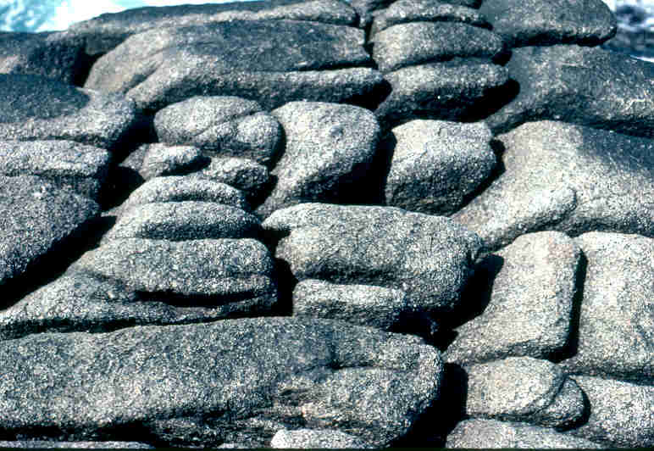
Copyright © Norm Catto 2002
Notes:
Peggy's Cove NS - weathered Devonian granite (salt spray plus frost wedging).

Slide 31
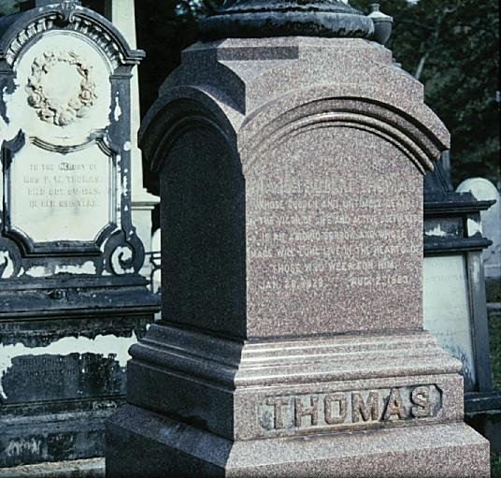
Copyright © Randy Schaetzl 2002
Notes:
Granite vs marble weathering, Athens, GA.

Slide 32
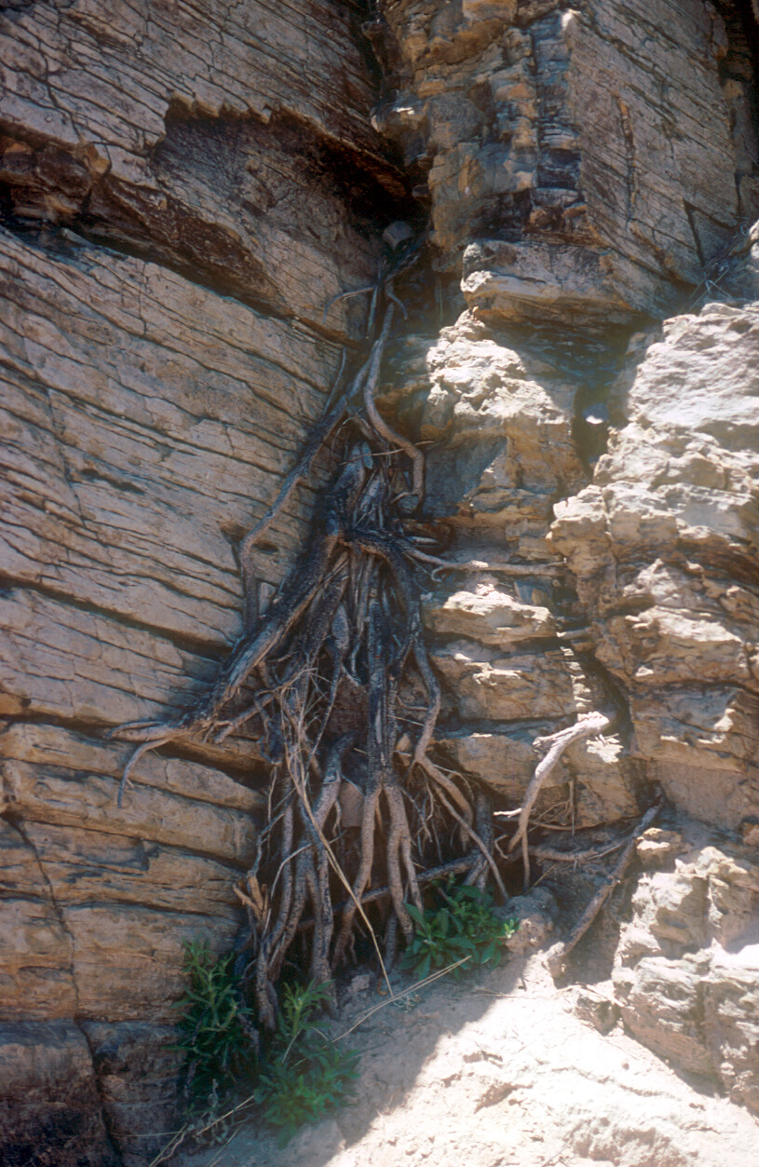
Copyright © Frank Eckardt 2002
Notes:
Root weathering.

Slide 33
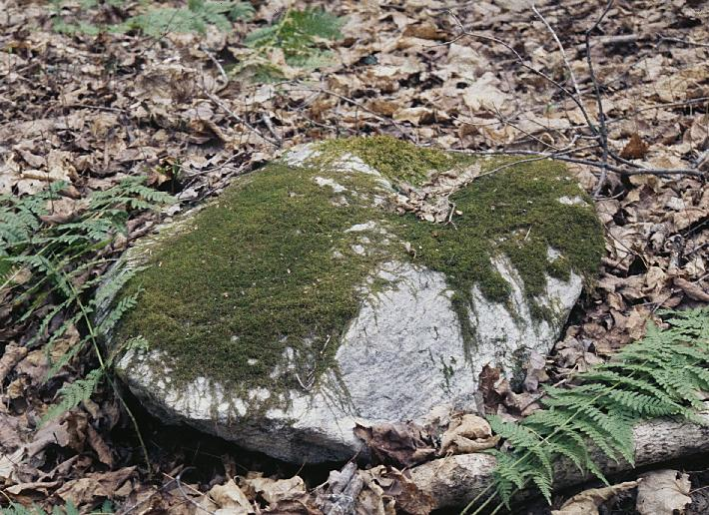
Copyright © Randy Schaetzl 2002
Notes:
An example of biotic weathering.

Slide 34
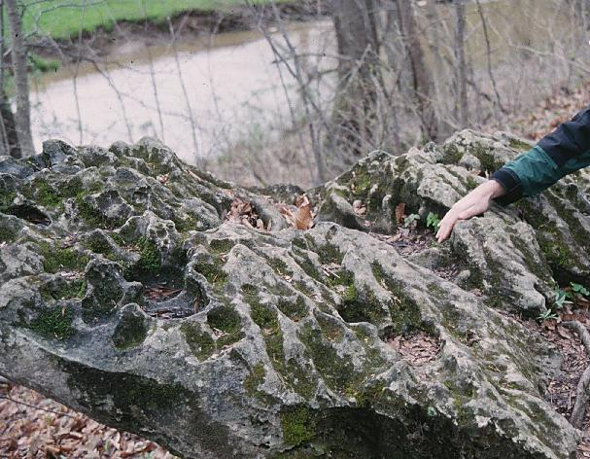
Copyright © Randy Schaetzl 2002
Notes:
Chemical weathering of limestone, southern Indiana.

Slide 35
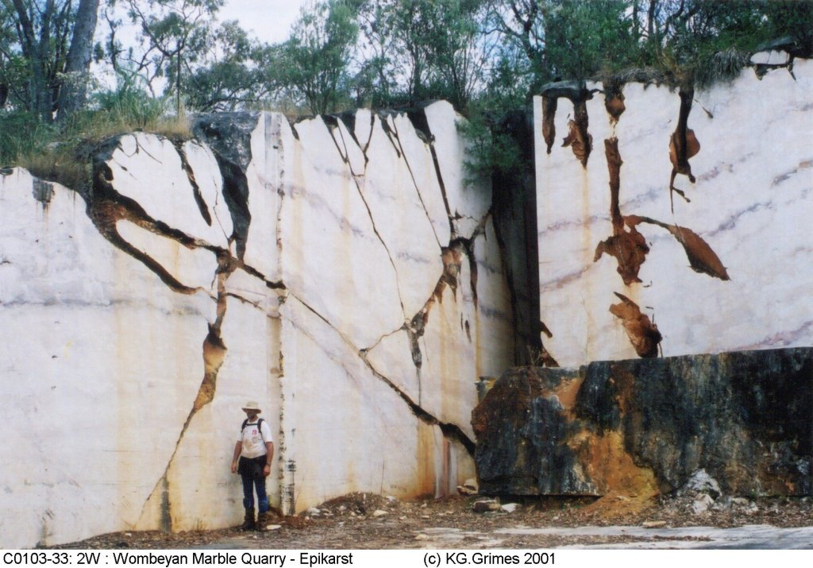
Copyright © Ken Grimes 2002
Notes:
Subsoil solution fissure in marble, Wombeyan Caves, New South Wales, Australia.

Slide 36
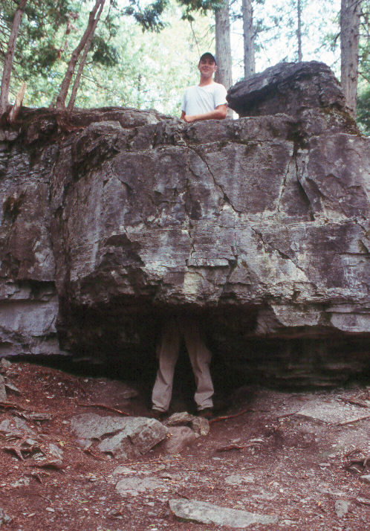
Copyright © Daryl Dagesse 2002
Notes:
Pothole, Warsaw, Ontario, Canada.

Slide 37
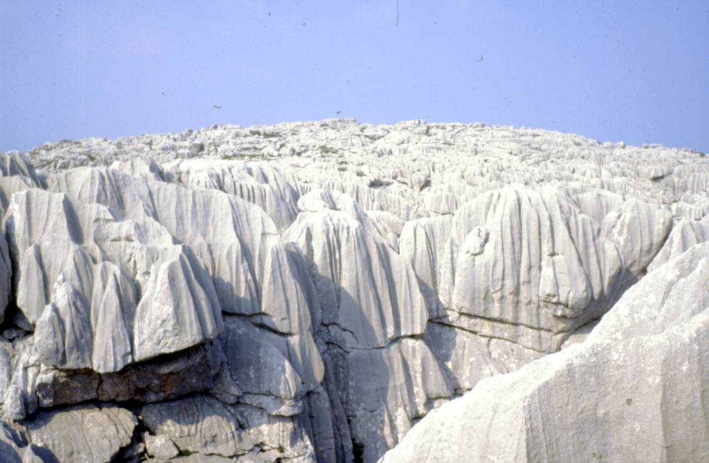
Copyright © Jelena Calic-Ljubojevic 2002
Notes:
Karren, Mt. Maganik in Montenegro (Yugoslavia). It is a south-eastern part of the famous Dinaric Karst.

Slide 38
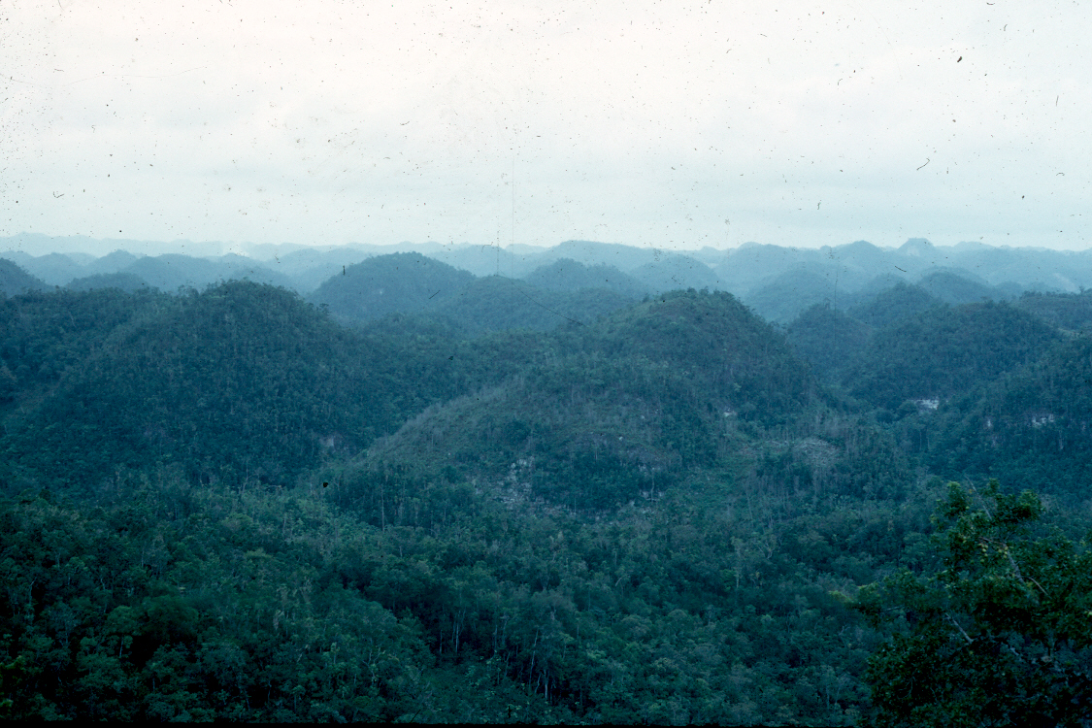
Copyright © Richard Kesel 2002
Notes:
Cockpit karst, Jamaica.

Slide 39
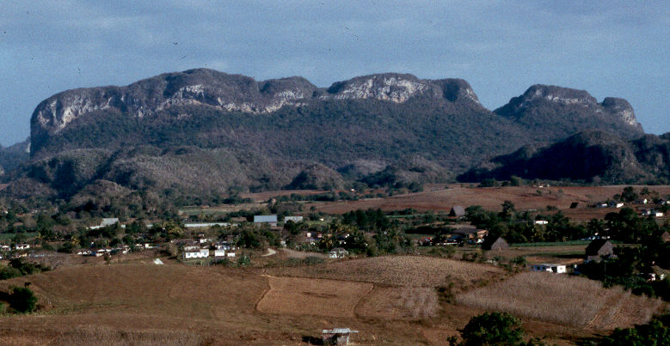
Copyright © Daryl Dagesse 2002
Notes:
Tower Karst, Venales Valley, Cuba. The limestone bedrock has been subjected to extensive chemical weathering by acidic waters, resulting in spectacular karst hills in this tropical environment.

Slide 40
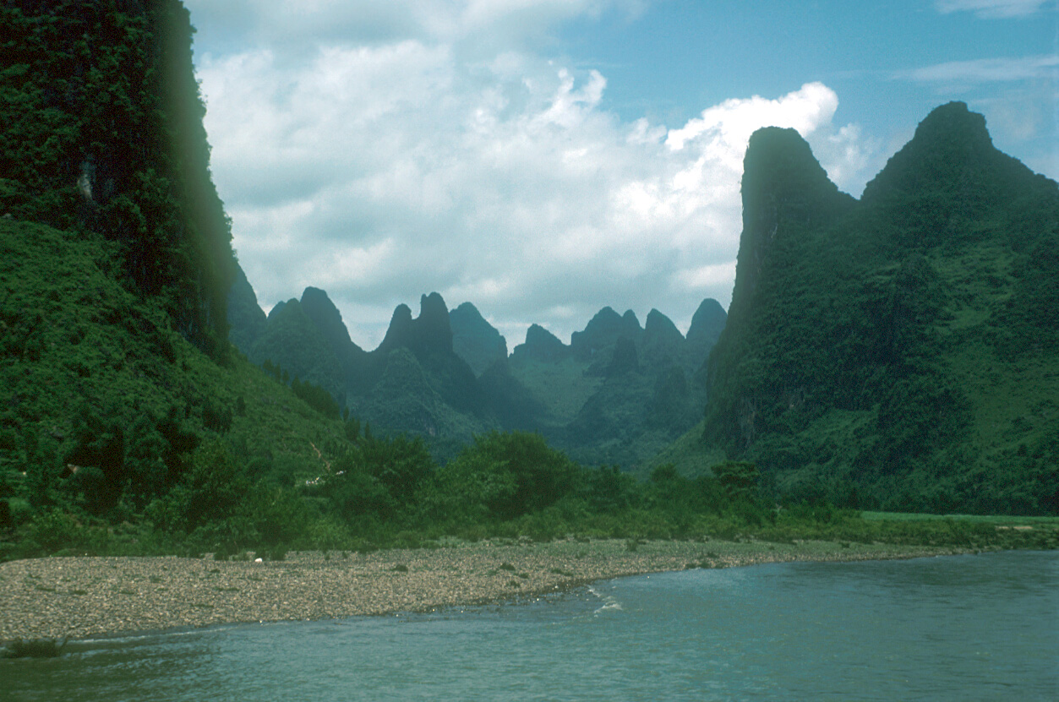
Copyright © Frank Eckardt 2002
Notes:
Tower Karst, China.

Slide 41
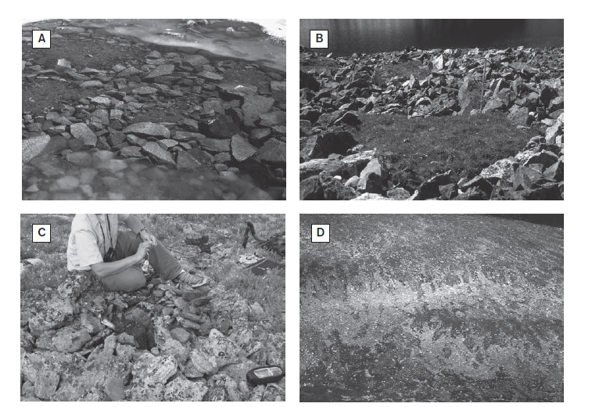

Slide 42
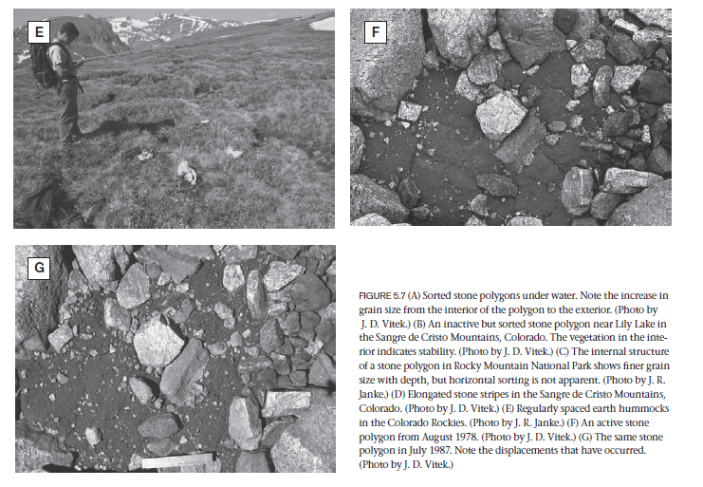

Slide 43
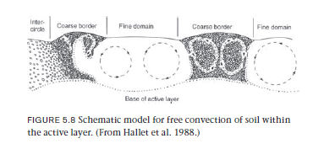

Slide 44
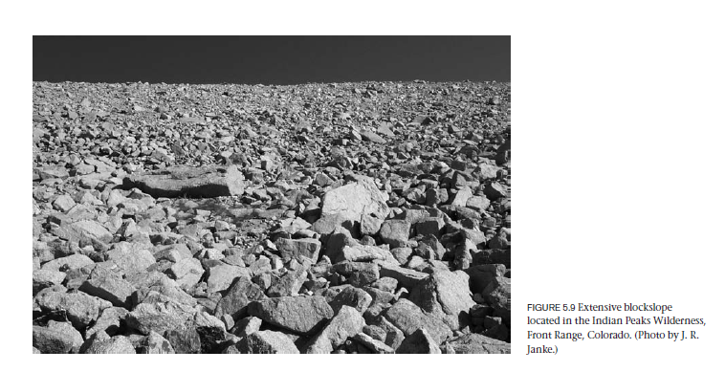

Slide 45
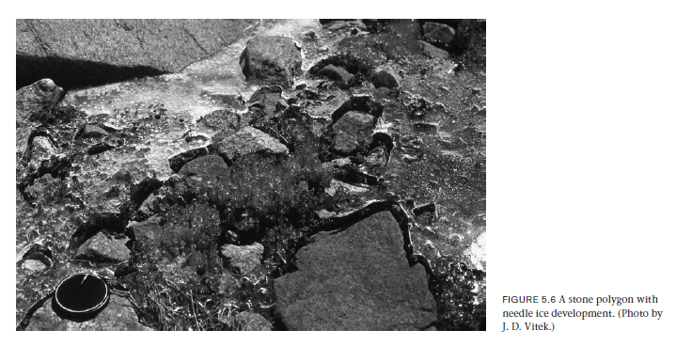

Slide 46
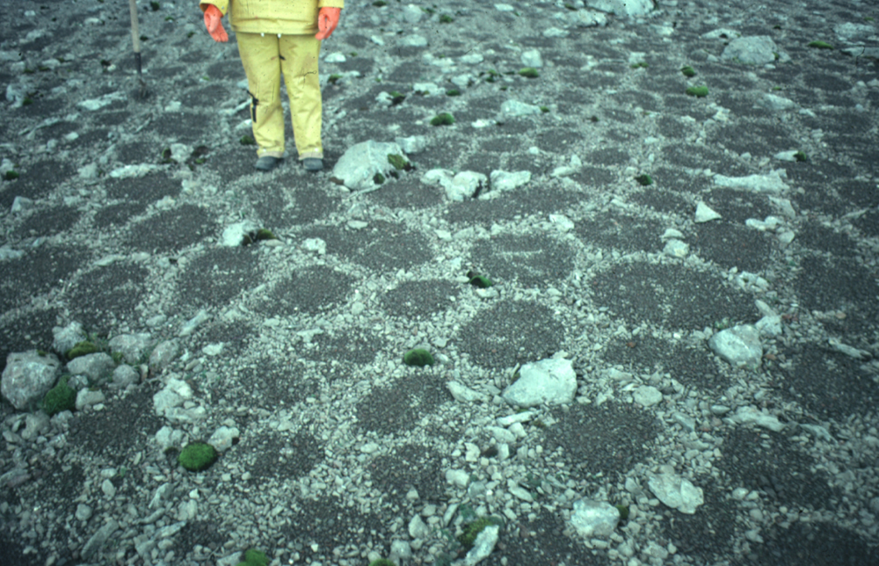
Copyright © Frank Nicholson 2002
Notes:
Patterned ground, sorted circles/polygons (equiforms), marked by fine soil centres and stone margins. Faroe Islands.

Slide 47
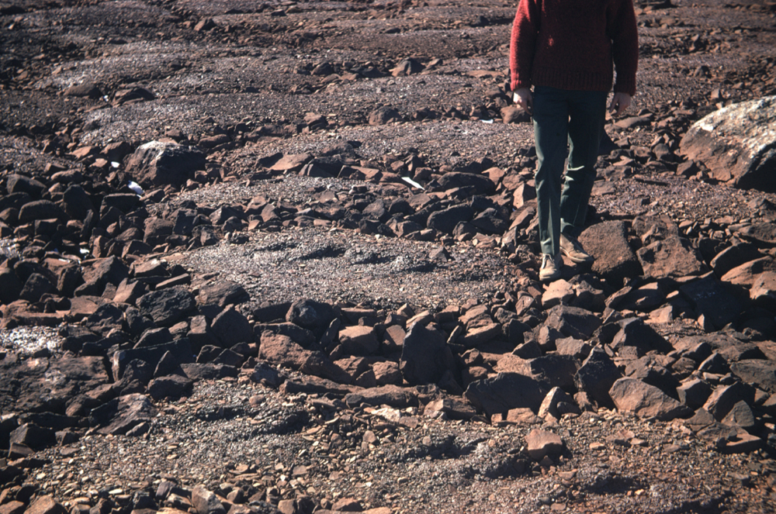
Copyright © Frank Nicholson 2002
Notes:
Patterned ground. Sorted polygons/circles (equiforms). 2-3m diameter units with stony margins (up to small boulder size) and fine soil centres. Near Schefferville, Quebec-Labrador boundary area, Canada. In this area, this type of patterned ground only occurs in small vegetation free areas occupied by ephemeral lakes for a few weeks after snow melt.

Slide 48
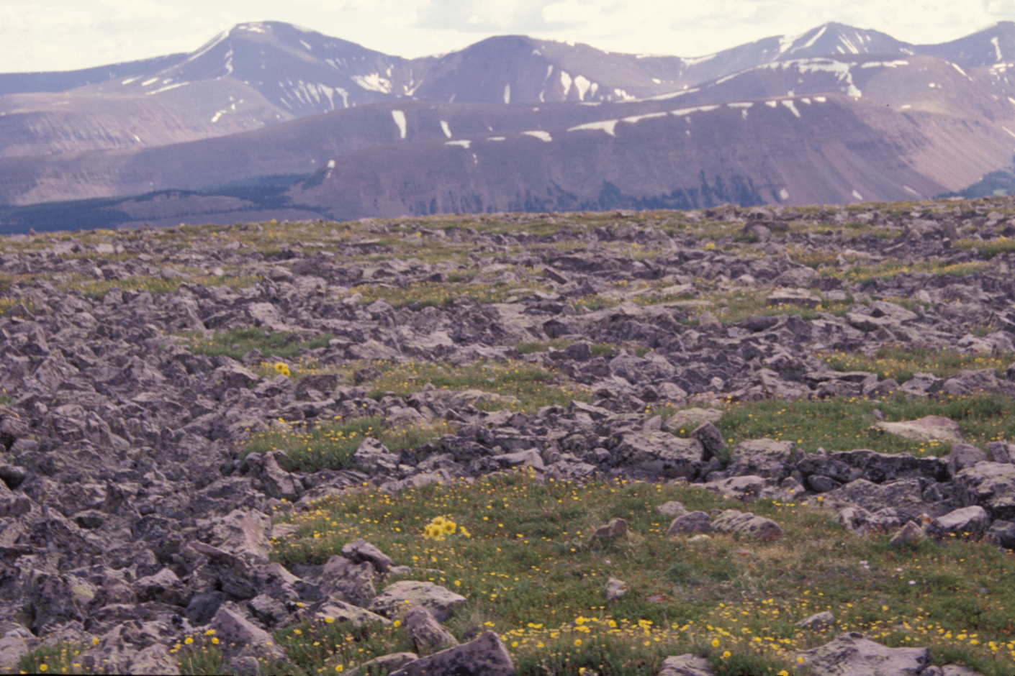
Copyright © Jeff Munro 2002
Notes:
Sorted stone nets in the Uinta Mountains, northeastern.

Slide 49
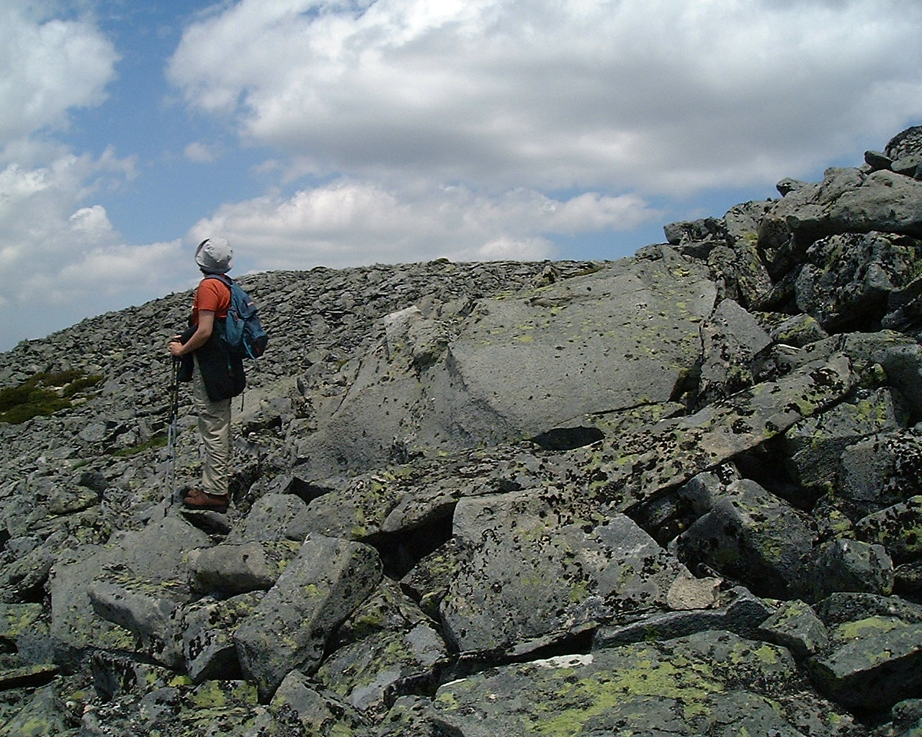
Copyright © Goncalo Vieira 2002
Notes:
Blockslope (granite), Serra da Estrela (Portugal), Periglacial geomorphology.

Slide 50
Copyright © Goncalo Vieira 2002
Notes:
Blockslope (granite), Serra da Estrela (Portugal), Periglacial geomorphology.

Slide 51
Copyright © Stephane Veyrat-Charvillon 2002
Notes:
Slope debris flows located in Isere - French North Alps.

Slide 53
Copyright © William Locke 2002
Notes:
Periglacial - mountain features between mounts Tabeguache and Shavano, Sawatch Range, CO. Old rock glaciers, active rock glaciers, talus, and leveed debris flows are evident.

Slide 54
Copyright © William Locke 2002
Notes:
Periglacial - debris flow levees over old rock glacier deposits; Mount Tabeguache, Sawatch Range, CO.

Slide 58
Copyright © Matthias Jakob 2002
Notes:
Recent rock avalanche on Anderson Lake, southwestern B.C., Canada.

Slide 64
Copyright © Keith Richards 2002
Notes:
Tasman River, Mount Cook, South Island, New Zealand.

Slide 65
Copyright © Daryl Dagesse 2002
Notes:
Braided stream, Denali National Park, Alaska, USA. The combination of high sediment loads and seasonally variable discharge has resulted in a braided pattern to this river. Only during the highest flows is the majority of this material mobilized as bedload.

Slide 67
Copyright © Matthias Jakob 2002
Notes:
Colluvial cones between the town of Lillooet and Seton Lake, southwestern B.C., Canada.

Slide 68
Copyright © Norm Catto 2002
Notes:
Alluvial Fan - Snake River, Yukon, August 1982.

Slide 69
Copyright © Nicola Surian 2002
Notes:
Alluvial fan in the Venosta valley (Alps, Italy).

Slide 70
Copyright © Matthias Jakob 2002
Notes:
Small rock slope failure in limestone on a strike slope in Jasper National Park, Canadian Rocky Mountains.

Slide 71
Copyright © Matthias Jakob 2002
Notes:
Front of active rock glacier, Kluane National Park, Yukon Territory.

Slide 72
Copyright © Matthias Jakob 2002
Notes:
Small rock avalanche, northern Vancouver Island, B.C., Canada.

Slide 73
Copyright © Keith Richards 2002
Notes:
Scree chute on road in Alaknanda Valley, Gharwal Himal, India (jeep for scale beneath rock outcrop near left edge).

Slide 74
Copyright © Martin Geertsema 2002
Notes:
Earthflow at confluence of Muskwa and Chisca rivers, northern British Columbia.

Slide 75
Copyright © Matthew Larsen 2002
Notes:
Debris flow damage to an apartment building following heavy rainfall and flash flooding in December, 1999, Venezuela.

Slide 76
Copyright © Daryl Dagesse 2002
Notes:
Slump, St. Catharines, Ontario, Canada. The construction of embankments associated with engineering structures (in this case a highway) may display instability until they reach their own equilibrium. This photo illustrates slumping in a clayey parent material almost a decade after construction.

Slide 77
Copyright © Randy Schaetzl 2002
Notes:
Slump blocks in colluvium north of Pittsburgh, PA.

Slide 78
Copyright © Christiane Mainzer 2002
Notes:
Aerial of the La Conchita slump. Santa Barbara County,California. March 1995. Classic slump clearly detailing the scarp, slump and flow at base of the movement. An orchard is at the top of the slope.

Slide 79
Copyright © Frank Eckardt 2002
Notes:
Exfoliation of granite, Namibia.

Slide 80
Copyright © Nicolaus Kuhn 2002
Notes:
Rilled slope in the Zin Valley Badlands, central Negev, Israel; note integrated rill networks and discontinuous parallel rills.

Slide 81
Copyright © Alan Arbogast 2002
Notes:
Headward erosion somewhere in the Great Basin.

Slide 82
Copyright © Frans Kwaad 2002
Notes:
System of V-shaped valley side gullies in the Rif Mountains (N Morocco), west of Al Hoceima.

Slide 83
Copyright © Frans Kwaad 2002
Notes:
Badland, fully dissected by gullies in the Rif Mountains (N Morocco), west of Al Hoceima.

Slide 84
Copyright © J. Michael Daniels 2002
Notes:
Knife-edged slopes in deeply weathered basalt, Oahu, Hawaii.

Slide 86
Copyright © Frank Eckardt 2002
Notes:
Loess terraces, China.

Slide 87
Copyright © Joe Mason 2002
Notes:
Thickest known loess section in the world, at Jiuzhoutai Mountain near Lanzhou, China, in the western Loess Plateau. The loess here is 318 meters thick, and has been accumulating more or less continuously since about 1.4 Ma. The loess rests on a strath terrace of the Yellow River, cut in Tertiary red beds, which are visible toward the base of the mountain in the distance. The dark line at the top of the red beds is the outcrop of Yellow River gravels, and it's all loess from there to the top of the mountain in the upper left. The loess sources are the dry regions to the northwest of Lanzhou.

