Slide 1
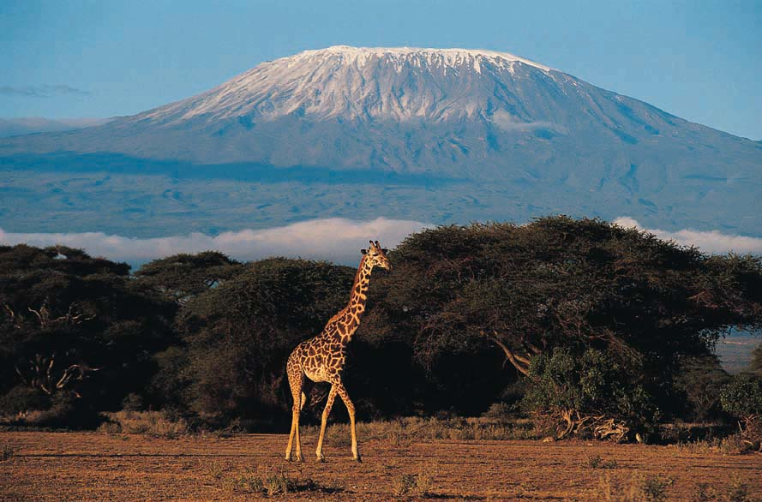
Example of Bioclimatic Belts

Slide 2
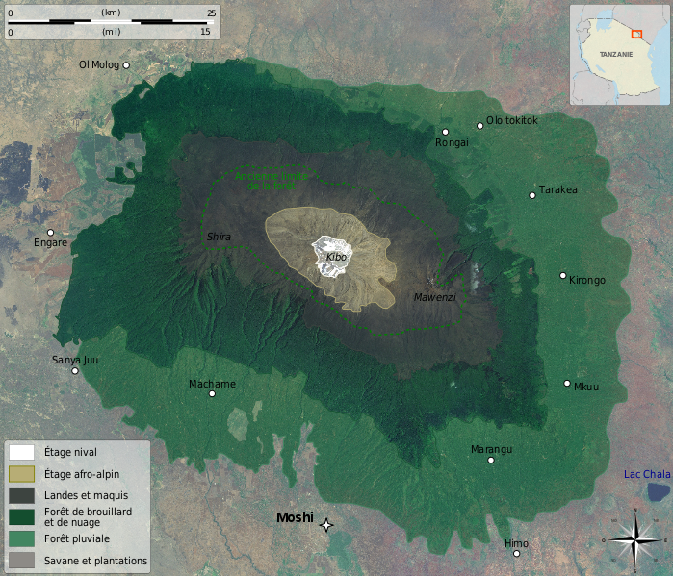
Vegetation zonation at Kilimanjaro

Slide 4
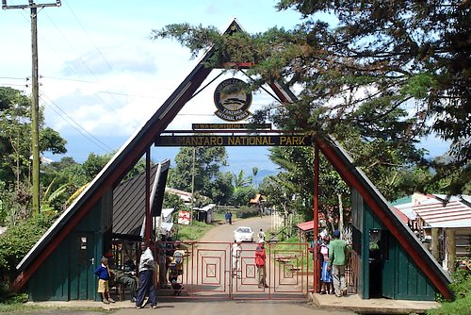
Starting up Kilimanjaro

Slide 5
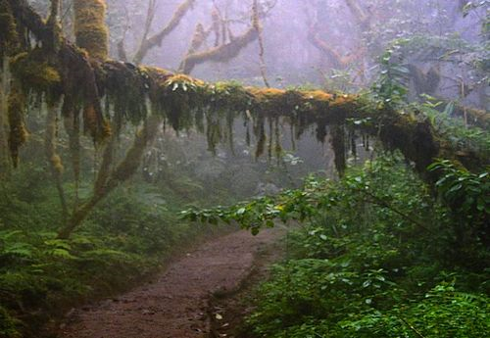
Lower altitude rainforest, Kilimanjaro

Slide 6
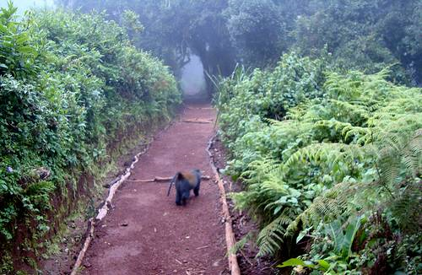
Monkey Forest, about 2700m

Slide 7
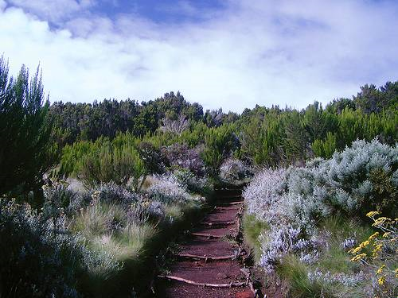
Moreland Zone

Slide 8
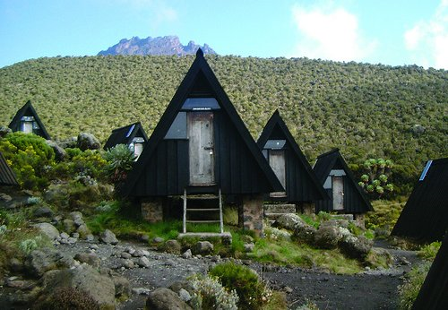
3700m, Giant Heather is not so giant anymore…

Slide 9
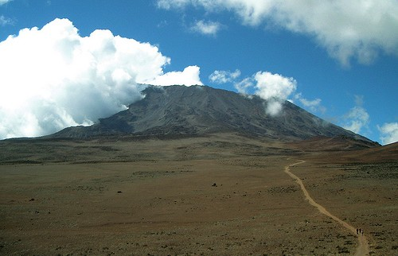
Alpine Tundra / Desert in Saddle between Mawenzi and Kibo (the main Kili peak)

Slide 10
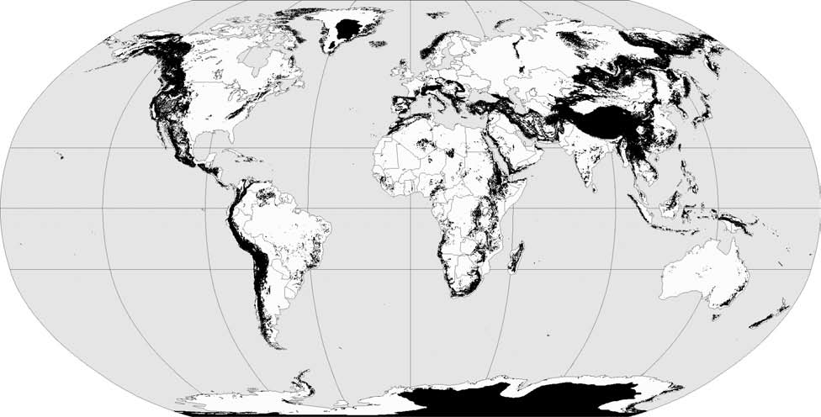

Slide 11
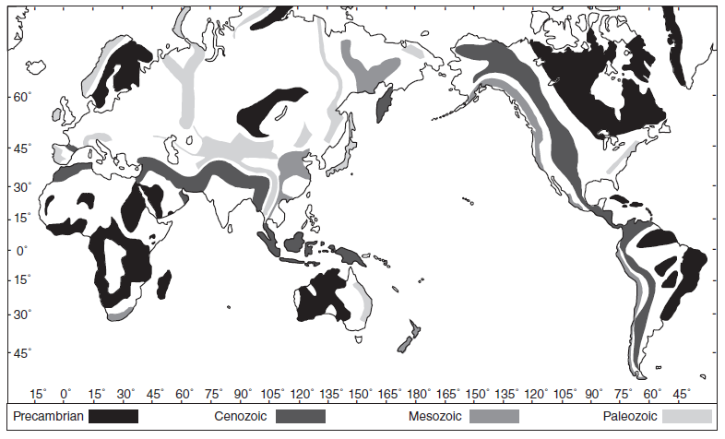

Slide 12
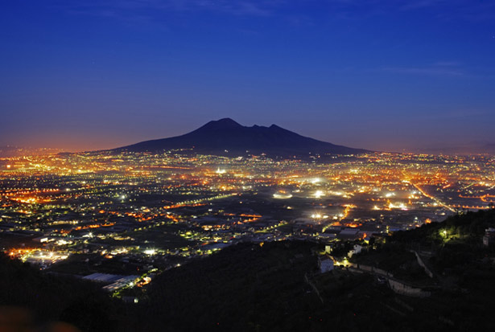
Mountain Challenges and Opportunities

Slide 13
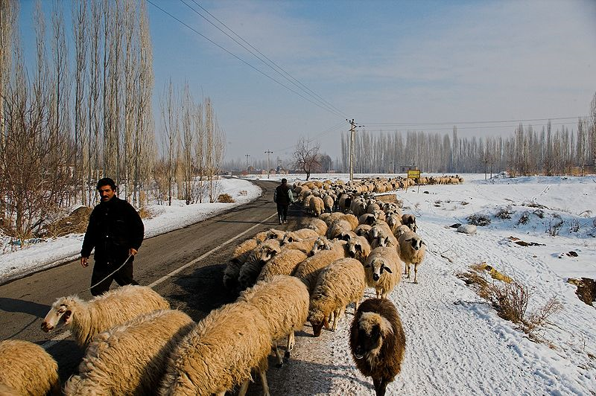
Shepherds in Northern Iran

Slide 14
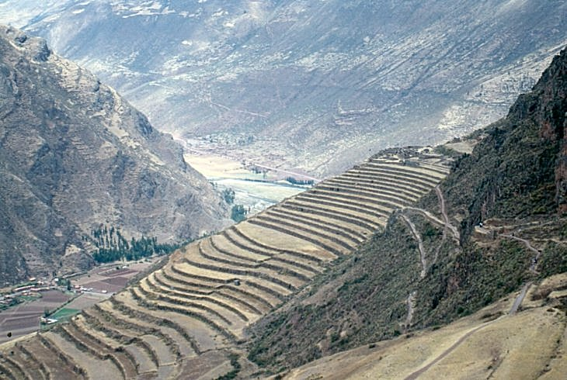
‘Andenes’ Terraces, Peru

Slide 15
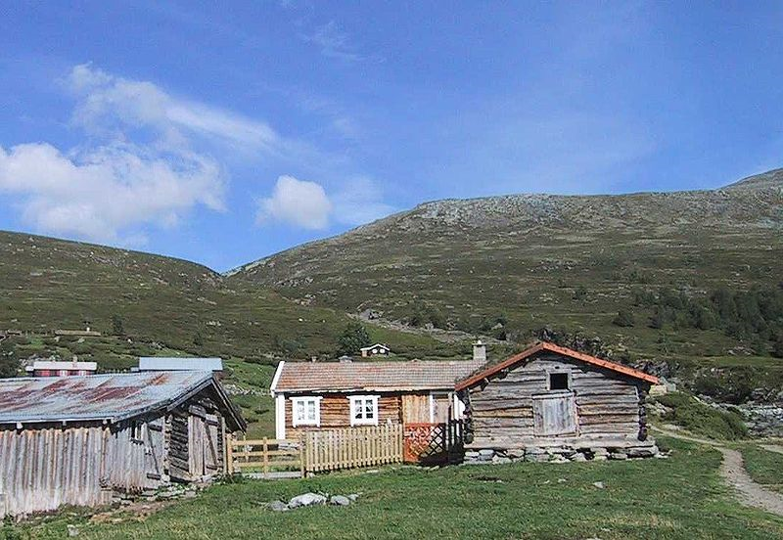
Seter in Norway, Transhumance (Summer)

Slide 16
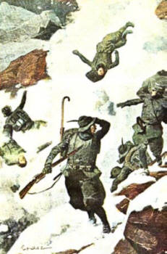
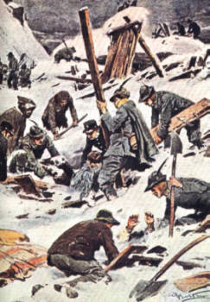
Austro-Italian Alps:1915-1918
60,000 soldiers killed from avalanches
To put in perspective, a total of 25,000 troops were killed by poison gas on this war's Western front in Belgium and France

Slide 18
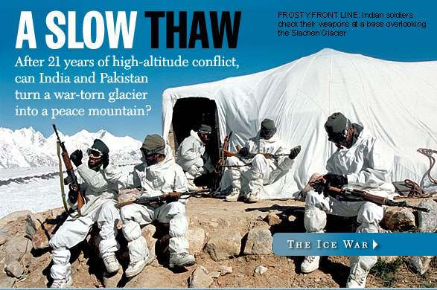

Slide 19
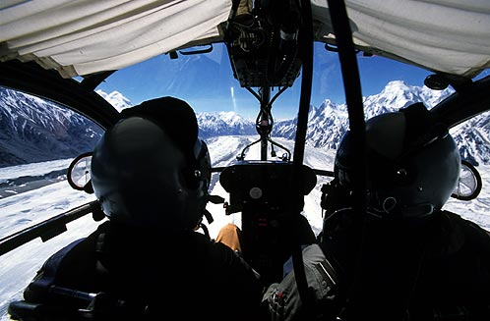
Siachen glacier from Indian helicopter

Slide 20
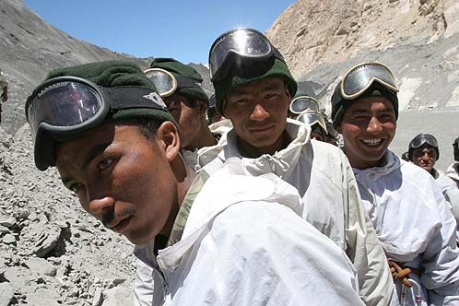
Indian soldiers

Slide 21
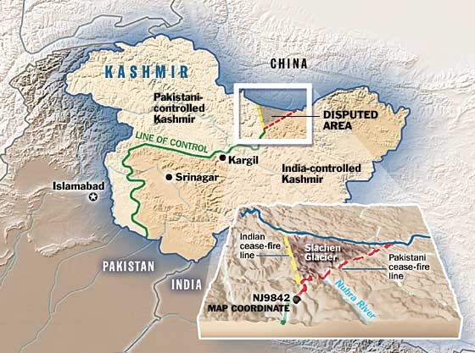

Slide 22
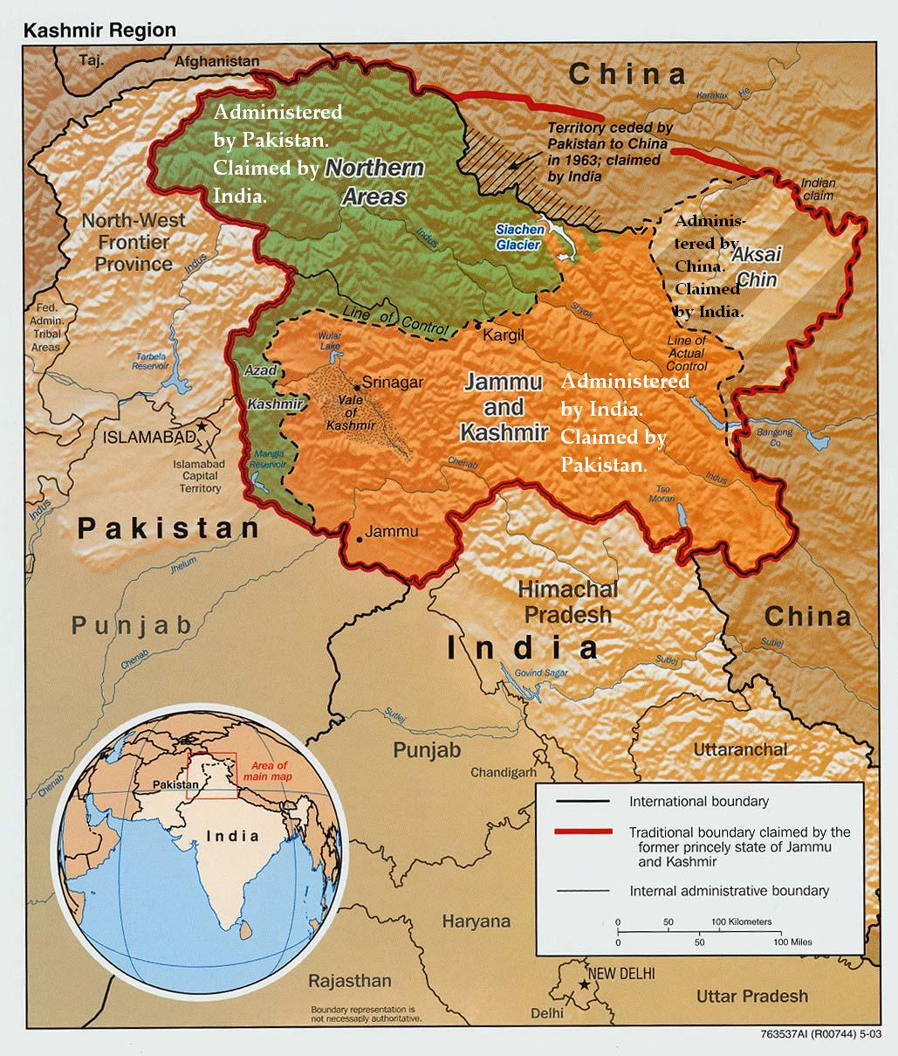

Slide 23
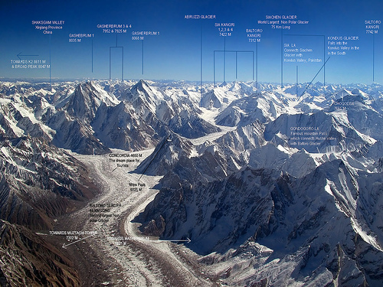
Siachen Glacier

Slide 24
Landslides: May 30, 1970 Peru disaster
Magnitude: 7.9
A large mass of ice and rock slid from a vertical face on Nevado Huascaran, the highest peak in Peru
Debris reached a velocity of 280 km/hr
traveled 11 km horizontally in about 4 minutes at a mean velocity of 165 km/hr.
Buried the towns of Yungay and Ranrahirca, The death toll in both villages was 20,000.
Notes:
A large mass of ice and rock separated from a vertical face on Nevado Huascaran, the highest peak in Peru
The slab fell 1000 m vertically, disintegrated, slid down the lateral slopes of the mountain, and then was launched off a 'ski jump'.
Debris reached a velocity as high as 280 km/hr
buried the towns of Yungay and Ranrahirca, having traveled 11 km horizontally in about 4 minutes at a mean velocity of 165 km/hr.
The death toll in both villages was 20,000.

Slide 25
The town of Huaraz flattened

Slide 26
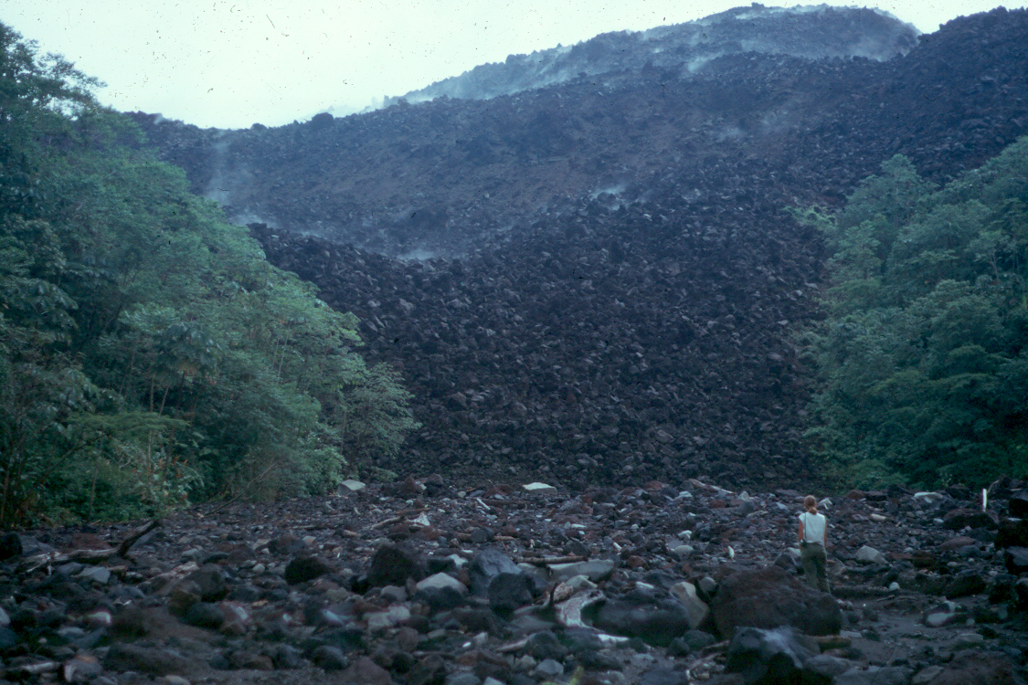
Copyright © Richard Kesel 2002
Notes:
Arenal volcano, Costa Rica with lava flow in the foreground.

Slide 27
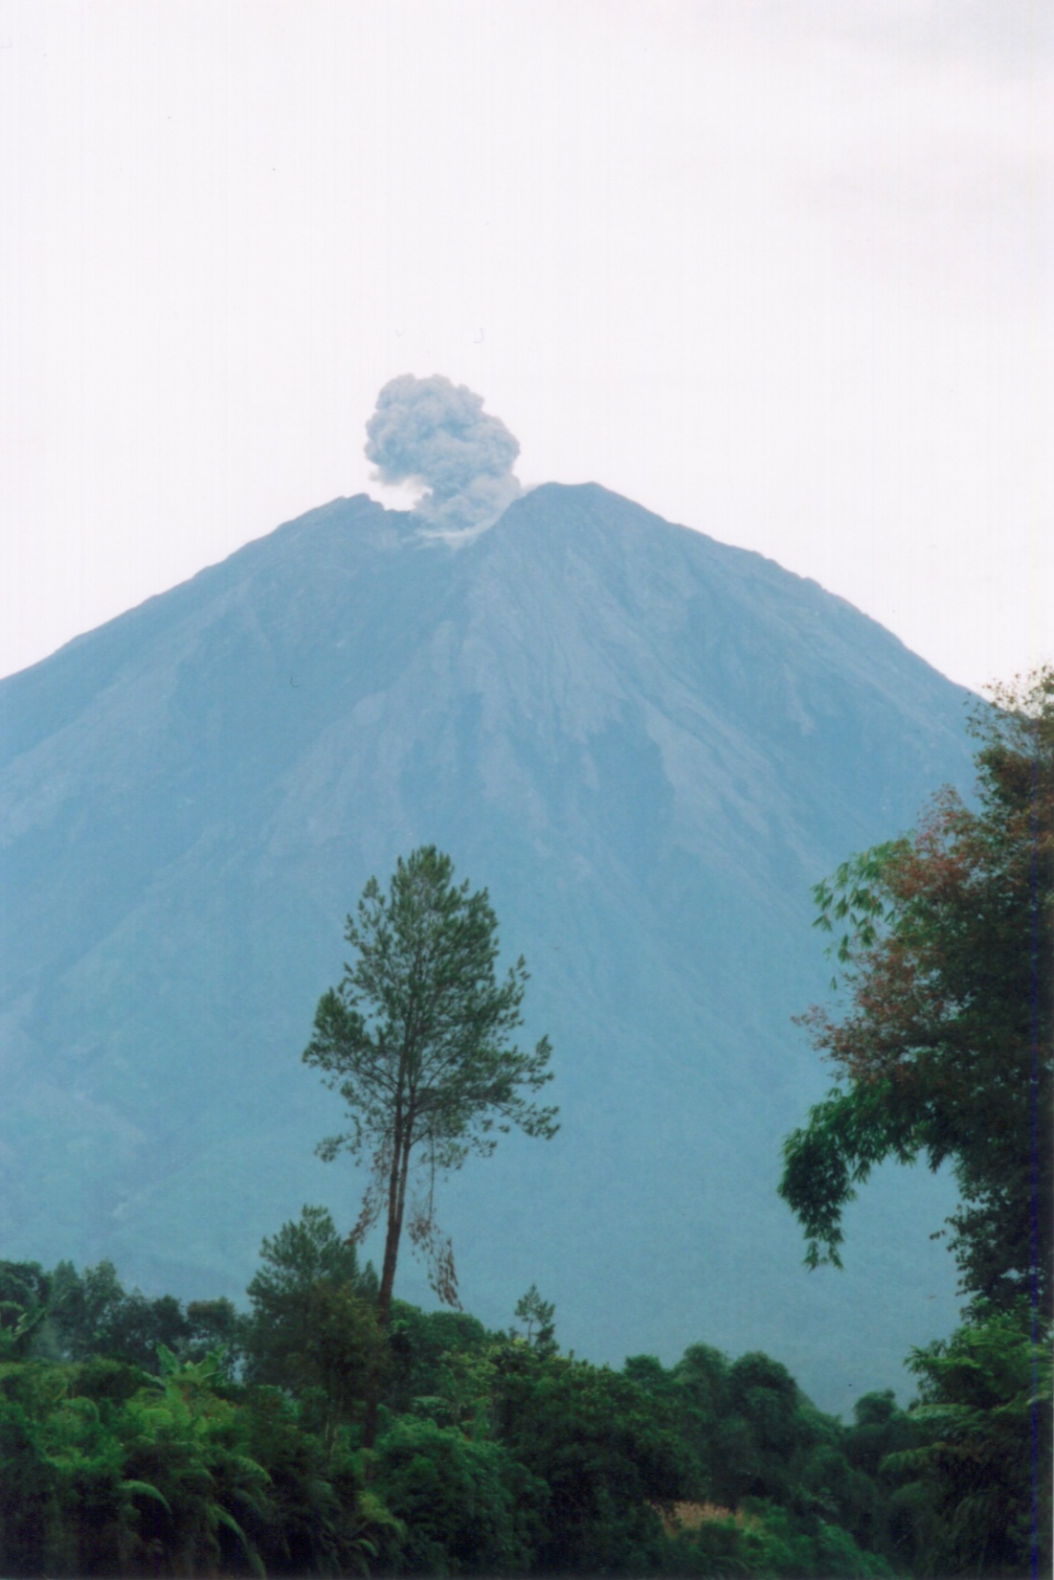
Copyright © Stephane Veyrat-Charvillon 2002
Notes:
Semeru active volcano located in the Lengkong river next to the Semeru volcano - Est of Java - Indonesia.

Slide 28
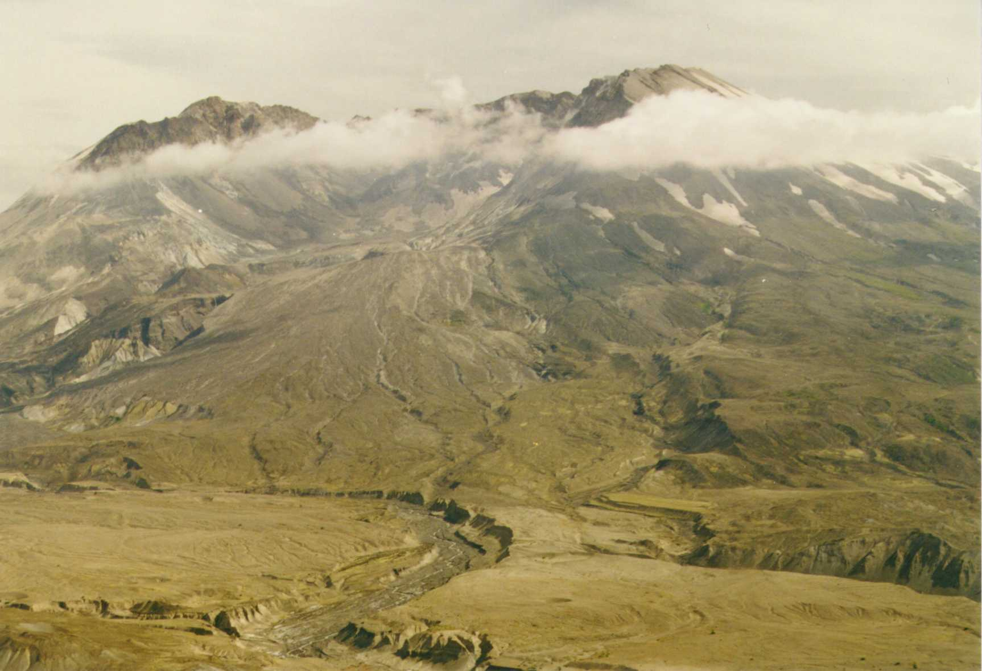
Copyright © Bob Andrle 2002
Notes:
Mt. St. Helens from Johnston Ridge.

Slide 29
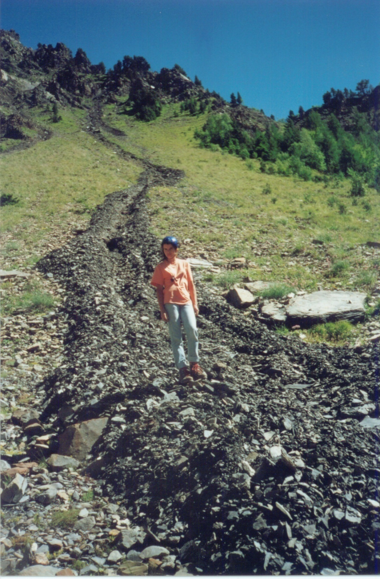
Copyright © Stephane Veyrat-Charvillon 2002
Notes:
Slope debris flows located in Isere - French North Alps.

Slide 30
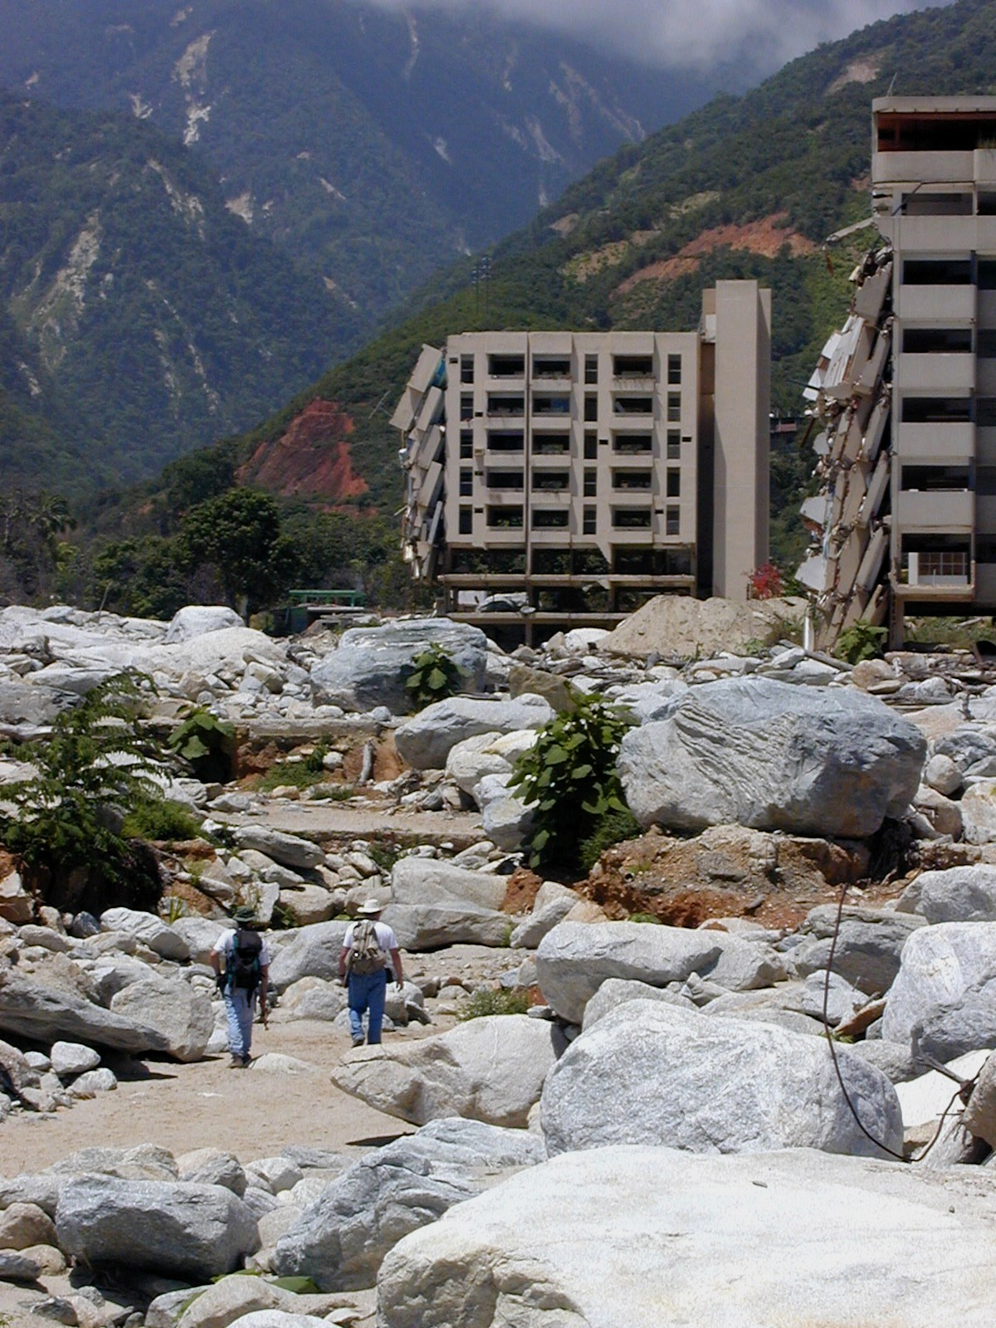
Copyright © Matthew Larsen 2002
Notes:
Debris flow damage to an apartment building following heavy rainfall and flash flooding in December, 1999, Venezuela.

Slide 33
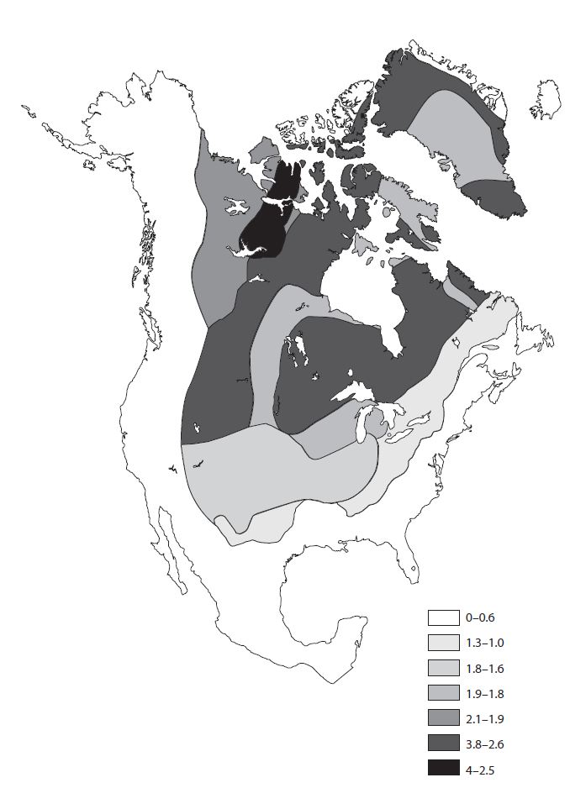

Slide 34
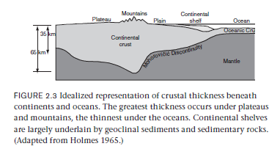
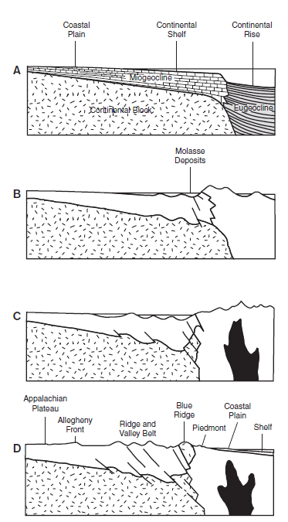

Slide 35
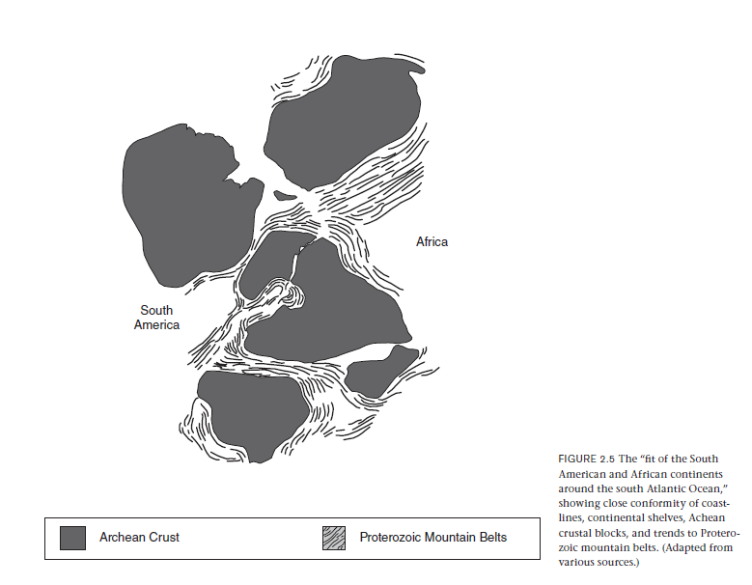

Slide 36
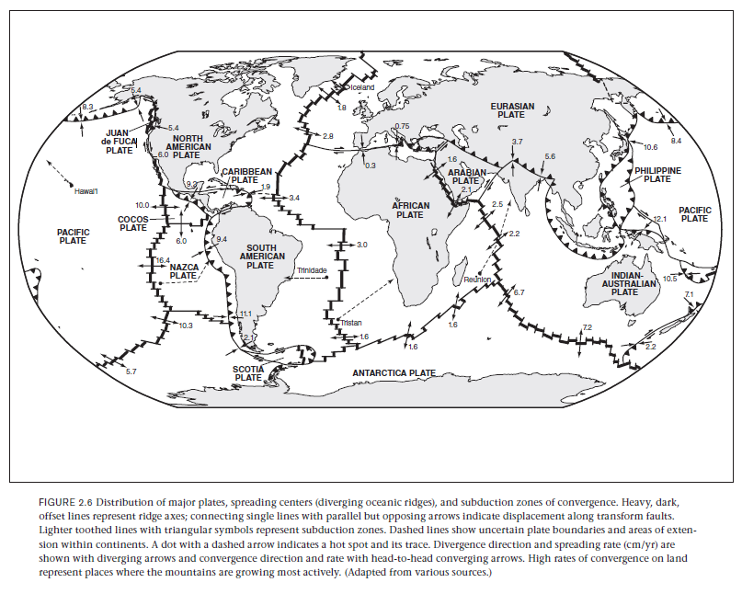

Slide 37
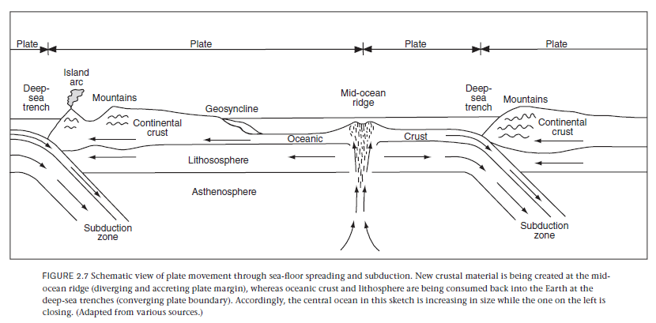

Slide 38
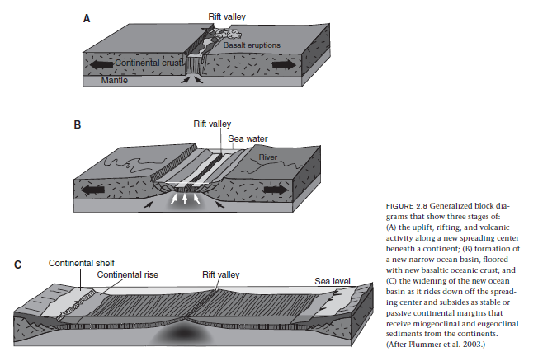

Slide 39
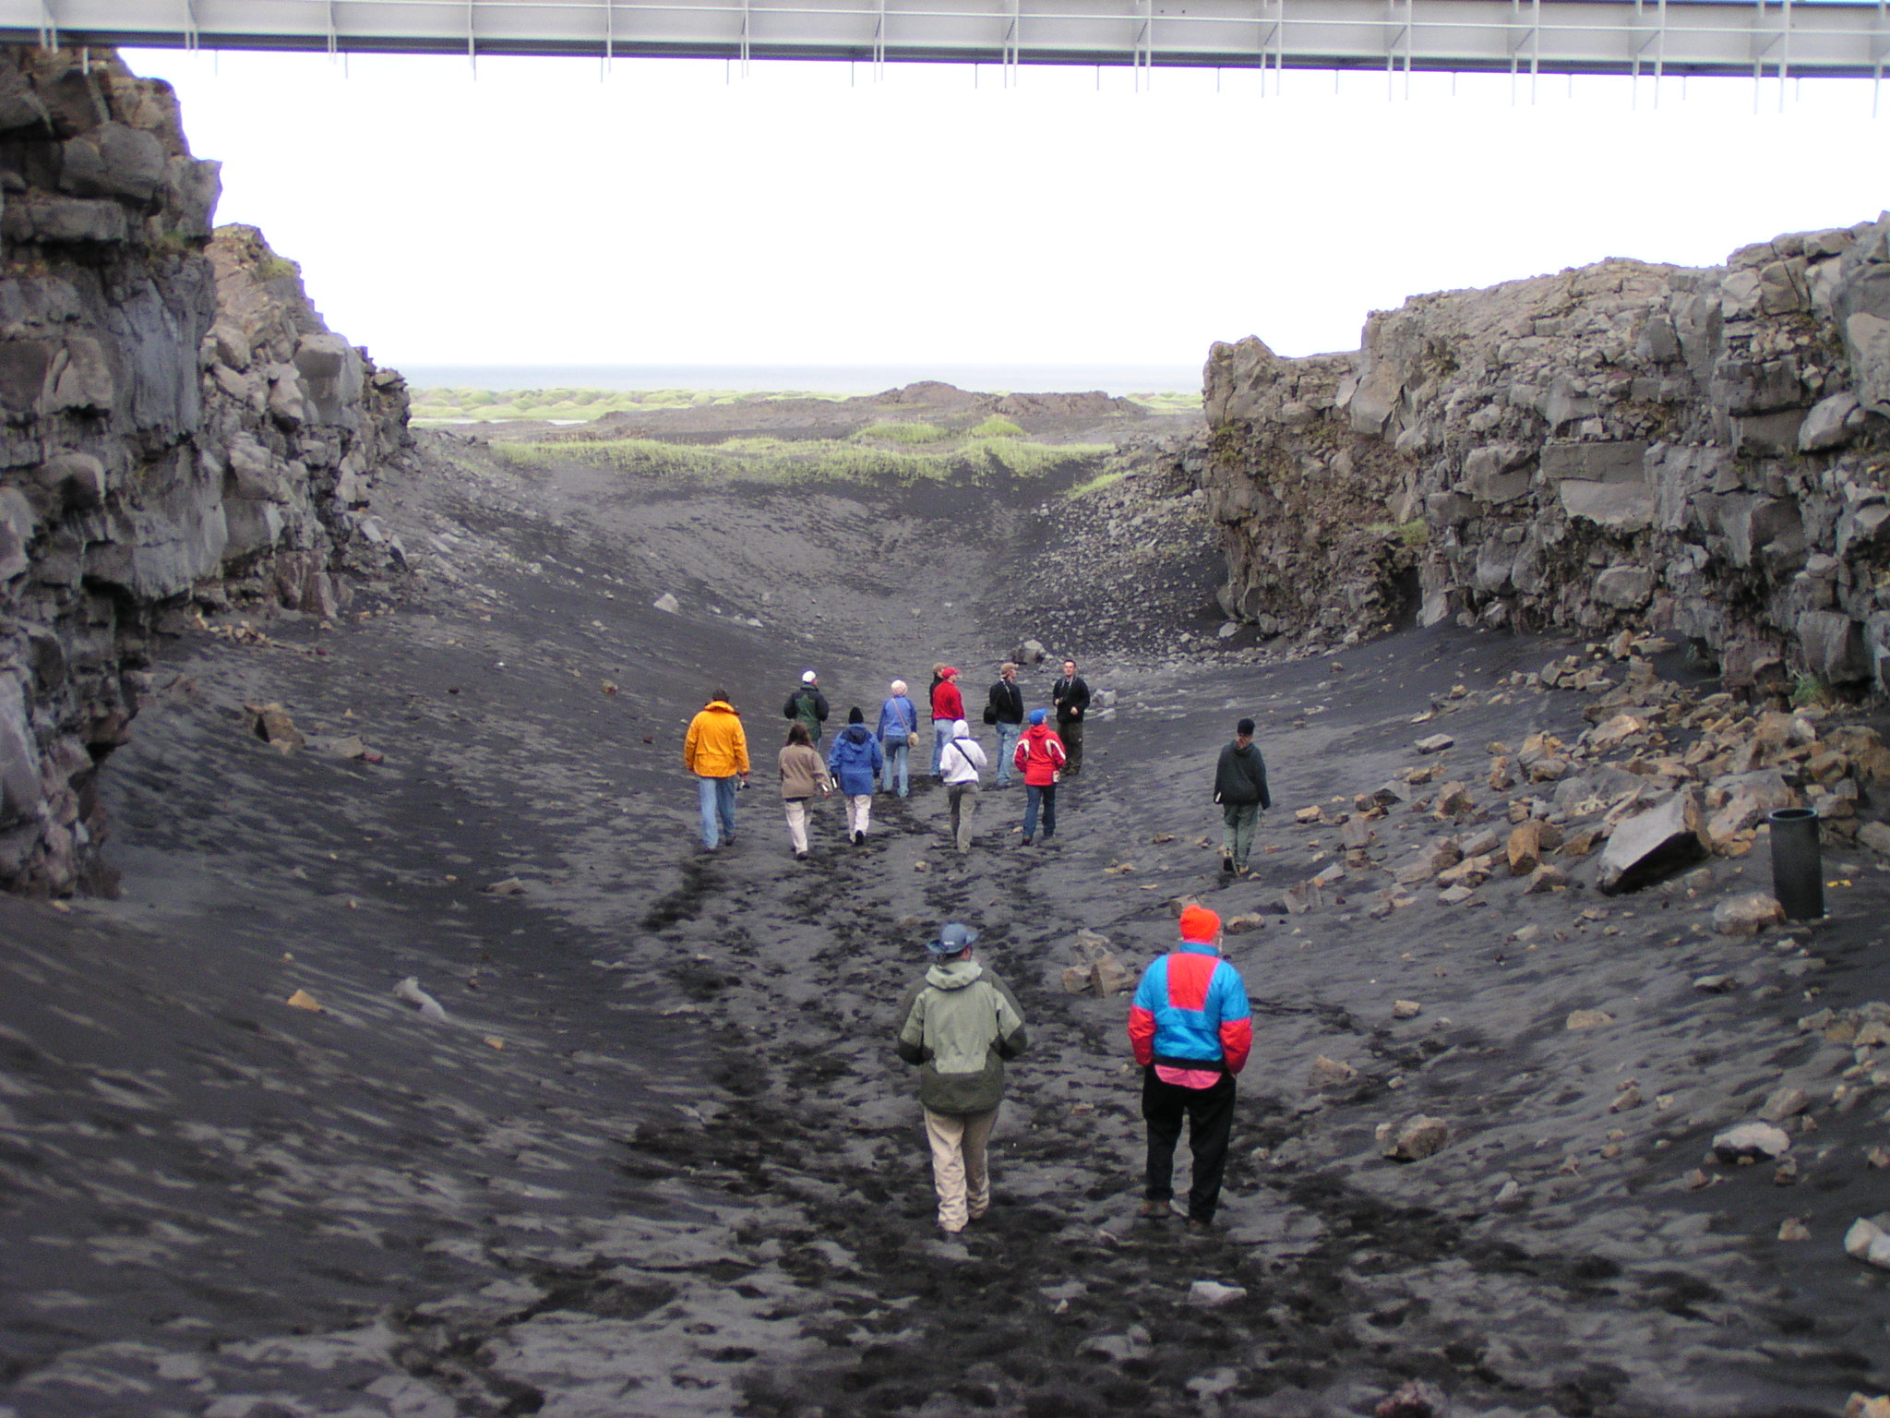
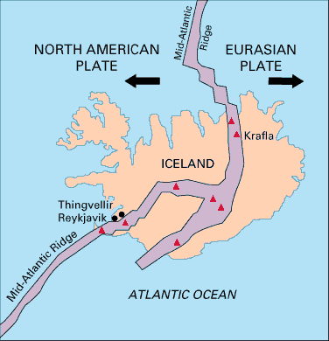

Slide 40
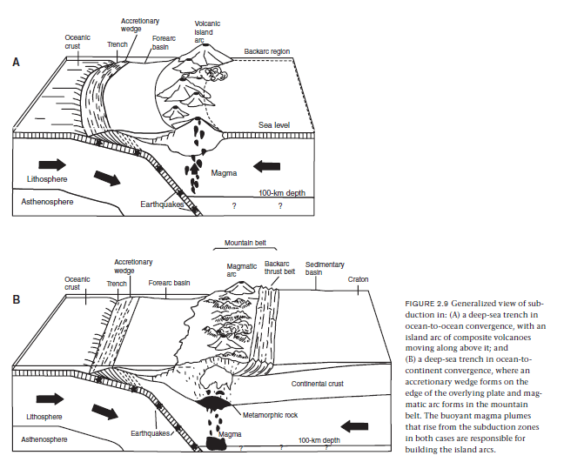

Slide 41
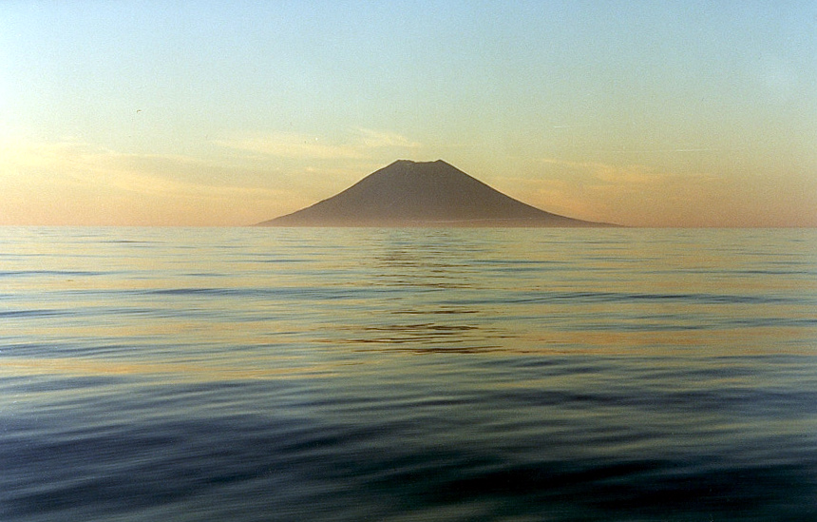

Slide 42
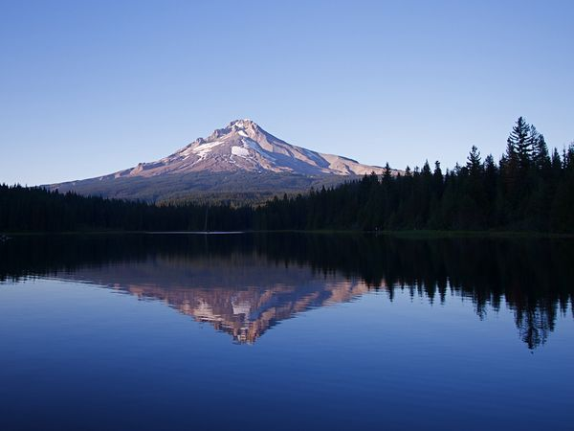

Slide 43
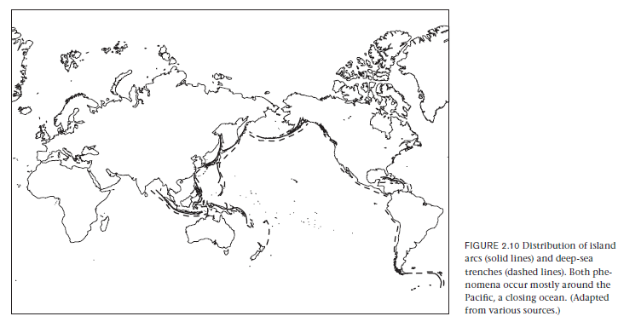

Slide 44
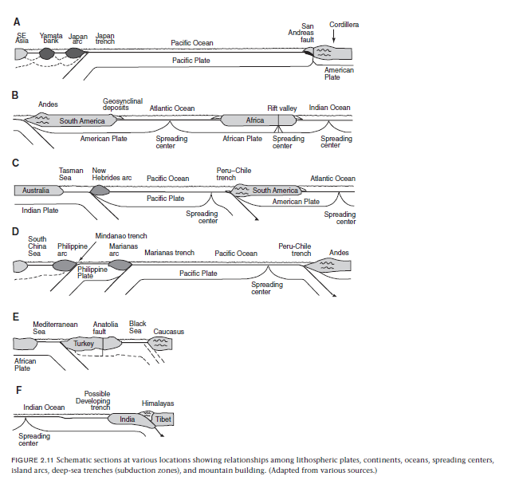

Slide 45
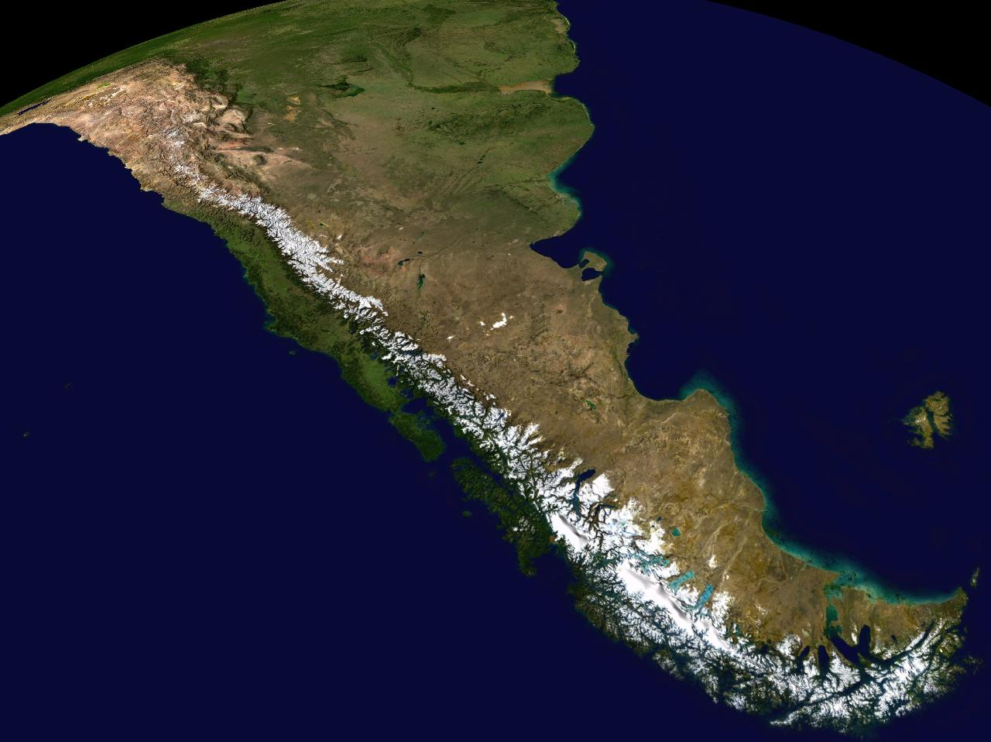

Slide 46
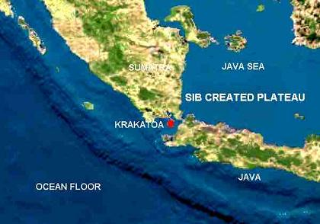
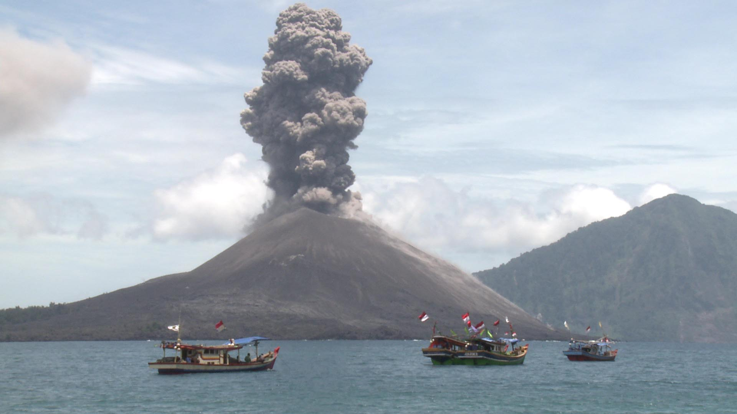

Slide 47
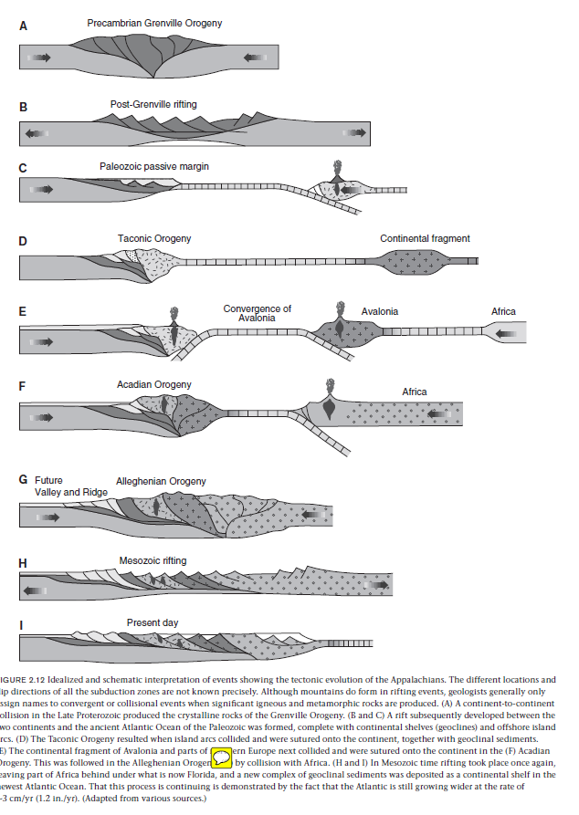

Slide 48
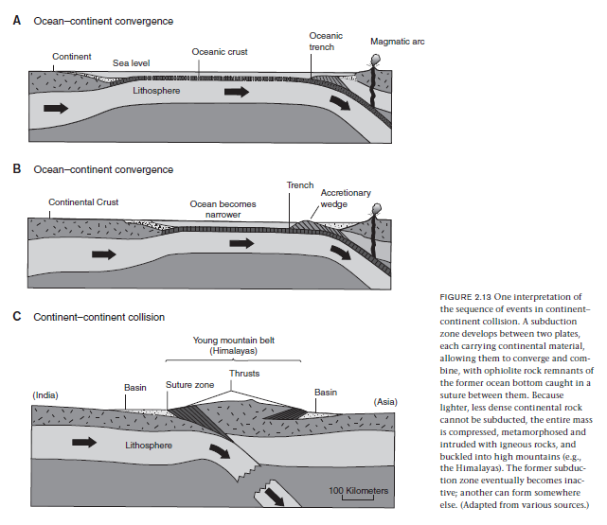

Slide 49
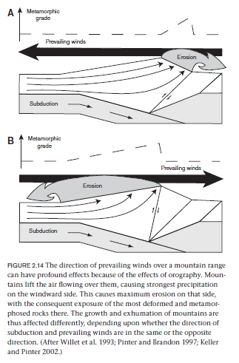
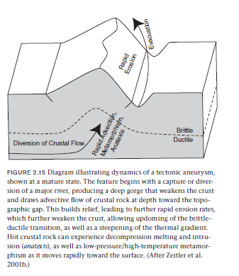

Slide 50
