Slide 1
McKibben on Climate Change & Fiction:
“Understand what things feel like”
“The background becomes the highest drama”
“to illuminate … to bear witness”
Notes:
1. Role of the artist is to make us feel 2. but these stories are a real departure from most literary work… concerned with the relationship between people & everything else 3. Make visible, especially the scale

Slide 2
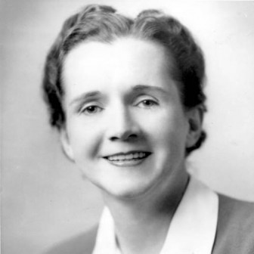
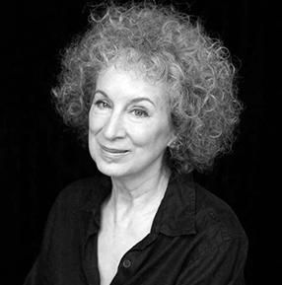
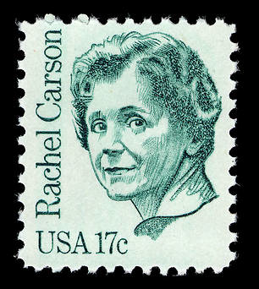
Rachel Carson & Margaret Atwood
From DDT to Climate Change
Notes:
Silent Spring published in 1962; Carson was a scientist turned lyrical writer; she died of complications from breast cancer 2 years after book came out – she was 57. Led to Nixon created the EPA in 1970.
Why are we reading this in a climate change course? It’s not about climate change, is it?
Atwood– contemporary Canadian novelist, The Handmaid’s Tale in 1985, Oryx and Crake in 2003, dystopian sci-fi writer

Slide 3
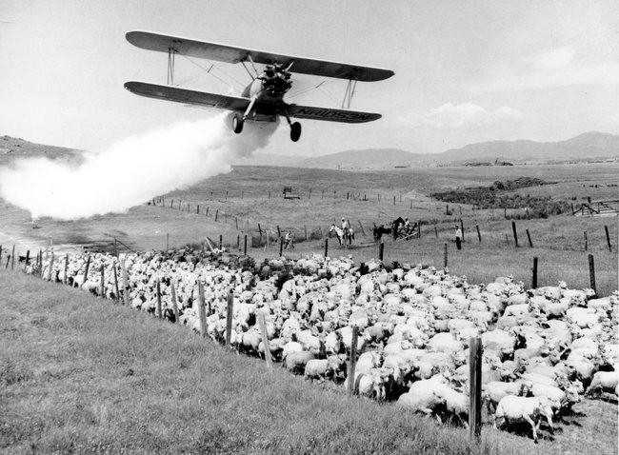

Slide 4
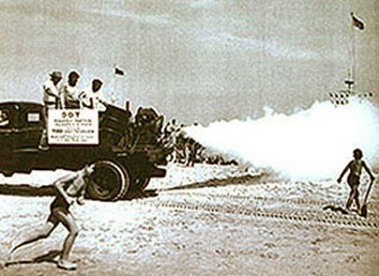

Slide 5
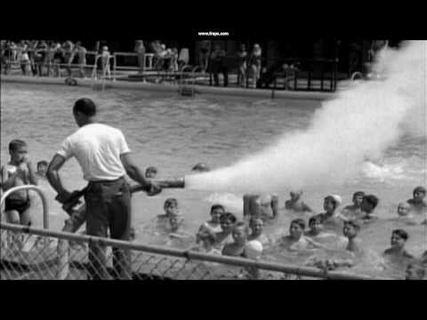

Slide 6
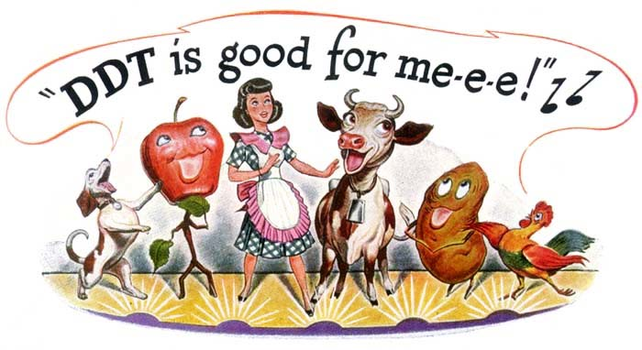

Slide 7
Close Reading “A Fable for Tomorrow”

Slide 8
A Fable for Tomorrow
Fiction: a story not entirely factual, but at least partially shaped, made up, imagined.
“Not entirely factual” ≠ “Not true”
Fable/parable (literary genres): short, succinct, didactic fictional story that almost always ends in an explicit moral lesson (the moral of the story). A fable usually includes animals/plants/natural forces that are anthropomorphized, while a parable usually includes only human actors.
Genre: A literary type or class. That is, a set of works characterized by similarities in subject matter, style, structure, etc.

Slide 9
Close Reading “Time Capsule Found on the Dead Planet”
Narrative
Story
Narrative Discourse
Fiction/truth
Fable/parable
Genre

