Slide 1
Marketing Plan

Slide 2
Mission Statement
Repertory Dance Theatre is dedicated to the creation, performance, perpetuation, and appreciation of modern dance.

Slide 3
RDT Wants to focus on…
Environmental Scan:
Increase budget to get out of debt
Even balance among 3 areas of income: government, contributed, earned
Building audience; especially among younger audience members
To connect young audiences members to performances through technology but to keep the patrons they already have
Growing the downtown arts culture

Slide 4
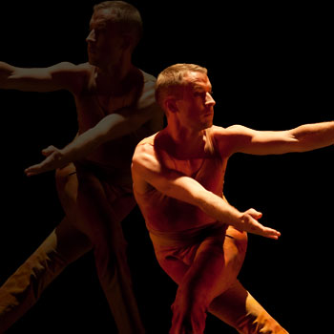
Three marketing strategies…

Slide 5
Dance and Drafts

Slide 6
Dance and Drafts
Institutional Program Development:
BUILDING BRIDGES TO MODERN DANCE
Goal: Build young audience demographic:
College Students/Young Professionals
Develop “Friends” of the Board of Directors
Goal: Enrich entire performance experience
Dancers and Directors join conversation
Build relationship with organization and community

Slide 7
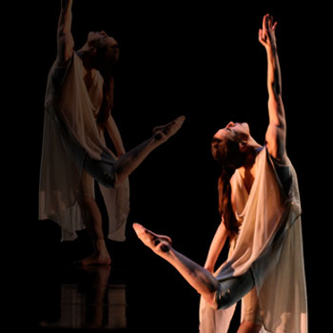
Contemporary on Broadway Reclaiming 3rd

Slide 8
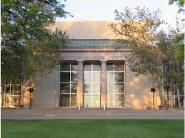
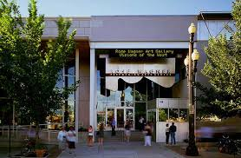
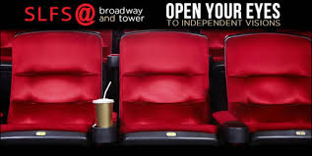
Contemporary On Broadway
Goal: Develop New Audience and Diversify Audience (access to member-lists of orgs)
Goal: Option for Cross-Disciplinary Experience
Grow Downtown Arts Audience
2 Movie Tickets to Salt Lake Film Society- Broadway Theatre
2 Tickets to Pioneer Theatre Company
2 Tickets to RDT

Slide 9
Ticket Prices Contemporary on Broadway
Premium/Standard Season Ticket Extension
Without Bundle=$107 Premium, $69 Standard
$75 Premium (Orchestra), $55 Standard (Balcony)
30% savings for Premium, 20% savings for Standard
Premium/Standard Ticket
Without Bundle=$167 Premium, $129 Standard
$125 Premium (Orchestra), $110 Standard (Balcony)
25% savings for Premium, 20% savings for Standard

Slide 10
Social Media Plan
Facebook= all types of interaction
Blog=Monthly Newsletter posted on Homepage
Draw readers in to the website
Advertised on Facebook
Twitter= Audience Member interaction
Prompts made by company through performance week and shows
Audience interaction whenever

Slide 11
New Strategies
Pandora= Younger, dance-oriented audience
Youtube= Channel= stream-lined, professional approach= all video content in one spot
Instagram/Twitter= during performance breaks to encourage audience participation
Take themed pics, scavenger hunt, most tweeted dance, etc.

Slide 12
Desired Outcomes

Slide 13
Timeline
Social Media Plan: Effective with start of the new season
Dance and Drafts:
3 Performances= April, October, November
Contemporary on Broadway
RDT- Spring Show, PTC- Winter Show, SLFS- Fall Preview Movie

