Slide 1
Projects in the Pipeline
Spring 2018

Slide 2
Projects with Planned Design Launch in 2018
Major Capital Projects
  Pacific Hall – Classroom 123 and Lobby Renovation
  Classroom Building
Capital Improvement Projects
  Condon Hall Window Replacement
Project Studies
  13th Ave. Concept Study
  Housing Facility Renewal

Slide 3
Construction Scheduled for Summer 2018
Capital Improvement Projects
  JSMA – Fountain Upgrades
  Lawrence Hall Glazing Replacement and Asbestos Abatement
  Onyx Bridge Elevator Replacement
  Lokey Education East – Exterior Restoration
  Lillis Partial Roof Replacement
  Volcanology Exterior Renovation

Slide 4
Construction Scheduled for Summer 2018
Major Capital Projects
  Bean Hall – East Building
  510 Oak Remodel – College of Design Studios
  Utility Installation to Hayward Field Project
  Black Cultural Center
  Tykeson Hall
  University Health and Counseling Center Addition and Renovation
  Klamath Hall 3rd Floor Renovation
  Knight Campus for Accelerating Scientific Impact

Slide 5
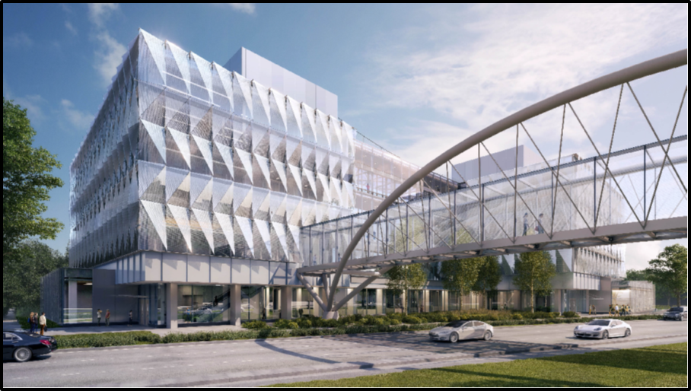
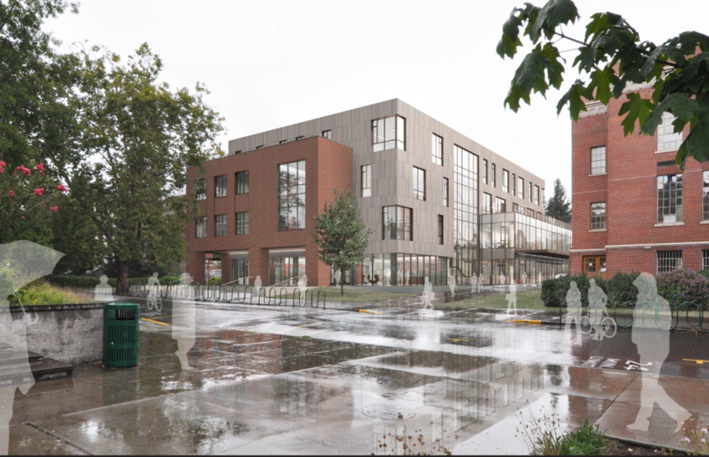
A Few Project Images
Tykeson Hall – View From NW
Knight Campus – View from SW

Slide 6
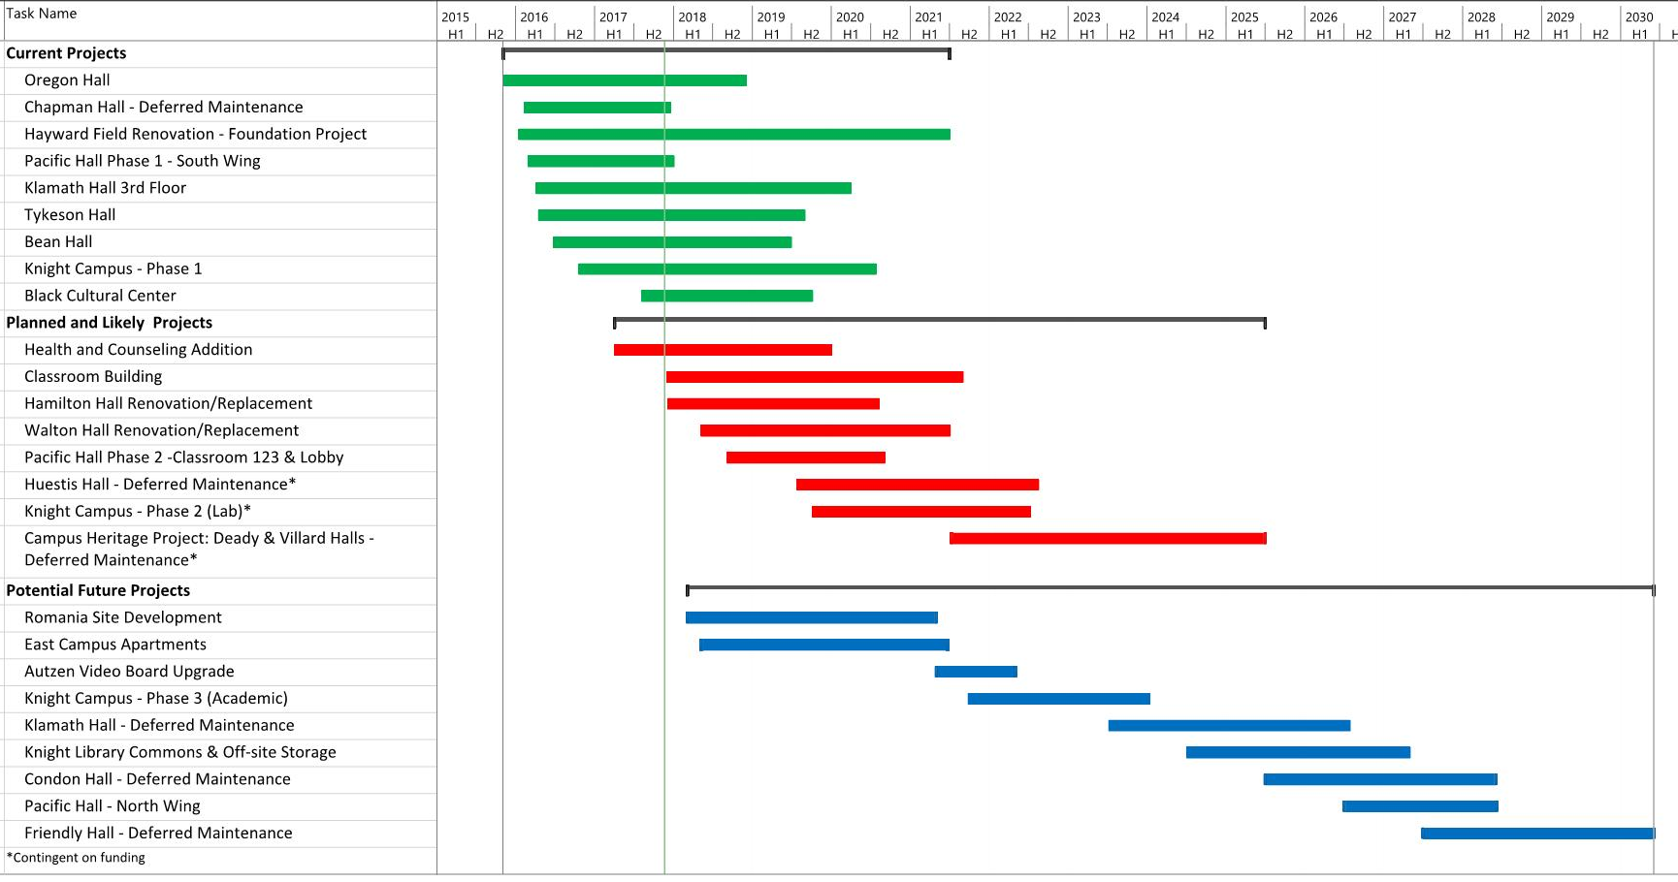
Looking Beyond 2018
Overview of 10- Year Capital Development Plan

Slide 7
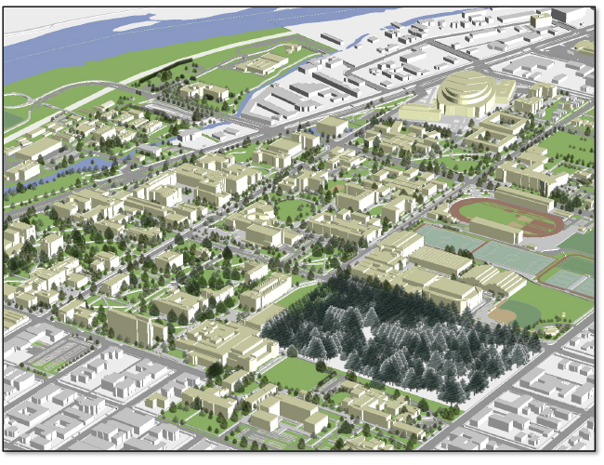
Overview of Capital Development Plan
Current Projects
Planned Projects
Potential Future Projects

