Slide 1
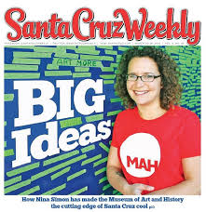
Santa Cruz Museum of Art and History
Marketing Plan - Alex Richardson
MMC II Winter 2014

Slide 2
Santa Cruz MAH: Overview
Emphasis on participatory exhibitions and events
Financially and organizationally secure
Recently won a large Irvine Foundation grant
Goals
Track attendance and conduct segmentation
Increase Latino attendance by 100%
Increase MAH membership by 25%
Create more crossover between exhibition and event attendees
Focus use of social media

Slide 3
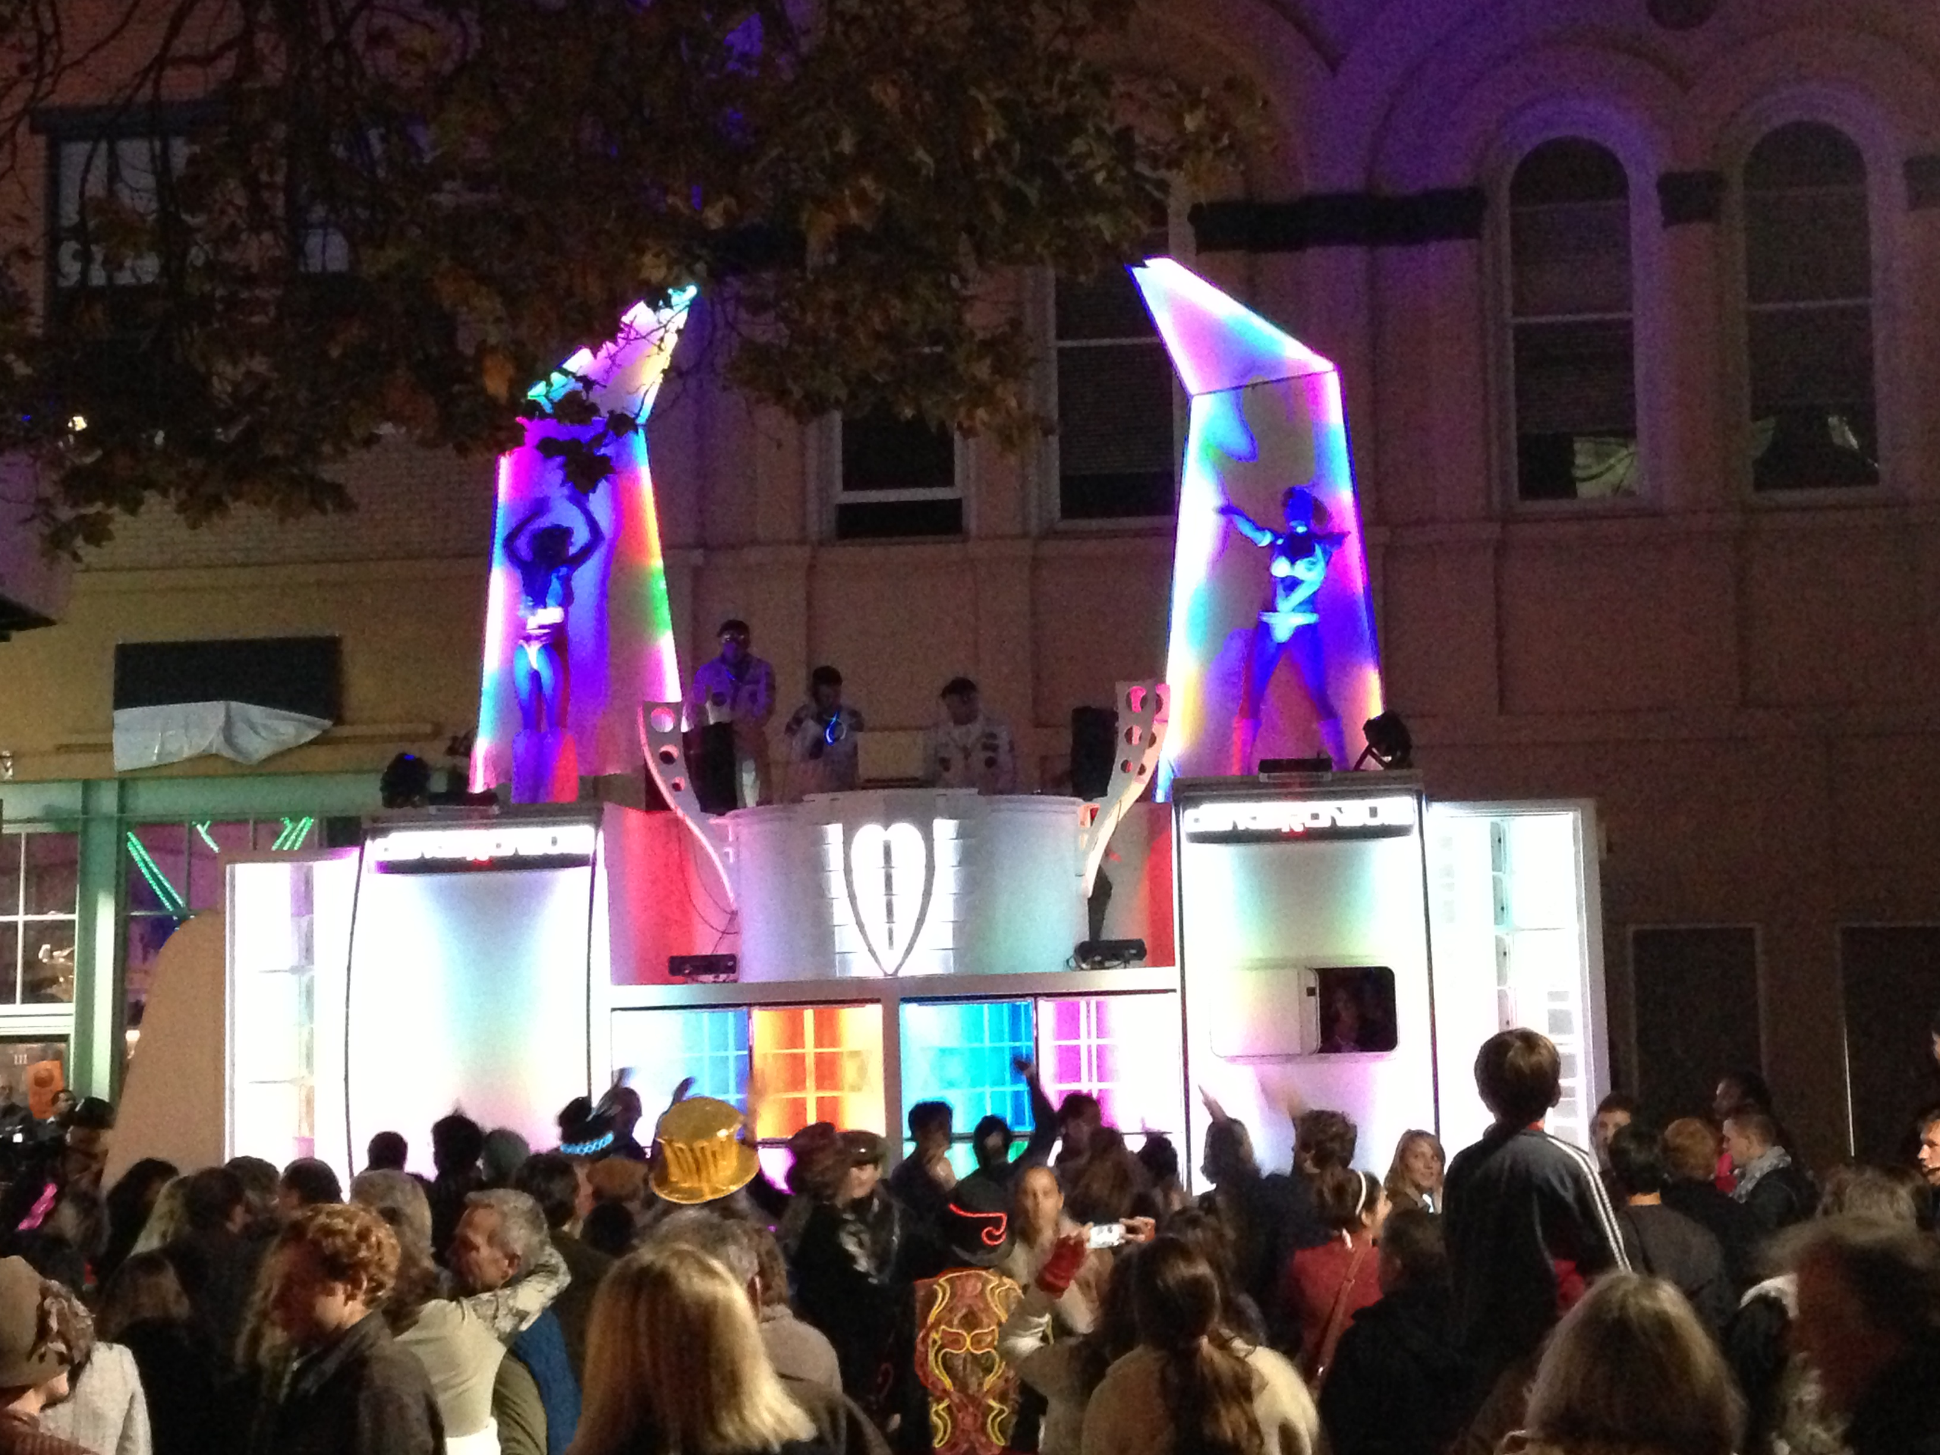
Strategy 1: Target Market to Latino Santa Cruzians
Advertise in La Ganga Especial magazine (both print and online)
Create Spanish-language event flyers
Actions dovetail with relationship-building at Familia and Beach Flats Community Centers and new bilingual hires
Aim to increase Latino attendance by 100%
Budget: $400/month
Impact assessed through membership ethnicity tracking in Salesforce (CRM) and Community Center surveys

Slide 4
Strategy 2: Create New Ad Campaign for Memberships
New membership brochure emphasizes event admission
Visitor Services and event staff understand and promote uniform message
Dovetails with new “goobyers” program
Aim to close gap between exhibition and event attendance
Budget: $148 total
Impact assessed through new memberships

Slide 5
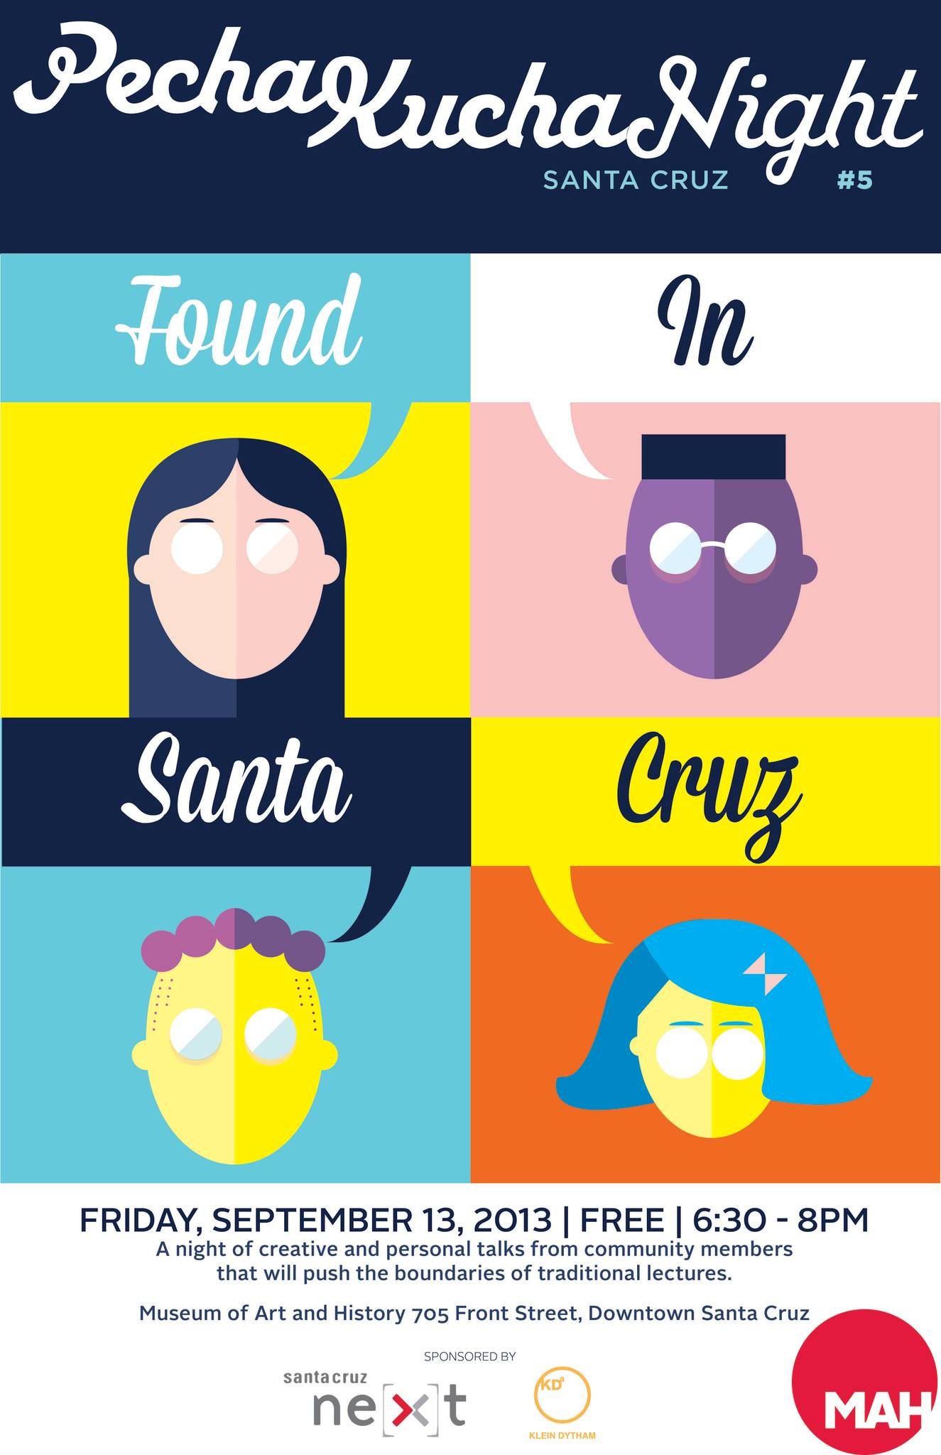
Strategy 3: Focus Use of Social Media
Film Pecha Kucha and artist talks and upload to Vimeo
Videos used as extension of programming, not simply promotional
Tweet out time-sensitive updates/clues during surprise and short-term events
Aim to increase Twitter followers to 2,000
Budget: $300 total
Impact assessed through video views and followers

Slide 6
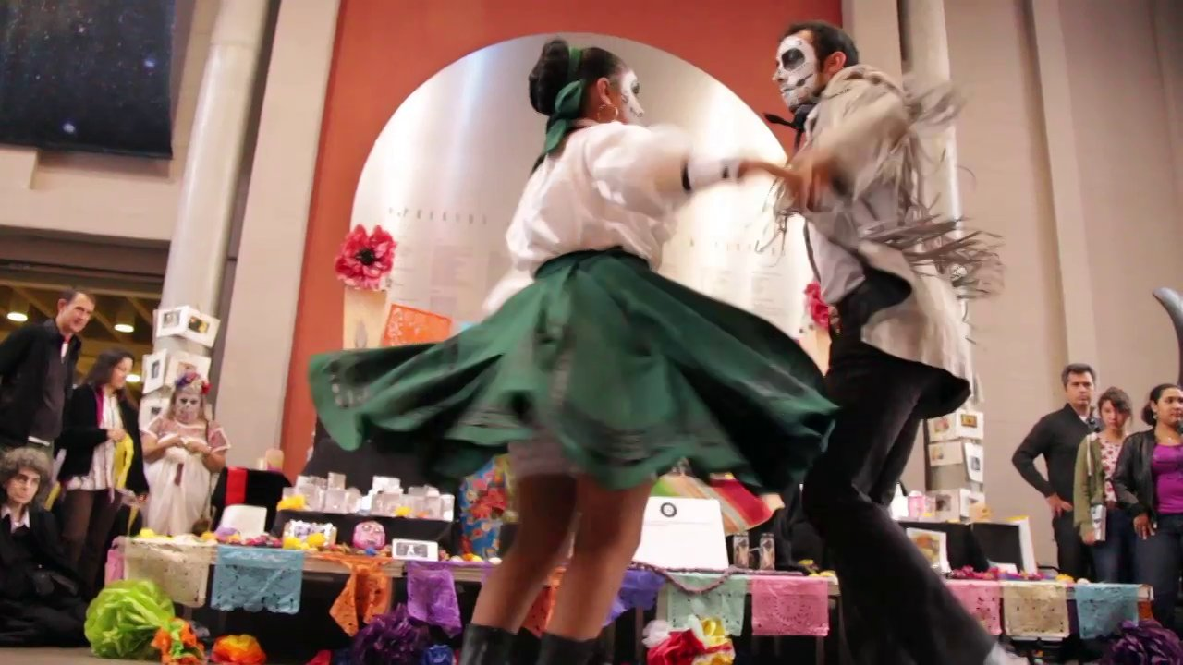
Strategy 4: Develop MAH Street Squad
Dispatch guerilla marketing team for:
Cradle Project exhibition (create cradles and leave downtown)
Crossing Cultures exhibition (create “passports” and leave downtown)
Aim to drive awareness to social justice issues, increase daytime museum visitors
Budget: $10
Impact assessed through visitor surveys

Slide 7
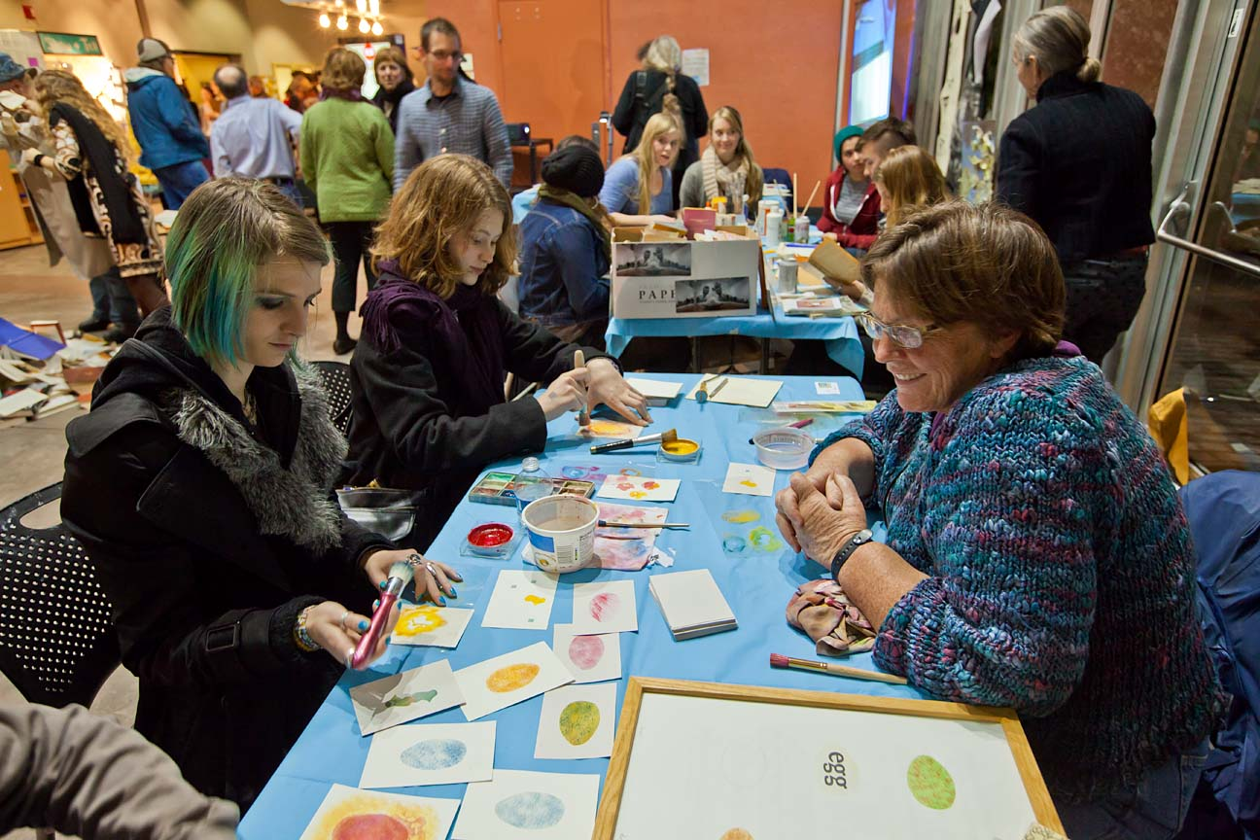
Resources and Conclusion
Total personnel hours (initial month): 41
16 spent by paid employees
Involves high amount of intern labor
Budget to implement strategies:
Initial month: $858
Thereafter: $400/month

