Slide 1
Case Study Of BC MOMA
MADE BY
MAX (XIAOQING) MA
AAD 610 FALL TERM

Slide 2
Brief Overview
The Broadway Cinematheque
Opened in 2009 Located in Beijing
The only art house cinema in Mainland China

Slide 3
Economic Scan
Broadway Circuit
EDKO Films Ltd.
The New Film Association
William Kong

Slide 4
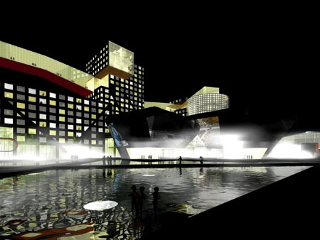
Bonus on leasing
Unique Rental agreement
with BC MOMA
A ￥10,000 rental fee /M
≥ ￥10,000 box office income
30% bonus sharing

Slide 5
Box office records
Year | Box office record | Number of audience | Screenings
2010 | 250,0000 | 7,1000 | 6200
2011 | 350,0000 | 10,000 | 6500
2012 | 450,0000 | 13,000 | 6700
2013 | 500,0000 | 14,000 | 7000

Slide 6
Promotion Opportunities
Online promotions
The coming events of international film festivals
An increase number of potential audience

