Slide 1
Brand Awareness
There are no prescribed success formulas, no secret color combinations or hidden shapes that dictate a logo’s success.
The keys to great design can be found in a company’s name or business focus, or in the “intangibles” such as its mission or attitude.
~ Marks of Excellence

Slide 2
Logo Design and Identity
“Trade marks are animate/inanimate/organic/geometric.
They are letters/ideograms/monograms/color things.
Ideally they do not illustrate/they indicate…
not present/but suggest…/and are stated with beauty and wit.”
~Paul Rand

Slide 3
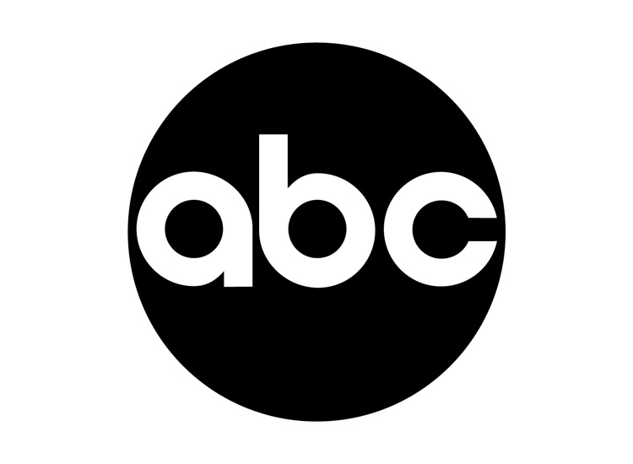
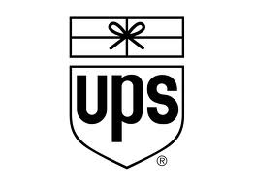
Paul Rand
Paul Rand: Thought and despair on logo design

Slide 4
Design Fate – Serendipity and Typography
Started as a red disk, inspired by Paris Metro nameplates
Initial design had name printed across it in a bar
Frank Pick, company attorney w/ no design experience, suggested inner circle would pull the eye if it were white, resulted in him becoming the company’s ID program director
Commissioned typographer Edward Johnston to create open, highly legible, masculine typeface
One of the world’s first sans-serif typefaces

Slide 5
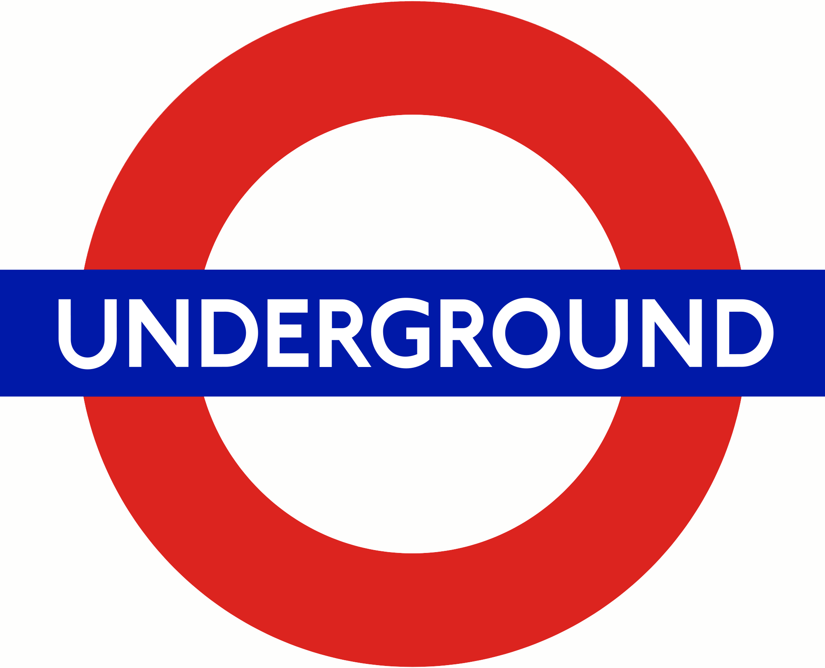
London Underground - 1916

Slide 6
Need for Flexibility
Few design projects require as much flexibility in application as a logo
Depending on your client, you may know at the onset that your creation not only will appear on stationary and business cards… more likely is that it will eventually be put to uses you can’t predict when you’re designing it.
So, a sound flexible design is paramount.

Slide 7
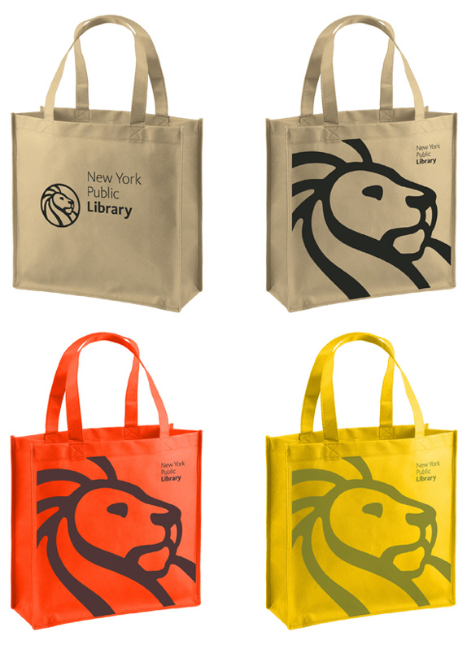
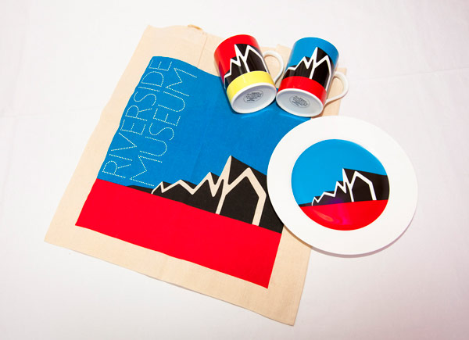
Custom Applications

Slide 8
Words and Pictures
Many logos consist of both words and pictures – often a visual icon plus a specific treatment of the company’s name
Others rely almost entirely on an image, or just words or letters
No rule as to which approach is better
Non-verbal images are more likely to translate well across international boarders

Slide 9
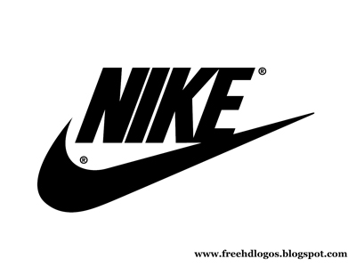
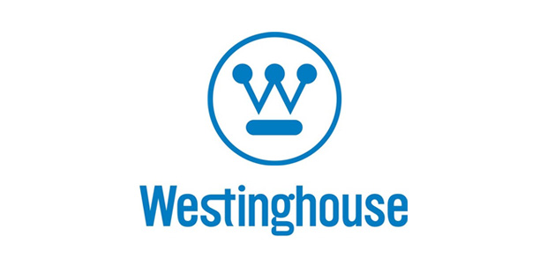
Word and Picture Examples

Slide 10
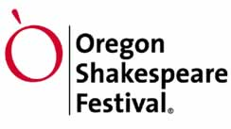
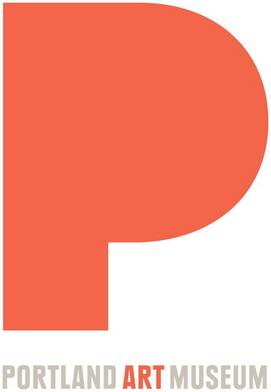
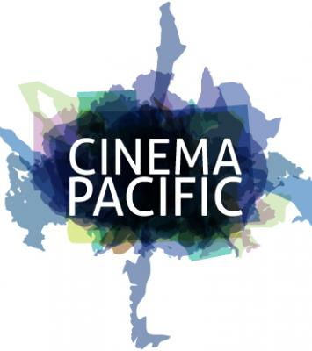
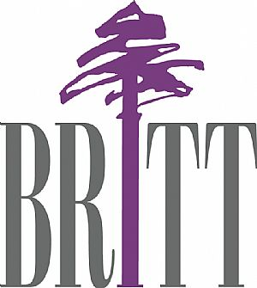
Word and Picture Examples 2

Slide 11
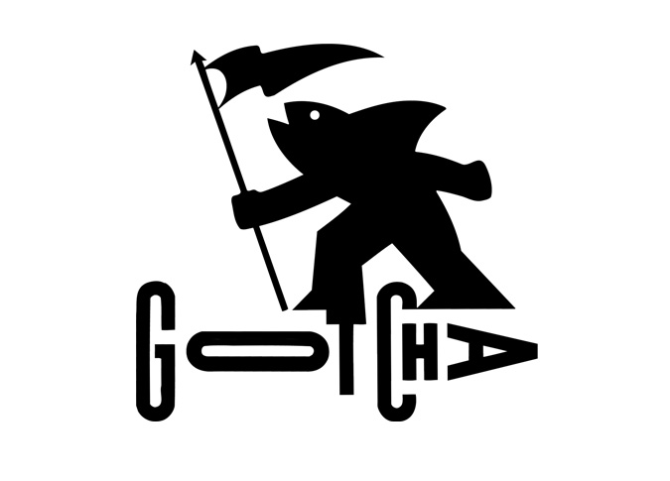
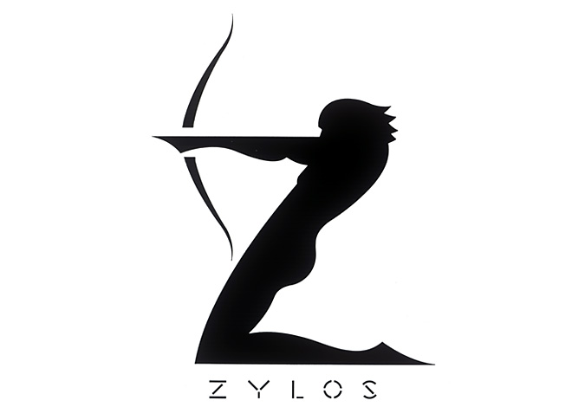
Jay Vigon – Complex Simplicity
Jay Vigon - Essential Emotion

Slide 12
Makeovers
Some logos may have a very long shelf-life, unchanged for decades
Others get altered or updated – sometimes repeatedly
Reasons for updating vary widely, sometimes confounding those viewing them
Typically a logo update or redesign serves a specific business purpose
As a business matures, it can become apparent that the visual brand needs updating
Application opportunities and treatment are factors
Diversification of products or services can drive a redesign or updating

Slide 13
Makeover Example
New York City Library Makeover

Slide 14
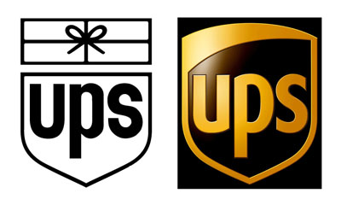
Makeover Example 2

Slide 15
Design Strategies
Subtle Visual Cues, Negative Space
Typographic Design
Historic/Company Symbolism
Genre Specific – Museum Arts
Design Psychology, Examples
Hidden Meanings

Slide 16
Essentials
Distilling a company into a single gesture or emotion that visual elements can convey is the core of the logo-design process
The final result must balance timeliness with timelessness, trading simultaneously on trend and tradition.
Whether the result is bold or subtle, innovative or conservative, the ultimate goal is to create a logo that stands out in a sea of business identities

Slide 17
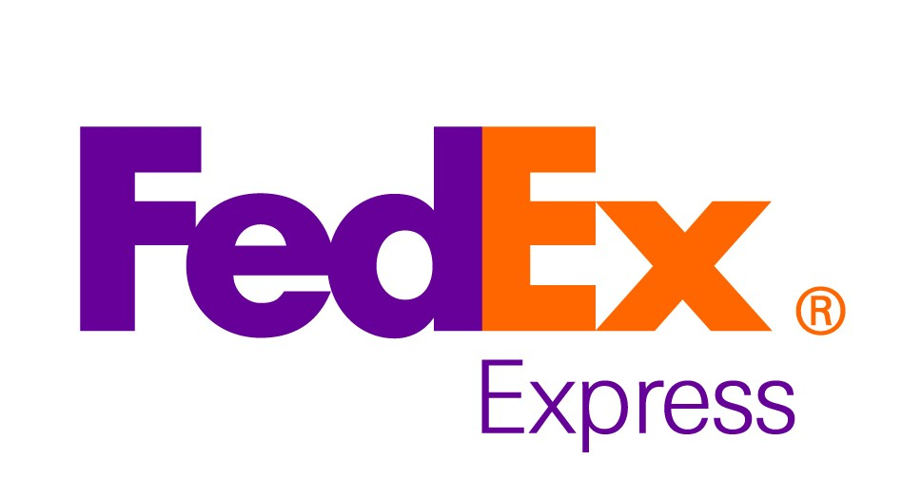
Success

